Slide 1
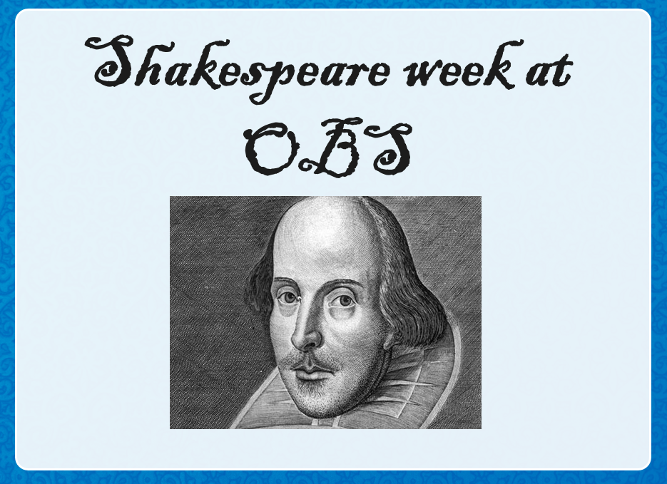

Slide 2
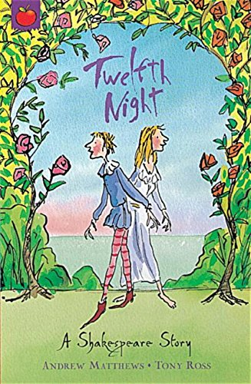
Twelfth
Night

Slide 3
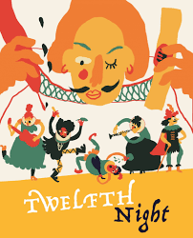
What is Twelfth Night about?
Twelfth Night is a comedy and a romance. In the play there is lots of confusion and mistaken identity, people falling in love with people who don't love them (unrequited love).

Slide 4
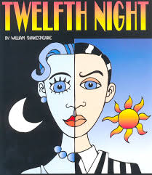
What is Twelfth Night about?
A young woman, called Viola, is shipwrecked and lands on the beach at Illyria. She has lost her brother, doesn't know anyone, so decides to get a job working for the governor of Illyria, Duke Orsino. However she needs to dress as a man to get the job and calls herself Cesario.
What do you think?

Slide 5
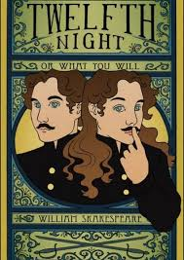
In Shakespeare's time all actors were men, women were not allowed to act. So all the parts were played by men, even the female roles.
So imagine, a male actor played the part of a woman (Viola) who then had to dress and as a man to get a job!
This all helped to make the play more confusing and gives opportunities for more comedy moments.

Slide 6
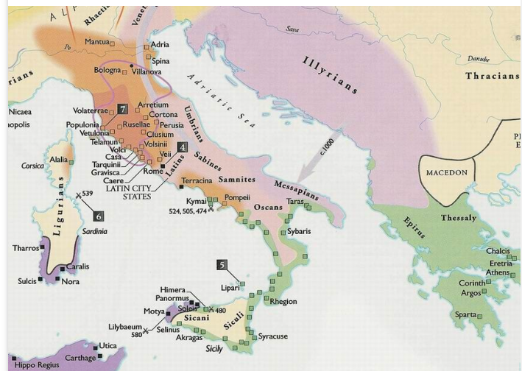
Where is Illyria?
Illyria is an ancient region that no longer exists. Can you recognise where Illyria was?
Shakespeare never went abroad but during his life people began to explore countries further afield.

Slide 7
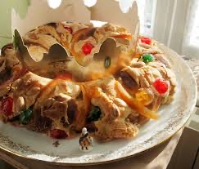
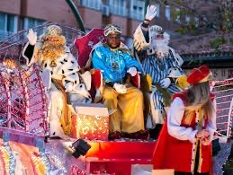
What else do we know about Twelfth Night?
Twelfth Night is also the name of a Christian celebration that was very popular in the times of Shakespeare and is still celebrated in Catholic countries such as Spain where it is known as Dia de los Reyes. This festival happens on the 5th/6th January (12 days after Christmas day) when it is believed that the 3 kings visited Jesus.

Slide 8
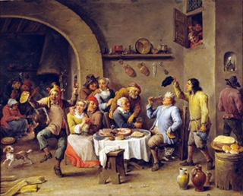
Twelfth Night in Shakespeare times
Christmas was the greatest festival celebrated by the Tudors. Everyone fasted during Advent and on Christmas Eve no meat, cheese or eggs could be eaten. Celebrations began on Christmas Day and all worked stopped (except for looking after farm animals). People visited friends and family to celebrate. The 3 main days of celebration were Christmas Day, New Year's Day and Twelfth Night. Work started again on Plough Monday, the first Monday after Twelfth Night.

Slide 9
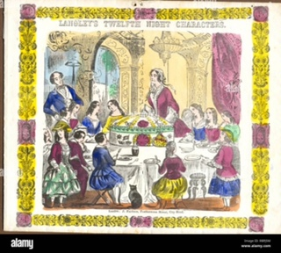
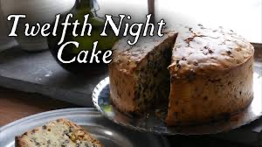
At this time of year the traditions included parties, lots of music, singing and dancing and masked balls. At the party there would be a cake with a pea or bean hidden inside it and whoever found the hidden surprise became the king or queen for the night called the 'Lord of Misrule'. Even servants were allowed to mix with their masters and could disguise themselves, play tricks and be in charge of the party and the general chaos.

Slide 10
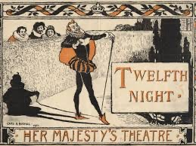
Another tradition in Tudor times would be to perform plays. Although Twelfth Night (the play) is not about Christmas, Shakespeare wrote it so that it could be performed at the end of the Christmas period in 1602. A lot of the themes in the play have lots of links to the traditions of the festive period at the time- confusion, mistaken identity, people swapping roles and playing tricks on each other.

Slide 11
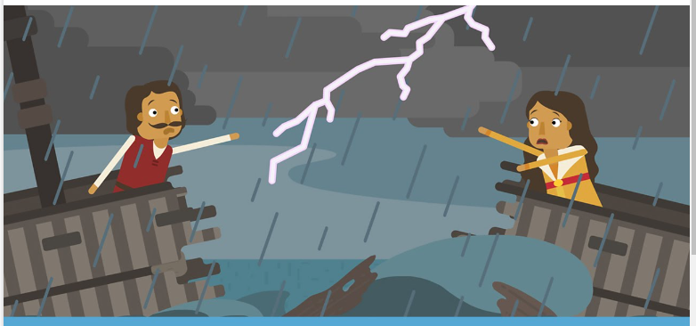
If music be the food of love play on
https://www.youtube.com/watch?v=SFgRJFTDHDQ

