Slide 1


Slide 2
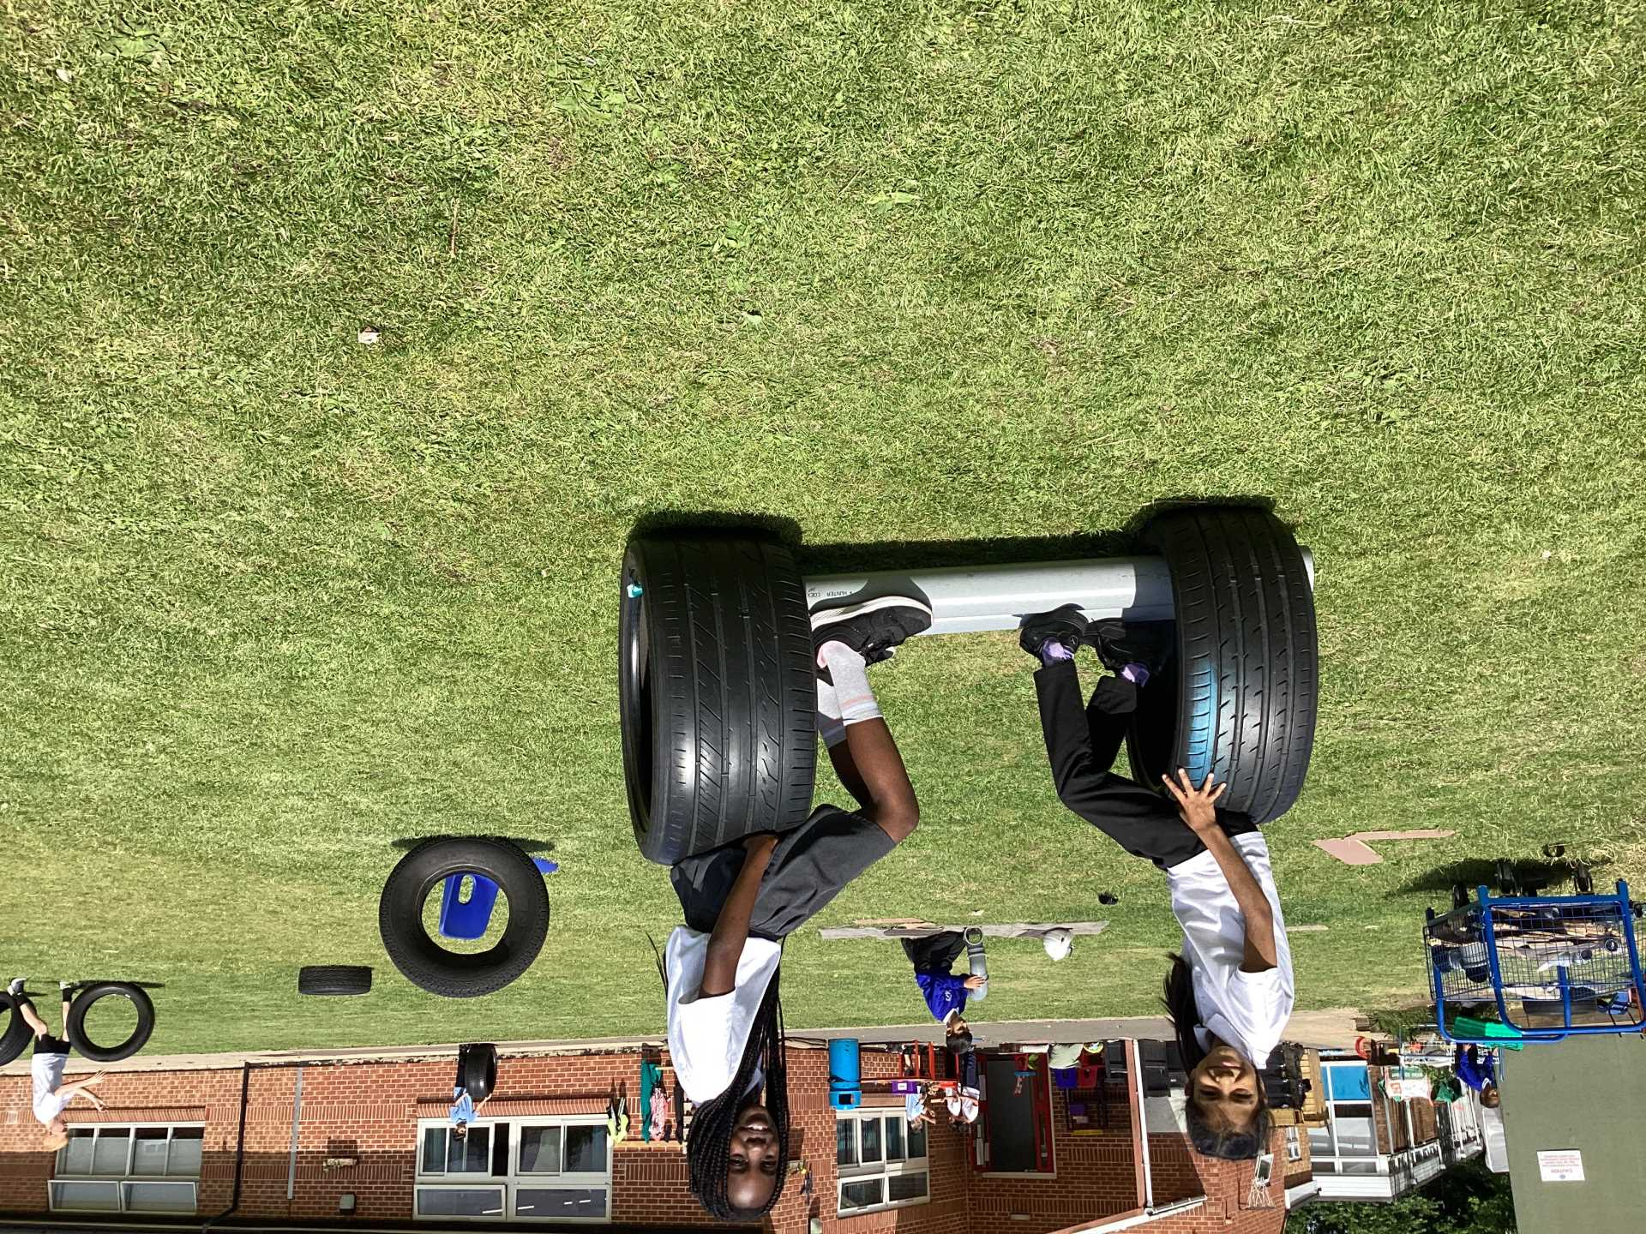
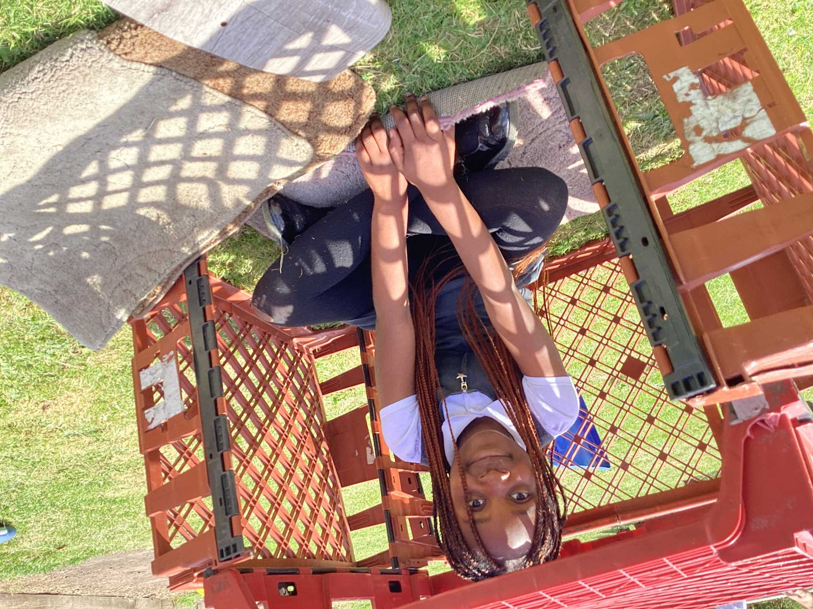
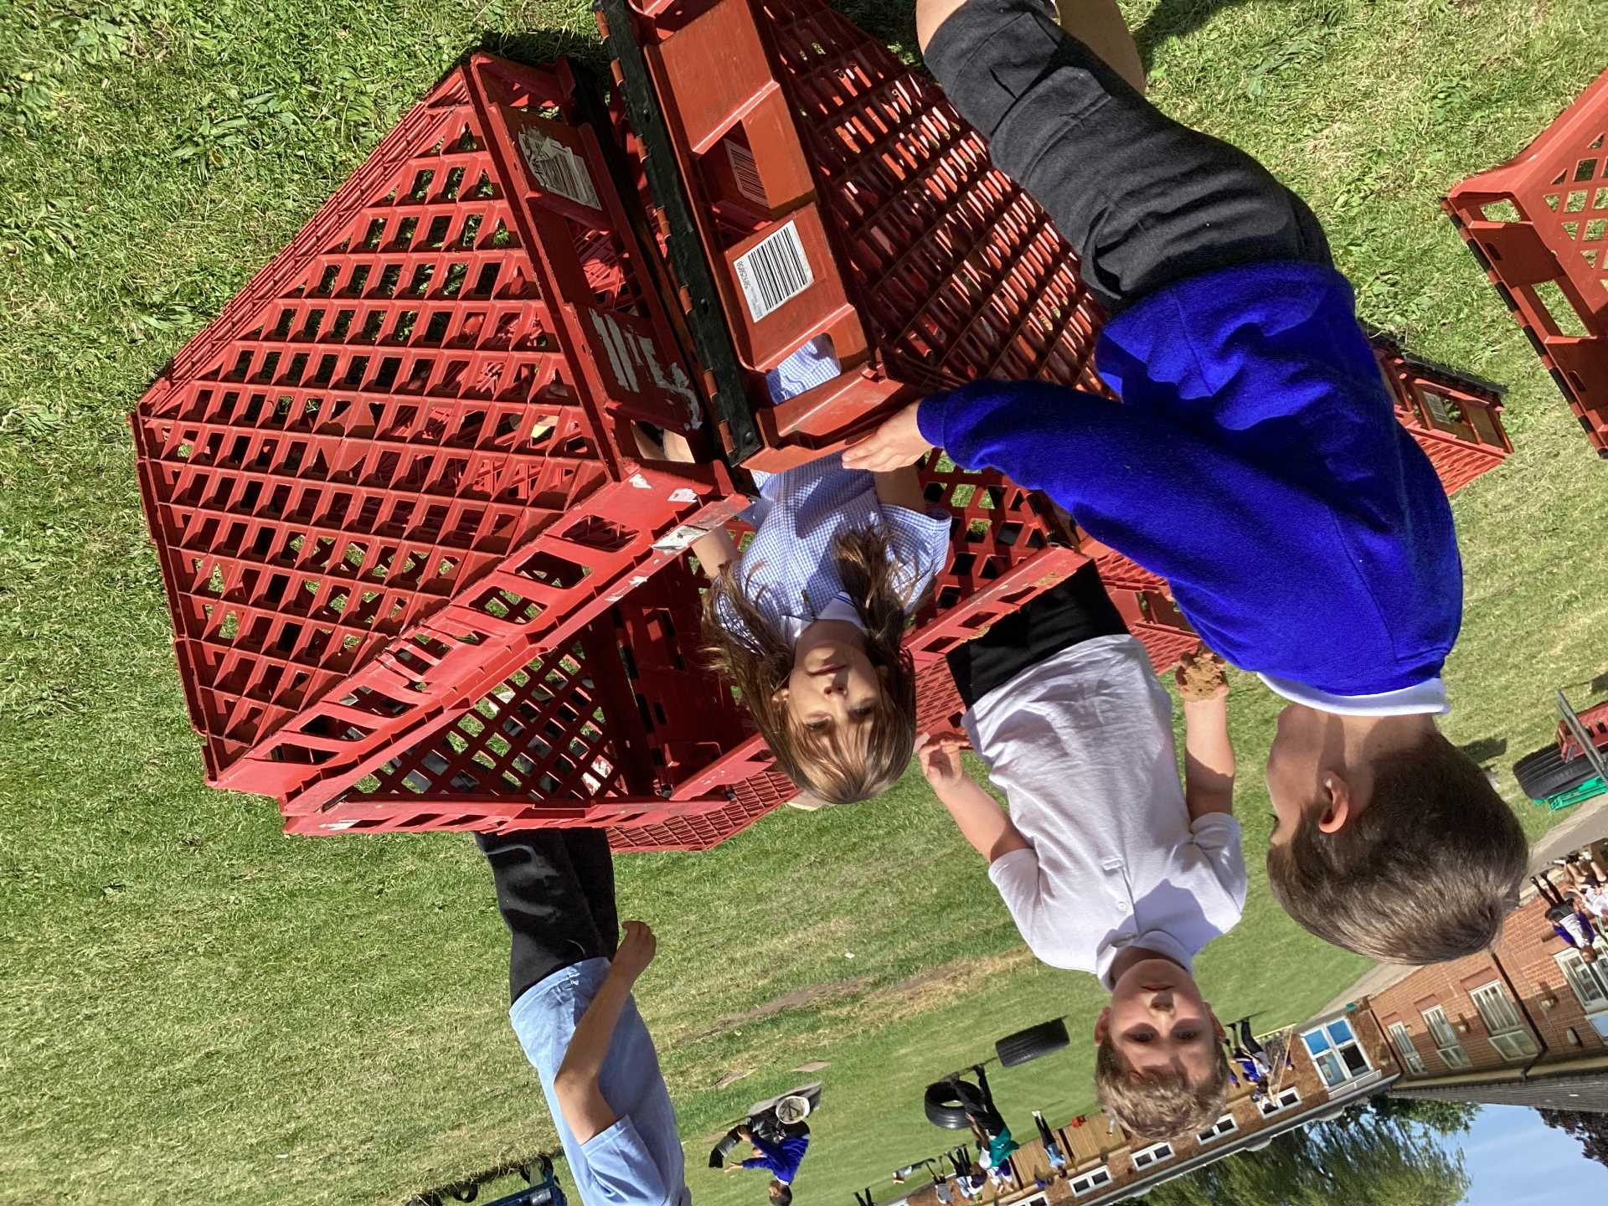
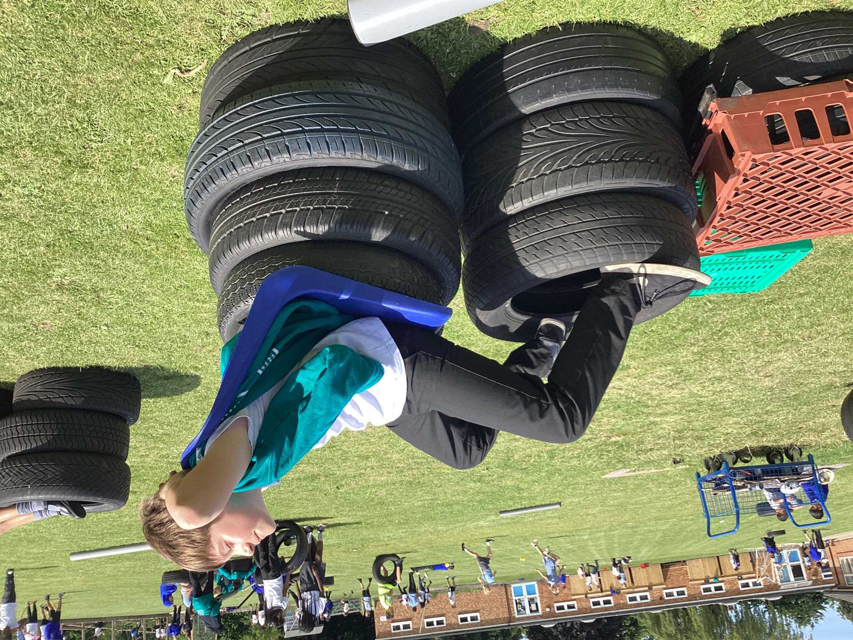
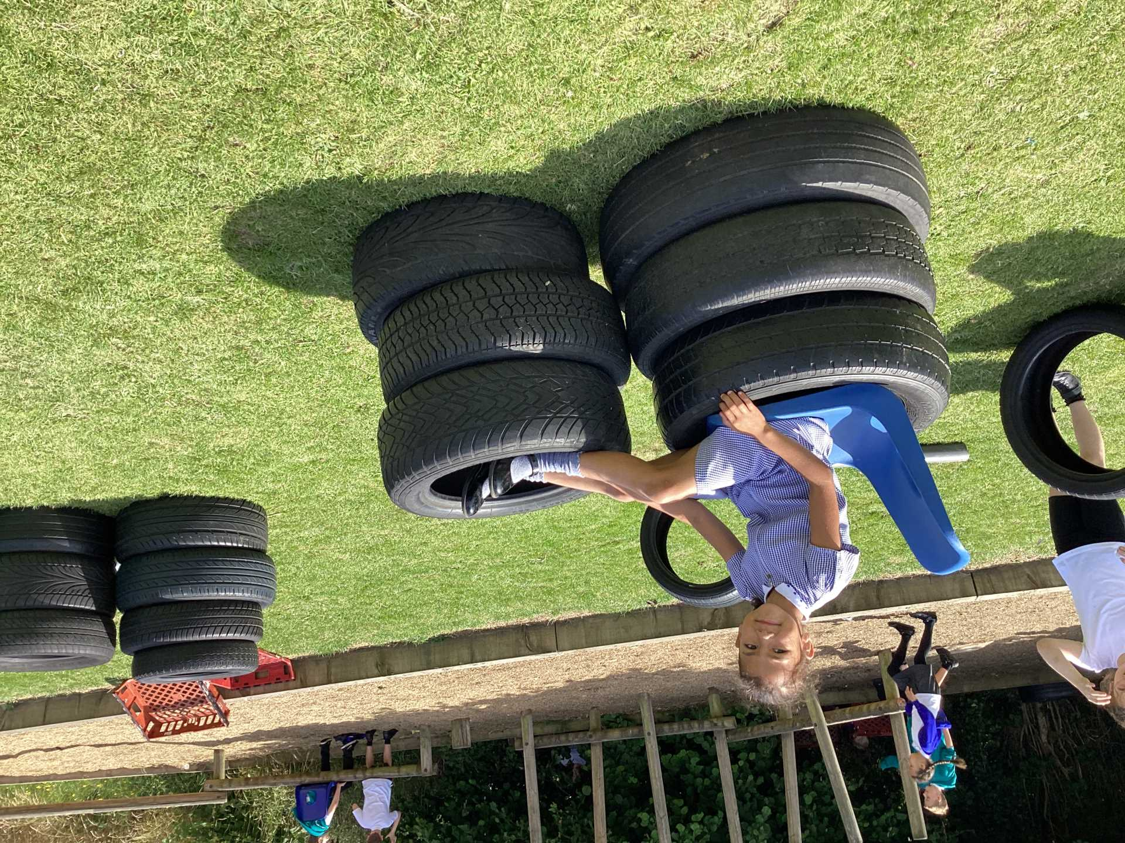
Celebration

Slide 3
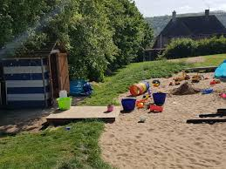
Inform
sand pit

Slide 4
Innovate
How can we play with the sand pit?
Make sandcastles
Sculpt buildings
Write and draw in the sand
Play archaeologists
Make roads with the cars
Make a race track

Slide 5
Negotiate
What rules do we need to have for the sand pit?
No throwing or kicking or putting in someon'e hair/ face
Don't pushing
Keep the sand and the toys in the sandpit
Keep shoes and socks on
Don't add water to the sand
Respect other people's play
You can put your wellies
Don't lay down in the sand
Y6 monitors to watch
Maximum of 12 children in sand pit at one time

Slide 6


The Golden Brush and Welly Awards

Slide 7


Year 6 respectful award

