Slide 1


Slide 2
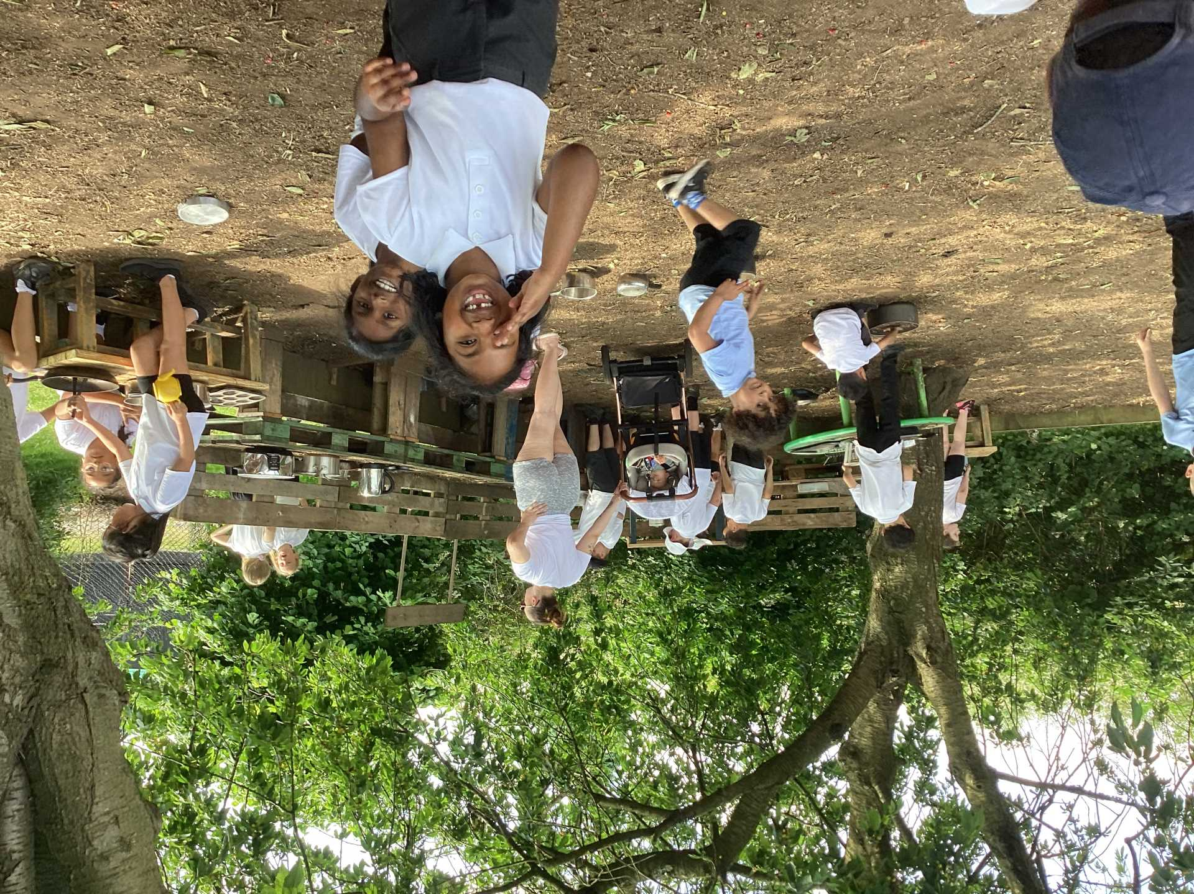

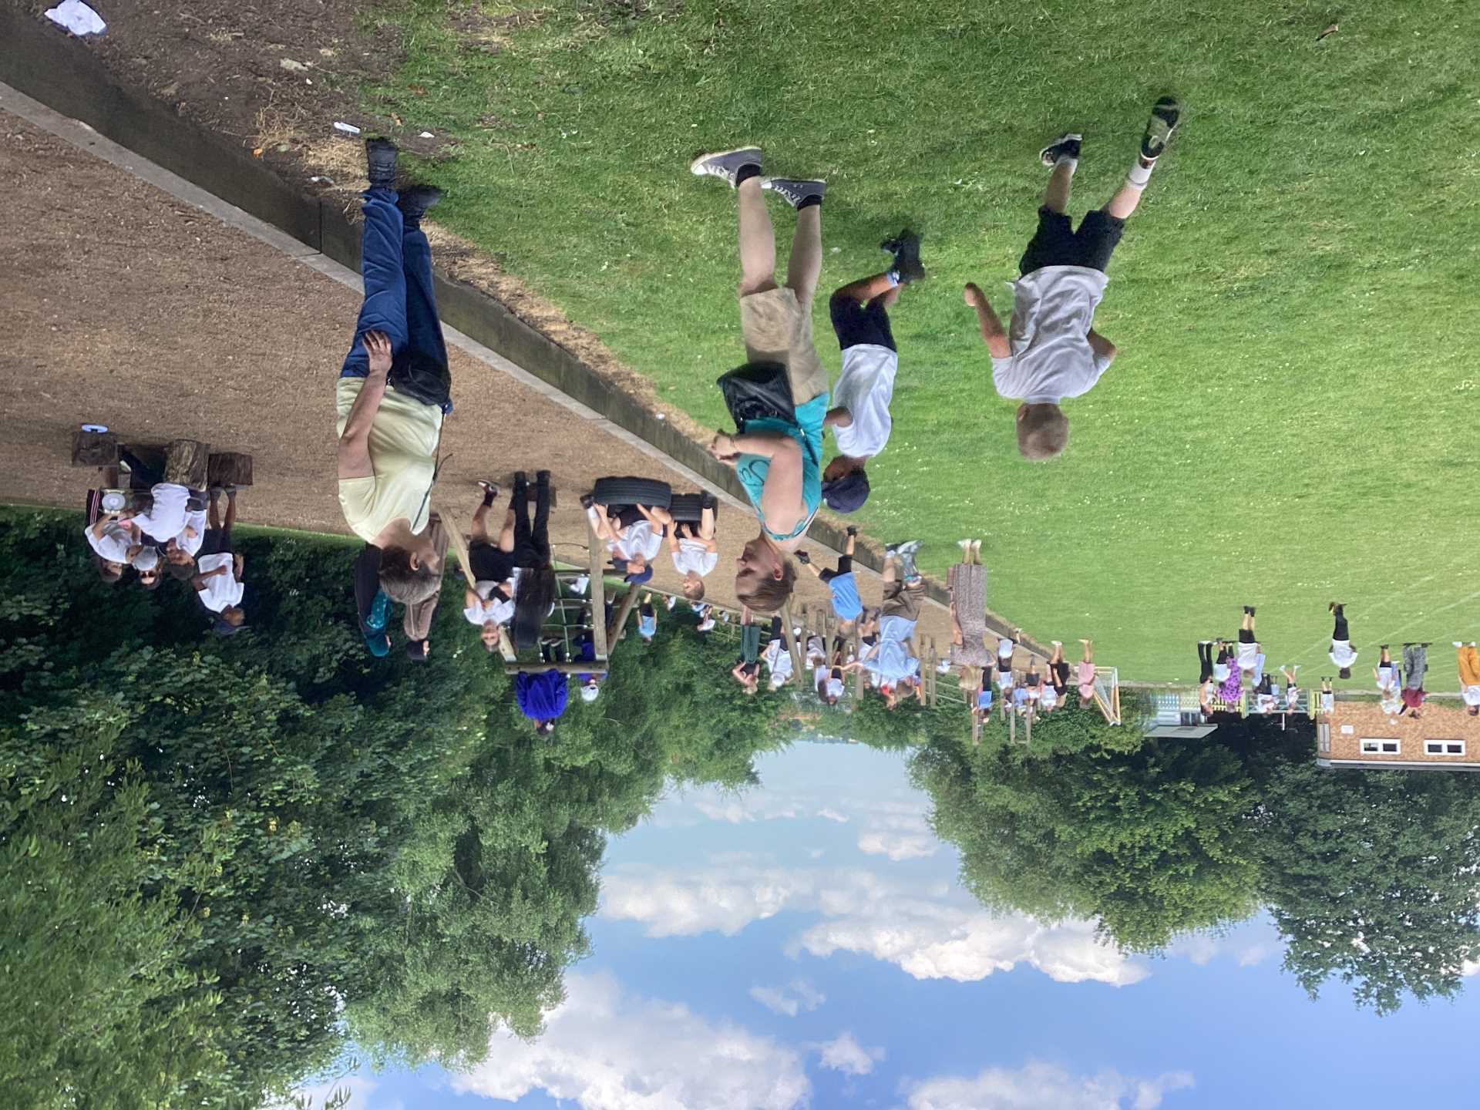
Celebration

Slide 3
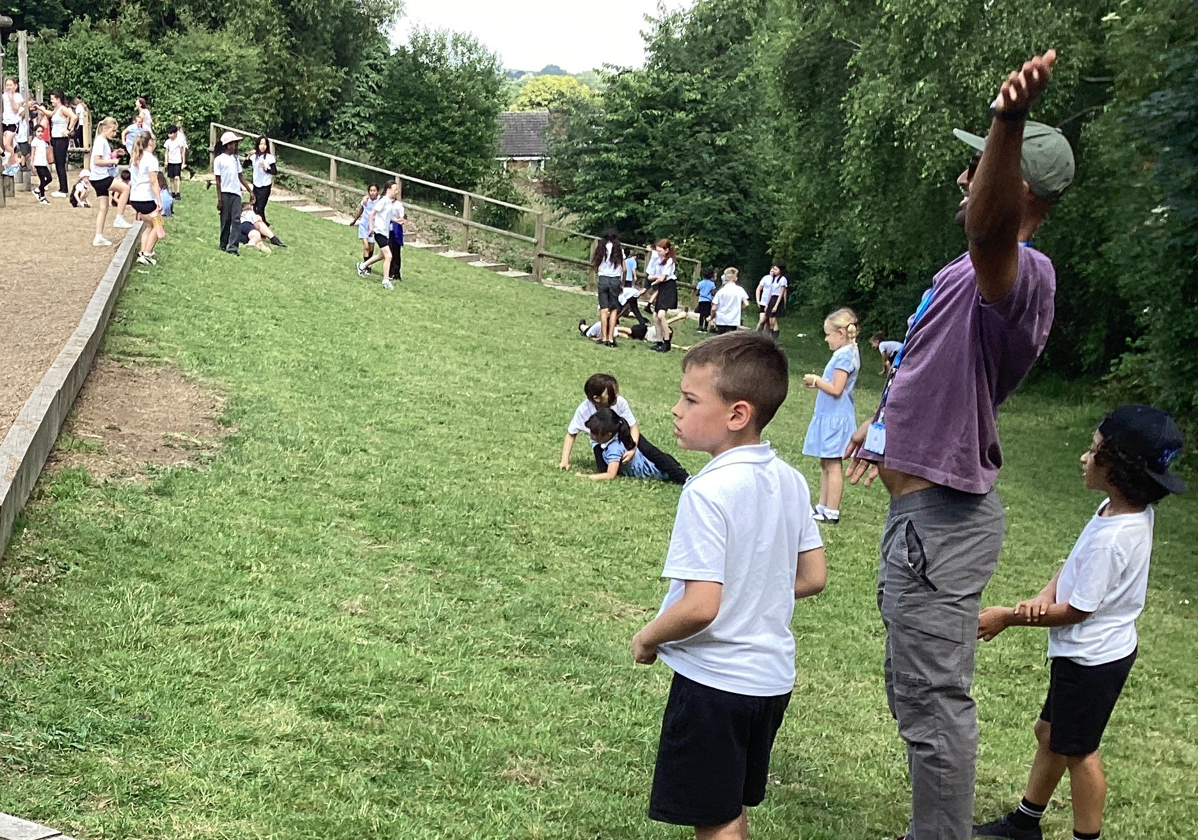
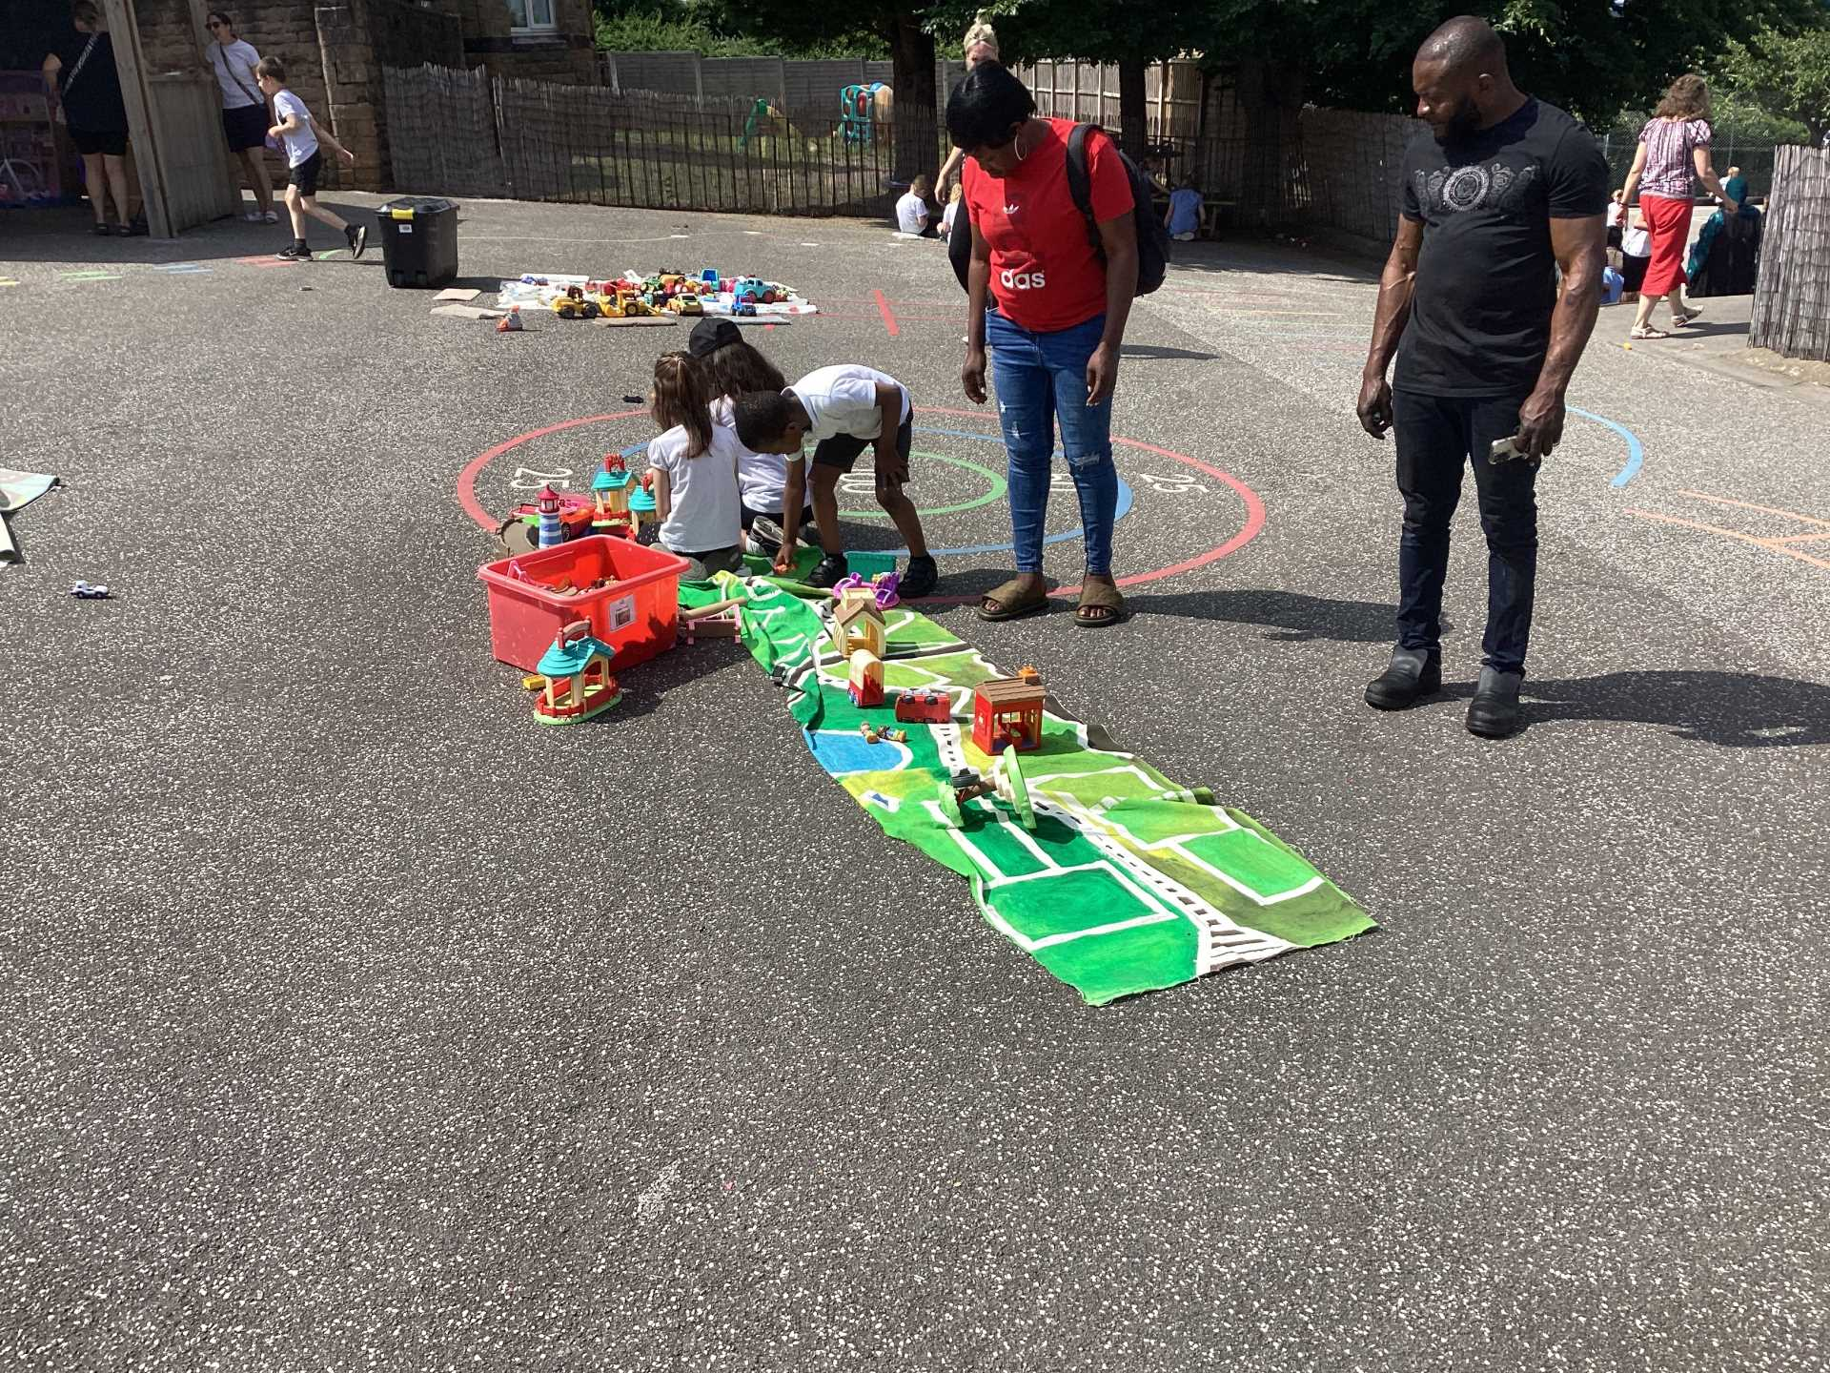
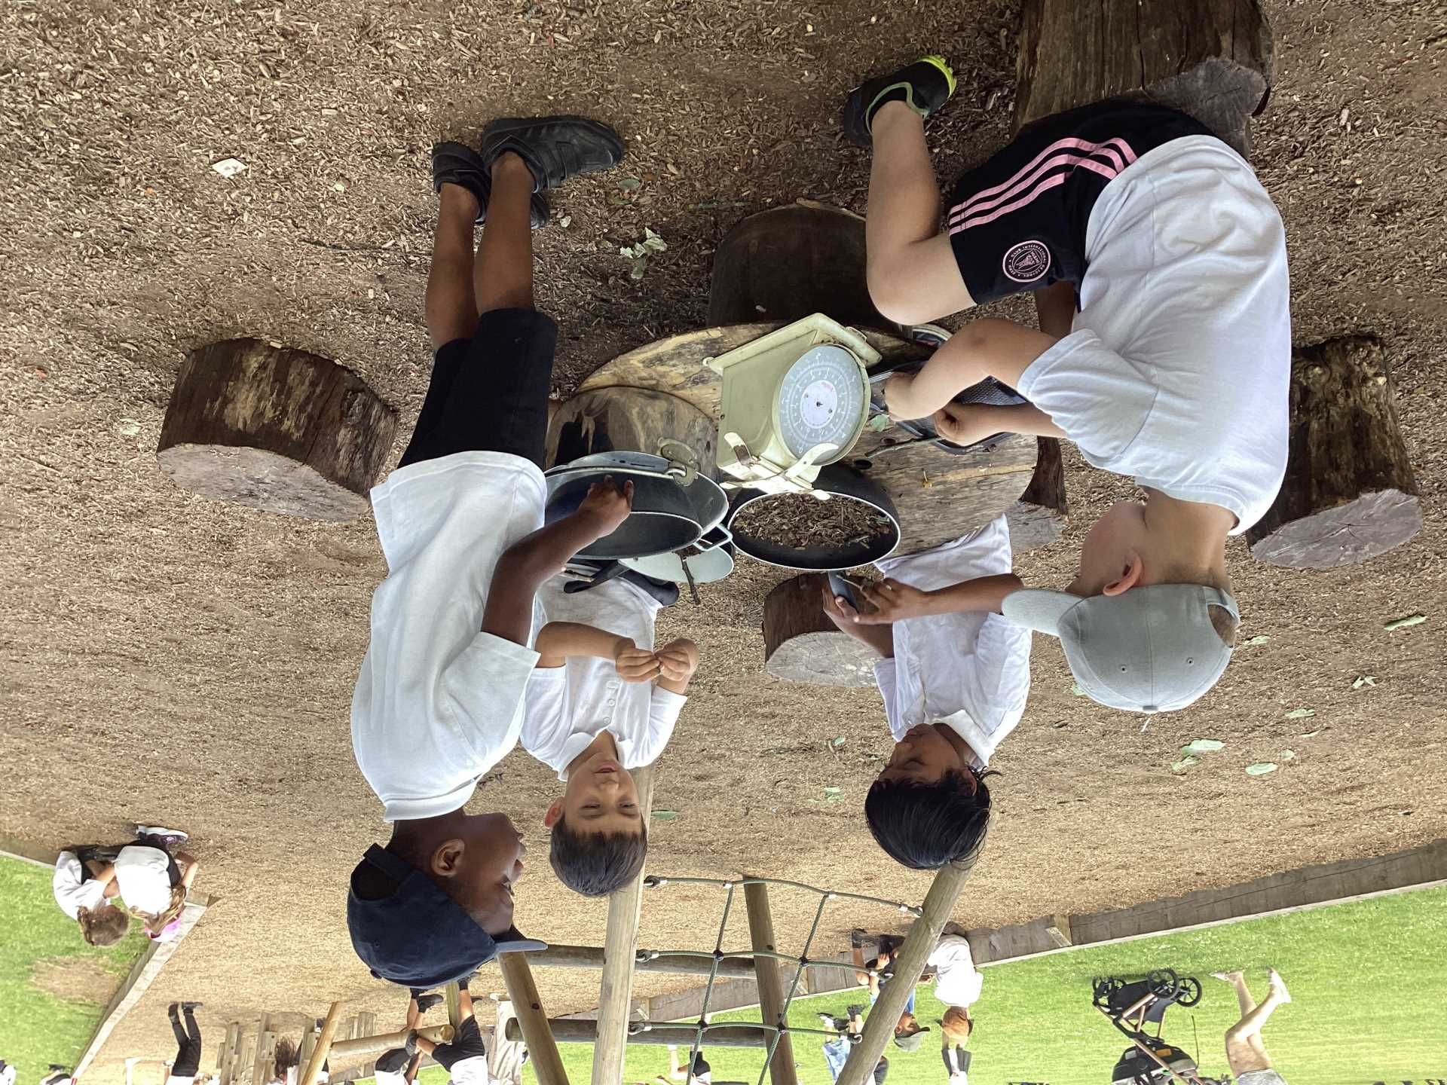
Celebration

Slide 4
Inform
Talking to strangers reminder.
Eating berries

Slide 5
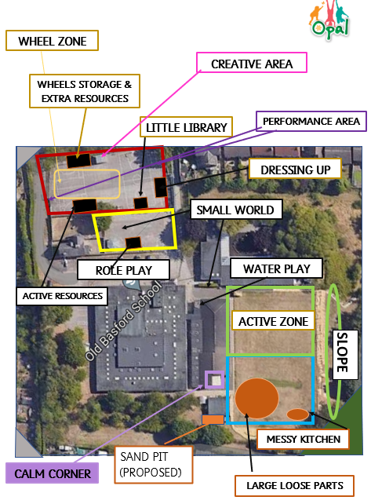

Slide 6
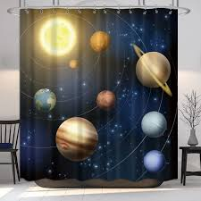


Inform
Theatrical play - back drops, extended stage and tambourines.

Slide 7
Innovate
Plays and shows
Make props in the creative area
Make puppets
Use the instruments

Slide 8
Negotiate
Don't pull on the curtains
Don't hide behind them
Don't wrap yourself in them
Ask permission to change the scene
Don't swing on them

Slide 9


9][
The Golden Brush and Welly Awards

Slide 10


Year 6 respectful award

