Slide 1


Slide 2
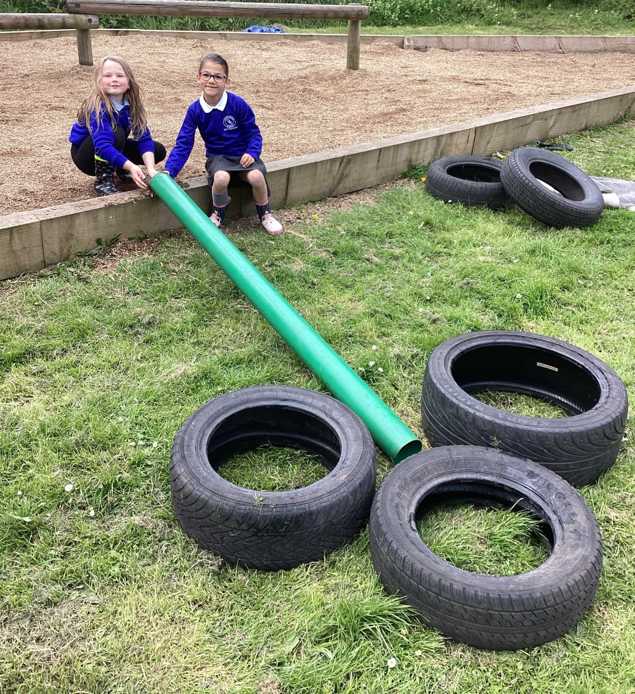
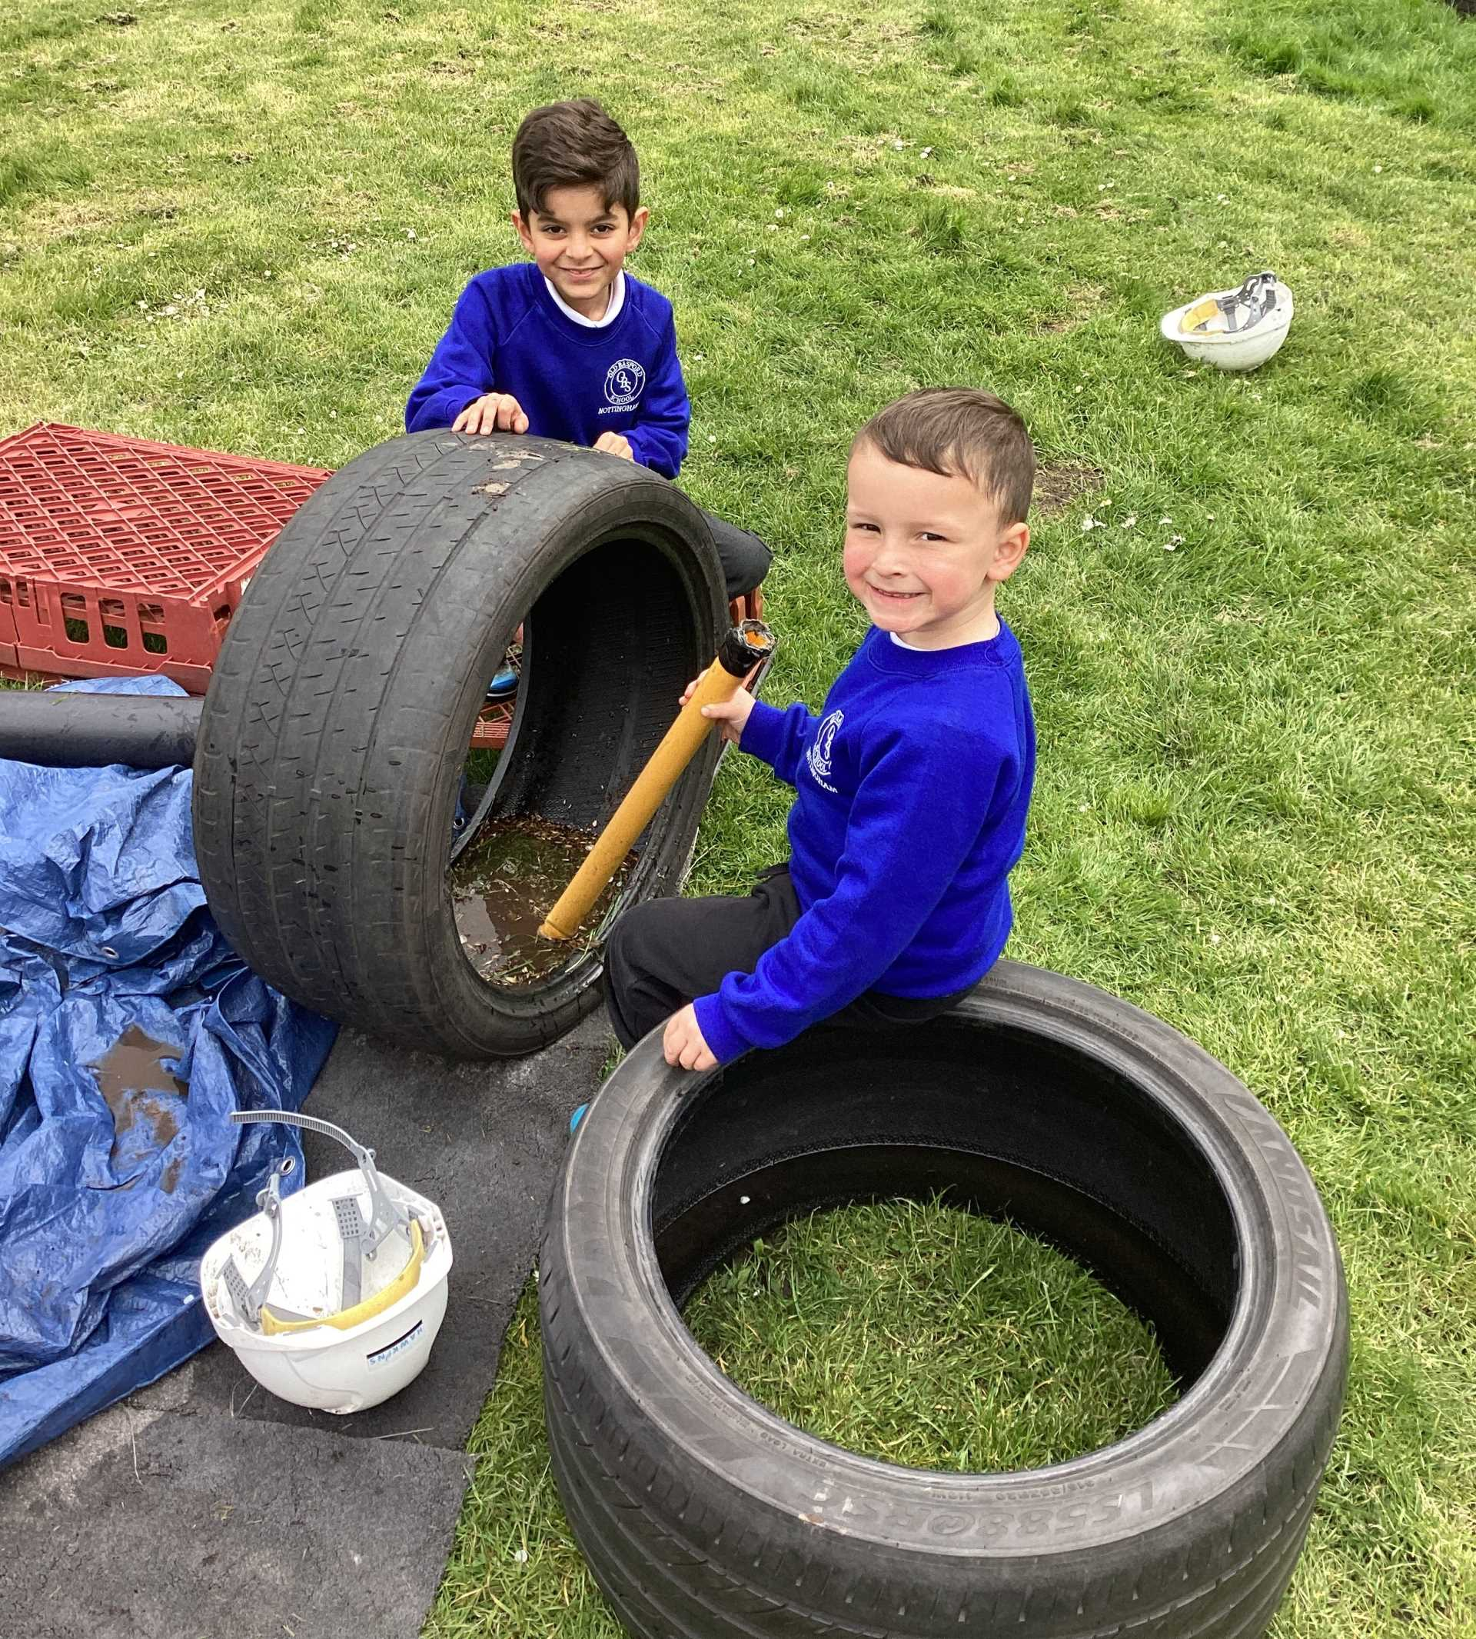

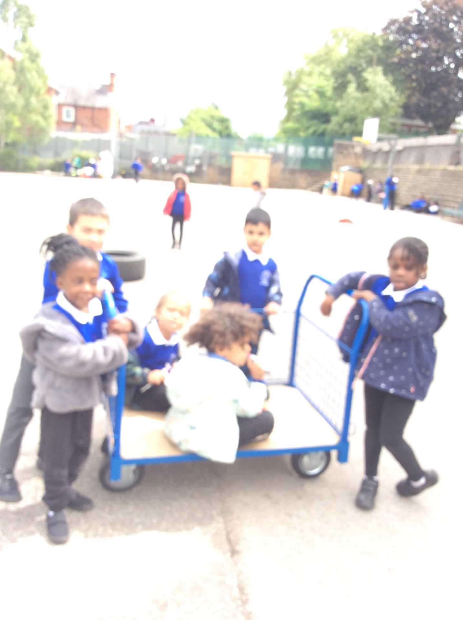
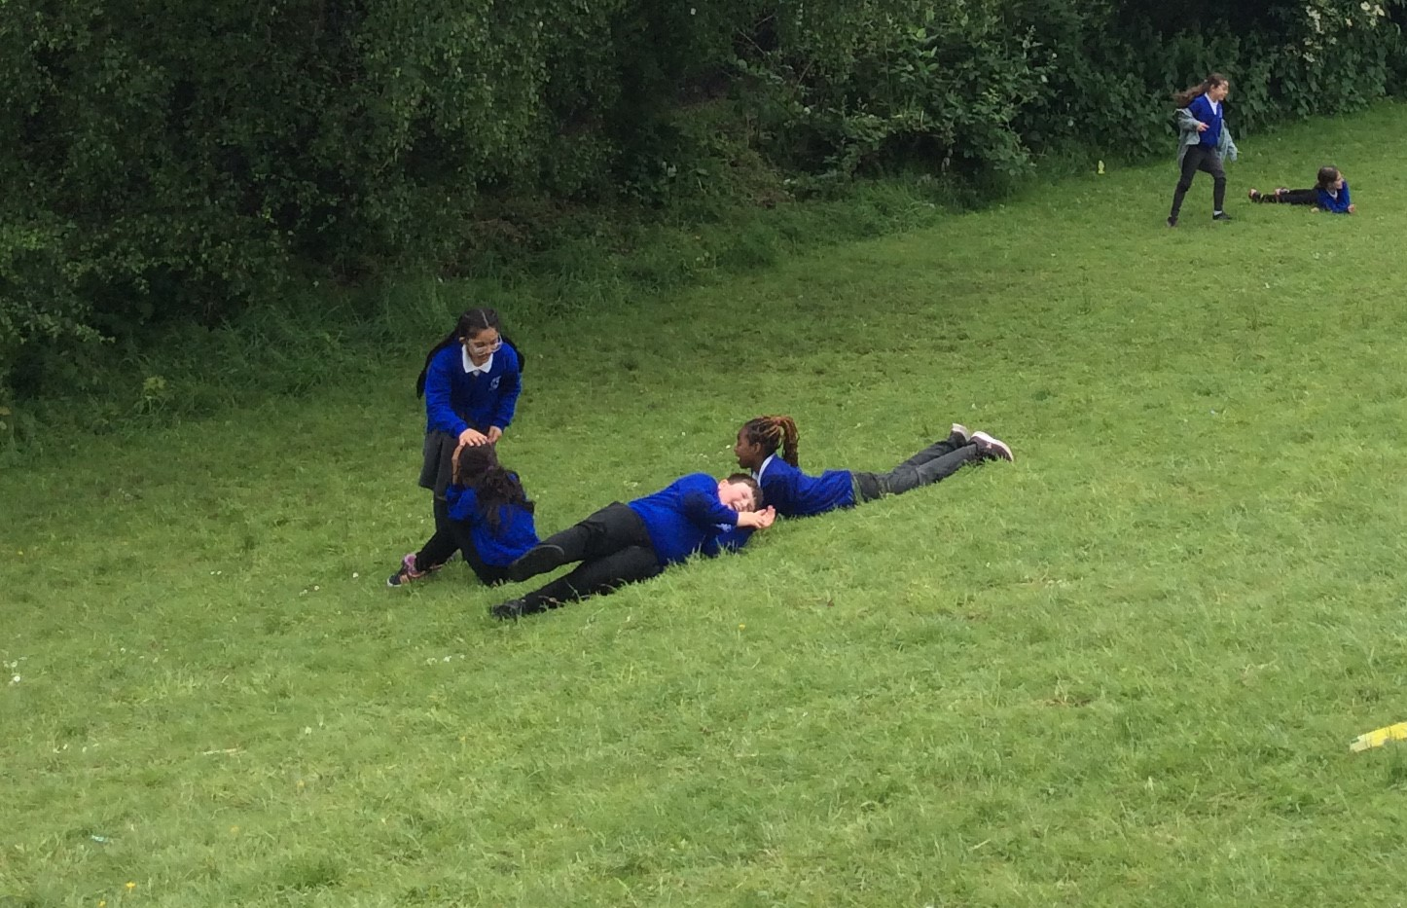
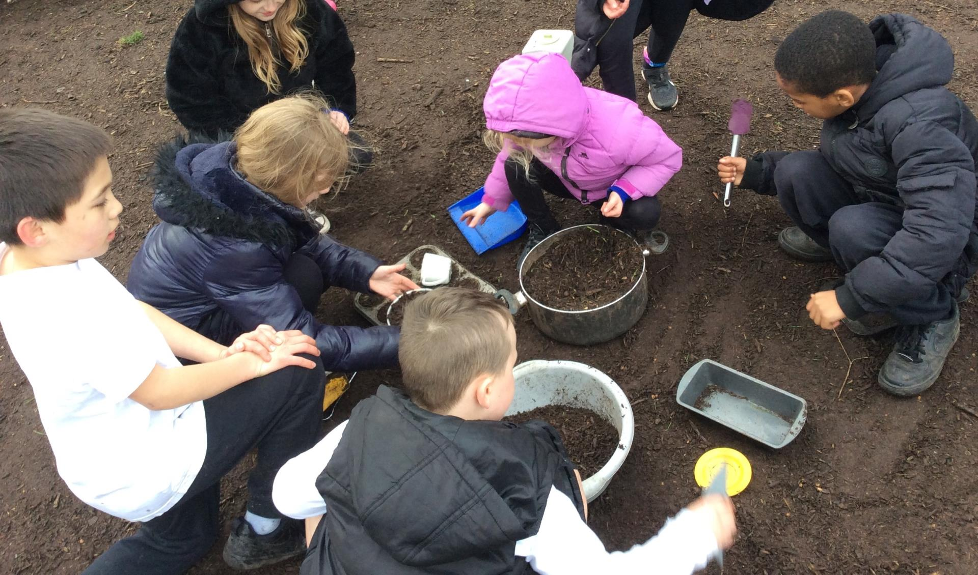
Celebration

Slide 3
Inform
The music area will now be closer to the school driveway (near the tyre trim trail).
Please put spoons and 'musical instruments' away in the black box.
Remember you CANNOT roll tyres down the slope on the field for safety reasons.
DO NOT go inside the tyres to roll we have not negotiated this yet!

Slide 4
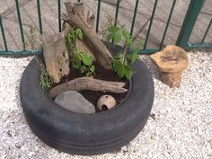
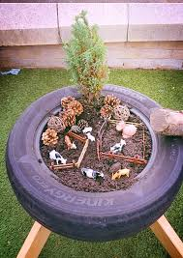
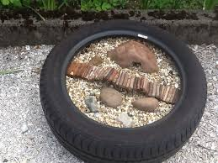
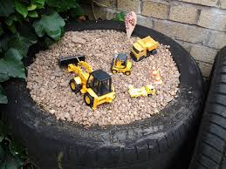
Inform
Imaginative play with tyres

Slide 5
Innovate
Sandcastles- with spoons and cups
Each tyre is a different planet
Animals- habitats
Twigs and leaves on the floor for decoration
Small people- for example at the beach
Small construction

Slide 6
Negotiate
Wash your hand before you go back in the school
Keep each tyre with it's own materials
Try and keep it in the tyre- clean up any spills
Sit on the mats around the edge- don't sit in the tyre
Don't through the materials
Cover the tyres at tidy up time
No water in the tyres

Slide 7


The Golden Brush and Welly Awards

Slide 8


Year 6 respectful award

