Slide 1


Slide 2
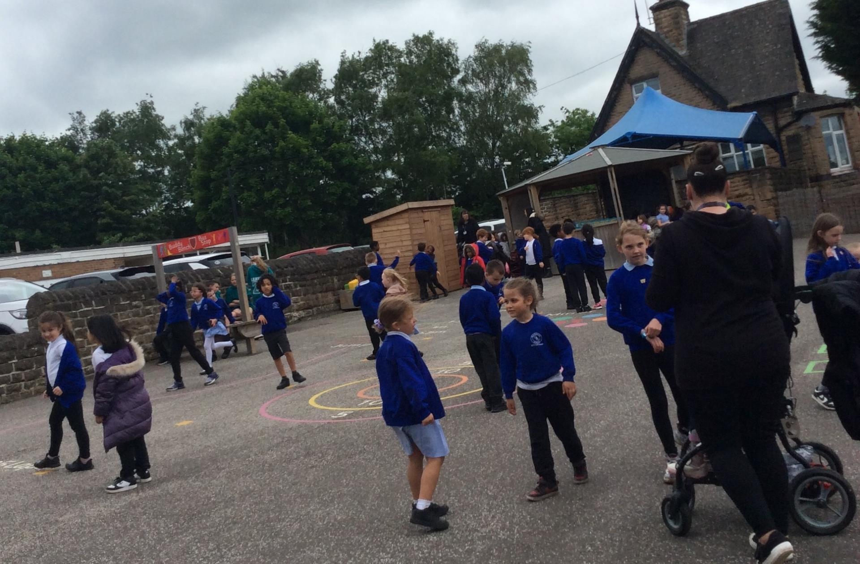

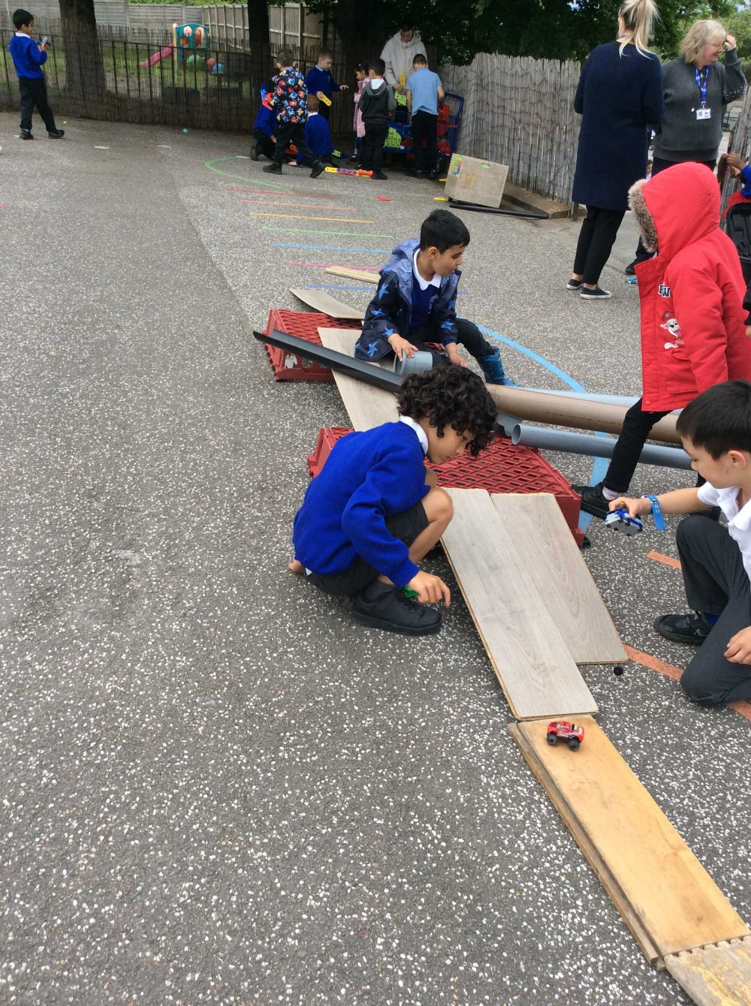
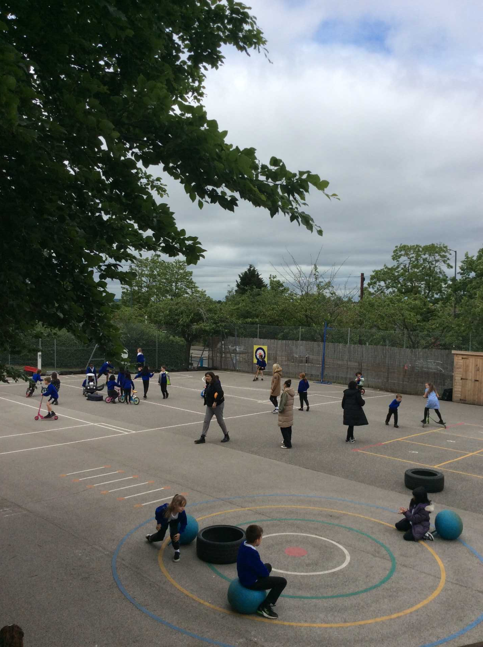
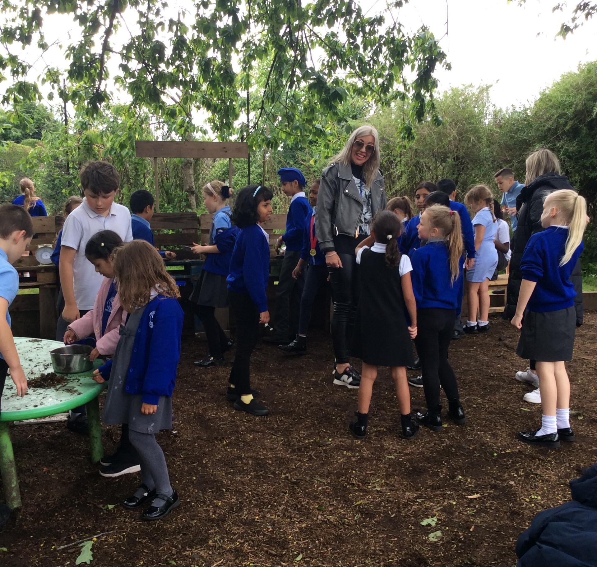
Celebration- Play afternoon

Slide 3
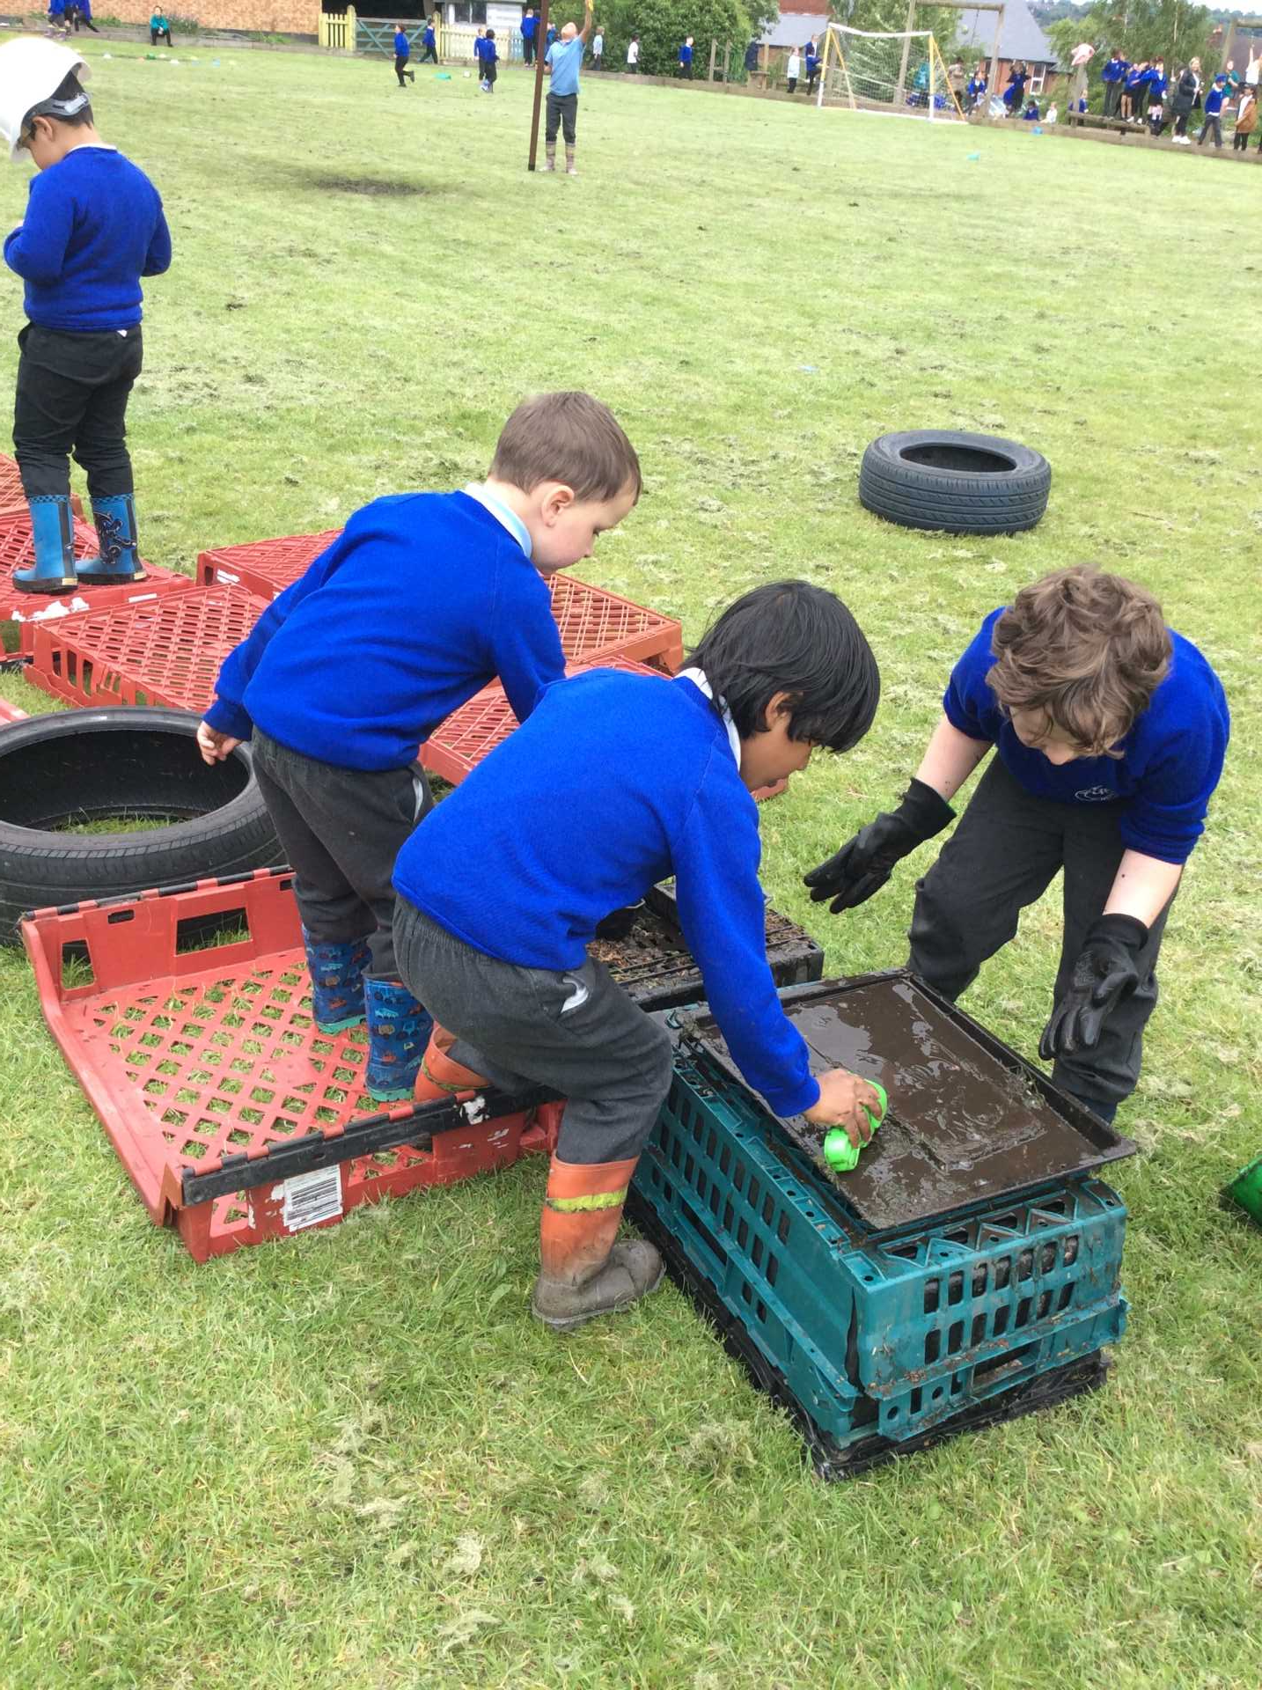
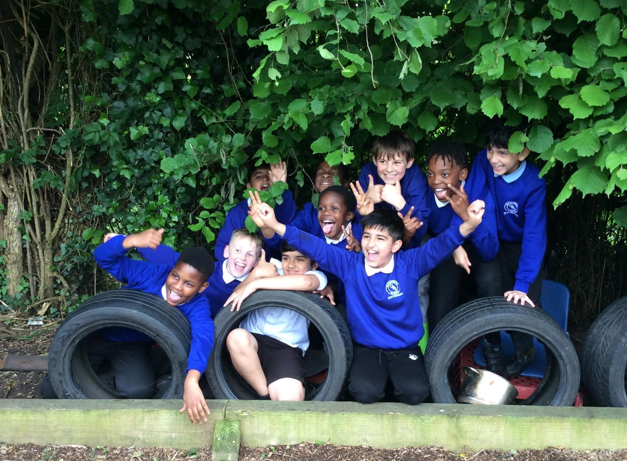
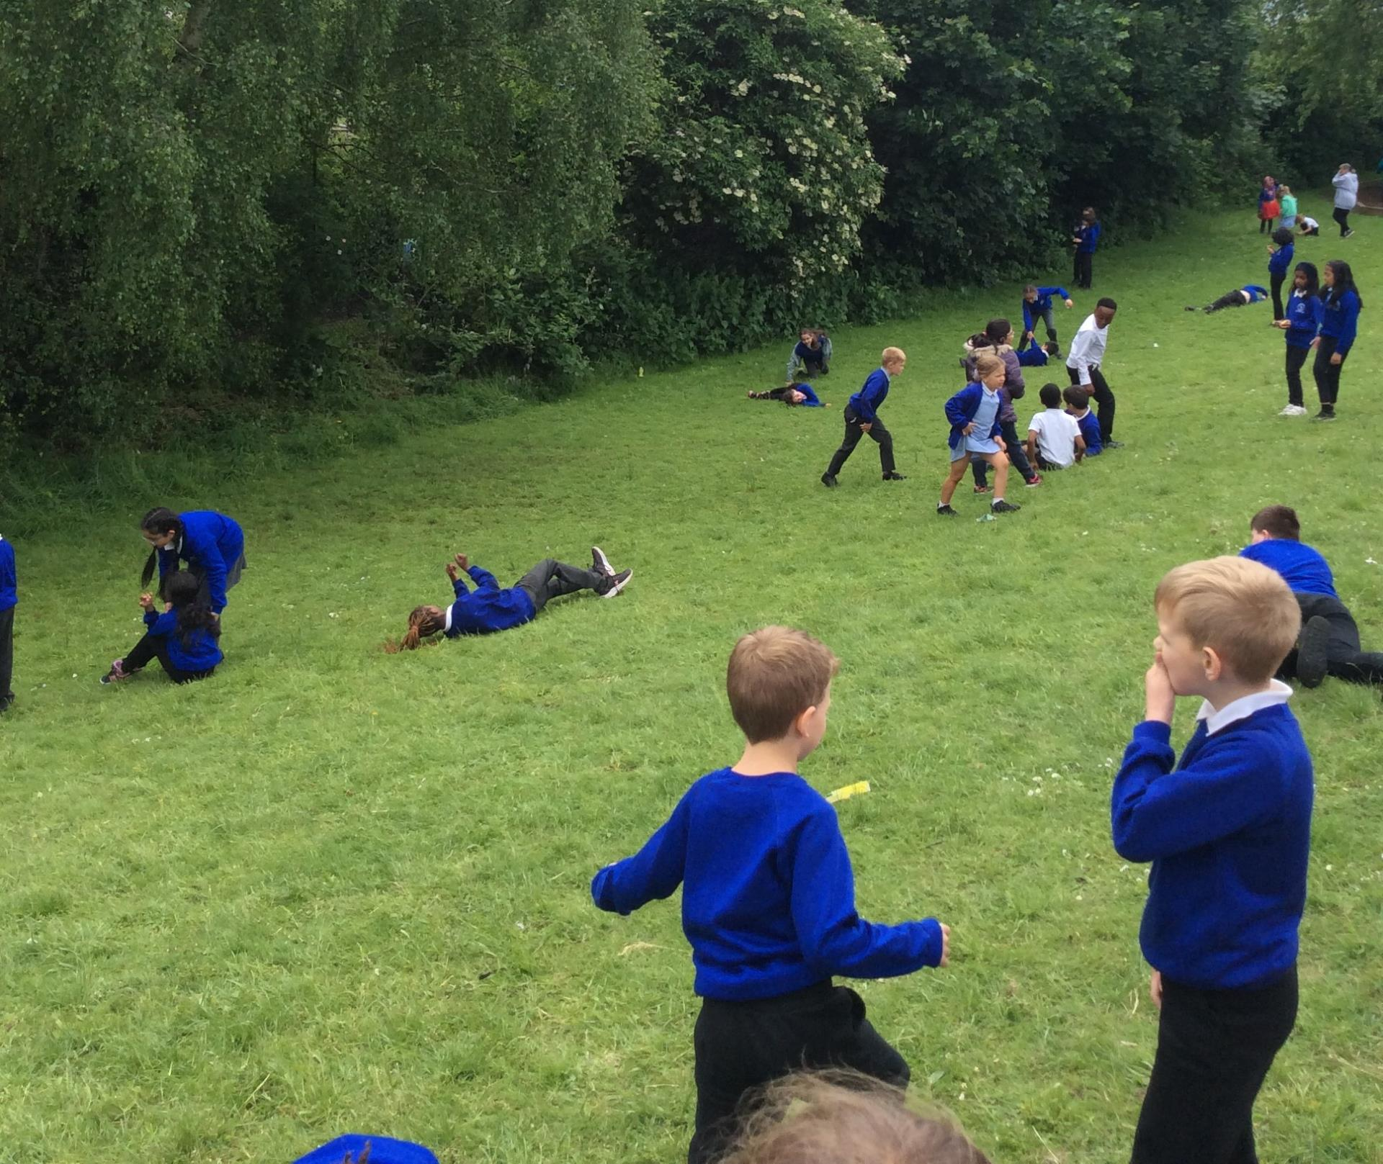
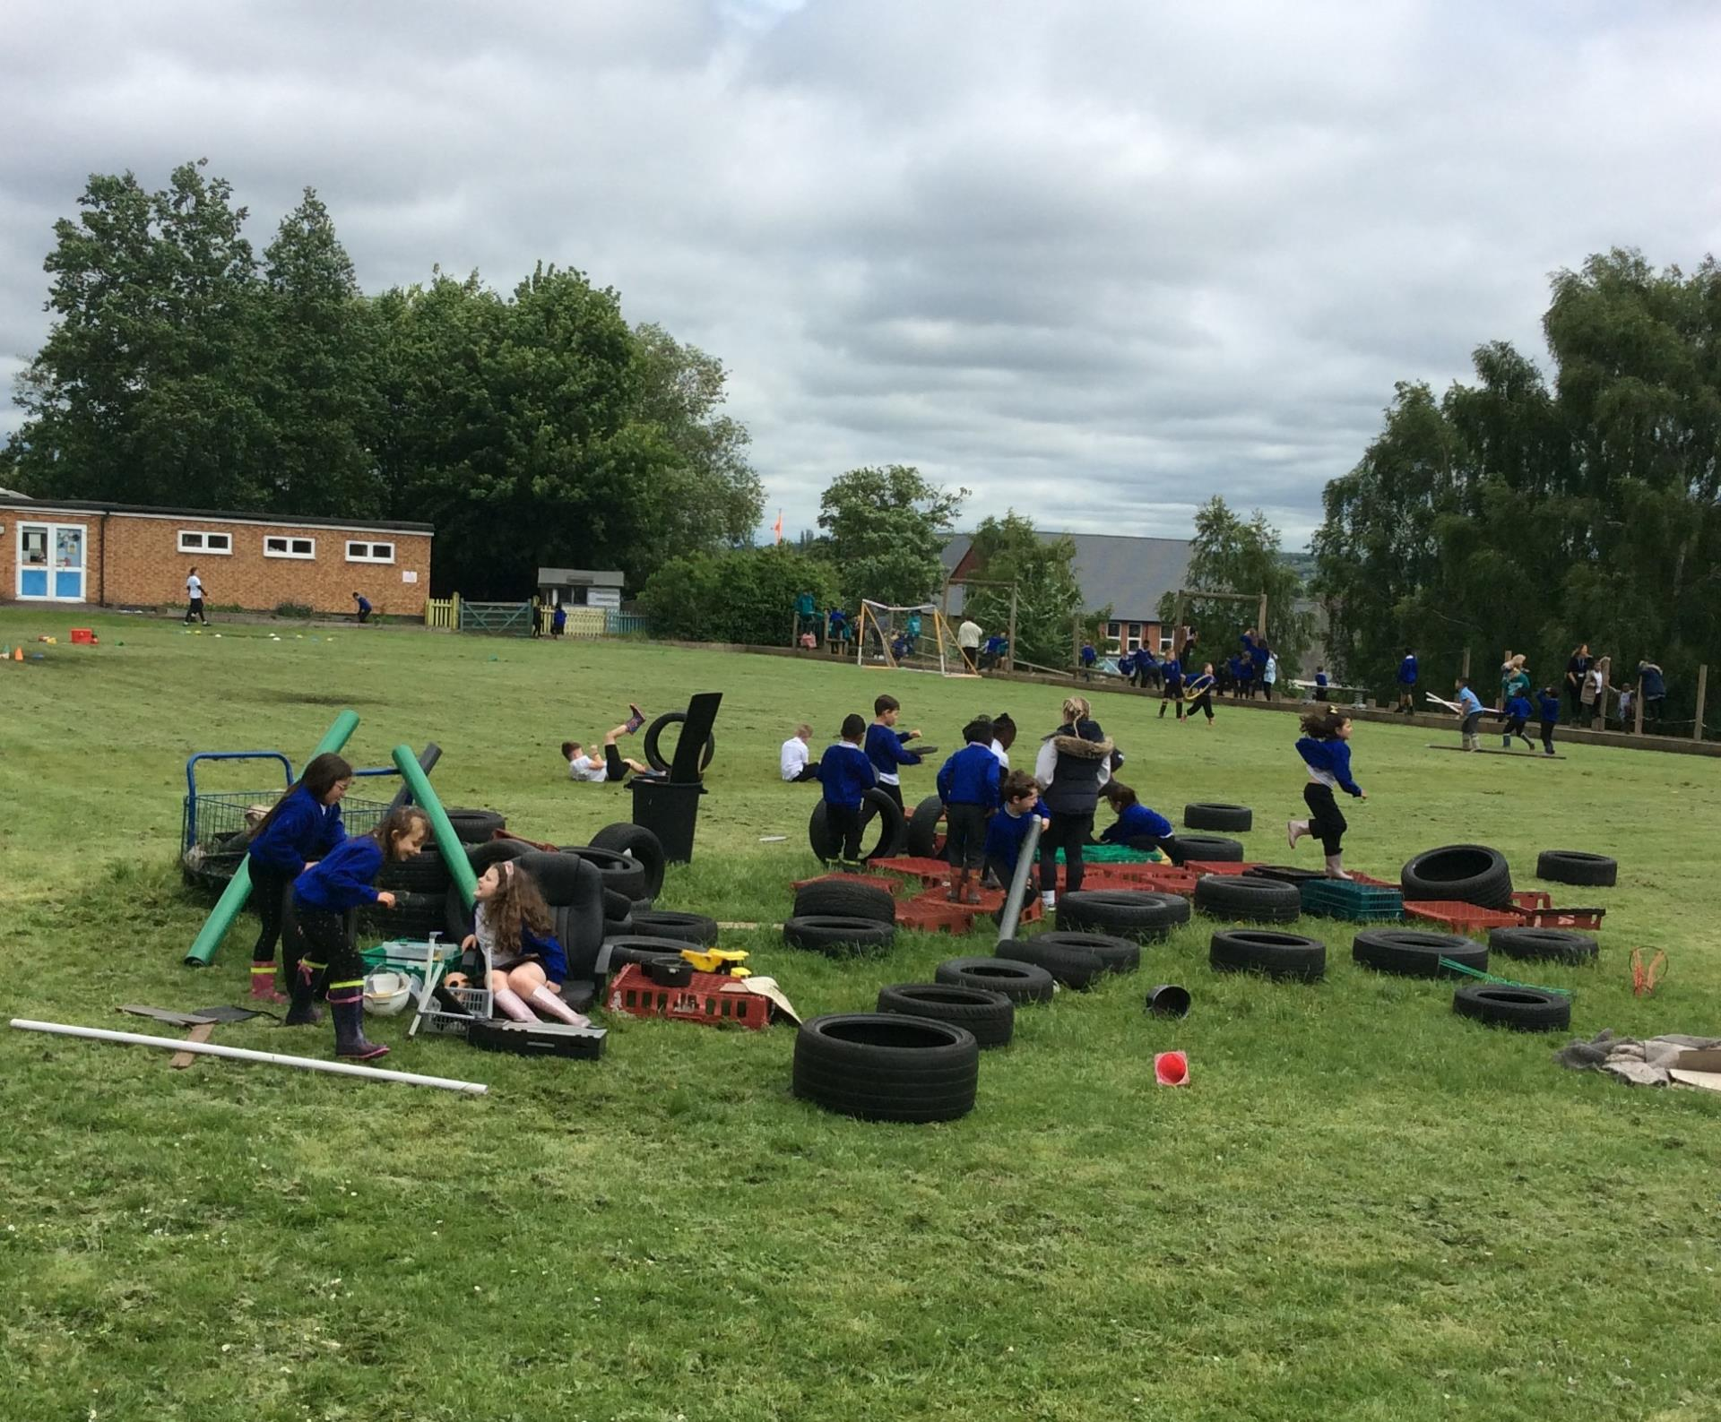
Celebration

Slide 4
Inform
Oaks and Chestnuts can now play on the field, in the calm corner and in the messy kitchen.
Listen for the whistle and line up on the playground when it is time to go in.
Y6 Opal guardians please keep a look out and help anyone from F2 in these areas and especially getting them to line up.

Slide 5
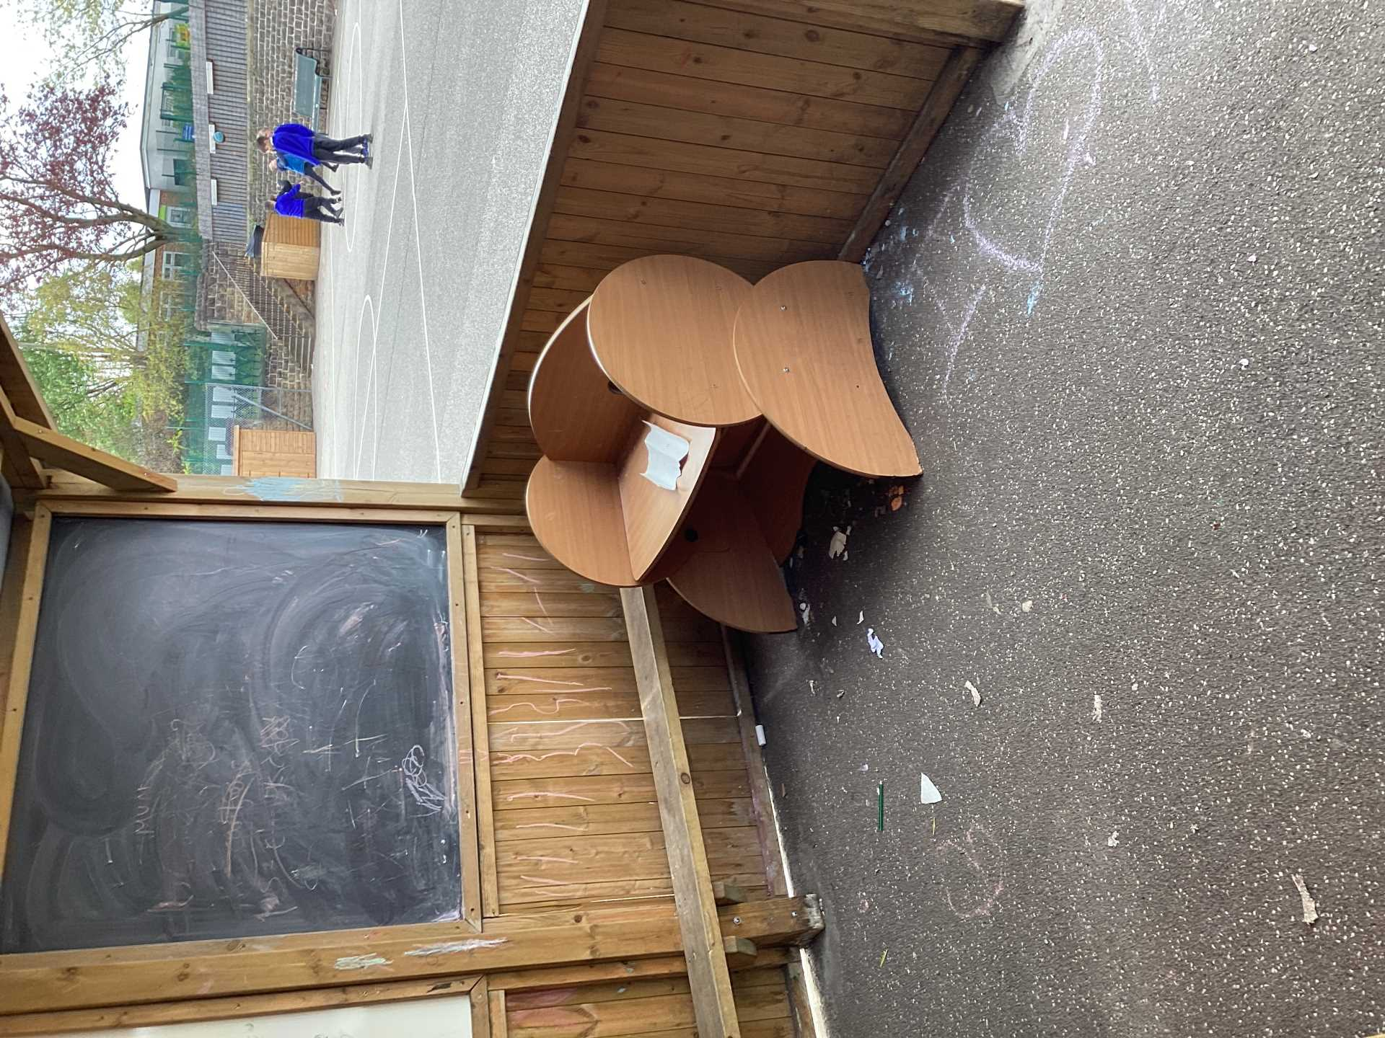
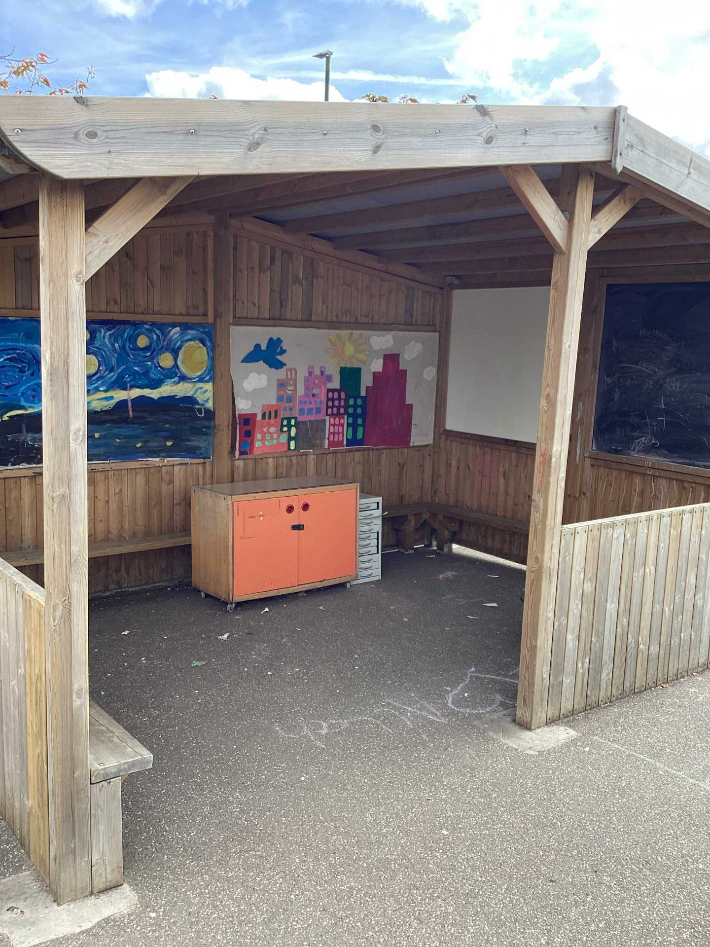
Inform
Creative area- before! What a mess! Where are the resources?

Slide 6
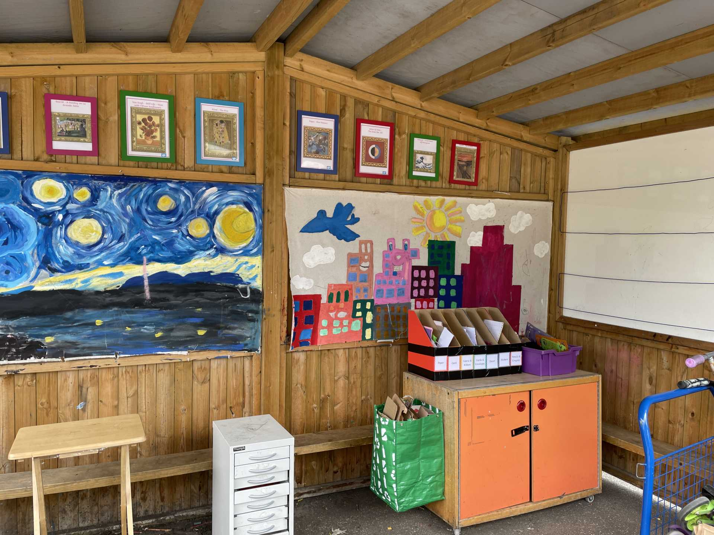
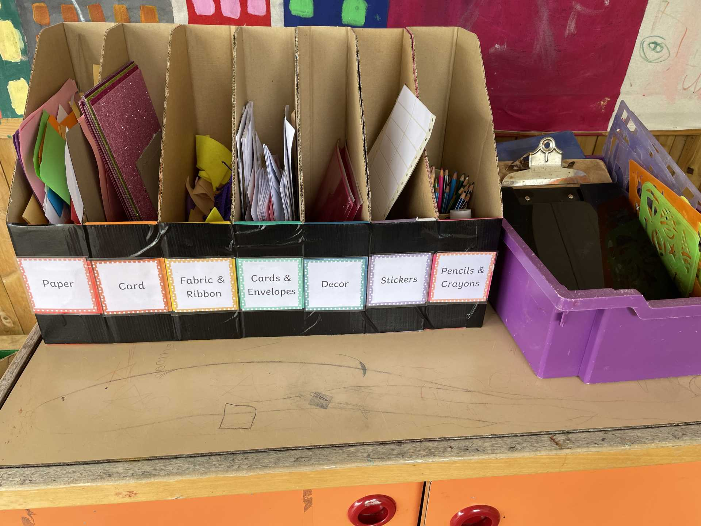
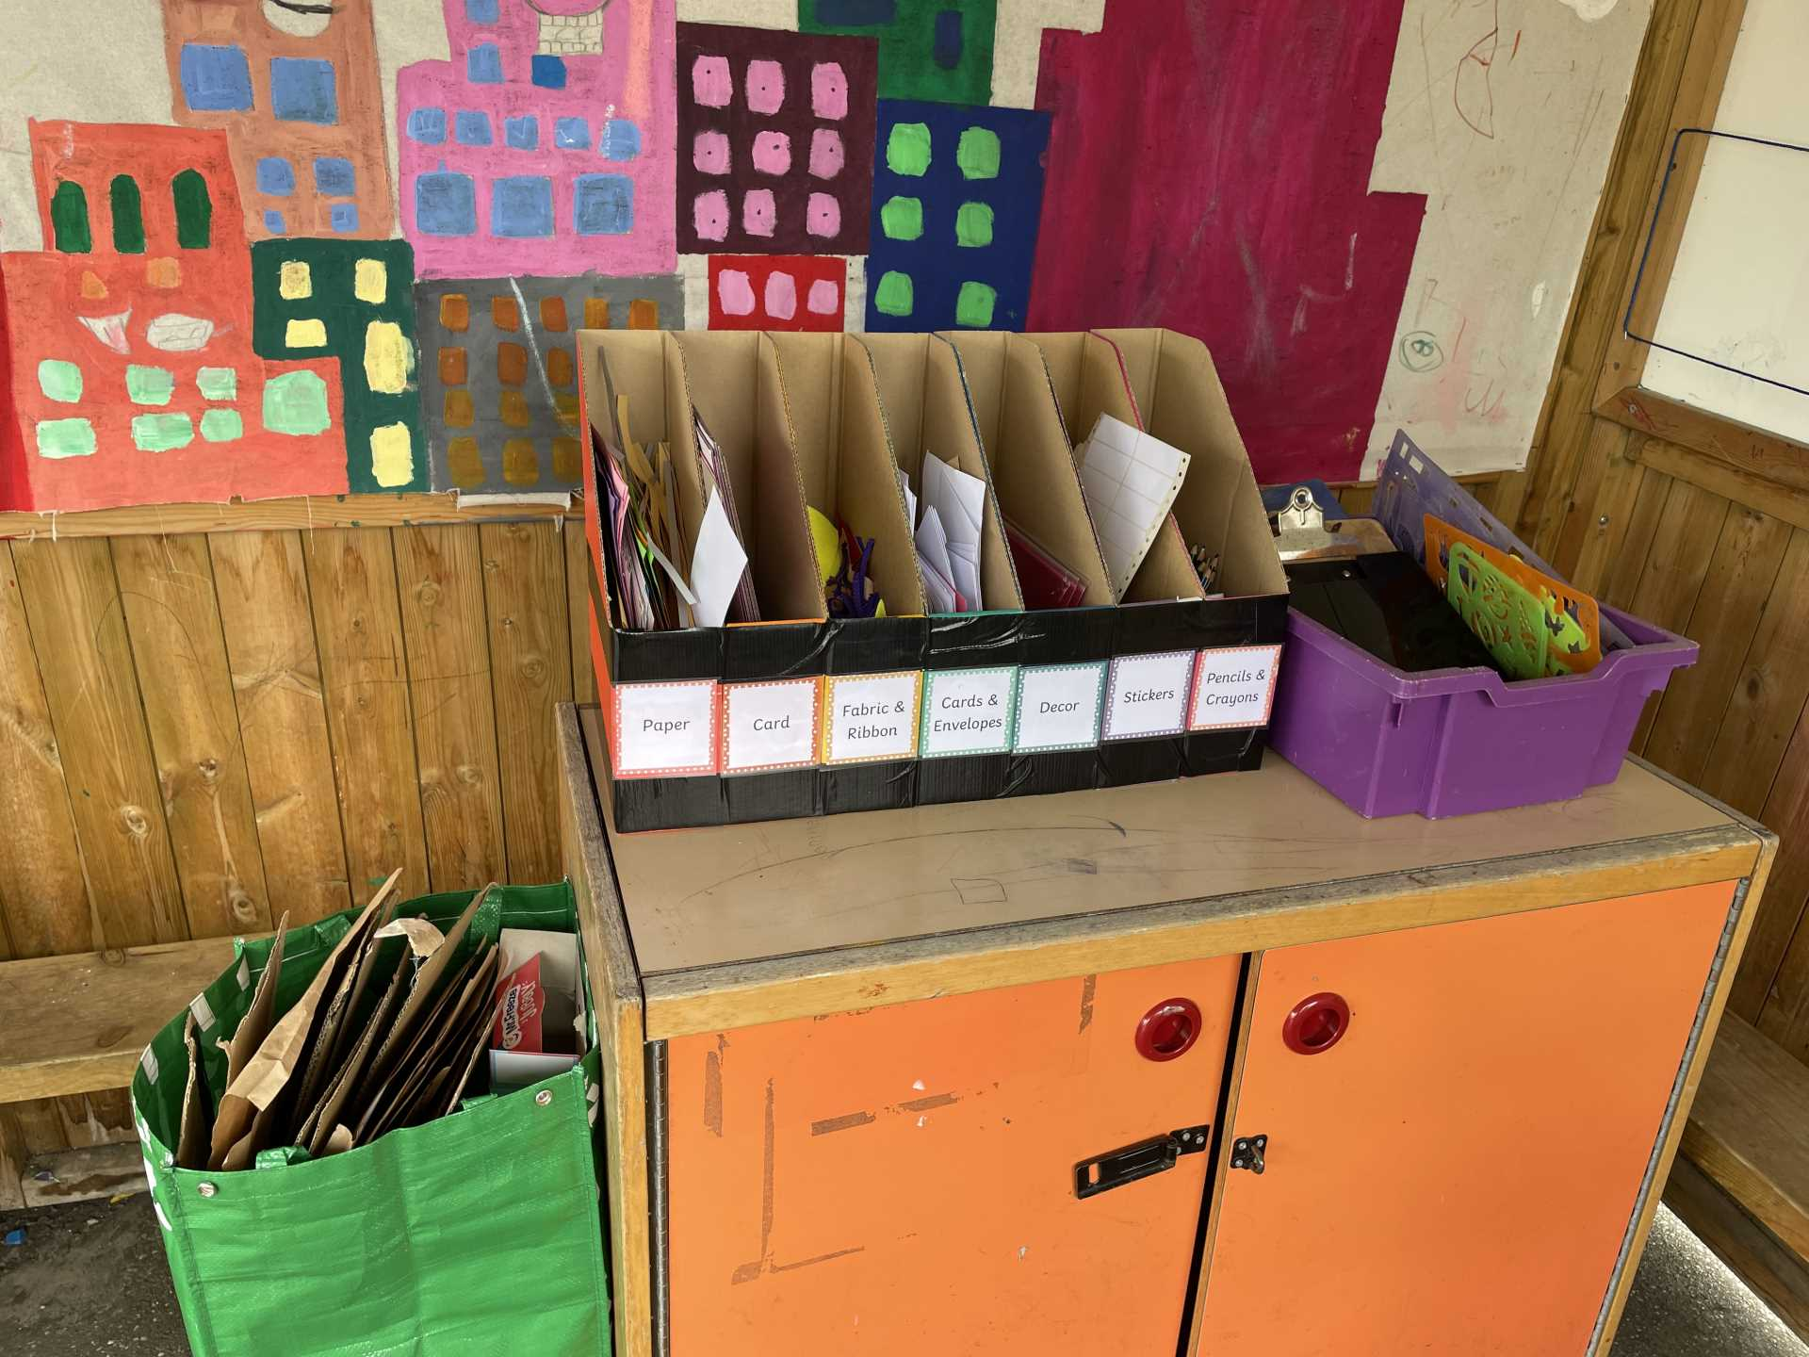
Inform
Creative area- after! Thank you for your suggestions.

Slide 7
Innovate
Make cards for a friend
Draw pictures
Make posters
Use the card to create a model
Use he paintings on the wall as inspiration
Hang up on the washing line, like a gallery

Slide 8
Negotiate
Only use what you need
Look after the resources
If you drop something pick it up
Put the lid on the gluestick
Tidy away where things belong
Don't take someone else's picture off the washing line.

Slide 9


The Golden Brush and Welly Awards
No winners this week. We will be focussing on good play and good tidying in the creative area.

