Slide 1


Slide 2
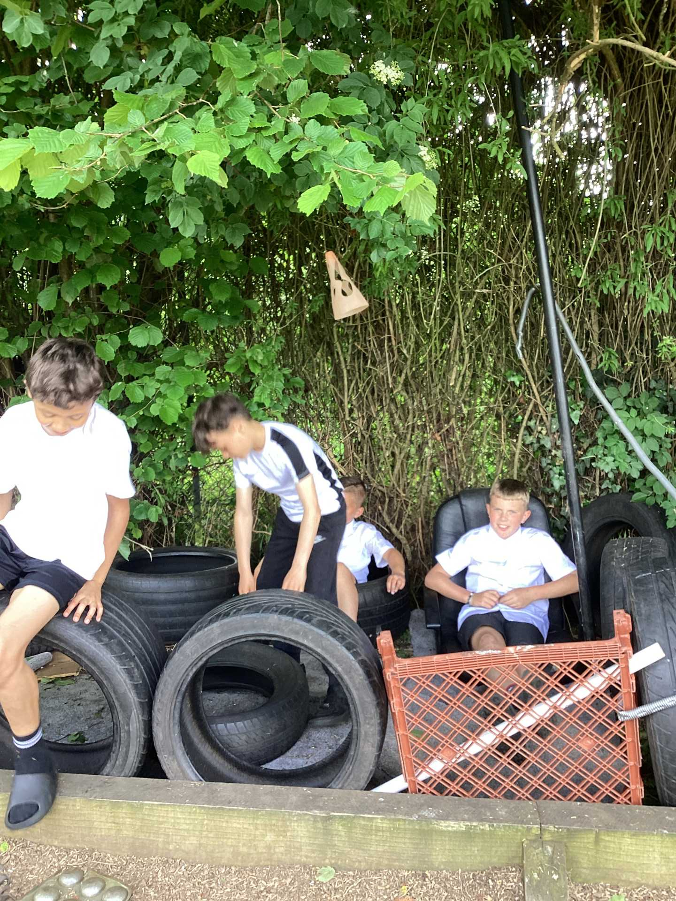
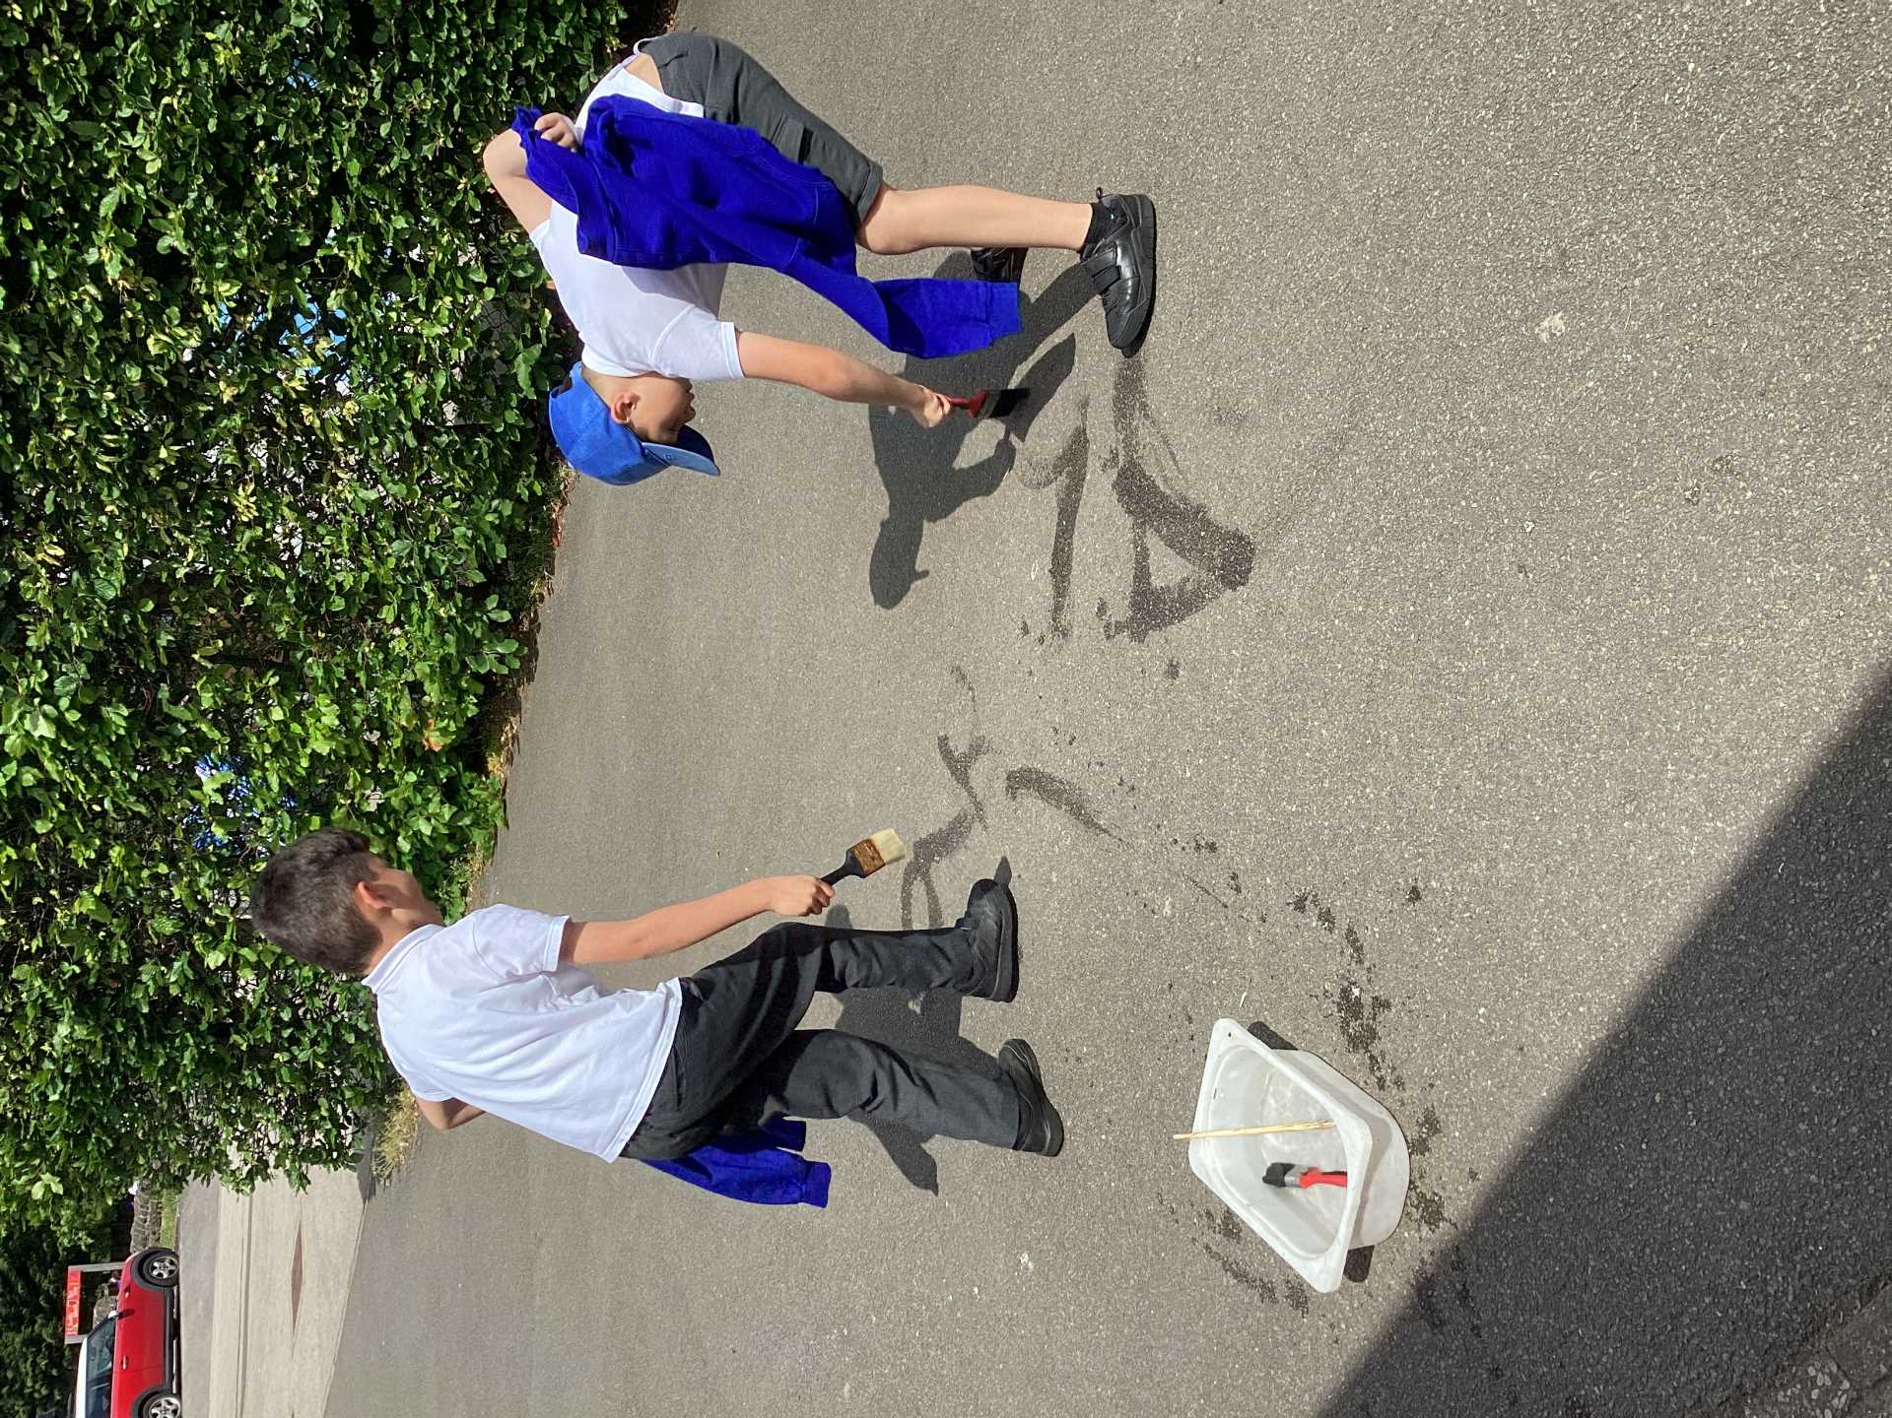
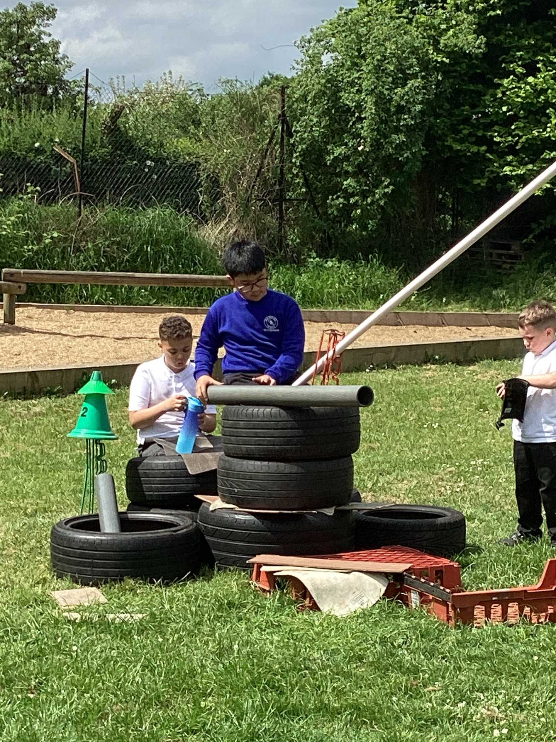
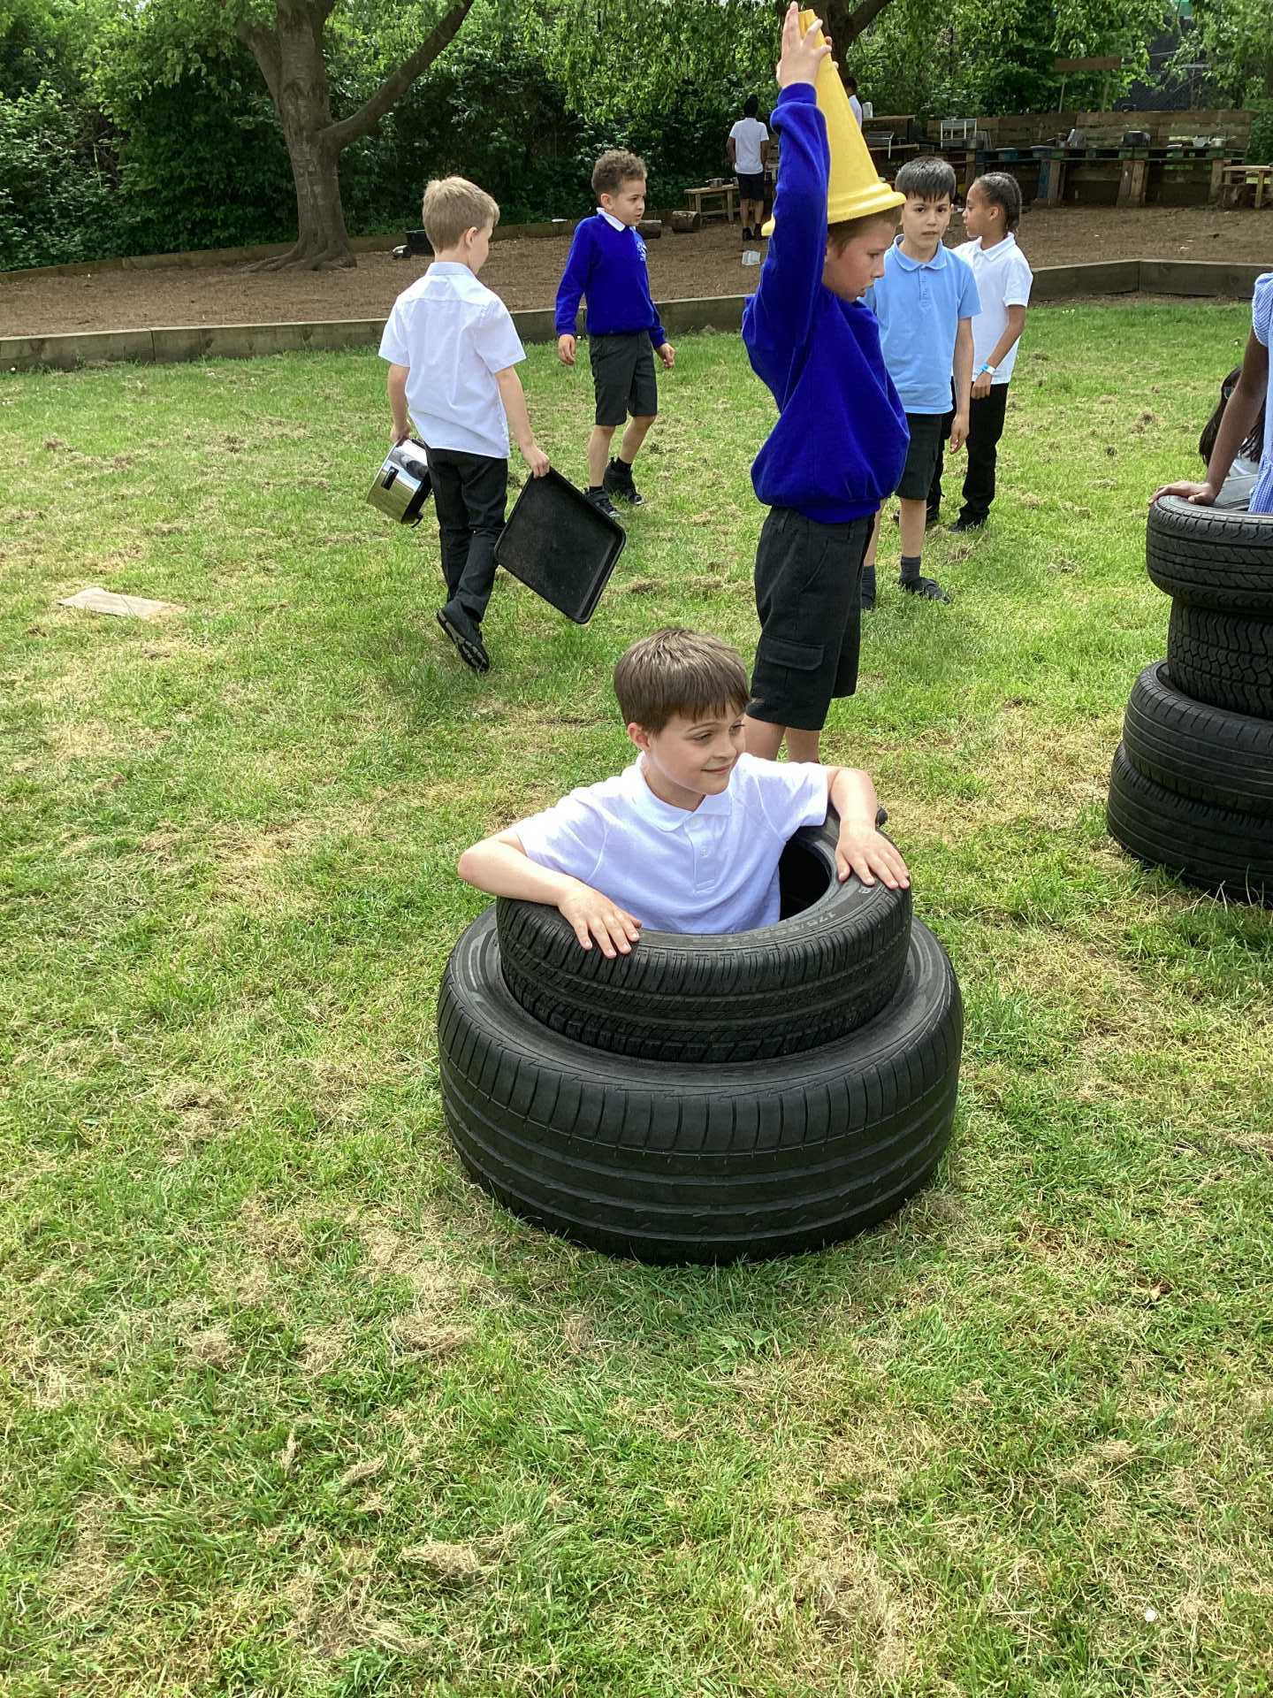
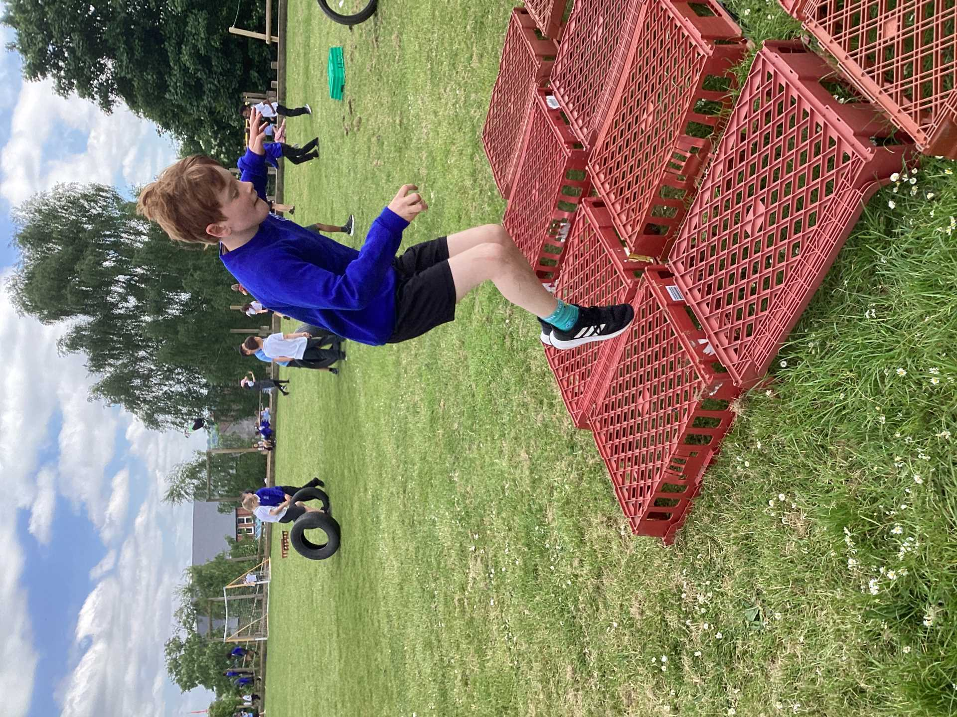
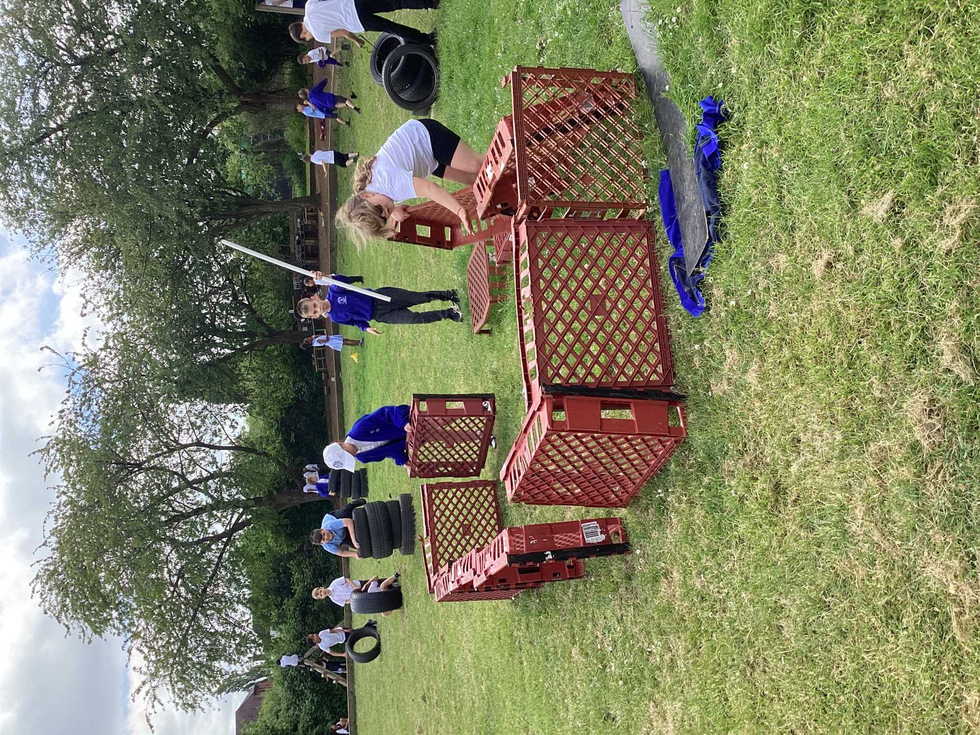
Celebration

Slide 3
Celebration- Creative Area Designs
Thank you for all your wonderful ideas! We will be looking to add:
* Washing lines and pegs to display work * Chairs and cushions * A bin
* Clipboards * Water colours * Tape * Dot to dots * Play dough
* Glue sticks
Well done to Joseph who created a fantastic 3D design that he is going to share with us

Slide 4
What is new this week?
* When it is not raining we WILL be allowed to go on the field without wellies. You need to check the welly sign every day.
* We will be moving the Active Zone onto the field.
The wheelie zone will now be bigger but remember to keep within the tyre area.
* The water will be out on sunny days so remember to ask someone from the Play Team to refill if you have run out of water.

Slide 5
Reminder of rules for equipment on the field
* Only stack tyres up to waist height ( can you get out?)
* No climbing on stacks of crates.( No higher than your waist)
* Share your dens with others.
* You can take equipment down the slope but you must return anything that you have used.

Slide 6
Reminder of rulesfor equipment on the field
* Only stack tyres up to waist height ( can you get out?)
* No climbing on stacks of crates.
* Share your dens with others
* You can take equipment down the slope but you must return anything that you have used.

Slide 7
New to playtimes
After speaking to girls across school , we have realised that football has not been fair to them. To make this fair, when your year group plays football on the playground at playtime, the girls from that year group can play football on the field.
Monday - Year 5
Tuesday - Year 4
Wednesday - Year 6
Thursday - KS1
Friday - Year 3

Slide 8


The Golden Brush and Welly Awards

Slide 9


Year 6 respectful award

