Slide 1


Slide 2
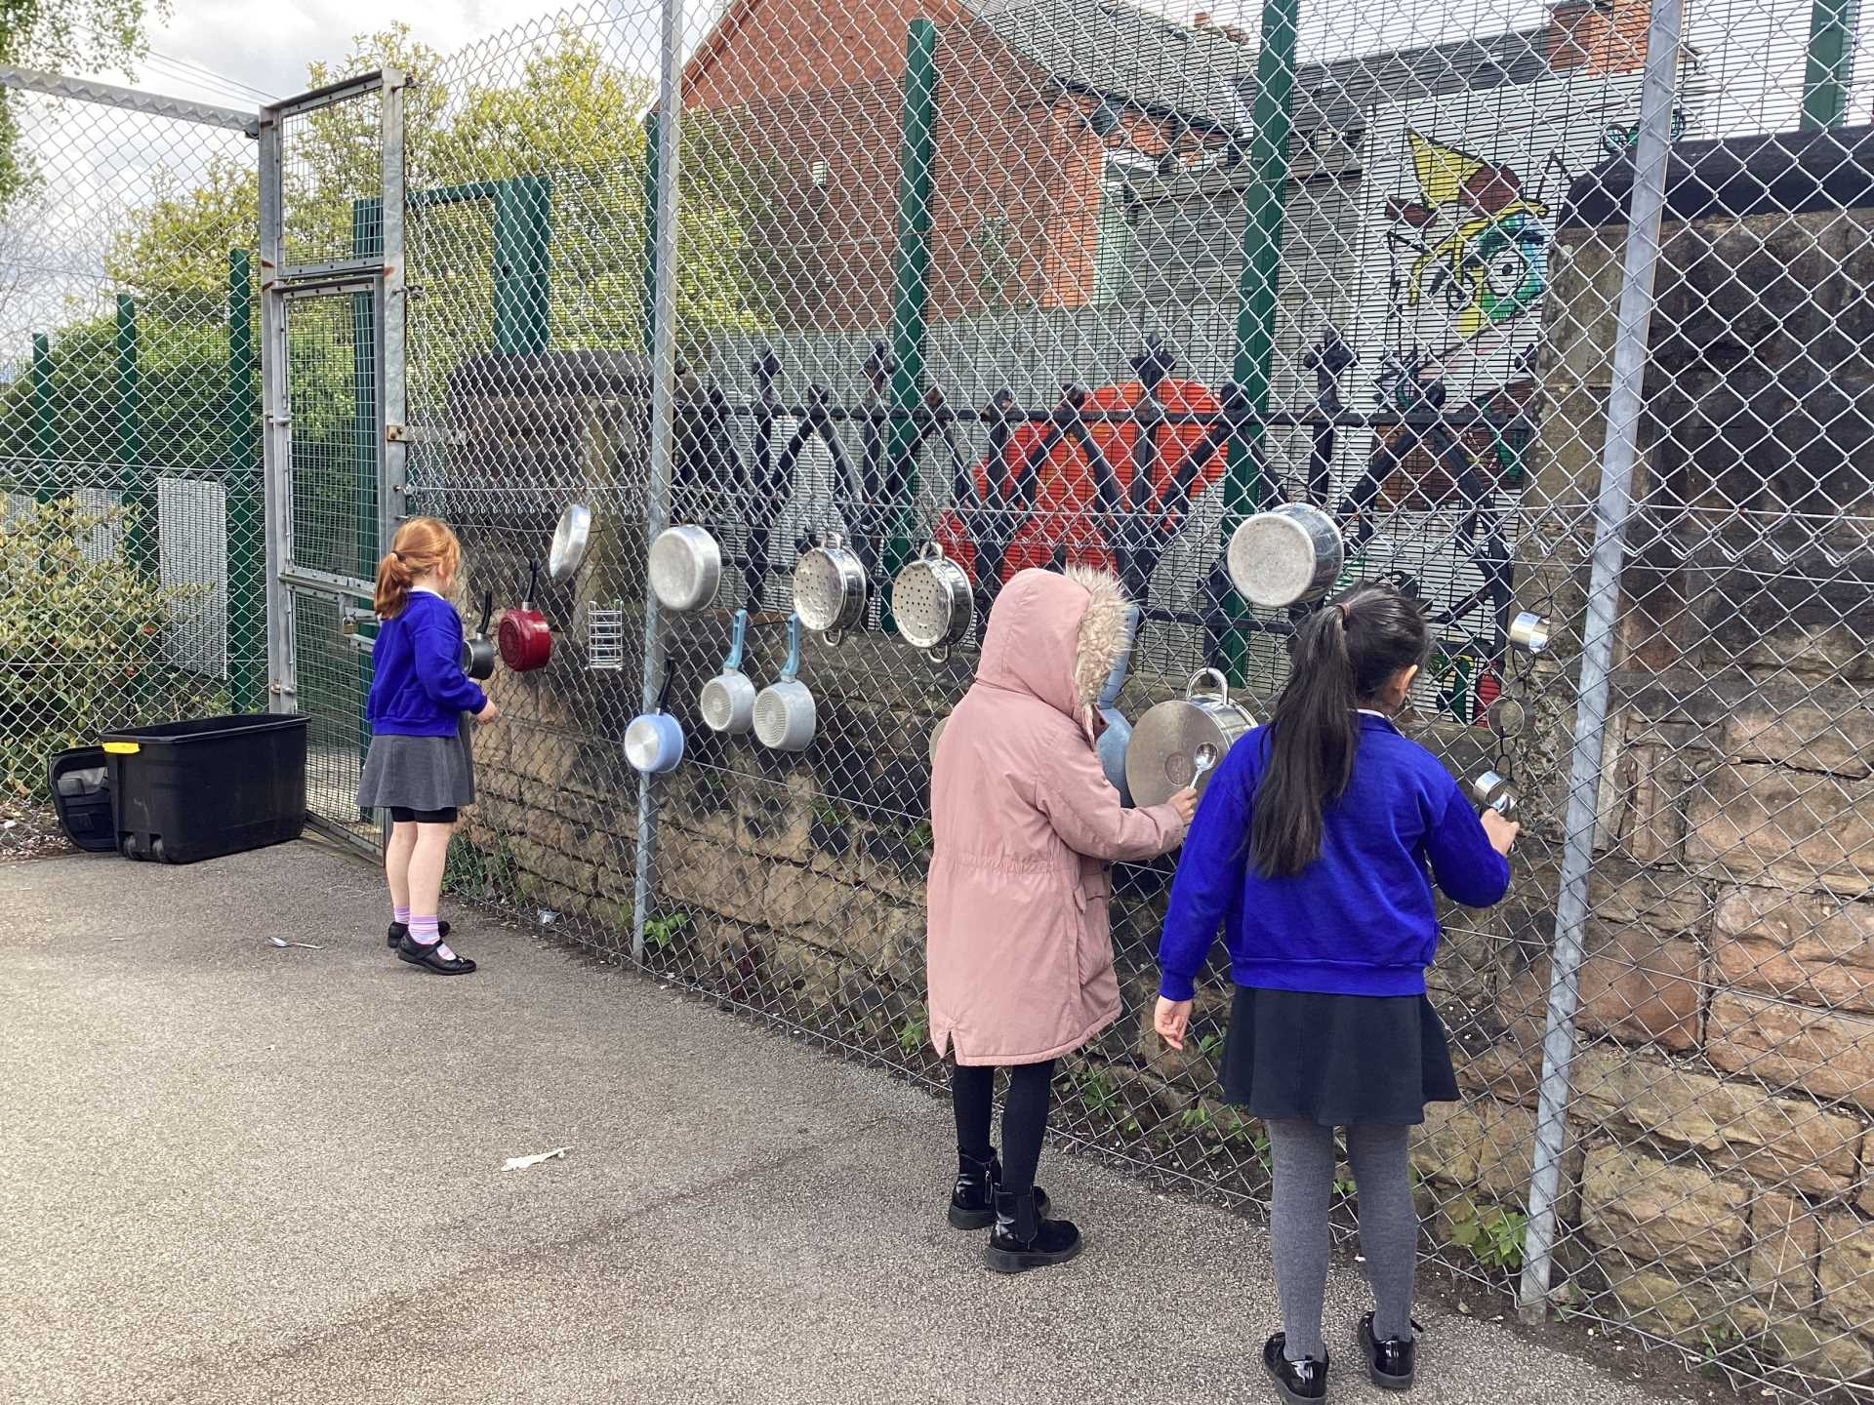
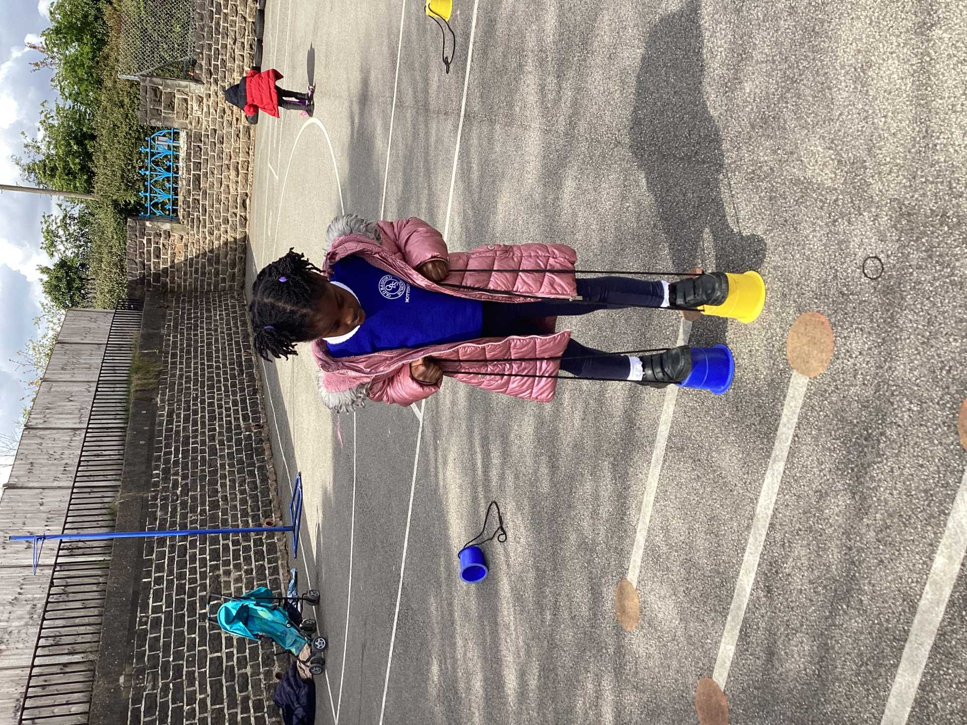
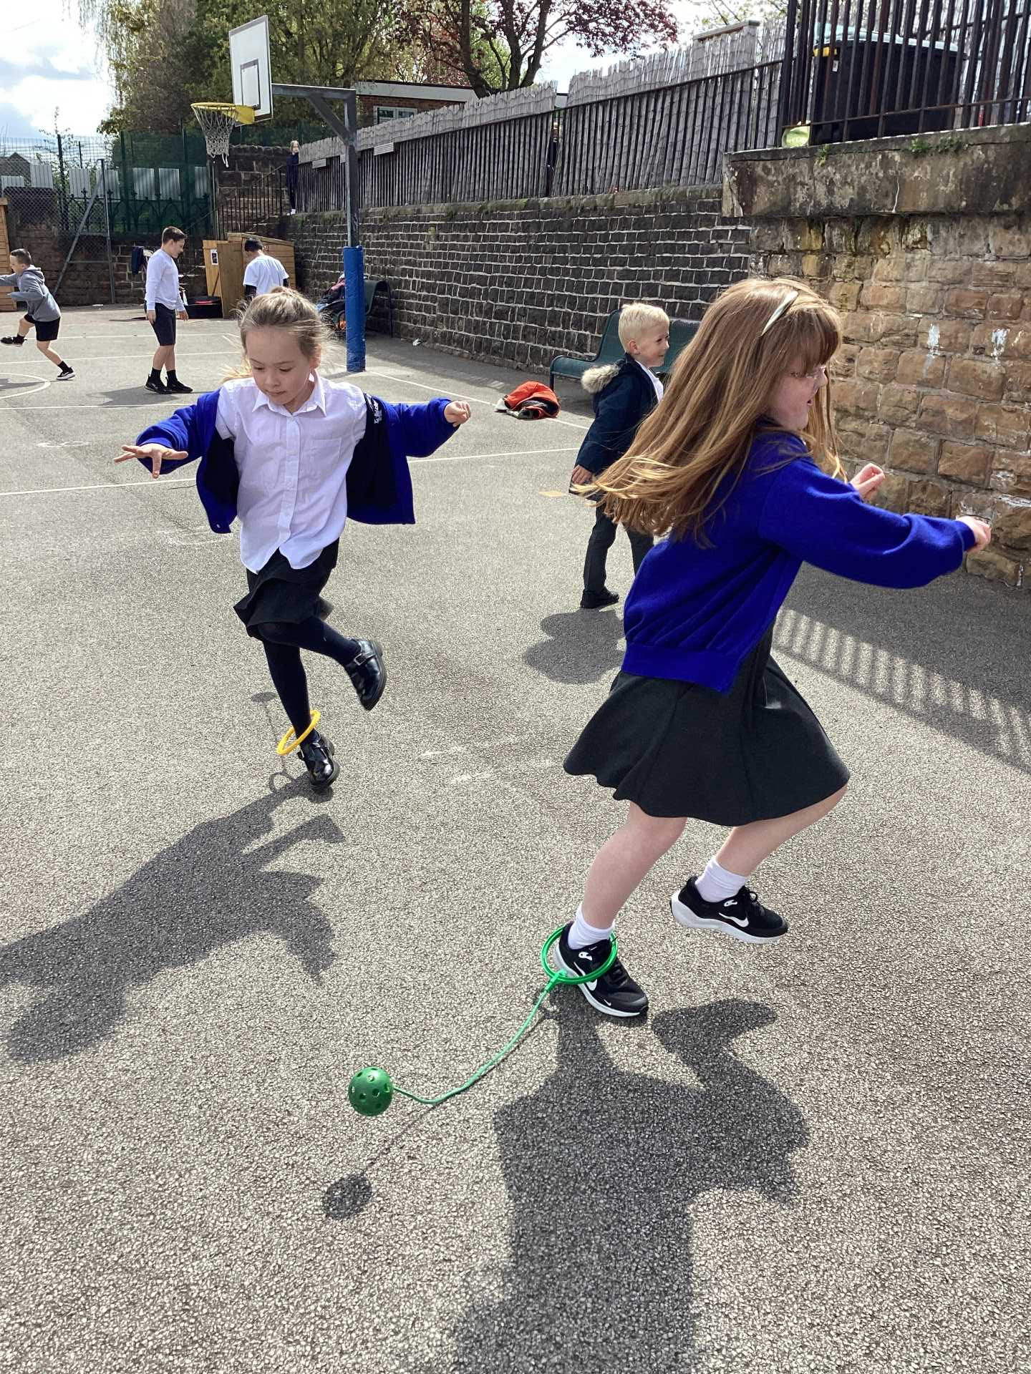
Celebration- Opal Play

Slide 3
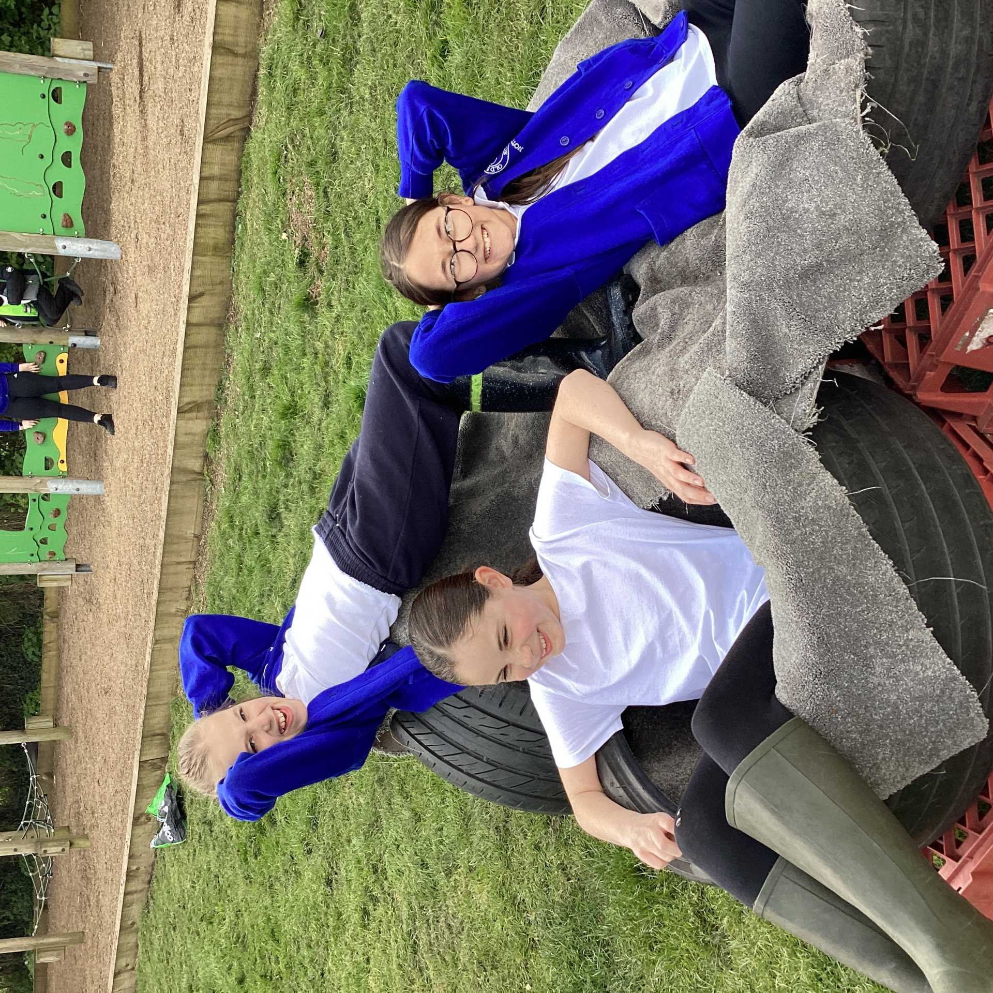
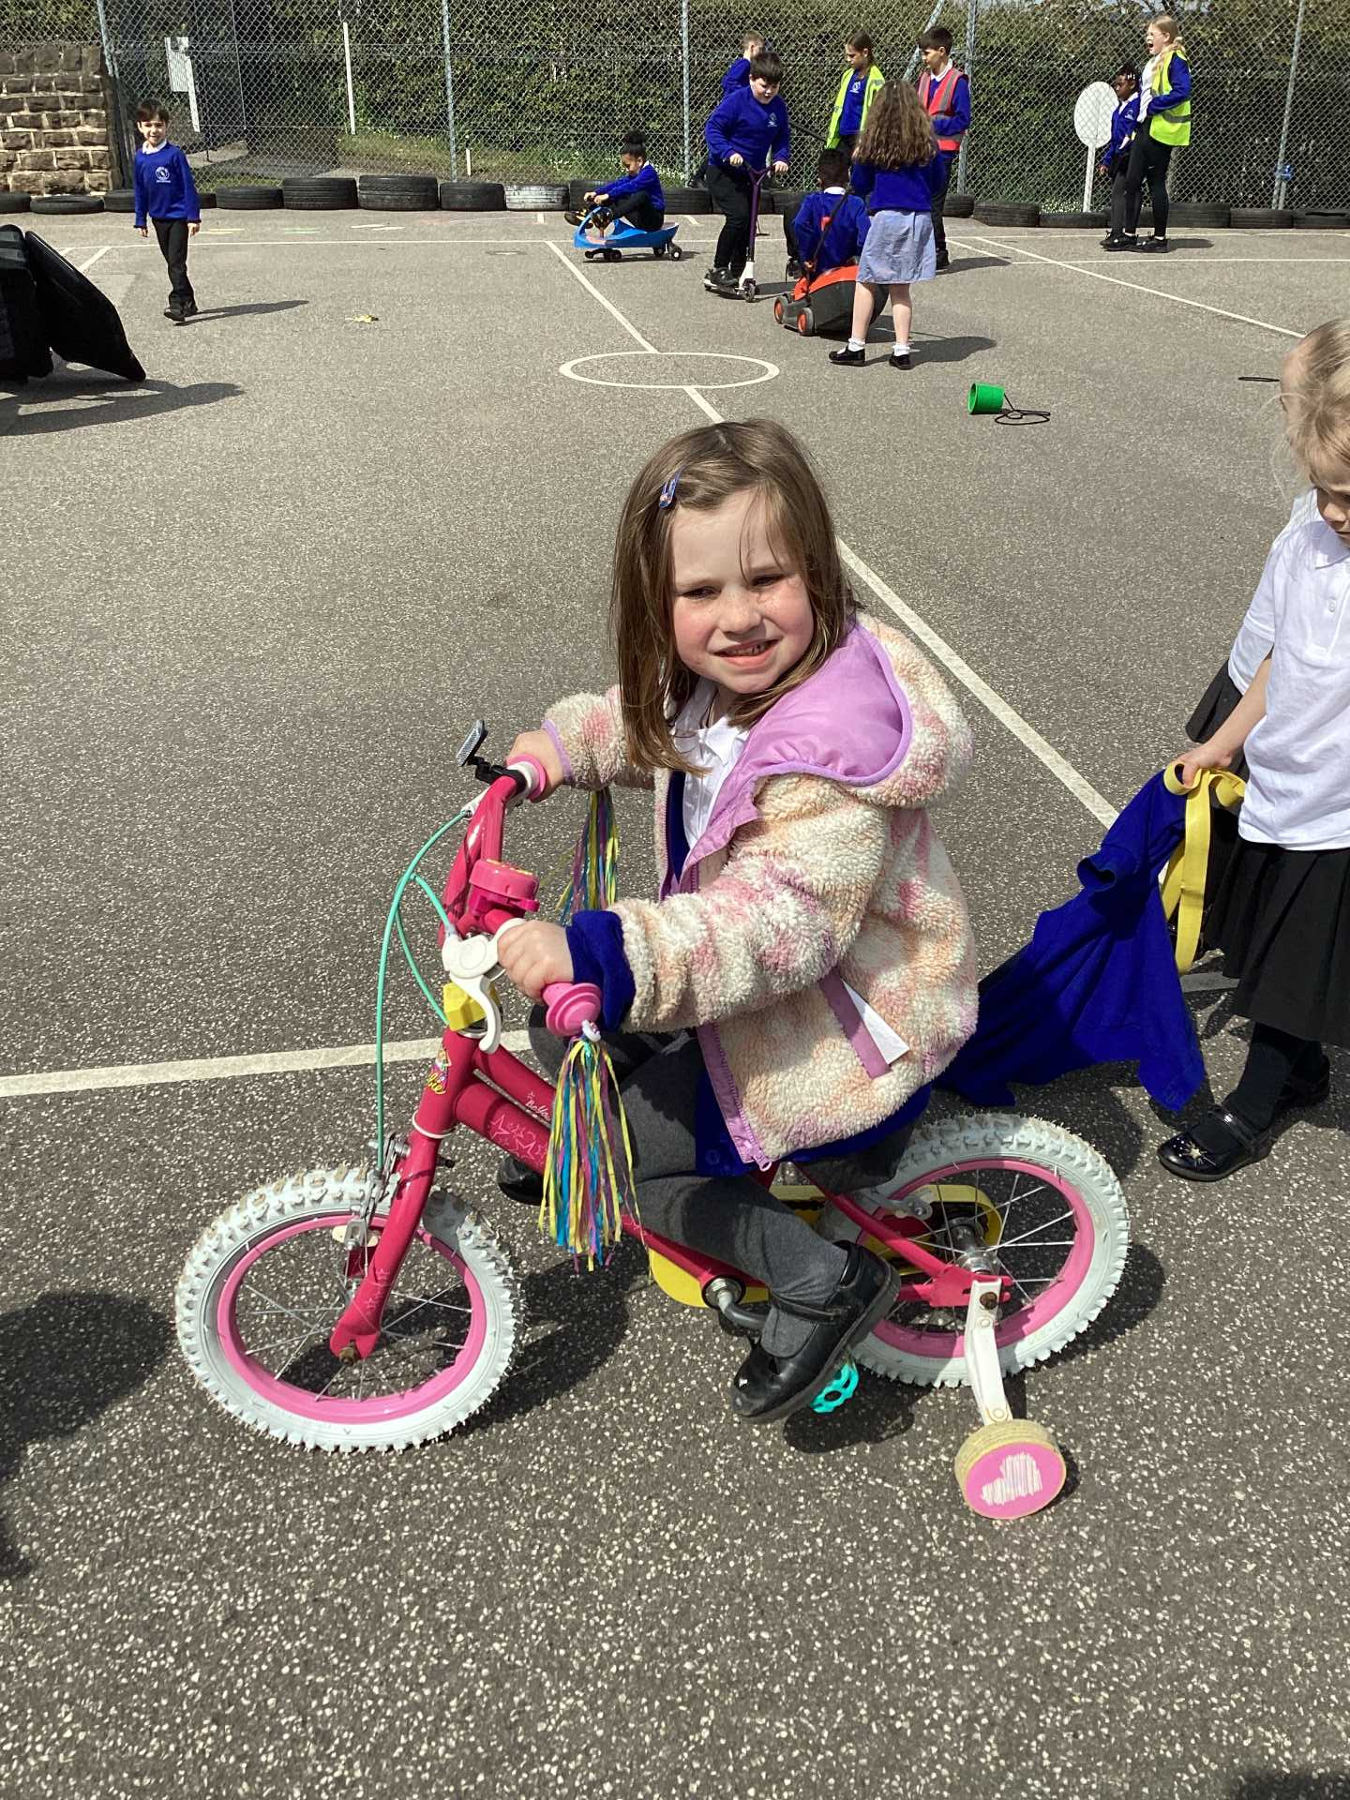
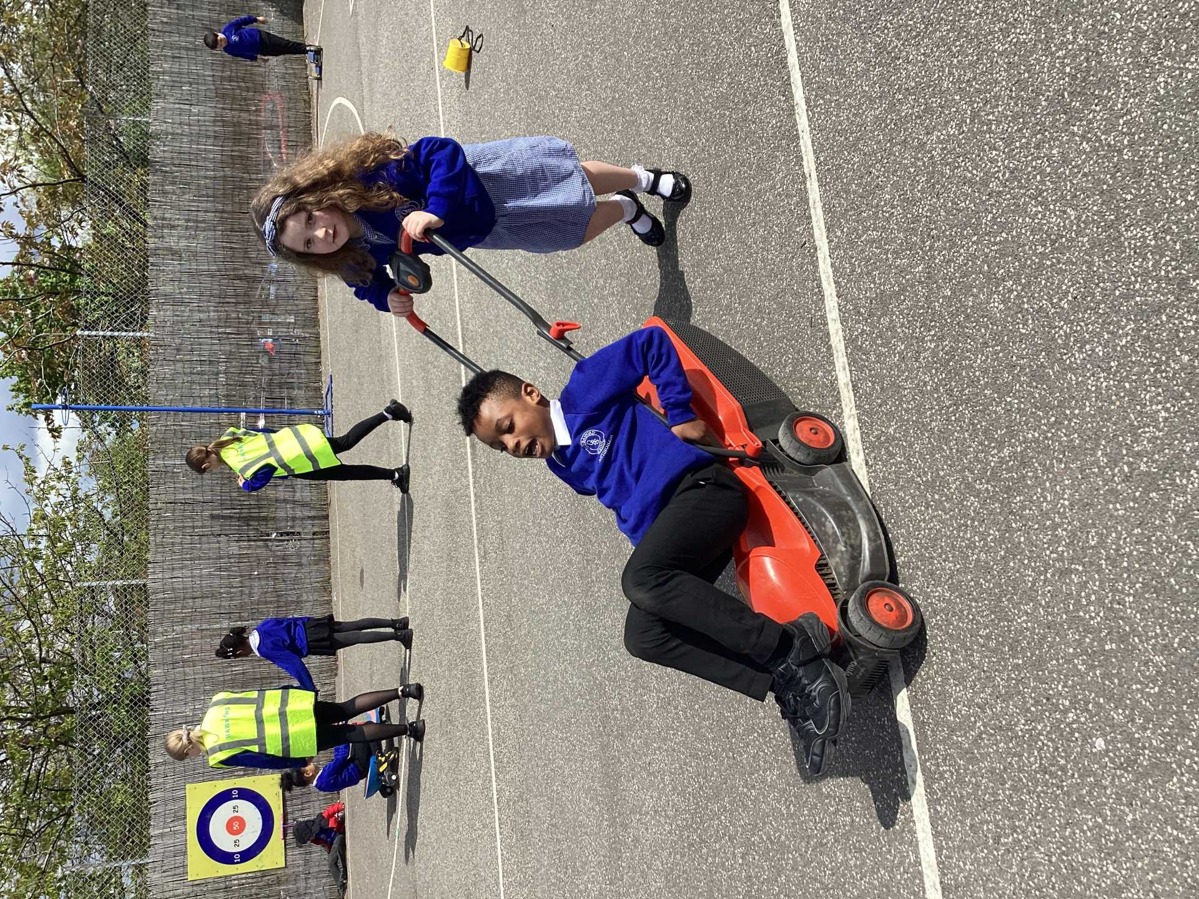
Celebration

Slide 4
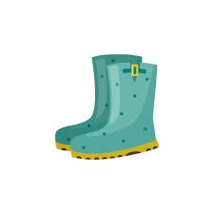
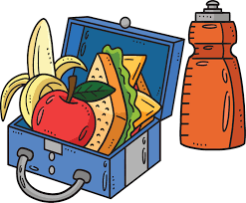
Reminders
You must always have your lunch when your class are called to the lunch hall!
Put your wellies/shoes in the correct shed.
Please do not borrow other children's welly boots!
It is YOUR job to tidy up!
Be careful when playing football to reduce the number of injuries.

Slide 5
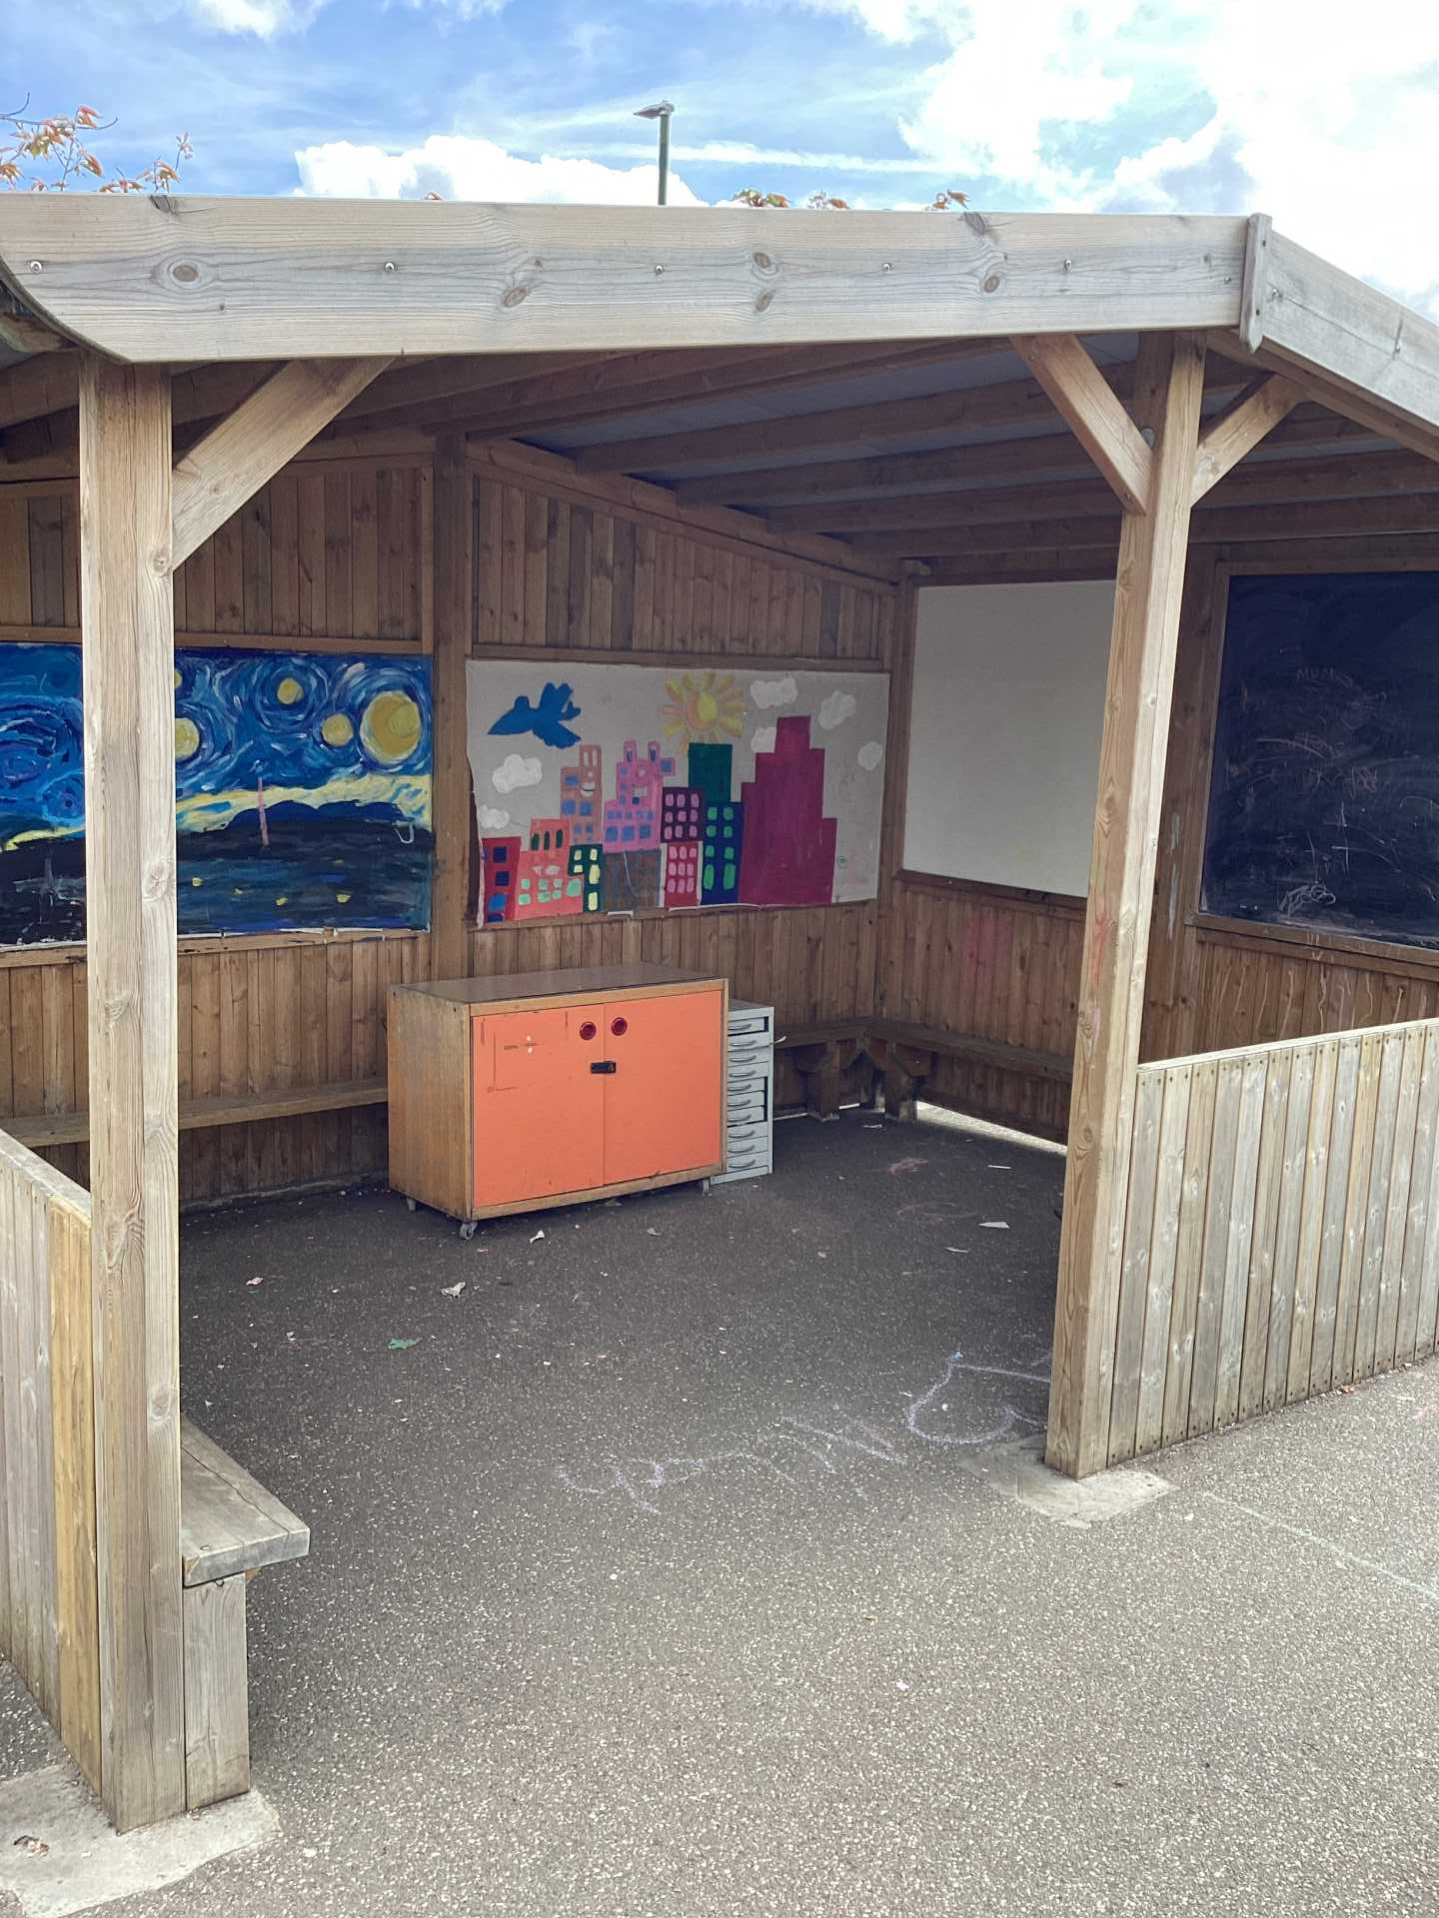
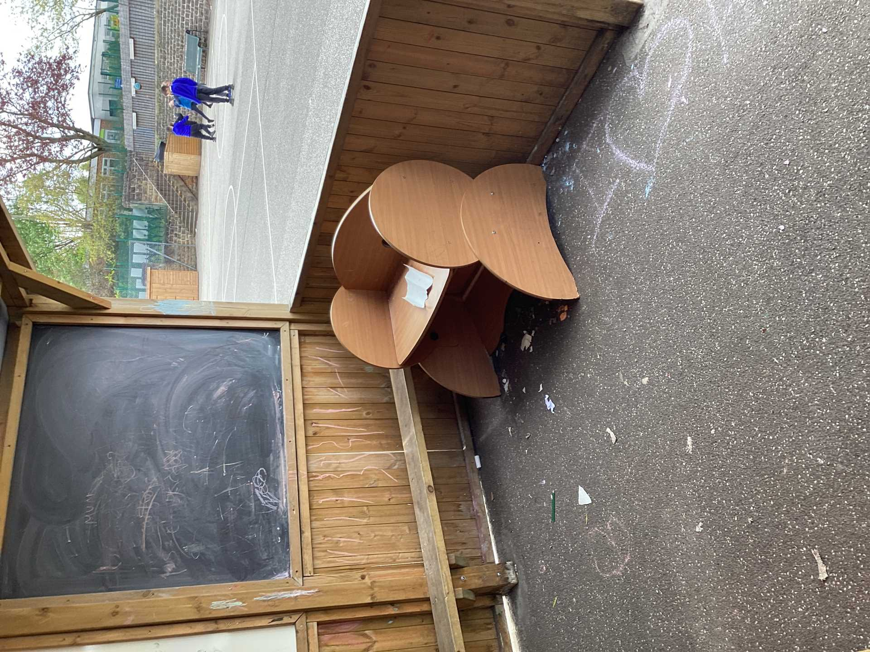
Inform
We need your help - the creative area needs a makeover!

Slide 6
Creative Area
Our creative area needs some fresh ideas as it is not very inviting.
What would you like to see in the creative area? - as a class make a list.

Slide 7
Competition
Can you design a fantastic creative area for our playground?
Draw your plan, write down your ideas and share these with us. Best ideas will be used to help us redesign and set up a new and improved creative area.
Designs to the Assistant Heads by Tuesday next week. We will share winning ideas in next weeks assembly.

Slide 8


The Golden Brush and Welly Awards
Divine - Class 4
Stevie-Jean - Class 6

Slide 9


Year 6 respectful award

