Slide 1


Slide 2
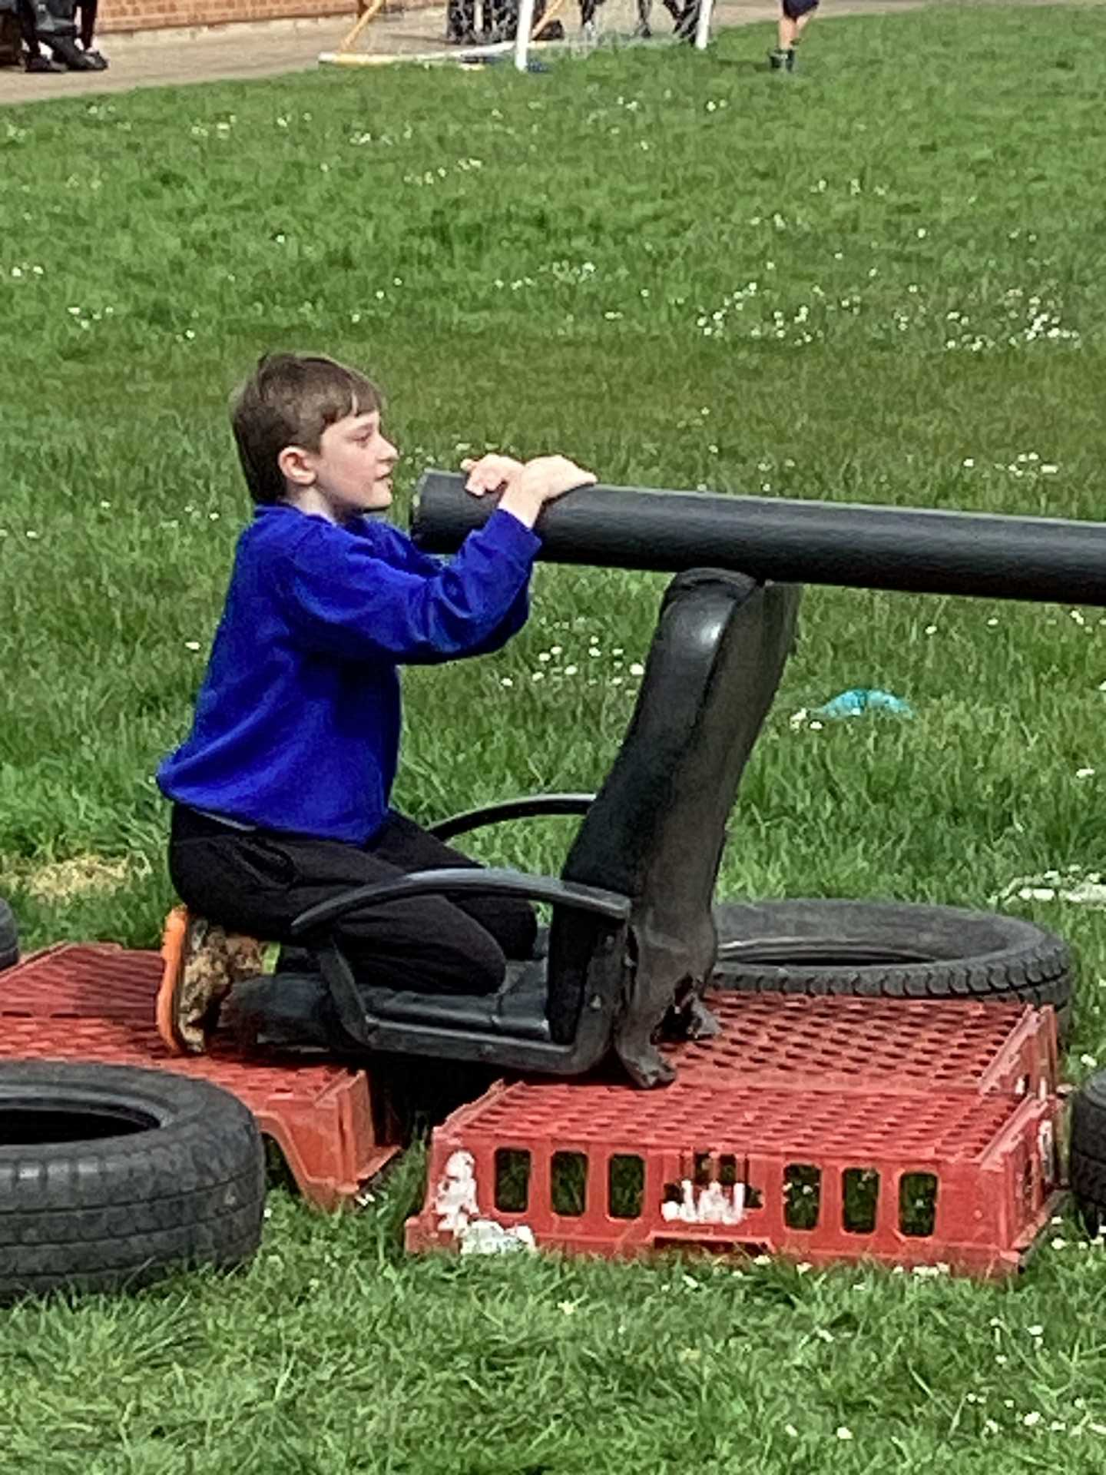
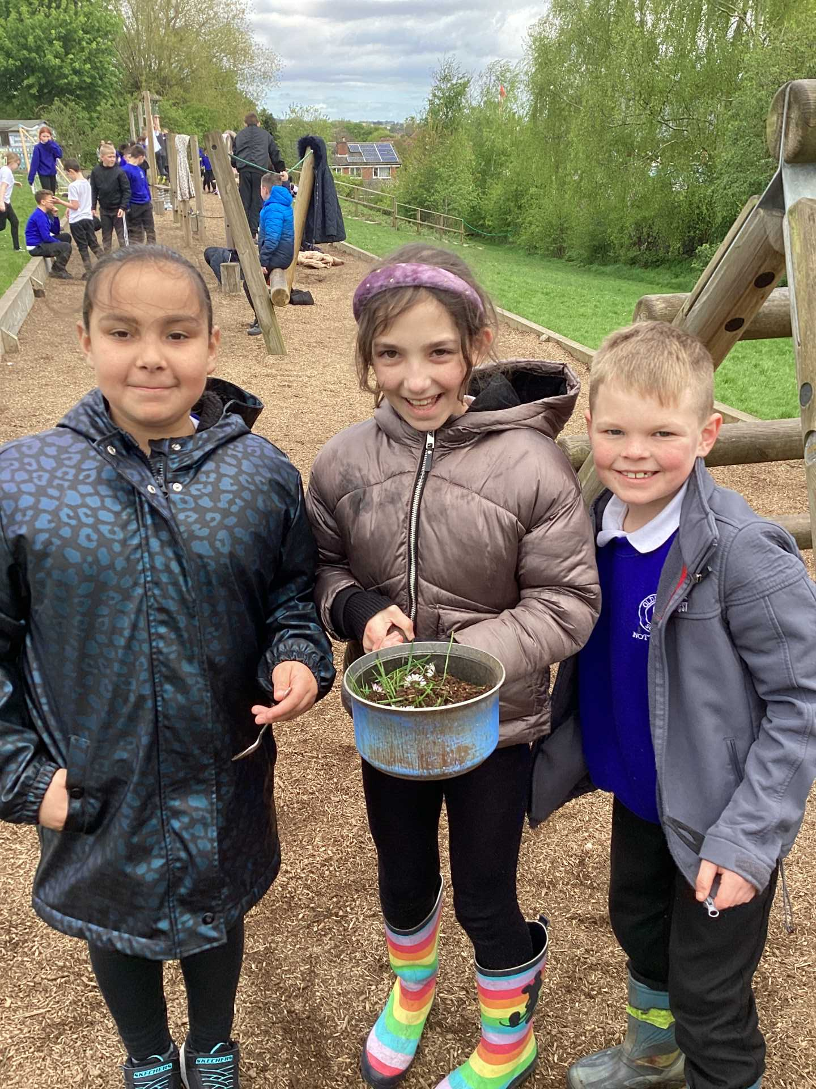
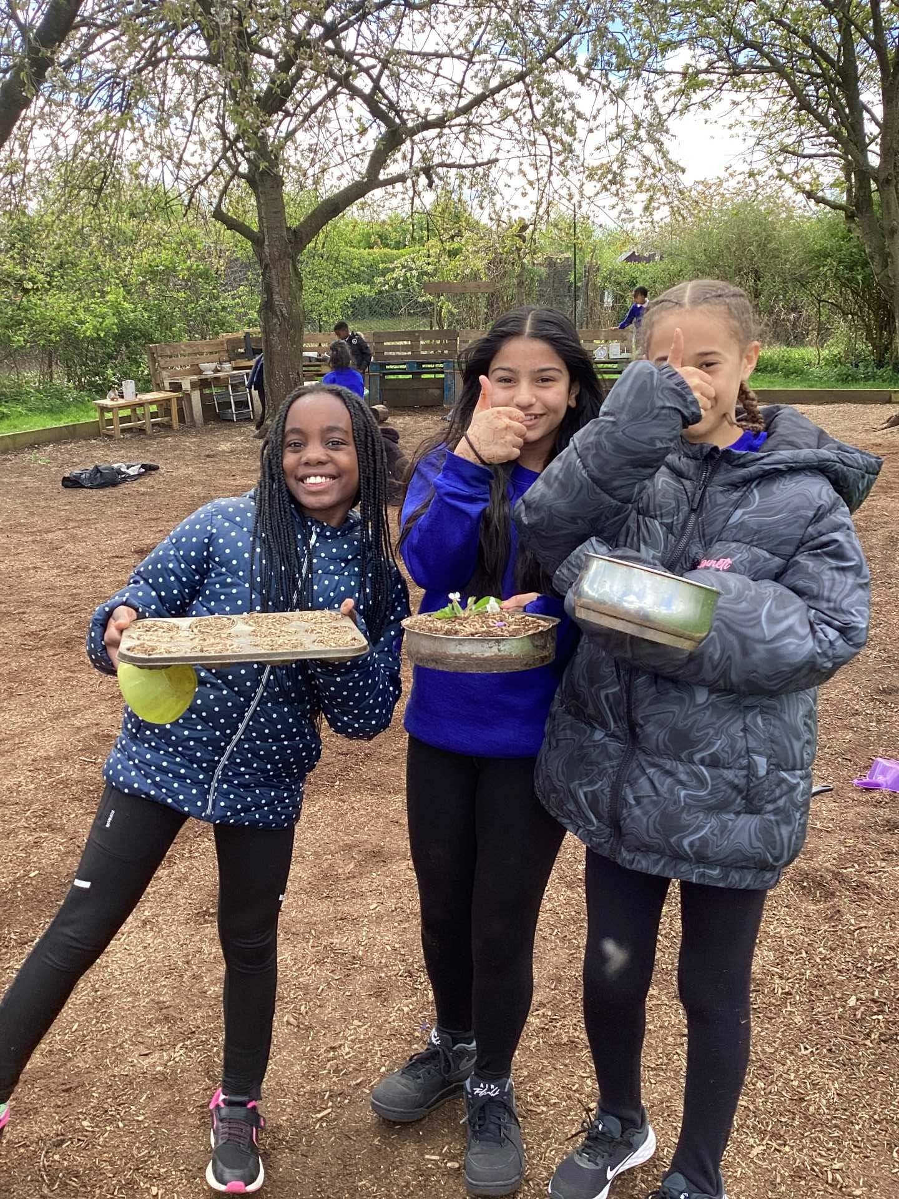
Celebration- Opal Play

Slide 3
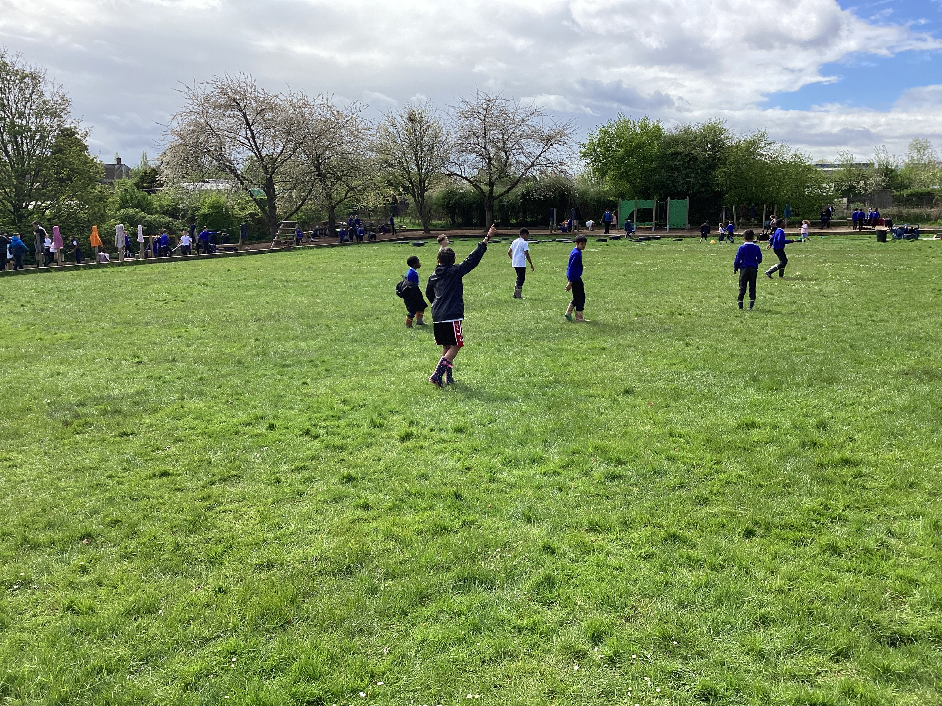
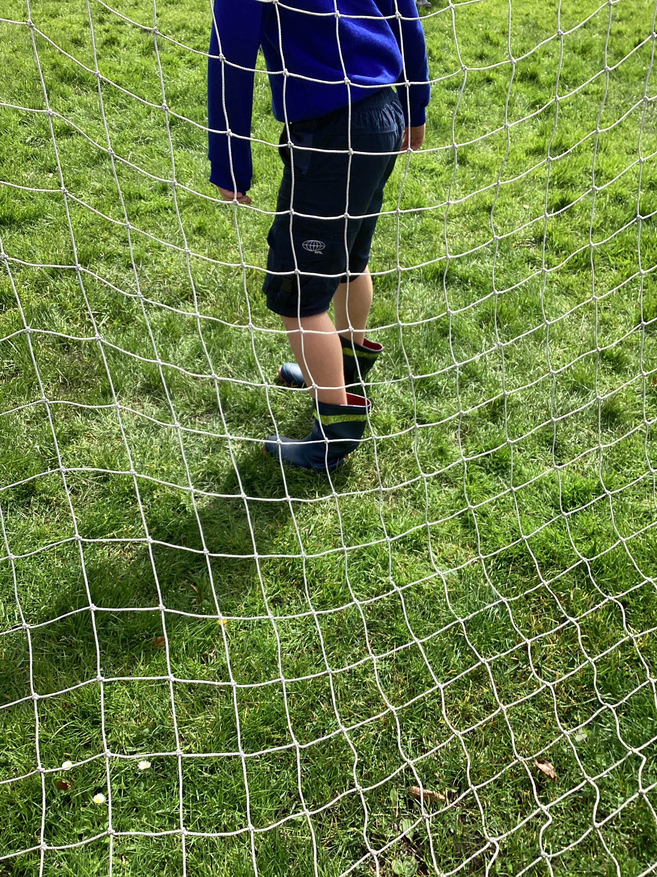
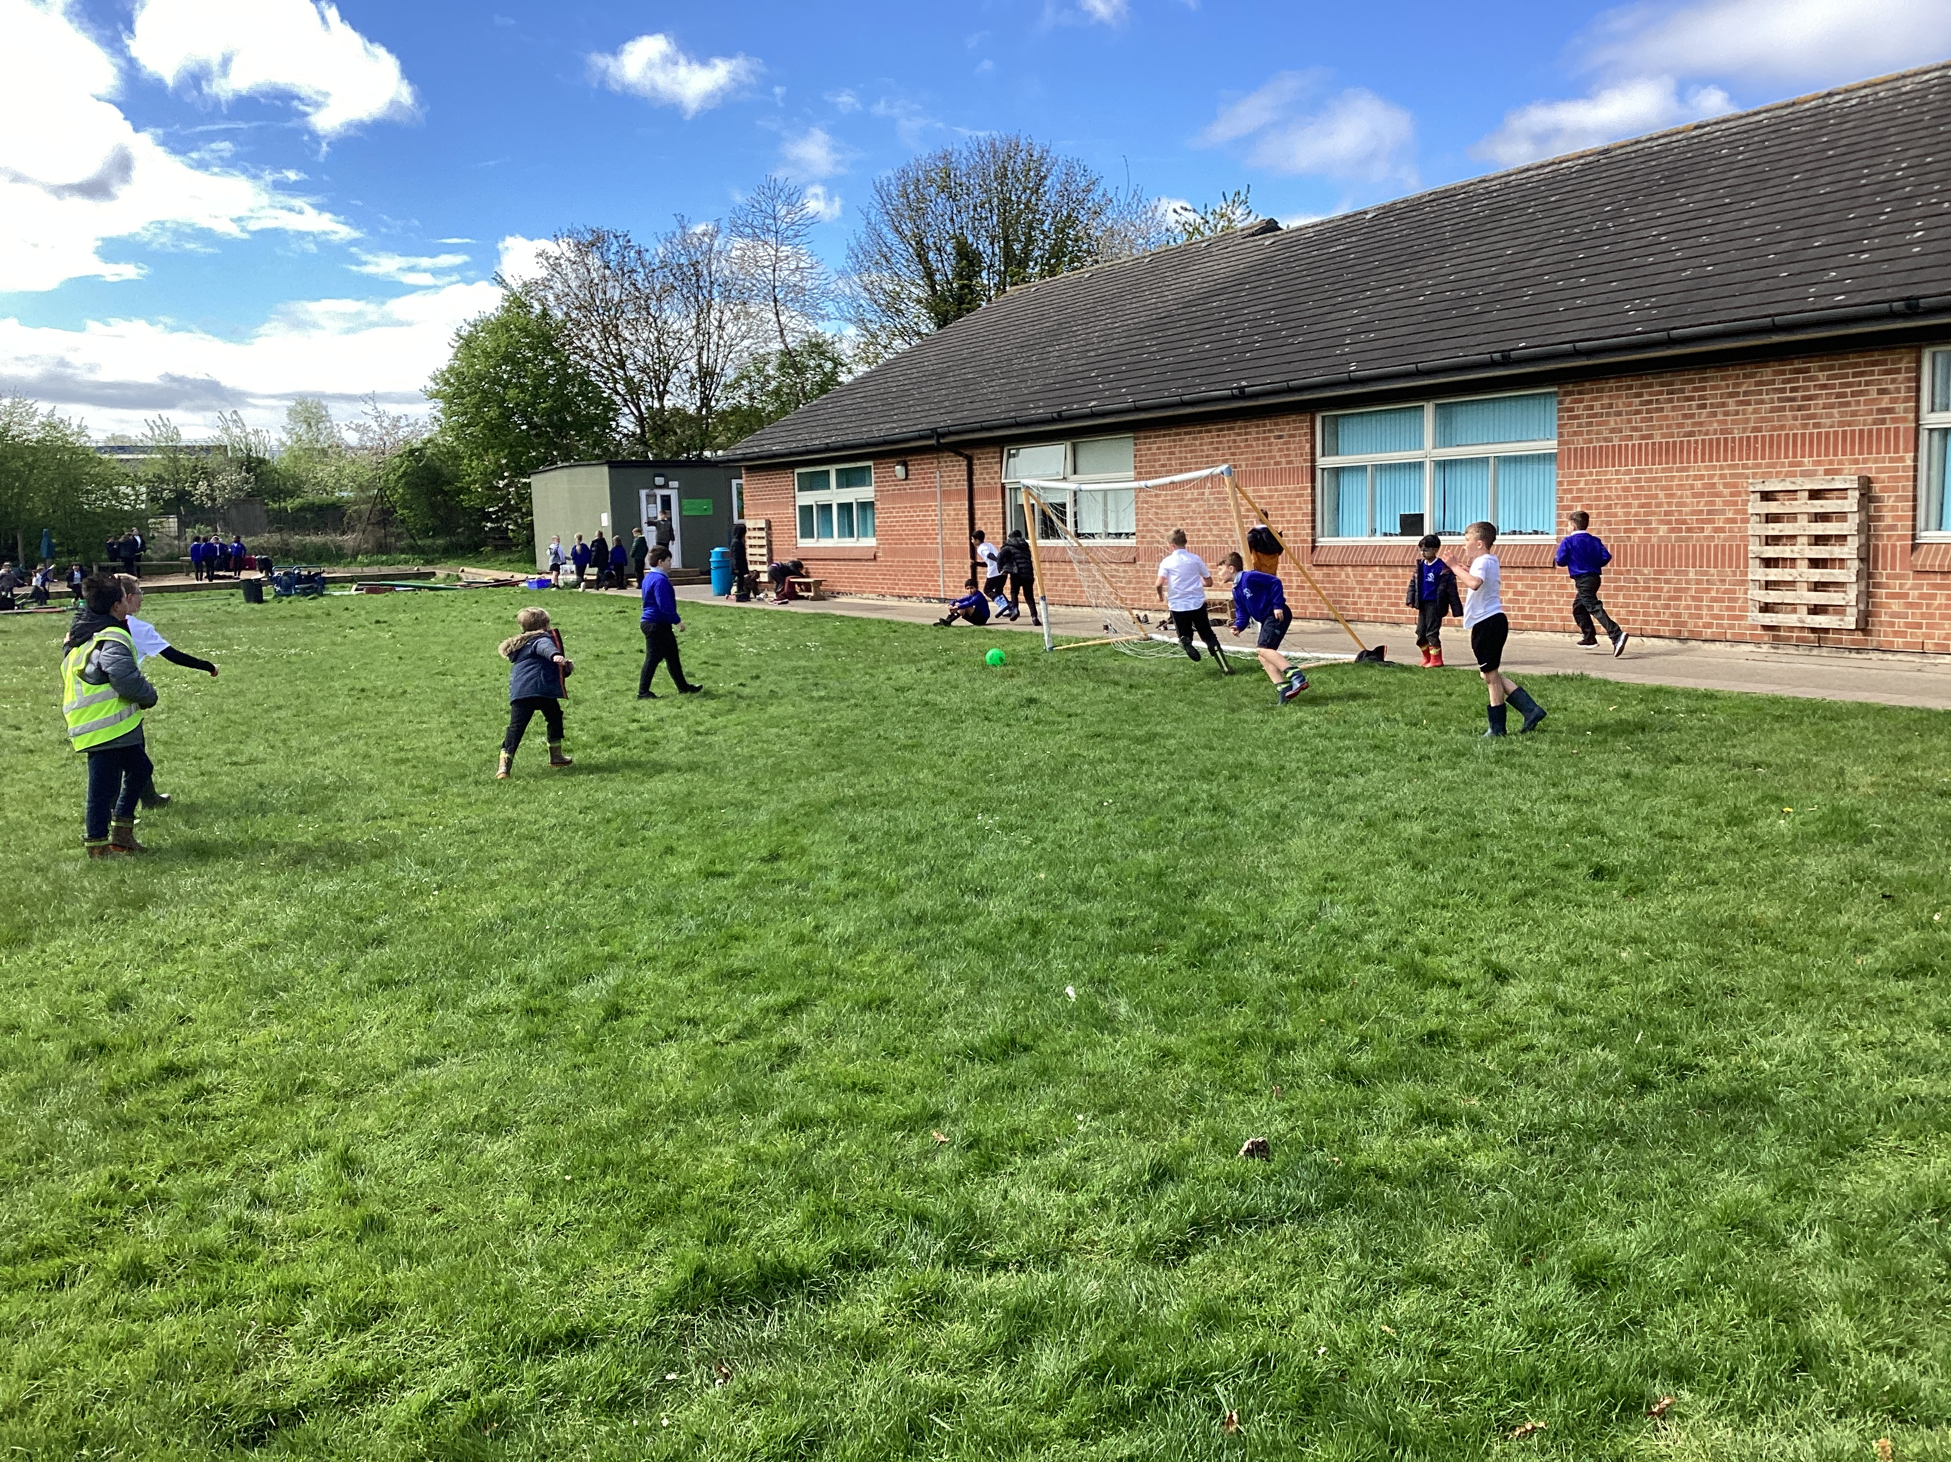
Celebration- Football

Slide 4

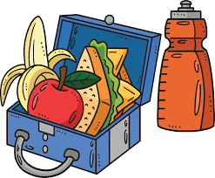
Important messages
You must always have your lunch when your class are called to the lunch hall!
Put your wellies/shoes in the correct shed.
Please do not borrow other children's welly boots!
It is YOUR job to tidy up!

Slide 5
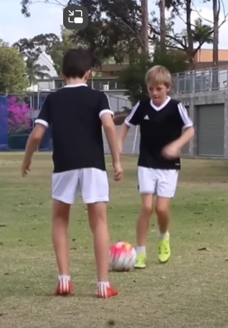
Inform
This week, we will introduce football skills alongside football!
https://www.youtube.com/watch?v=1vNmYNH8d4I

Slide 6
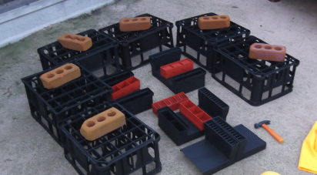
Areas on the Field
Football match | Football skills | Loose parts

Slide 7
Innovate
What skills could we practise?
dribbling
pass and move
stopping the ball
Keepie- uppies with feet or knees
1v1

Slide 8
Negotiate
What rules do we need to have when playing with the footballs for skills practise?
No deliberate kicks
Tackling too hard
Slide tackling
Only 1 football match in the football area- not in the skills area
Keep the footballs in the skills area

Slide 9


The Golden Brush and Welly Awards

Slide 10


Year 6 respectful award

