Slide 1


Slide 2
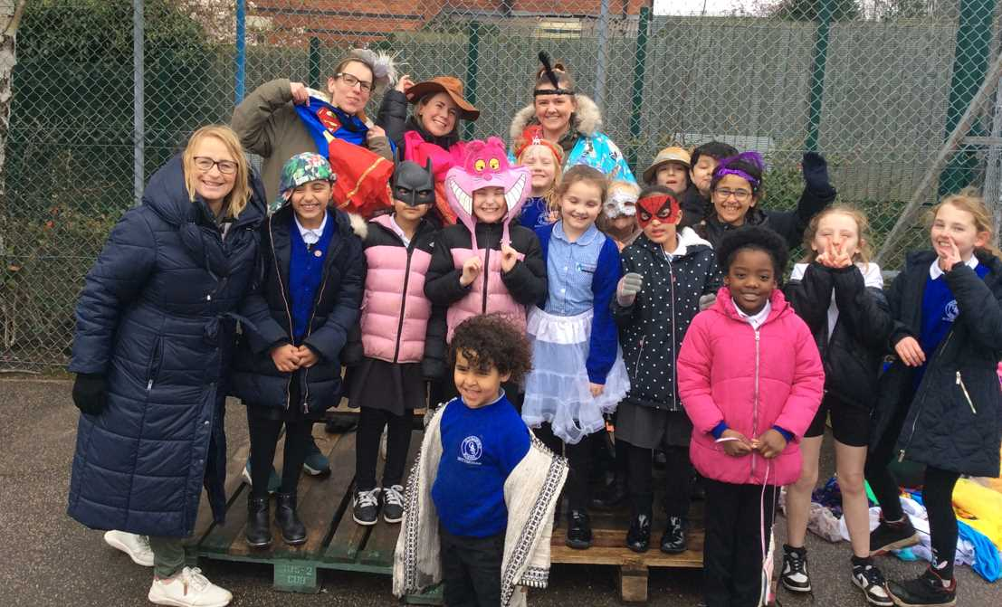
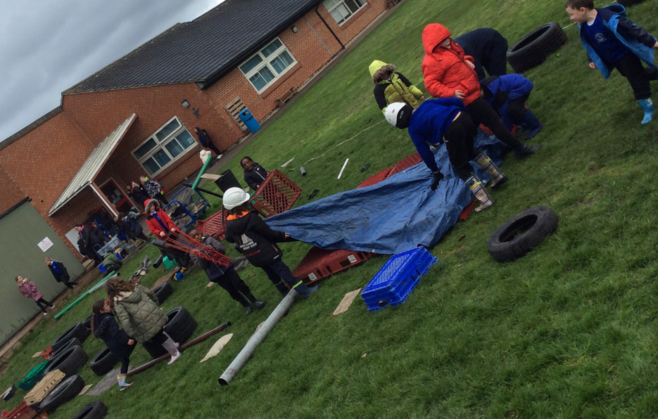
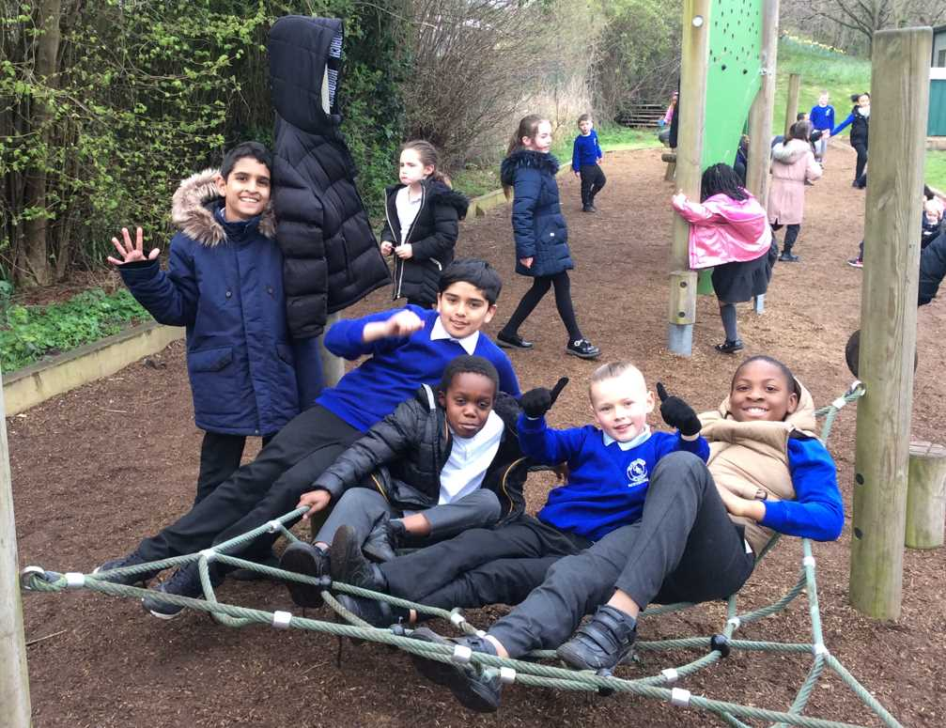
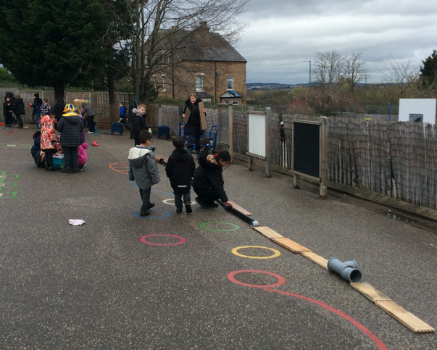
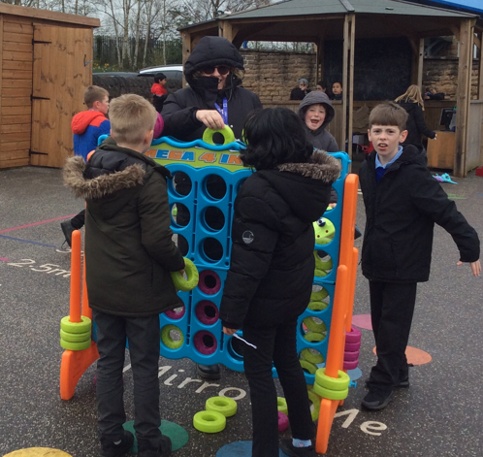
Celebration- Opal Afternoon

Slide 3
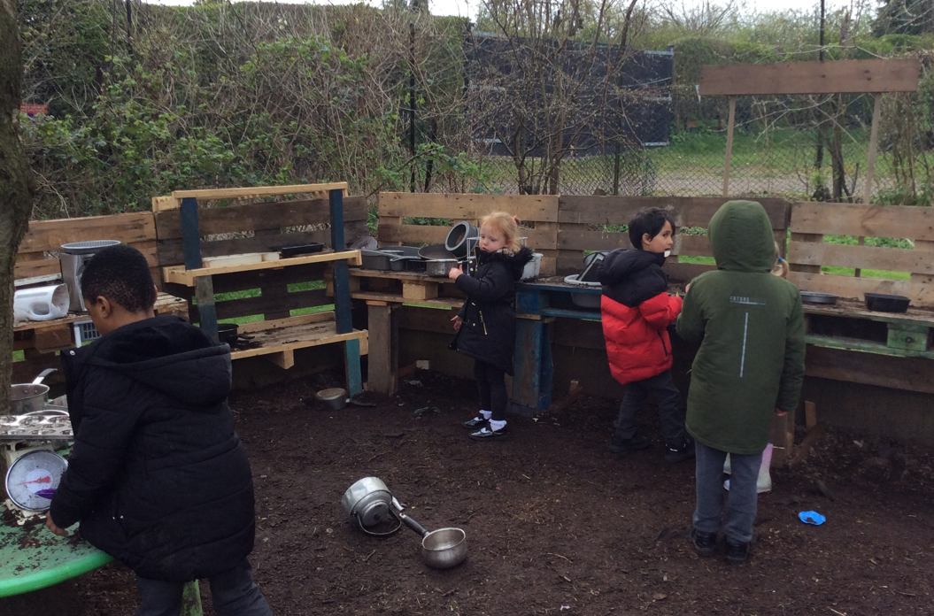
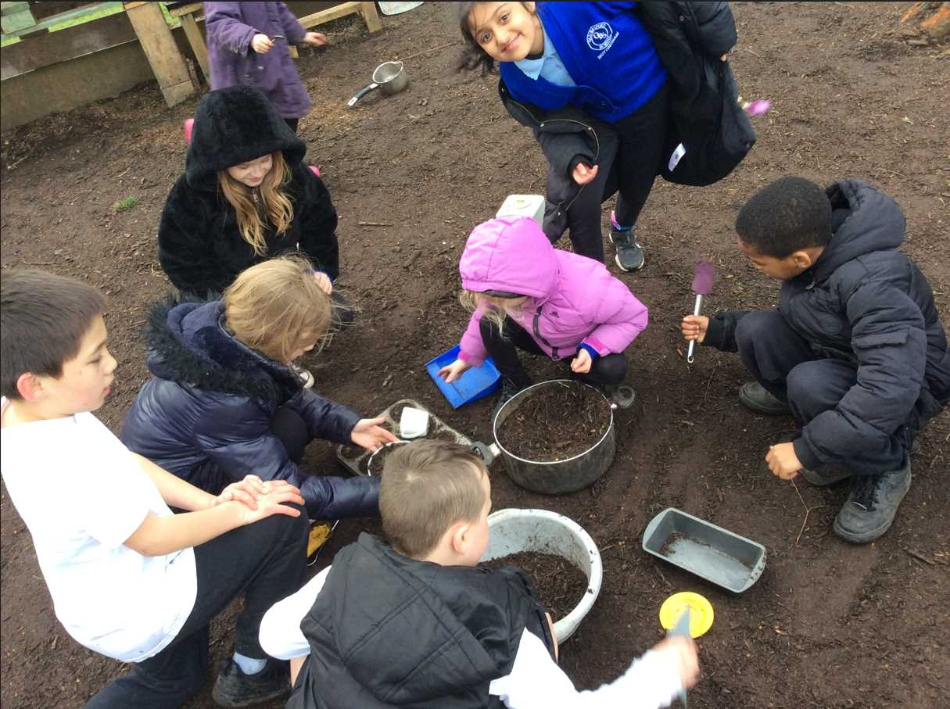
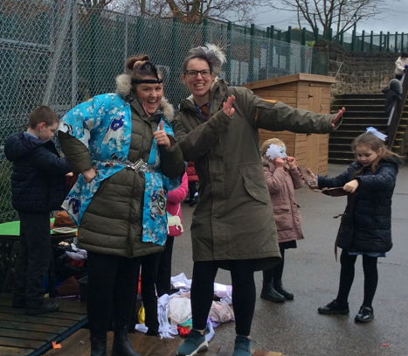
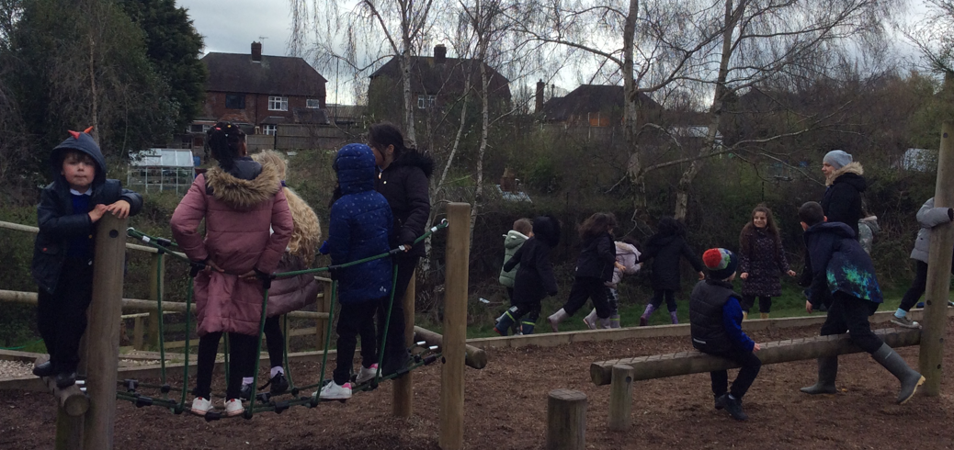
Celebration- Opal Afternoon

Slide 4
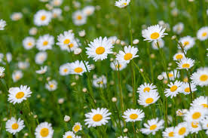
Important messages
We have big storage boxes for cars, musical instruments and non-waterproof items in the calm corner.
Do NOT pick the flowers! Except for daisies on the field for daisy chains or the potions in the messy kitchen.
Wellies are still needed for playing on the field and the slope.
Put your wellies/shoes in the correct shed.

Slide 5
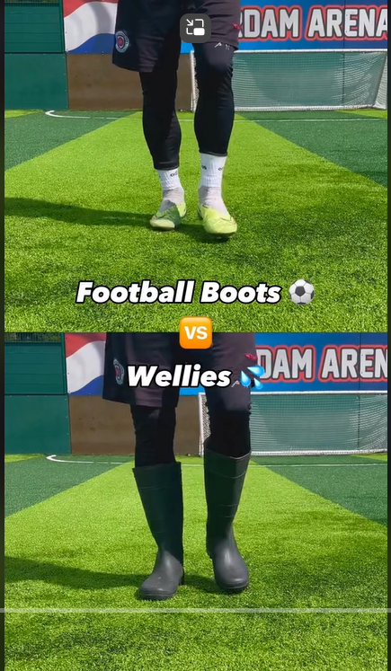
Inform
This week, we will introduce football in wellies!
https://www.tiktok.com/@ln6ixx/video/7268283756593679648

Slide 6
Innovate
What can we play?
Football
One touch
Keepie-uppies
Practise balls skills
Dribbling
Passing

Slide 7
Negotiate
What rules do we need to have when playing with the football?
No kicking others on purpose
Keep it in the designated area
Must wear wellies
Share and take turns
All children can join in

Slide 8


The Golden Brush and Welly Awards

Slide 9


Year 6 respectful award

