Slide 1


Slide 2
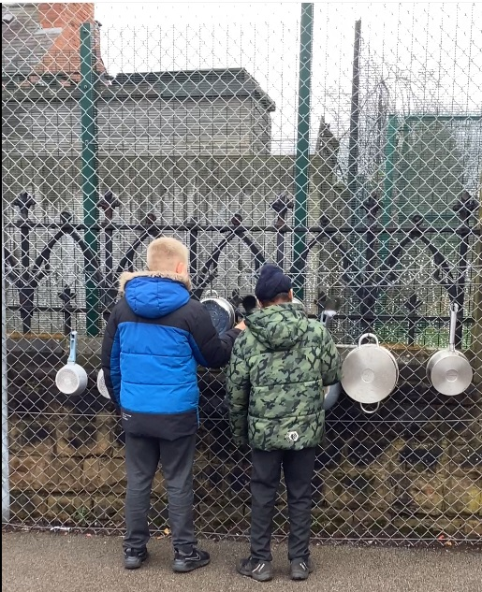
Celebration

Slide 3
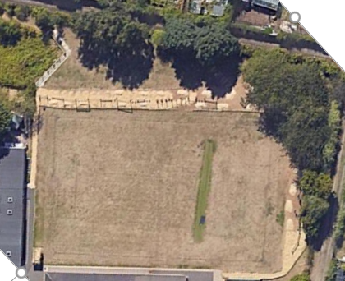

Inform
This week, we will introduce the slope behind the trim trail.

Slide 4
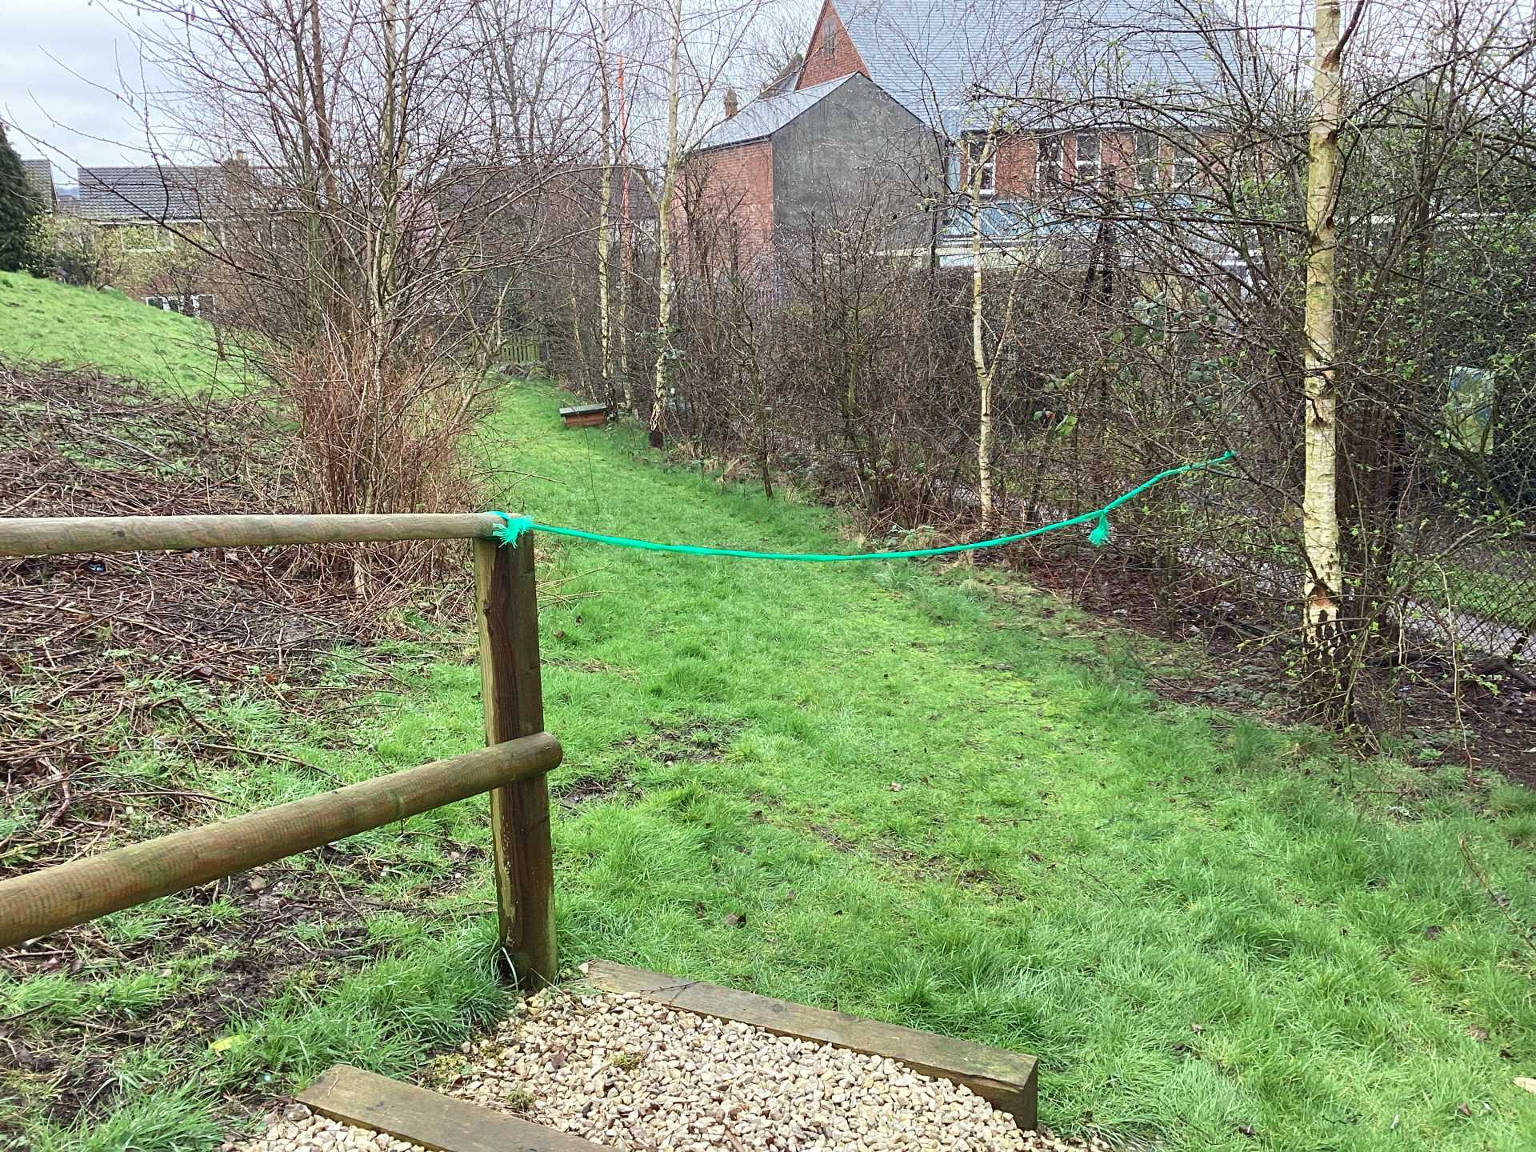
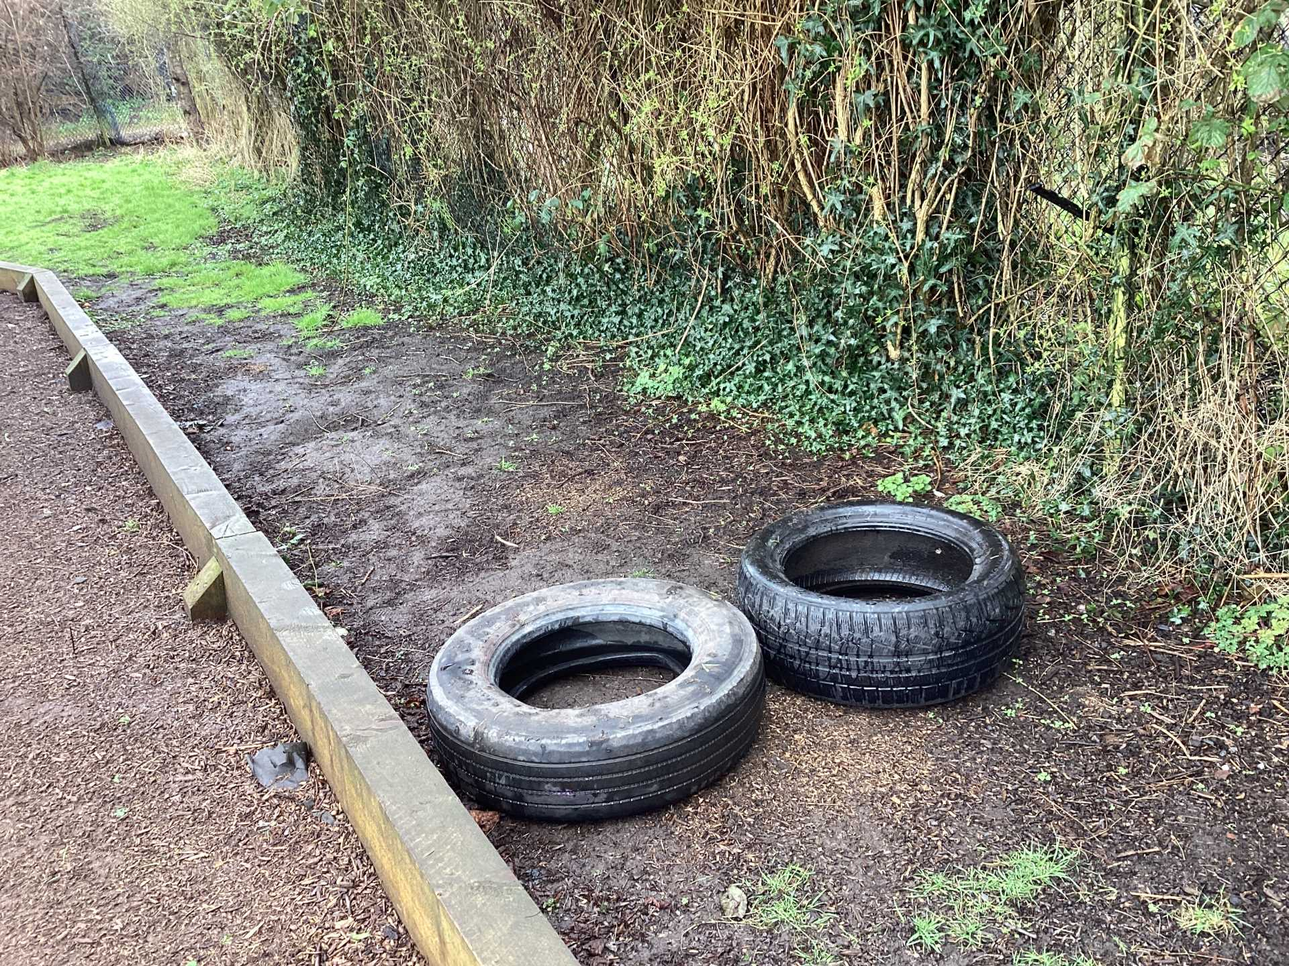
Beginning
End

Slide 5
Innovate
How can we play on the slope?
Roll down- pencil roll
Social place for a chat
Race
Roll objects down it
Pretend to have a camp fire
Hopscotch

Slide 6
Negotiate
What rules do we need to play on the slope?
No pushing people down
No throwing things down it
No rolling head first
Don't roll the tyres into people
Don't put sticks in the ground
Stay within the boundaries
Be careful of the prickles!
No cartwheeling down
Wear your wellies

Slide 7
New
Coming in time for Year 1 and Year 2:
The whistle will go and you will go straight into class.
You don't have to line up.
Walk in quietly and calmly.

Slide 8
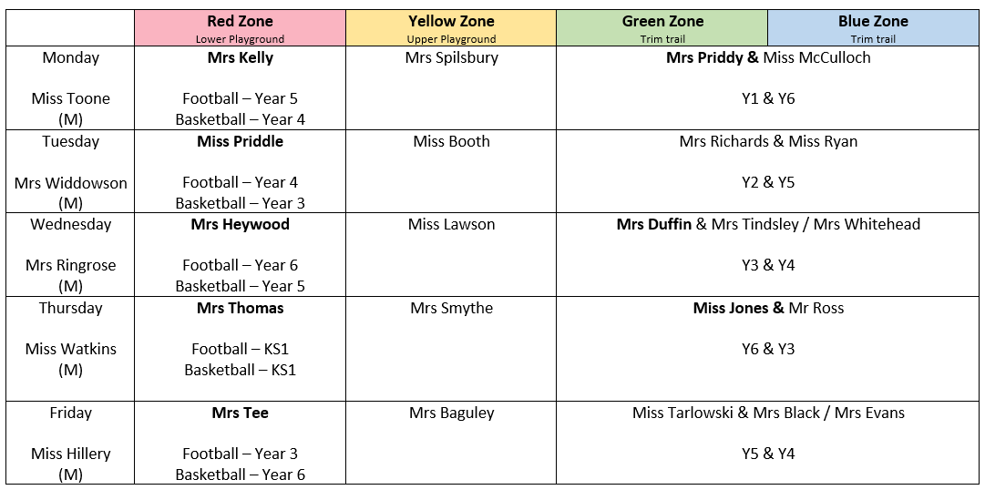
Reminder
Keep out of the way of the basketball court and the football pitch when it's not your turn.

Slide 9


The Golden Brush and Welly Awards

Slide 10


Year 6 respectful award

Slide 12
Attachments
IMG_0177.MOV

