Slide 1


Slide 2
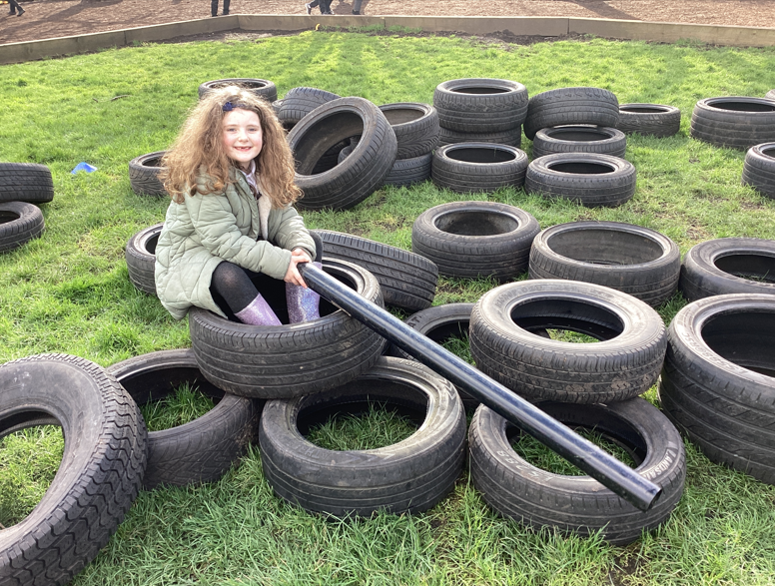
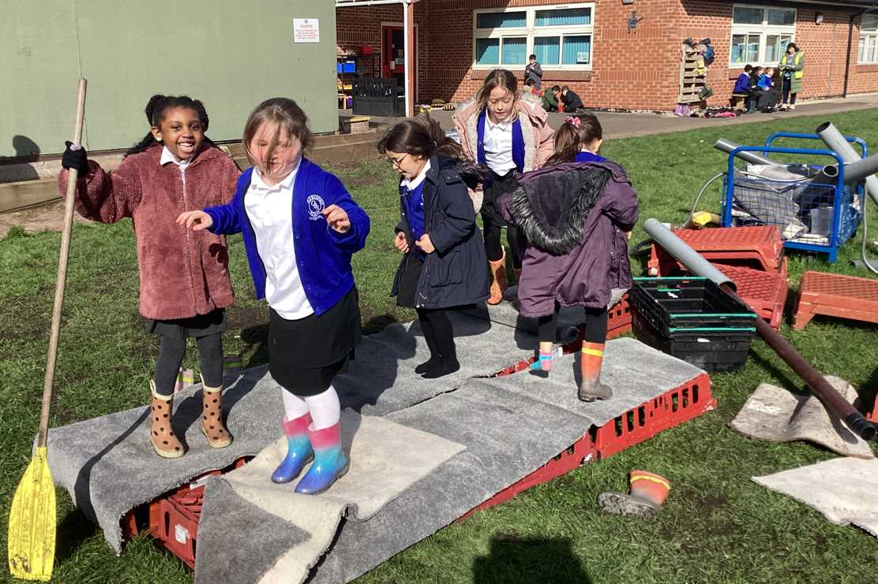
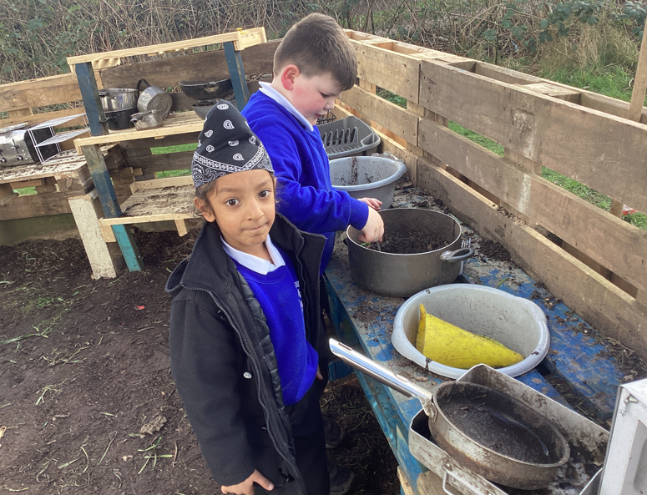
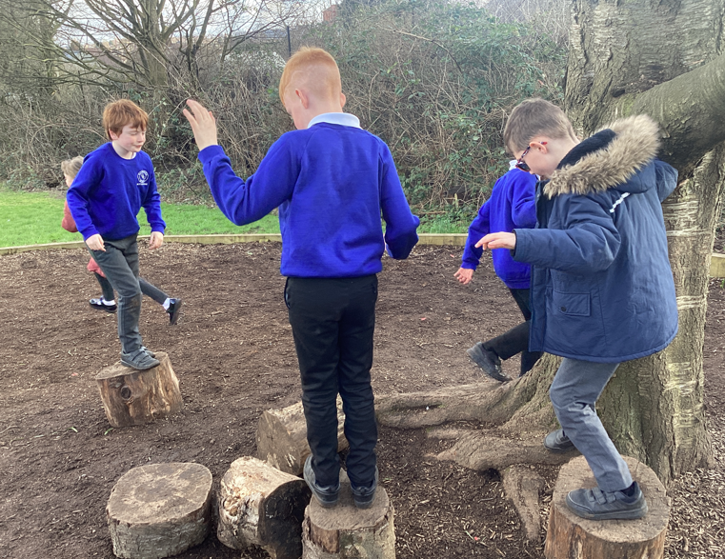
Celebration

Slide 3
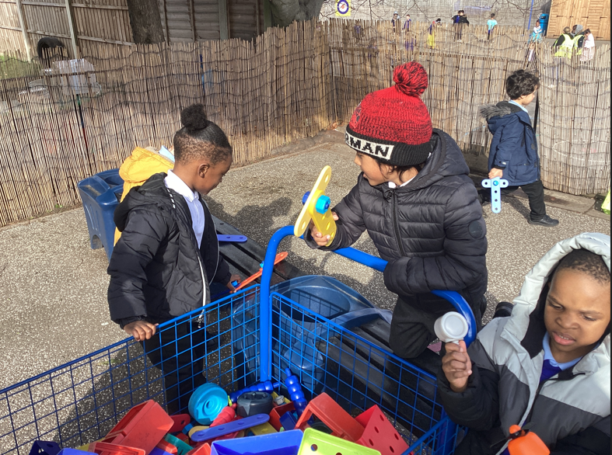
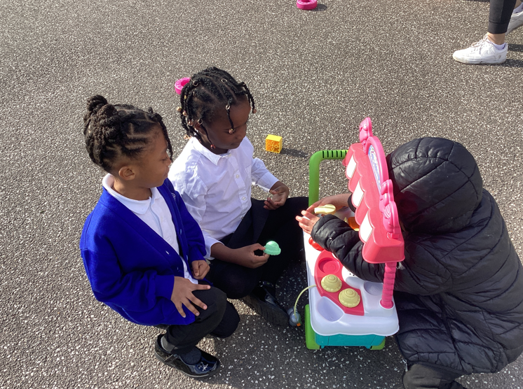
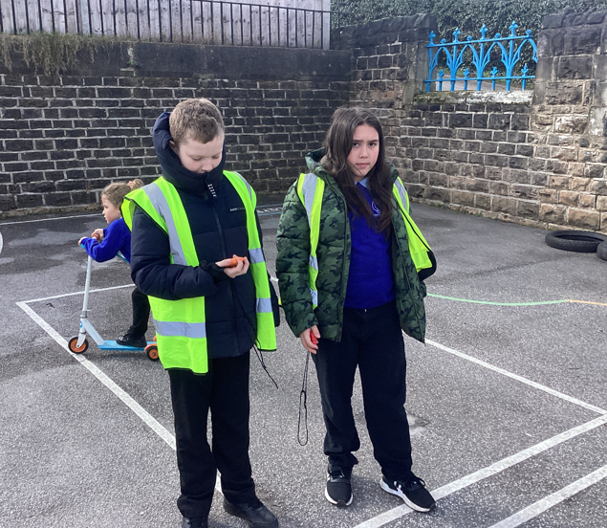
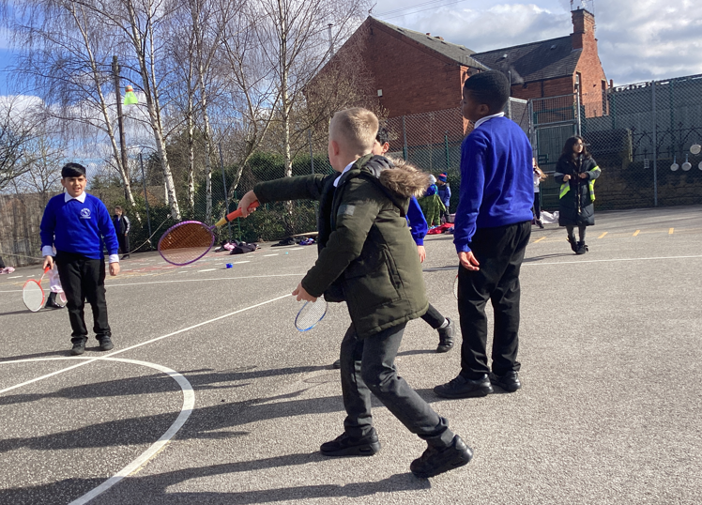

Slide 4
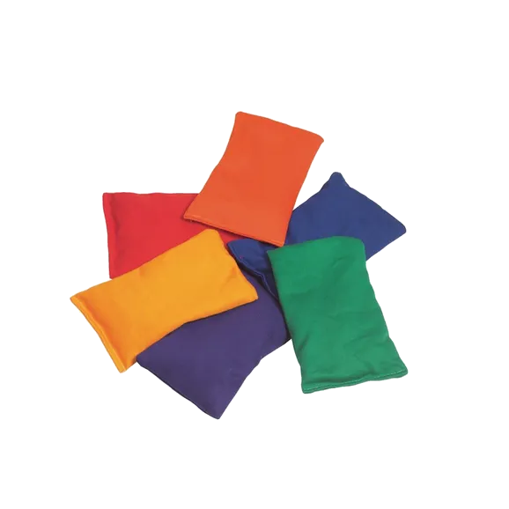
Inform
This week, we will introduce some bean bags.

Slide 5
Innovate
How can we play with the bean bags?
Group alphabet game
Hot potato
How many times can you clap in between throw?
Throwing and catching with a friend
Walk and balance
Juggle
Piggy in the middle

Slide 6
Negotiate
What rules do we need to play with the bean bags?
No throwing too high
Don't hide them
No throwing at people on purpose
No long throws/ lobs
Share them!

Slide 7
New
Reward for respectful Year 6 children:
Each week the playteam will put names in a box of children who have been respectful. The more times your name gets in the box, the more chance you have to win.
Four names will be picked out of the box and they will be able to go for lunch at 12:00 and have a longer lunchtime.

Slide 8
Reminder
* Go to dinner first.
* Opal Play Guardians must not swap the areas that they are on duty.
* Play with the children not on your own.
* Spread around, don't huddle like penguins!

Slide 9


The Golden Brush and Welly Awards

