Slide 1


Slide 2
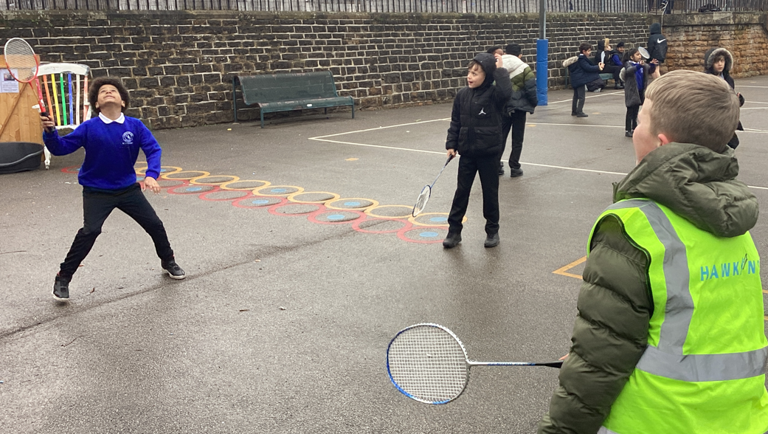
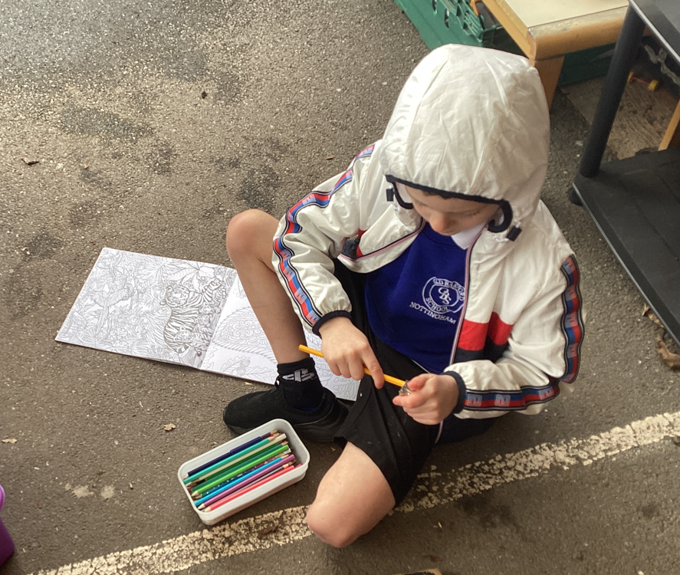
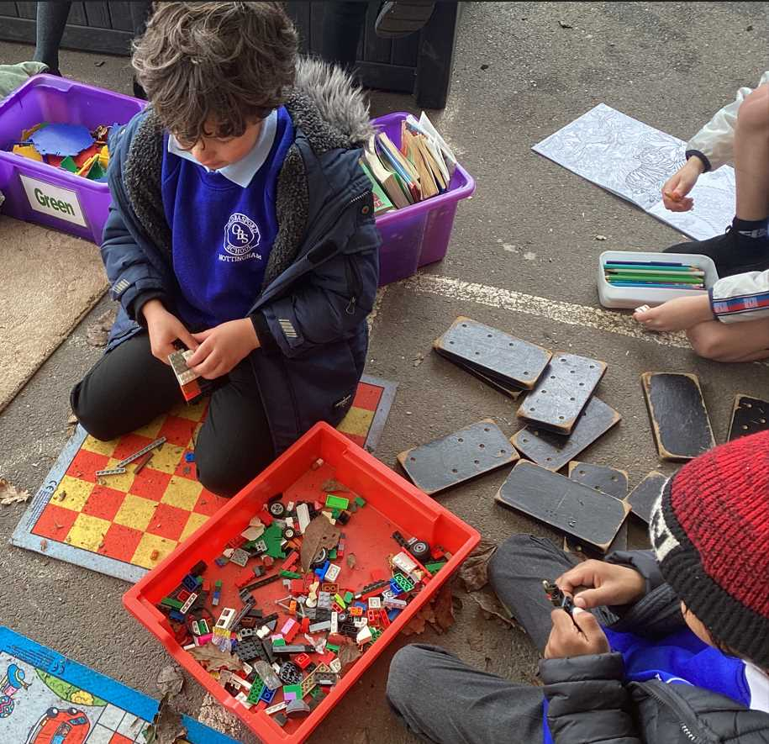
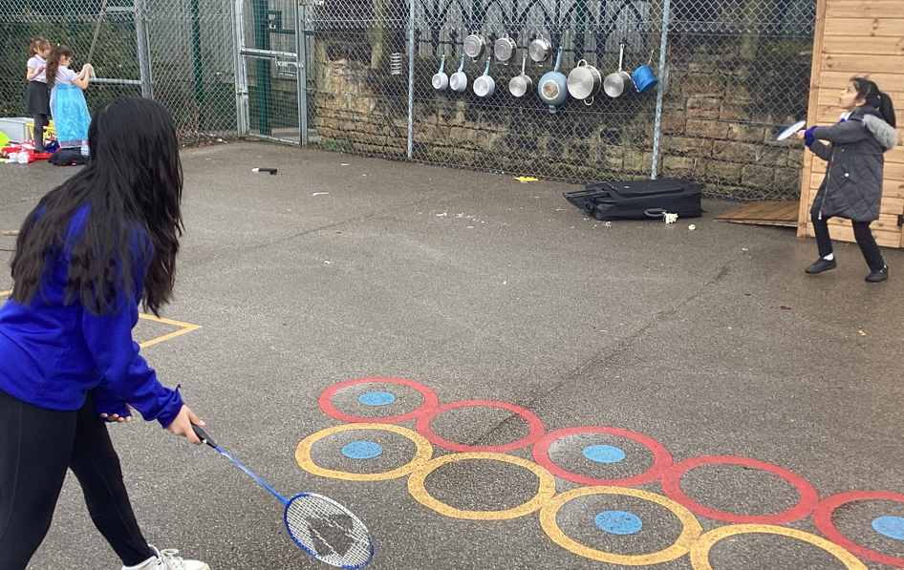
Celebration

Slide 3
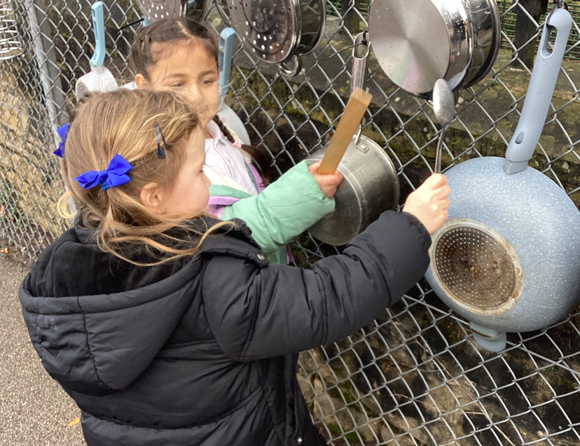

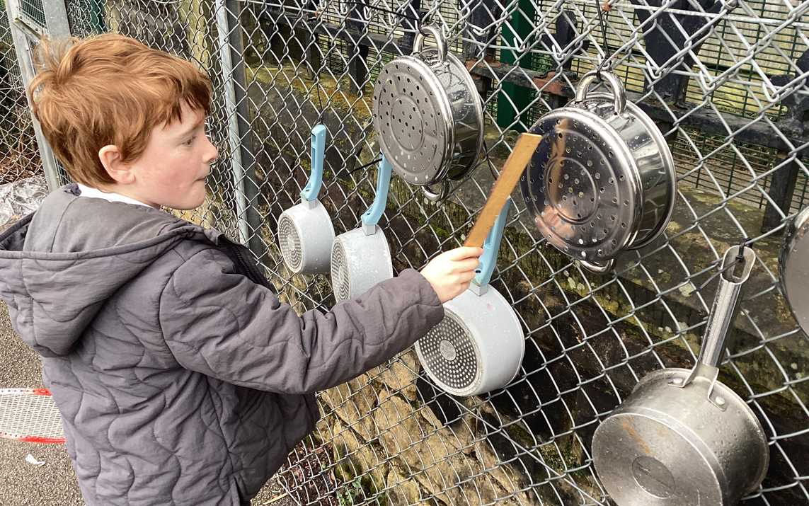

Slide 4
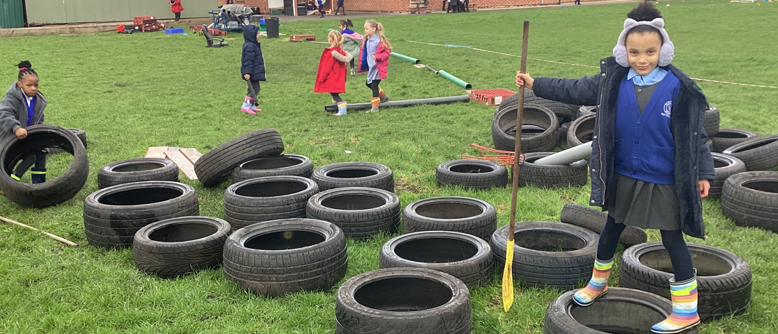
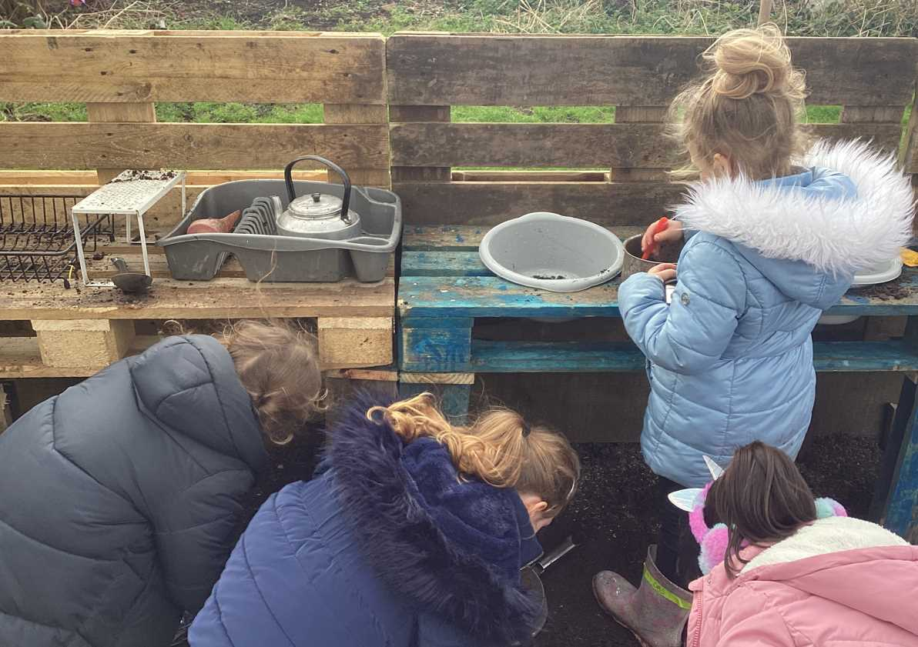
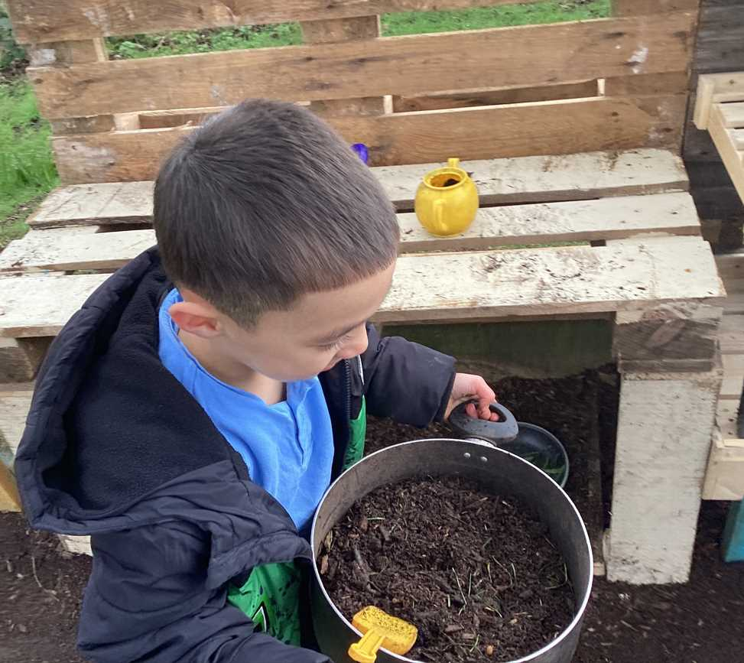

Slide 5
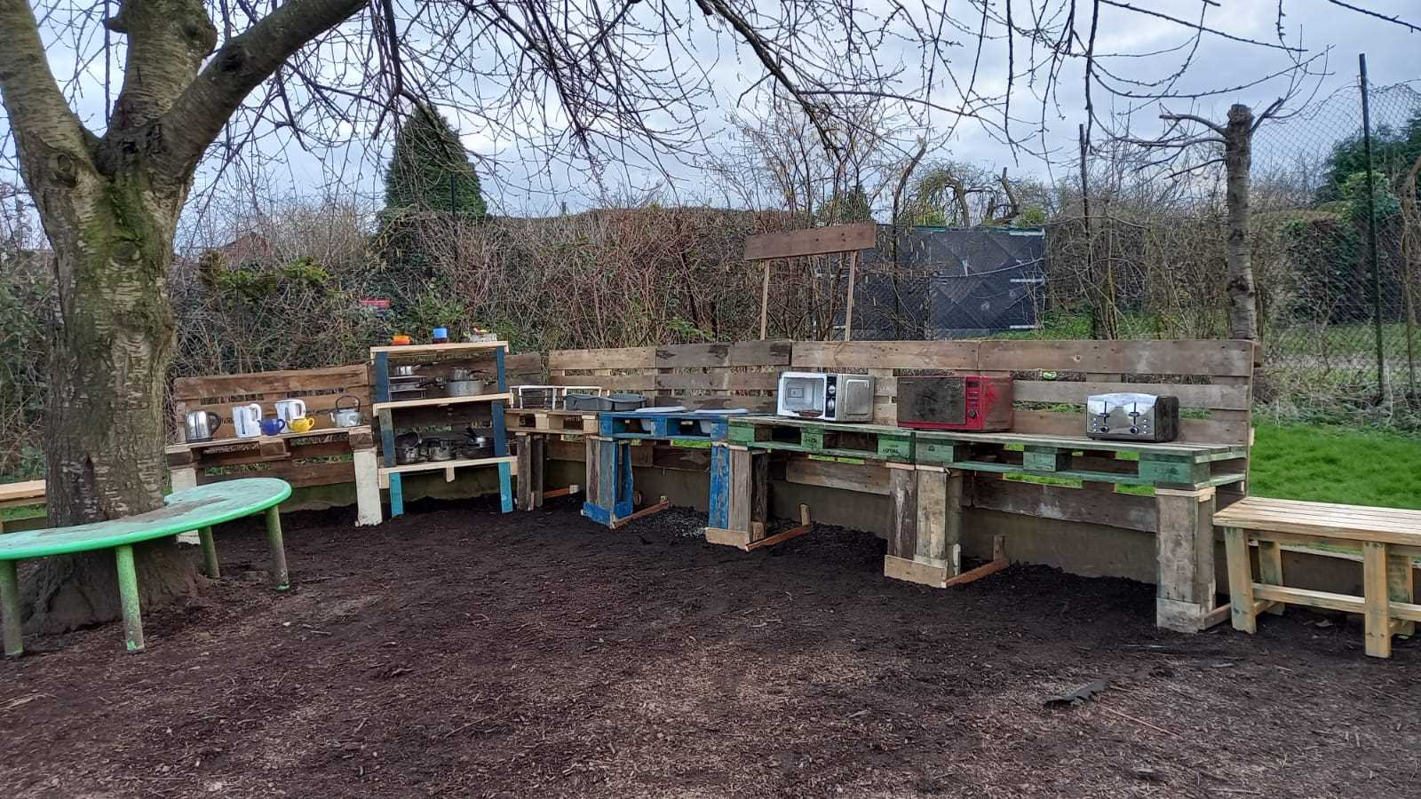
Inform
Messy kitchen

Slide 6
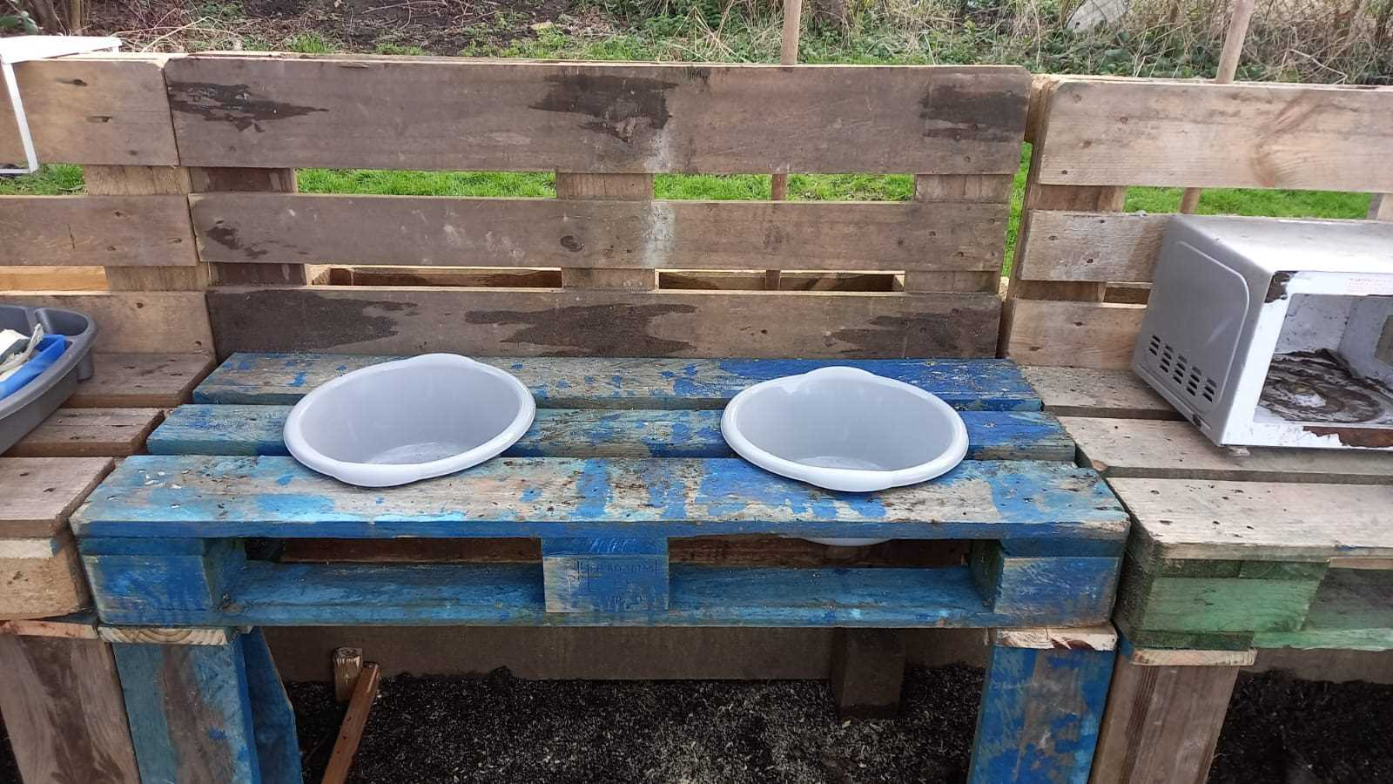
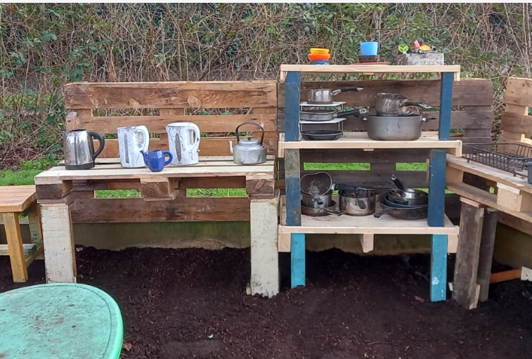
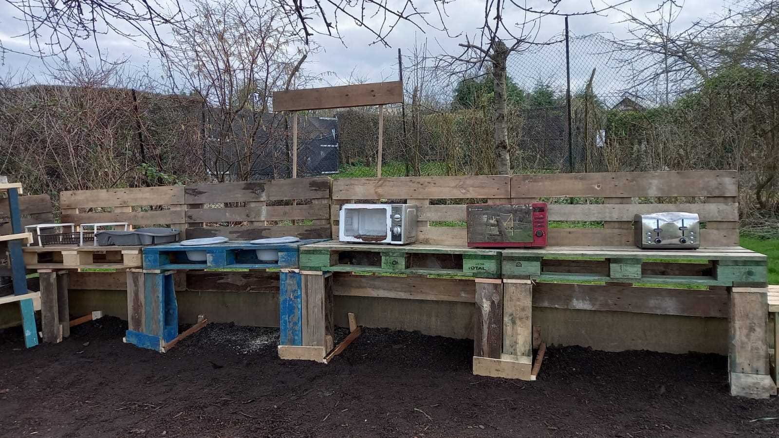
Inform
Messy kitchen

Slide 7
Negotiate
What rules do we need to play in the messy kitchen?
Tidy up afterwards (like in the photos)
No hitting and throwing the equipment or bark
Don't put the pans on your heads
Keep everything inside the messy kitchen area
Respect the equipment
Wear wellies on wet days

Slide 8

New
Opal Play Guardians will have a stop watch for the wheelie area. 5 minute timer then swap with someone so that it is fair.

Slide 9
Reminder
* Go to dinner first.
* Opal Play Guardians must not swap the areas that they are on duty.
* Play with the children not on your own.
* Spread around, don't huddle like penguins!

Slide 10


The Golden Brush and Welly Awards

