Slide 1


Slide 2
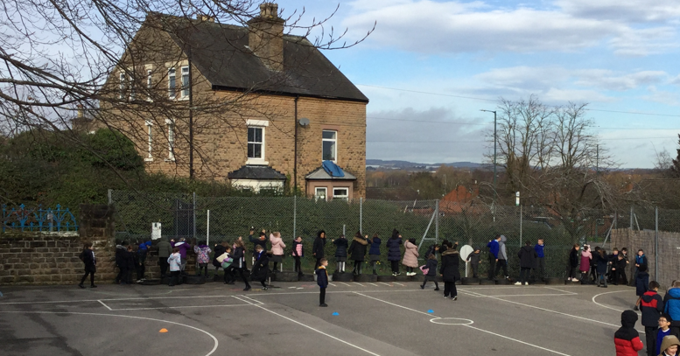
Celebration

Slide 3
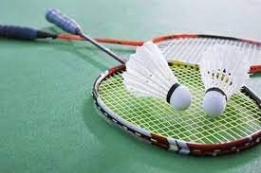
Inform
Badminton

Slide 4
Innovate
How do we play badminton?
Play a match with a partner
Score points if you're partner misses
Your partner gets a point if you miss
Make up your own rules (but you both have to agree)
Count how many times you can hit the shuttlecock without missing

Slide 5
Negotiate
What rules do we need to play badminton?
Don't hit someone with the racquet
Don't throw the shuttlecocks
Keep them on the bottom playground
Put the equipment back when you have finished
Don't hit the shuttlecocks too hard
Only play badminton with the equipment

Slide 6
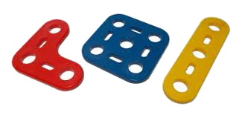
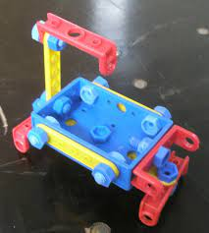
Inform
construction

Slide 7
Innovate
How can we play with the construction?
Build vehicles- cars, trucks, trains
Build buildings
Build bridges

Slide 8
Negotiate
What rules do we need to play with the construction?
Don't throw or kick the pieces
Keep them on the top playground
Don't fight with them
Respect the equipment
Put them away in the cart
Make sure the screw are tight

Slide 9
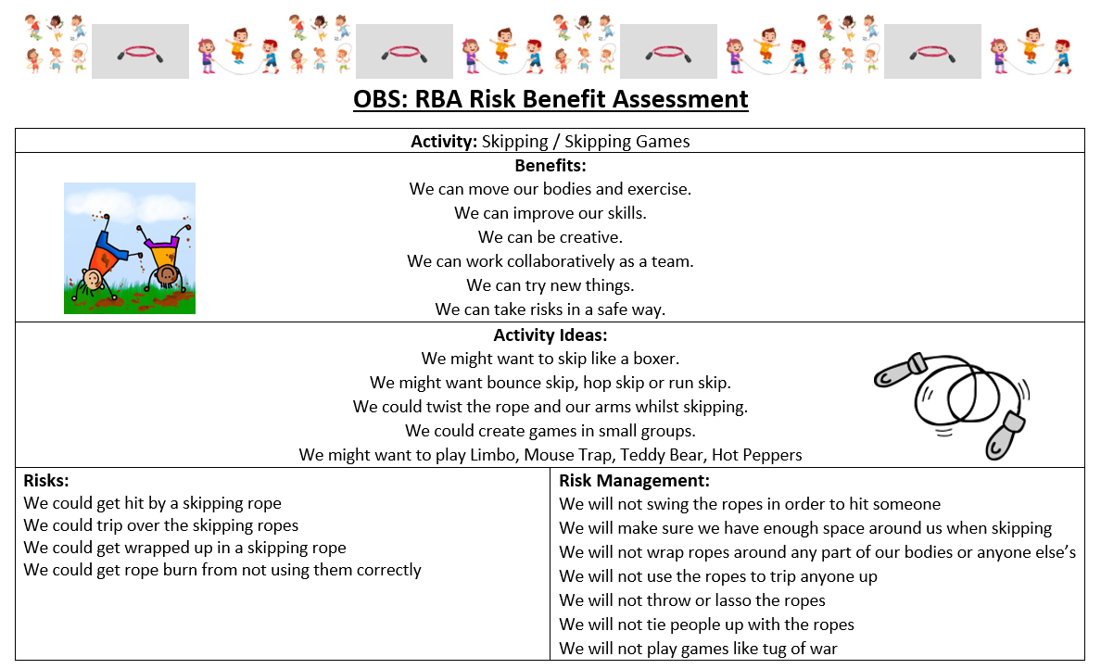

Slide 10


The Golden Brush and Welly Awards

