Slide 1


Slide 2
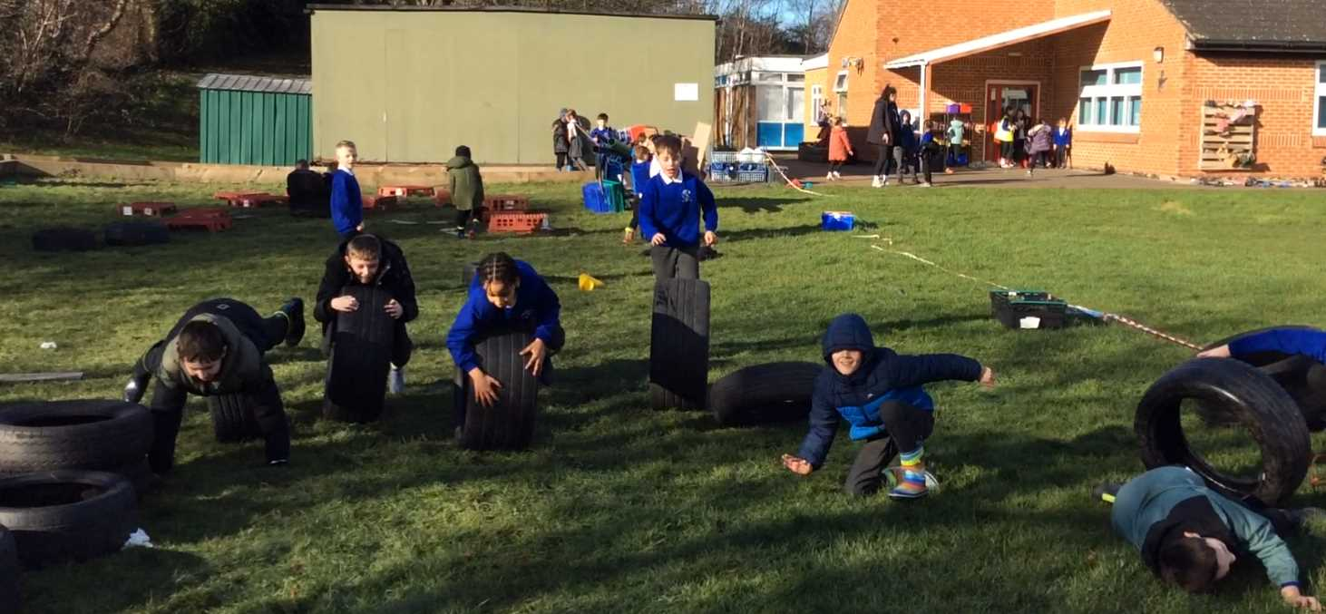
Celebrate
Examples of AMAZING play!
IMG_003.MOV

Slide 3

Inform
Hula hoops in the active zone- remember the rules!

Slide 4
Ideas for after half term:
Innovate
a slide (the slope near the trim trail)
a swing
racquets and balls
football
rugby
sponge balls
more instruments- yes
gymnastics (on the field)
badminton
puppet theatre (calm corner)
race track
frsibee

Slide 5
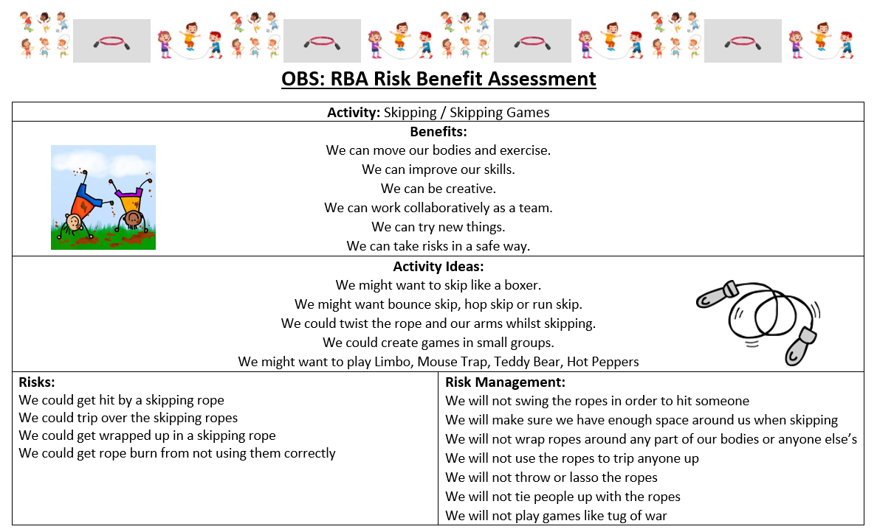

Slide 6


The Golden Brush and Welly Awards

