Slide 1


Slide 2
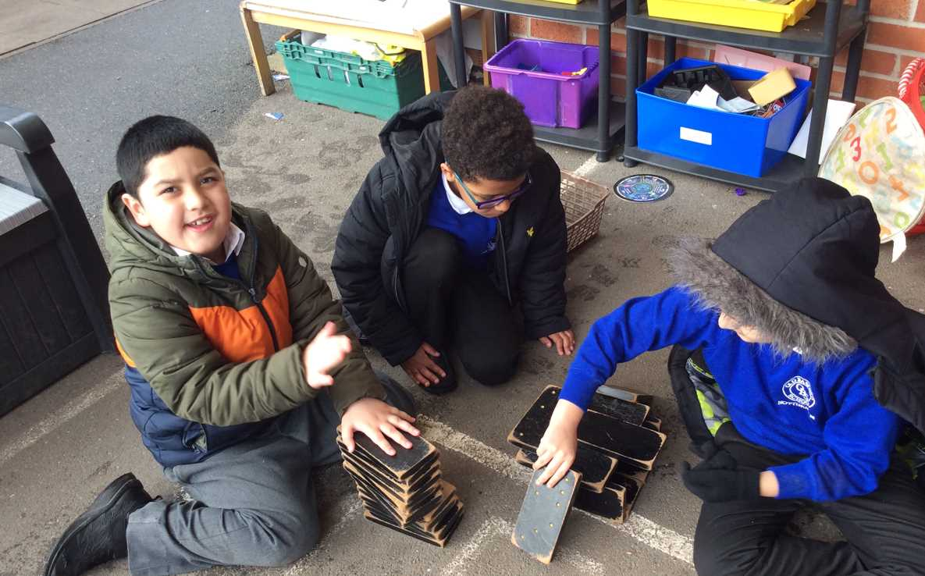
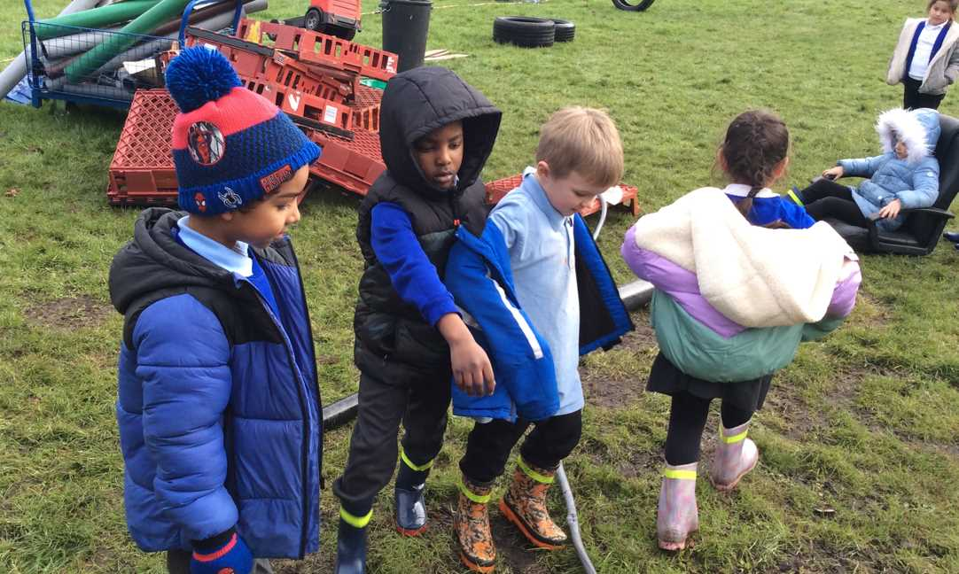
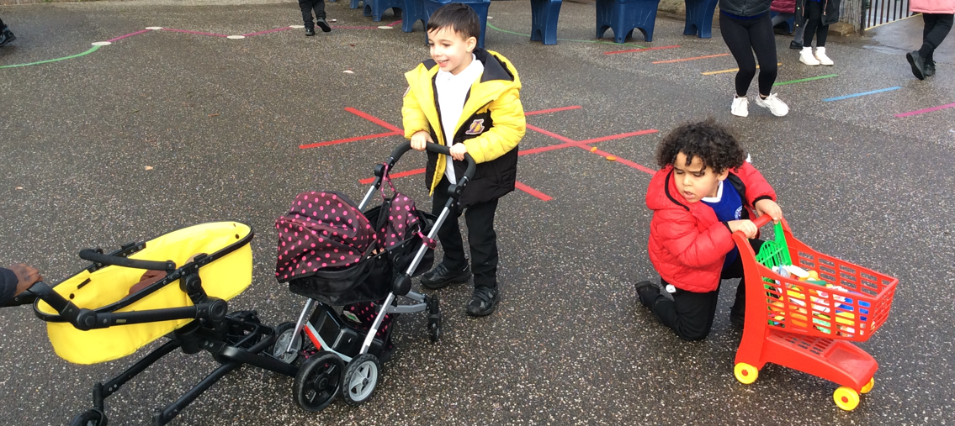
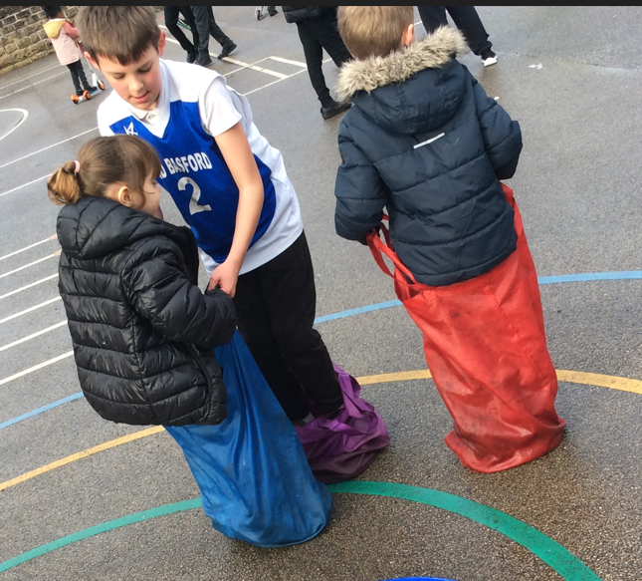
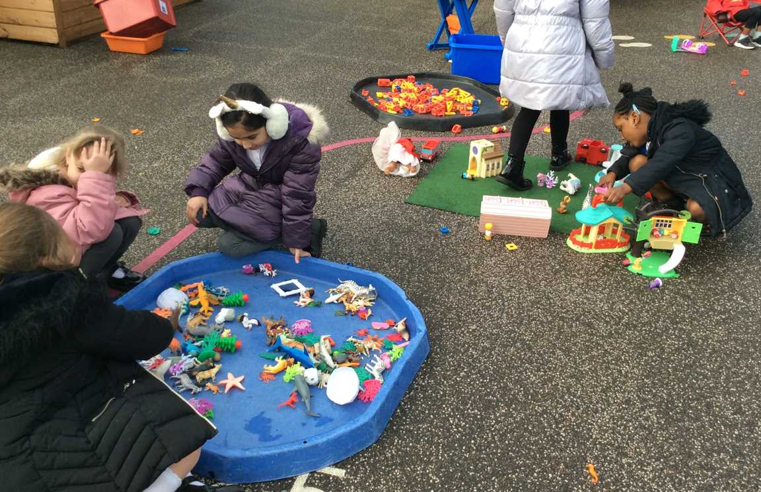
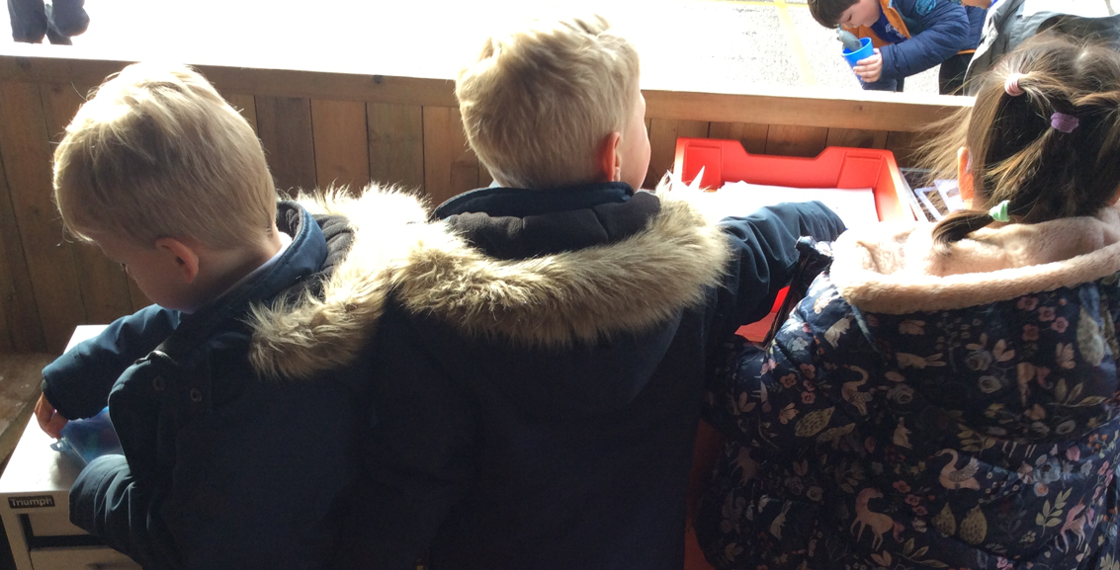
Celebrate
Examples of AMAZING play!

Slide 3
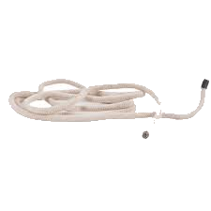
What will be new to play with this week:
Inform
Skipping ropes in the active zone.

Slide 4
Innovate
How can we play with the skipping ropes?
Single skipper
Skip like a boxer!
Start slow
Bounce skip for 60 seconds
Hop skip
Run skip
Boxer skip
Twist the rope and twist your arms
Group skipping
Limbo
Mouse trap
Teddy bear
Hot Peppers
School

Slide 5
What rules will we need for safe play?
Negotiate
Don't hit people with them
No tripping
No lassoes
Don't wrap people up on ANY part of the body
No throwing on the roof
Don't tie them together to make a long one
Don't tie people up
NOT for tug of war!
Don't swing them around.
Keep in the active zone!
Keep clear!

Slide 6
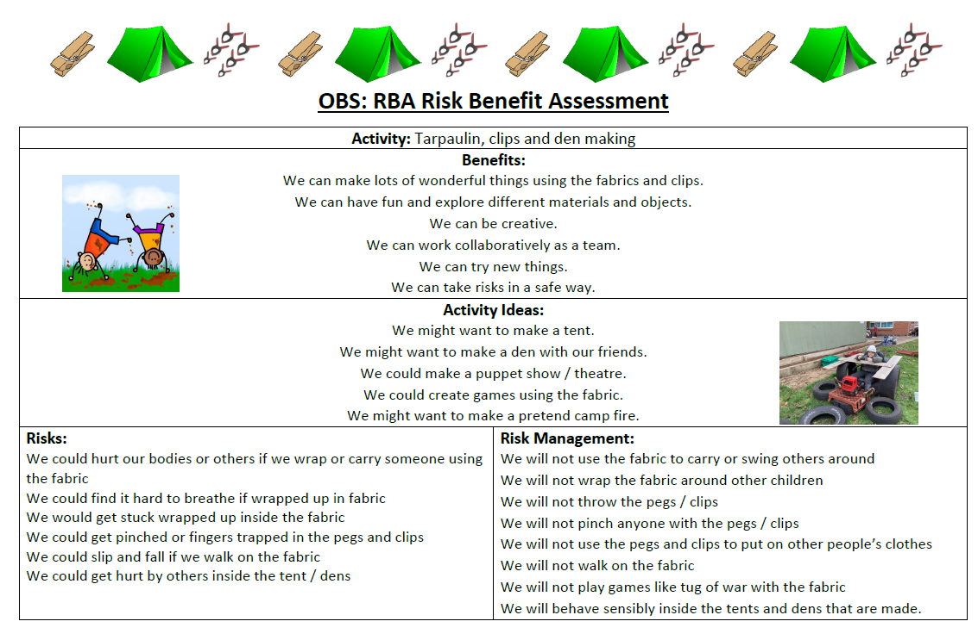

Slide 7


The Golden Brush and Welly Awards

