Slide 1


Slide 2
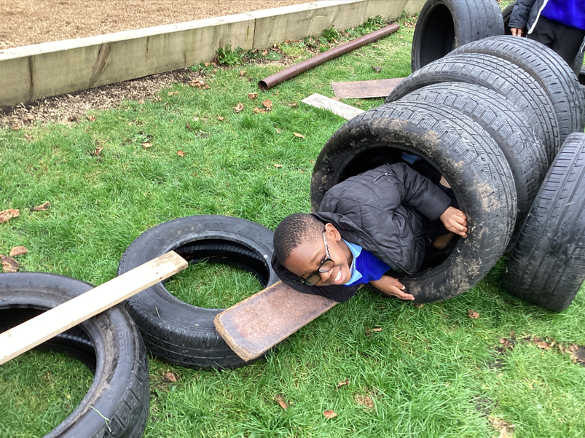
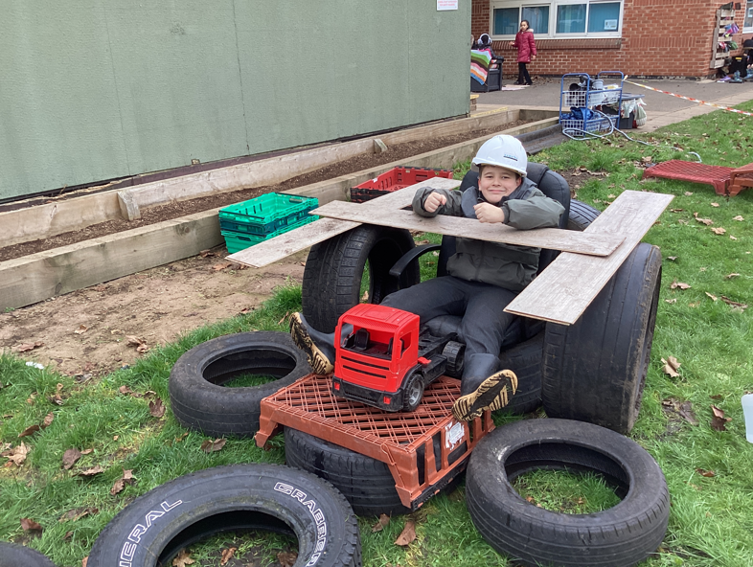

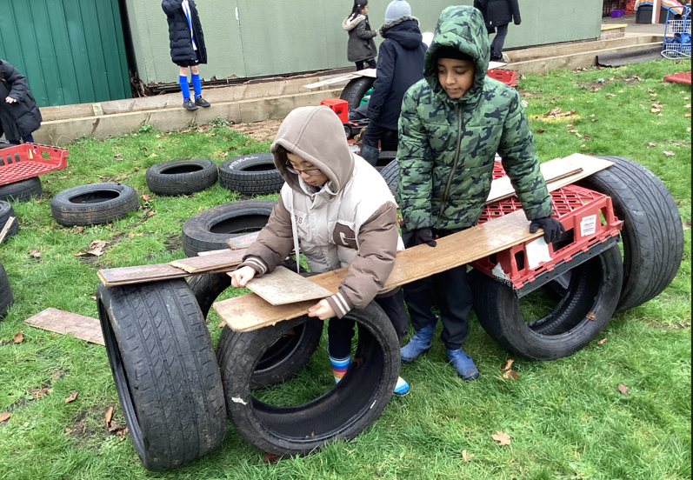
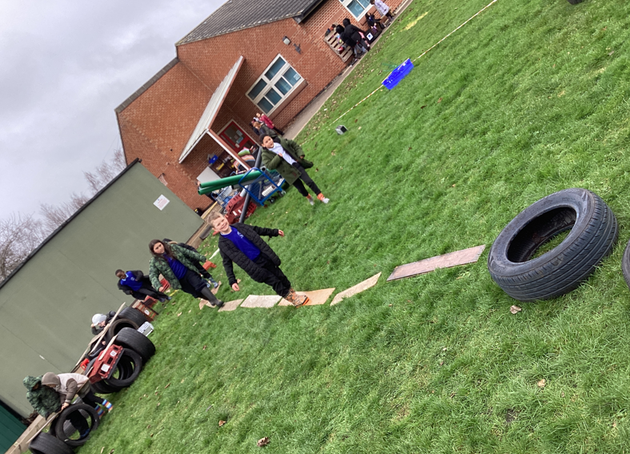
Examples of AMAZING play!
Celebrate

Slide 3
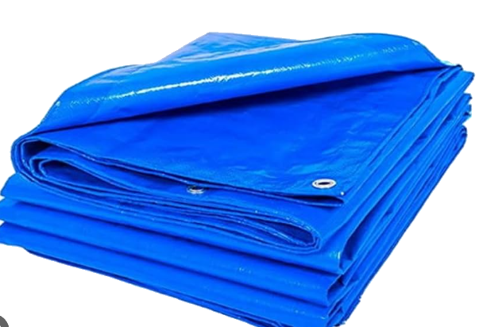
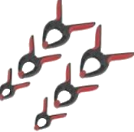
What will be new to play with this week:
Inform
clips and pegs
Tarpaulin and fabric

Slide 4
Innovate
Build a den
Pretend to camp and make a tent
Build a camp fire (pretend)
Make a puppet show
Tunnels
Create games with the fabric

Slide 5
What rules will we need for safe play?
Negotiate
Fabric is not to be used to carry others or swing at others
Don't wrap anyone in the fabric
Don't throw the pegs
Don't pinch anyone with the pegs
Don't put the pegs on peoples clothes
Don't walk on the fabric
Don't play tug of war

Slide 6
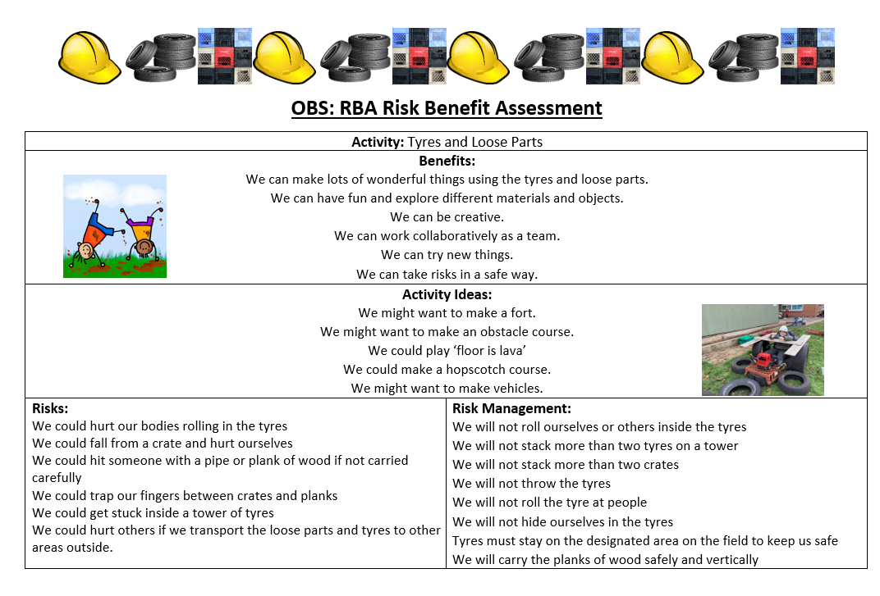

Slide 7
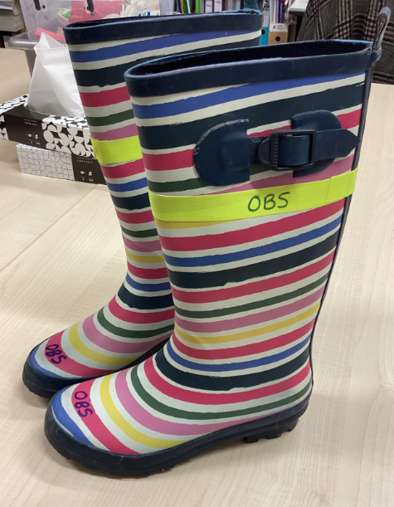
Reminder about wellies

Slide 8


The Golden Brush and Welly Awards

