Slide 1


Slide 2
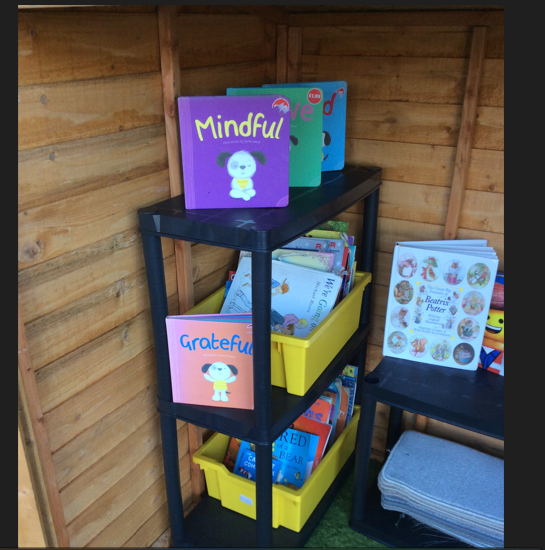
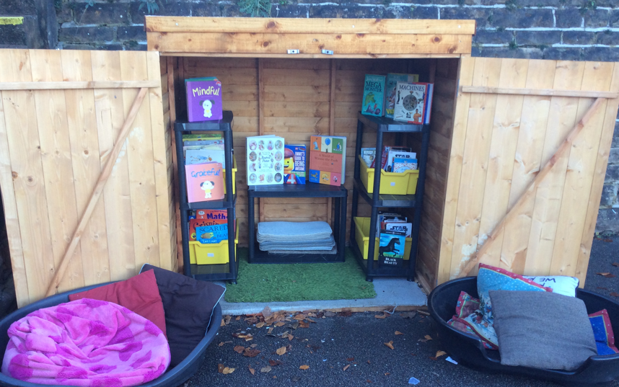
Something New!
We have bought some new shelves for the library and we think that they look great!
( Organised and tidy)

Slide 3
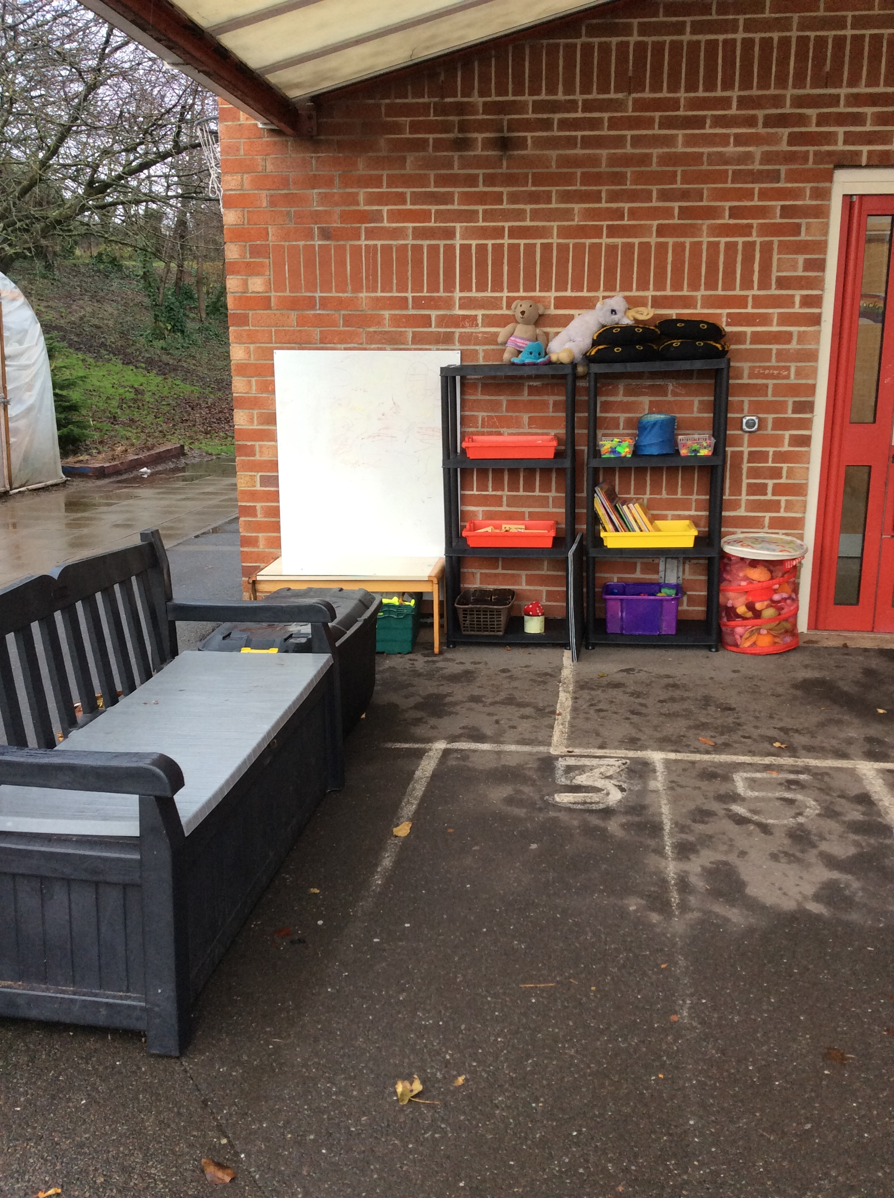
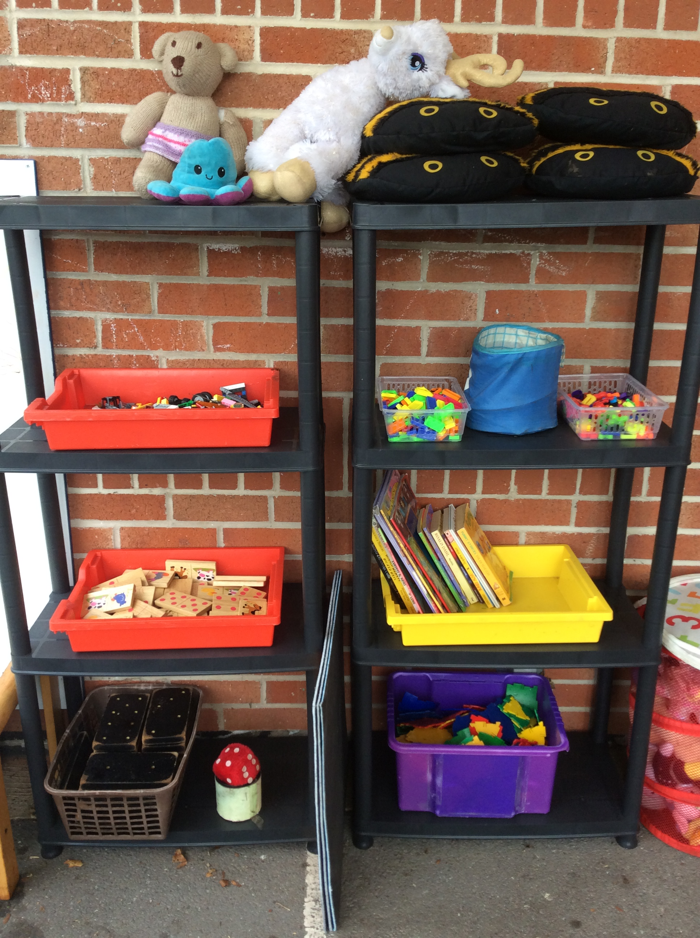
Something New!
We have added to our calm corner so there are some games and activities that you can quietly play.

Slide 4
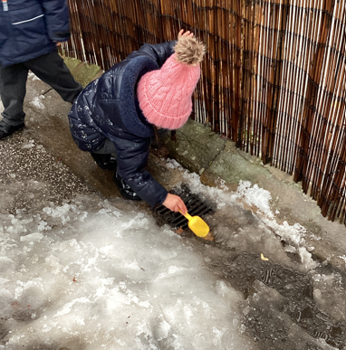
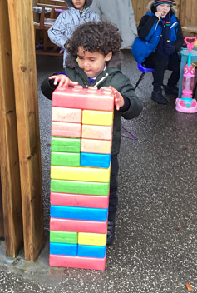
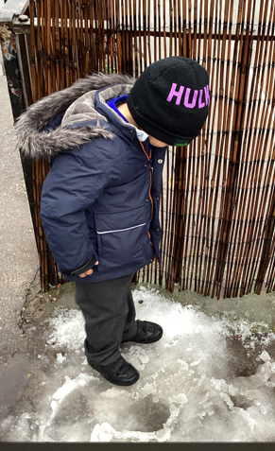
Amazing play last week!

Slide 5

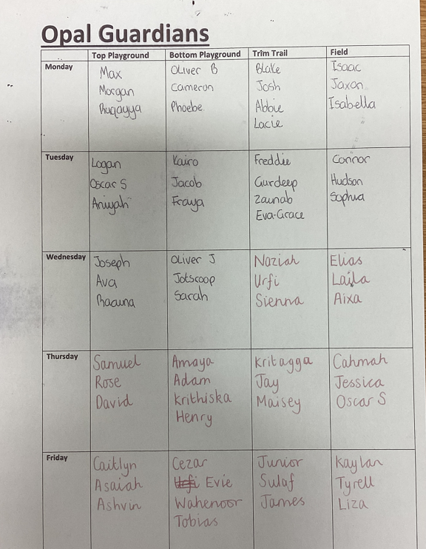
Opal Guardians
(Respect)
(Understanding other's needs)
Thank you!

Slide 6
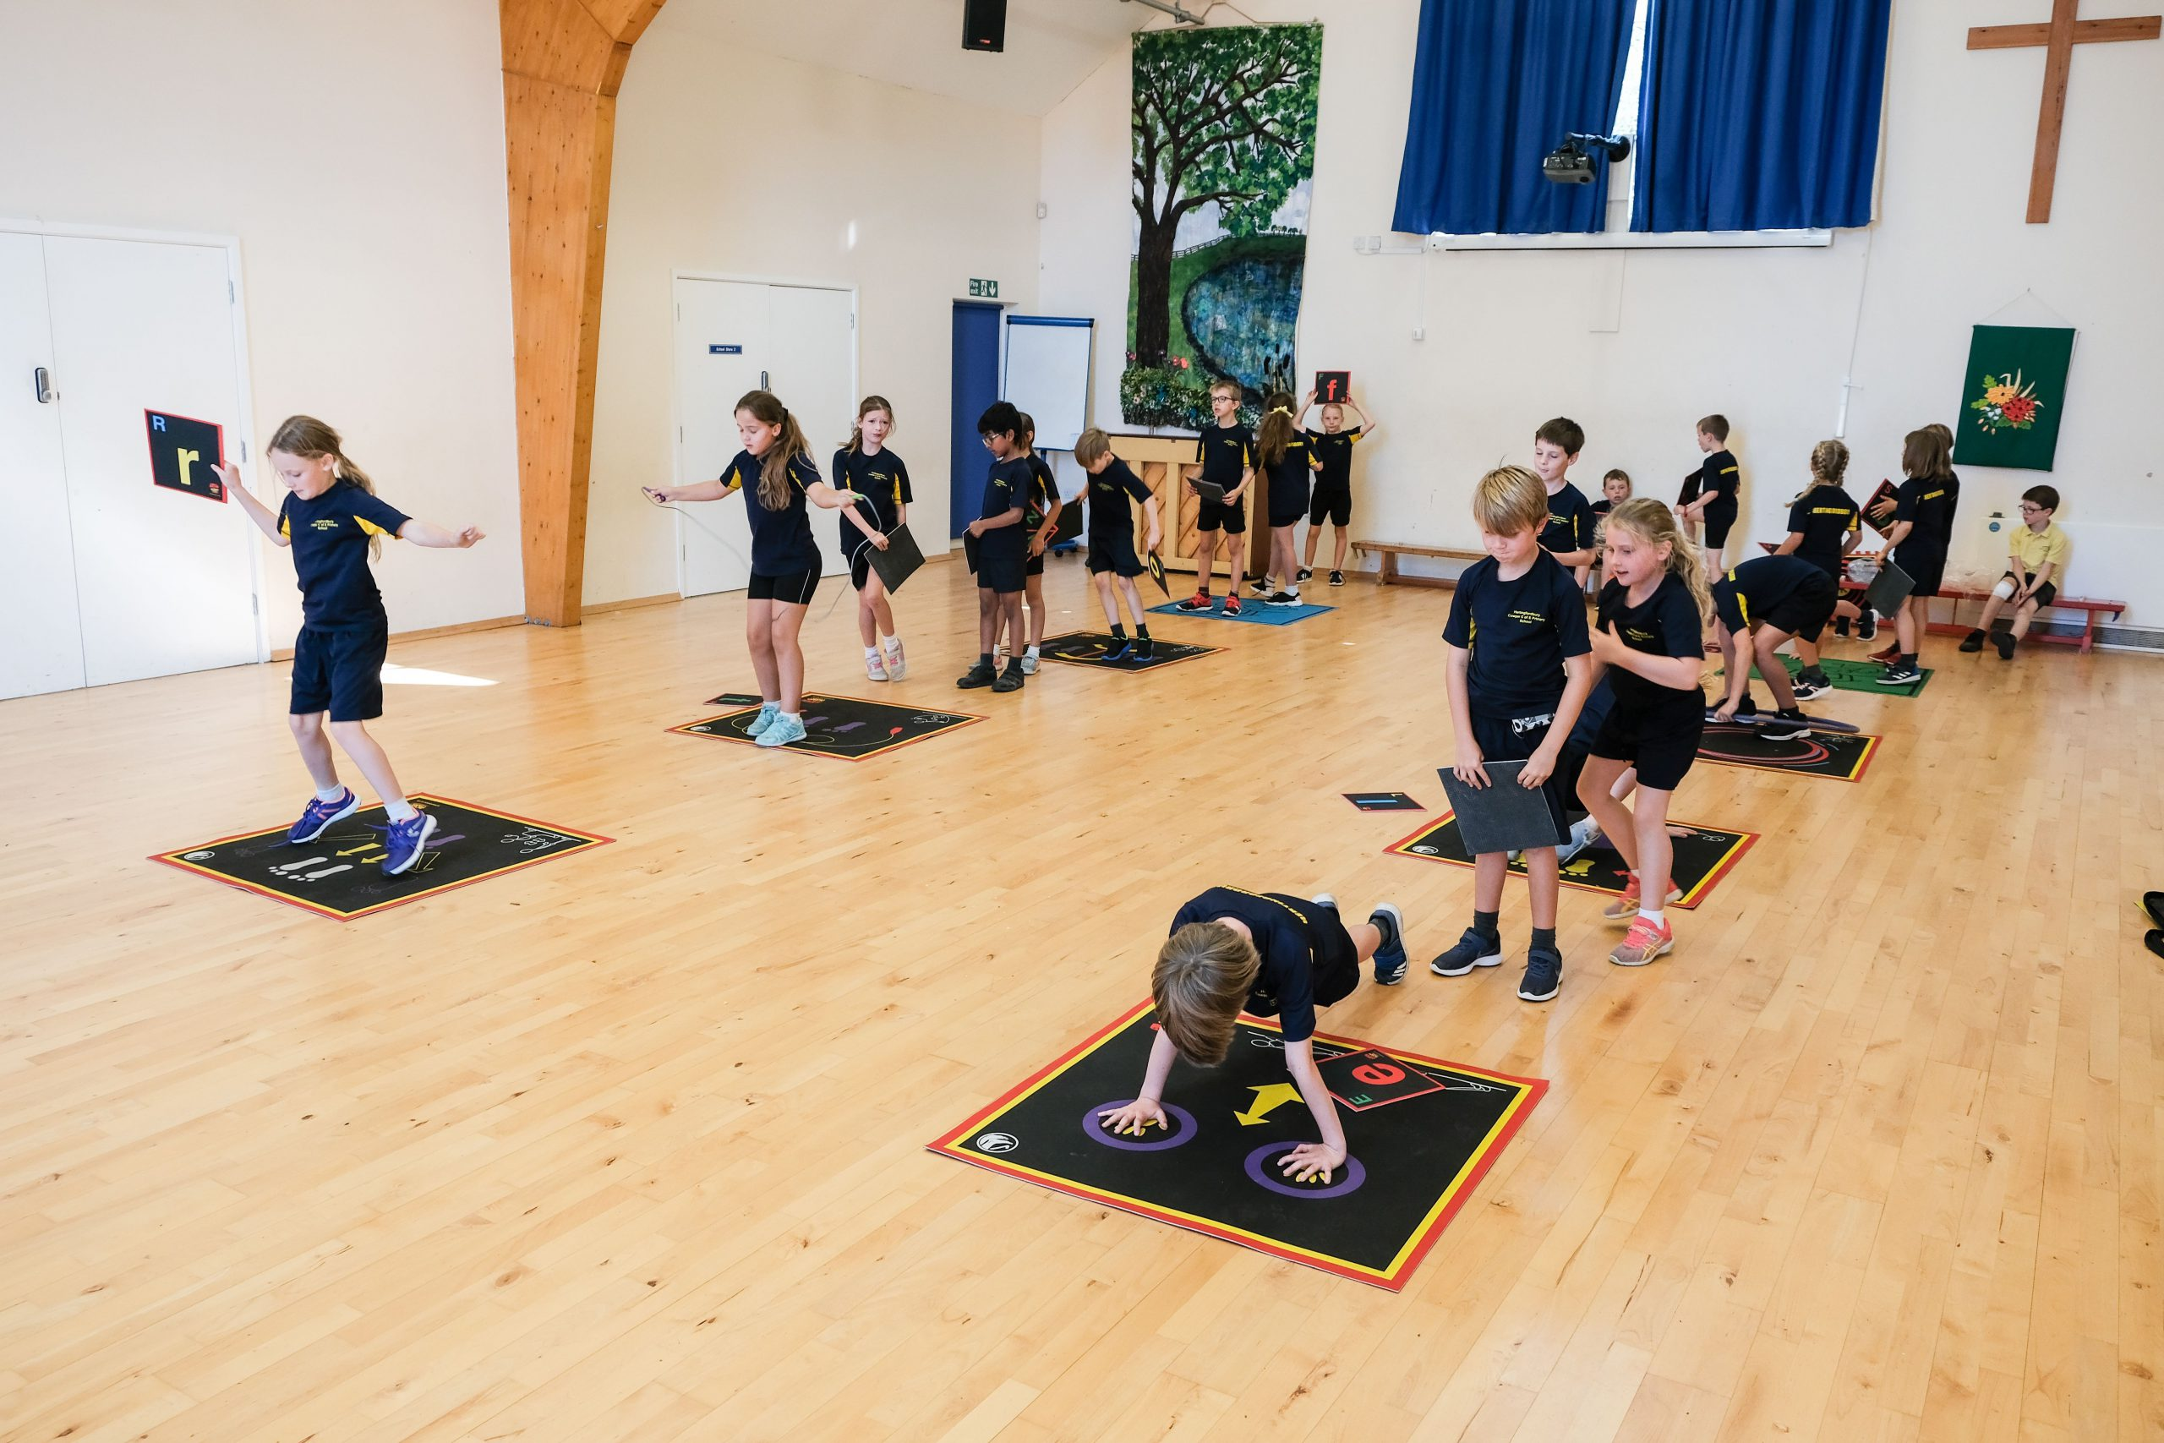
What are we introducing this week?
Action mats are our new activity in the active zone on the bottom playground. You can use these to create your own games and circuits.

Slide 7
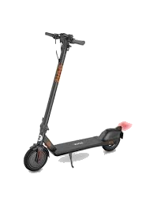
Scooters
Reminder - we don't wear helmets when using the scooters at Opal Play because it is a safe space where we move more slowly and there are no cars. However when you are scooting or riding a bike you MUST were a helmet because there are more dangers on the roads.

Slide 8


The Golden Brush and Welly Awards

Slide 9

New award for this week!

