Slide 1


Slide 2
We need your help!
We really need to more scooters to make our wheelie zone better.
Does anyone have an old scooter that they don't want anymore?
Or an old toddler's pram?

Slide 3
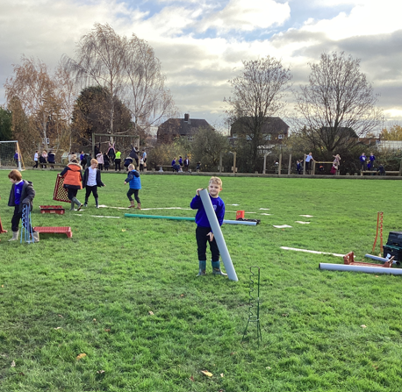
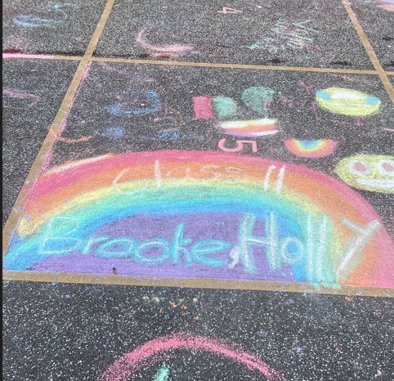
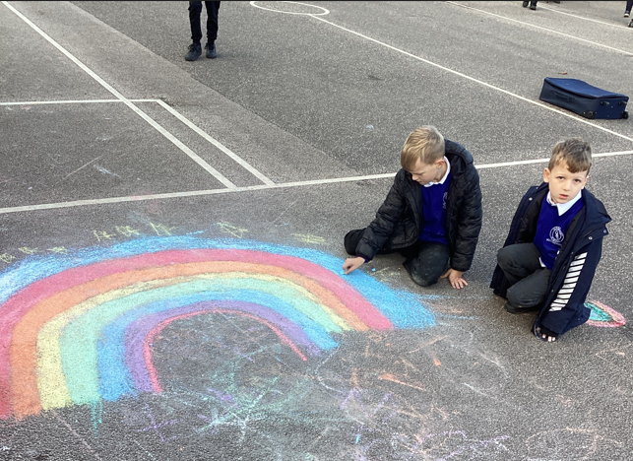
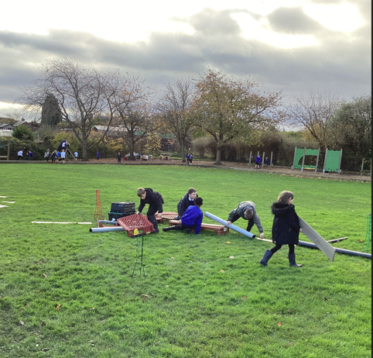
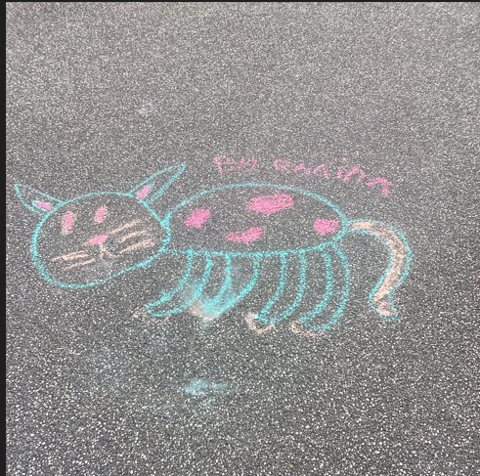
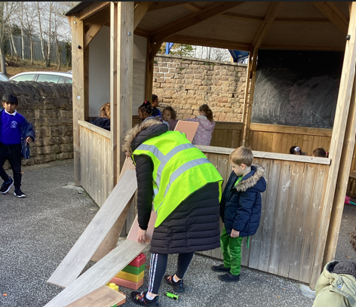
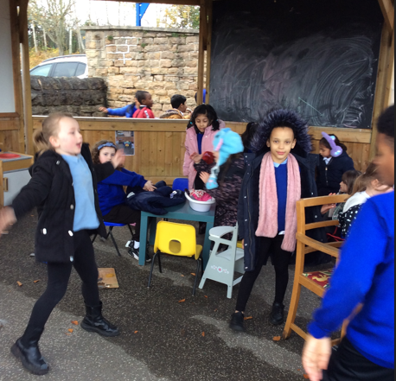
Amazing play last week!

Slide 4
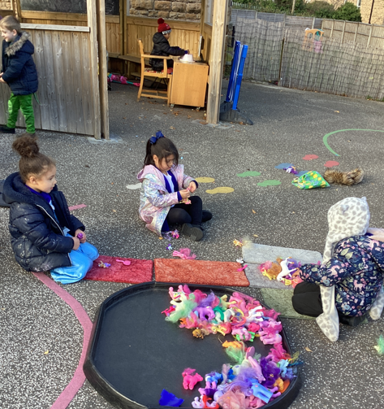
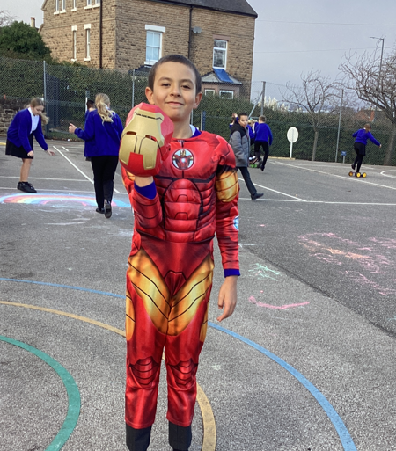
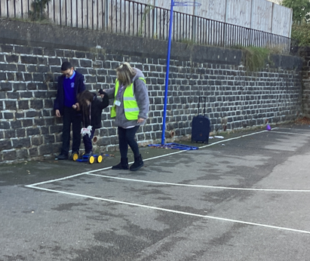
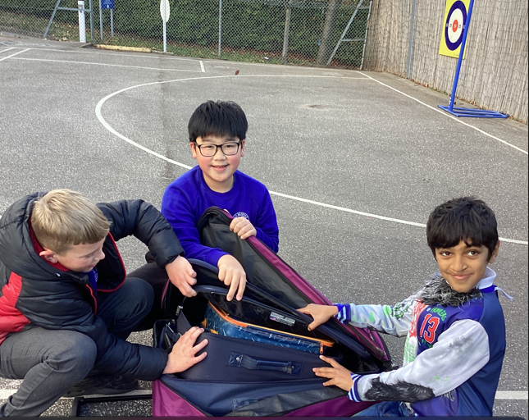
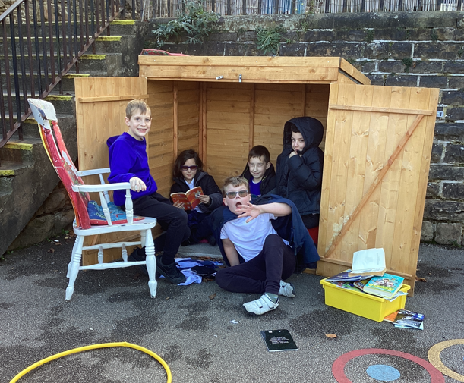
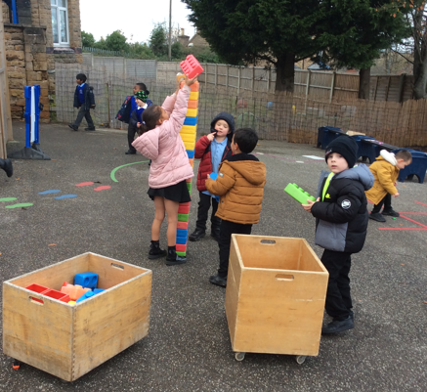

Slide 5
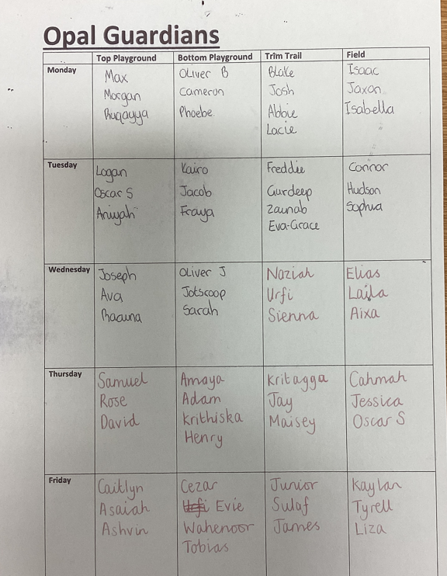

Opal Guardians(Innovate)

Slide 6
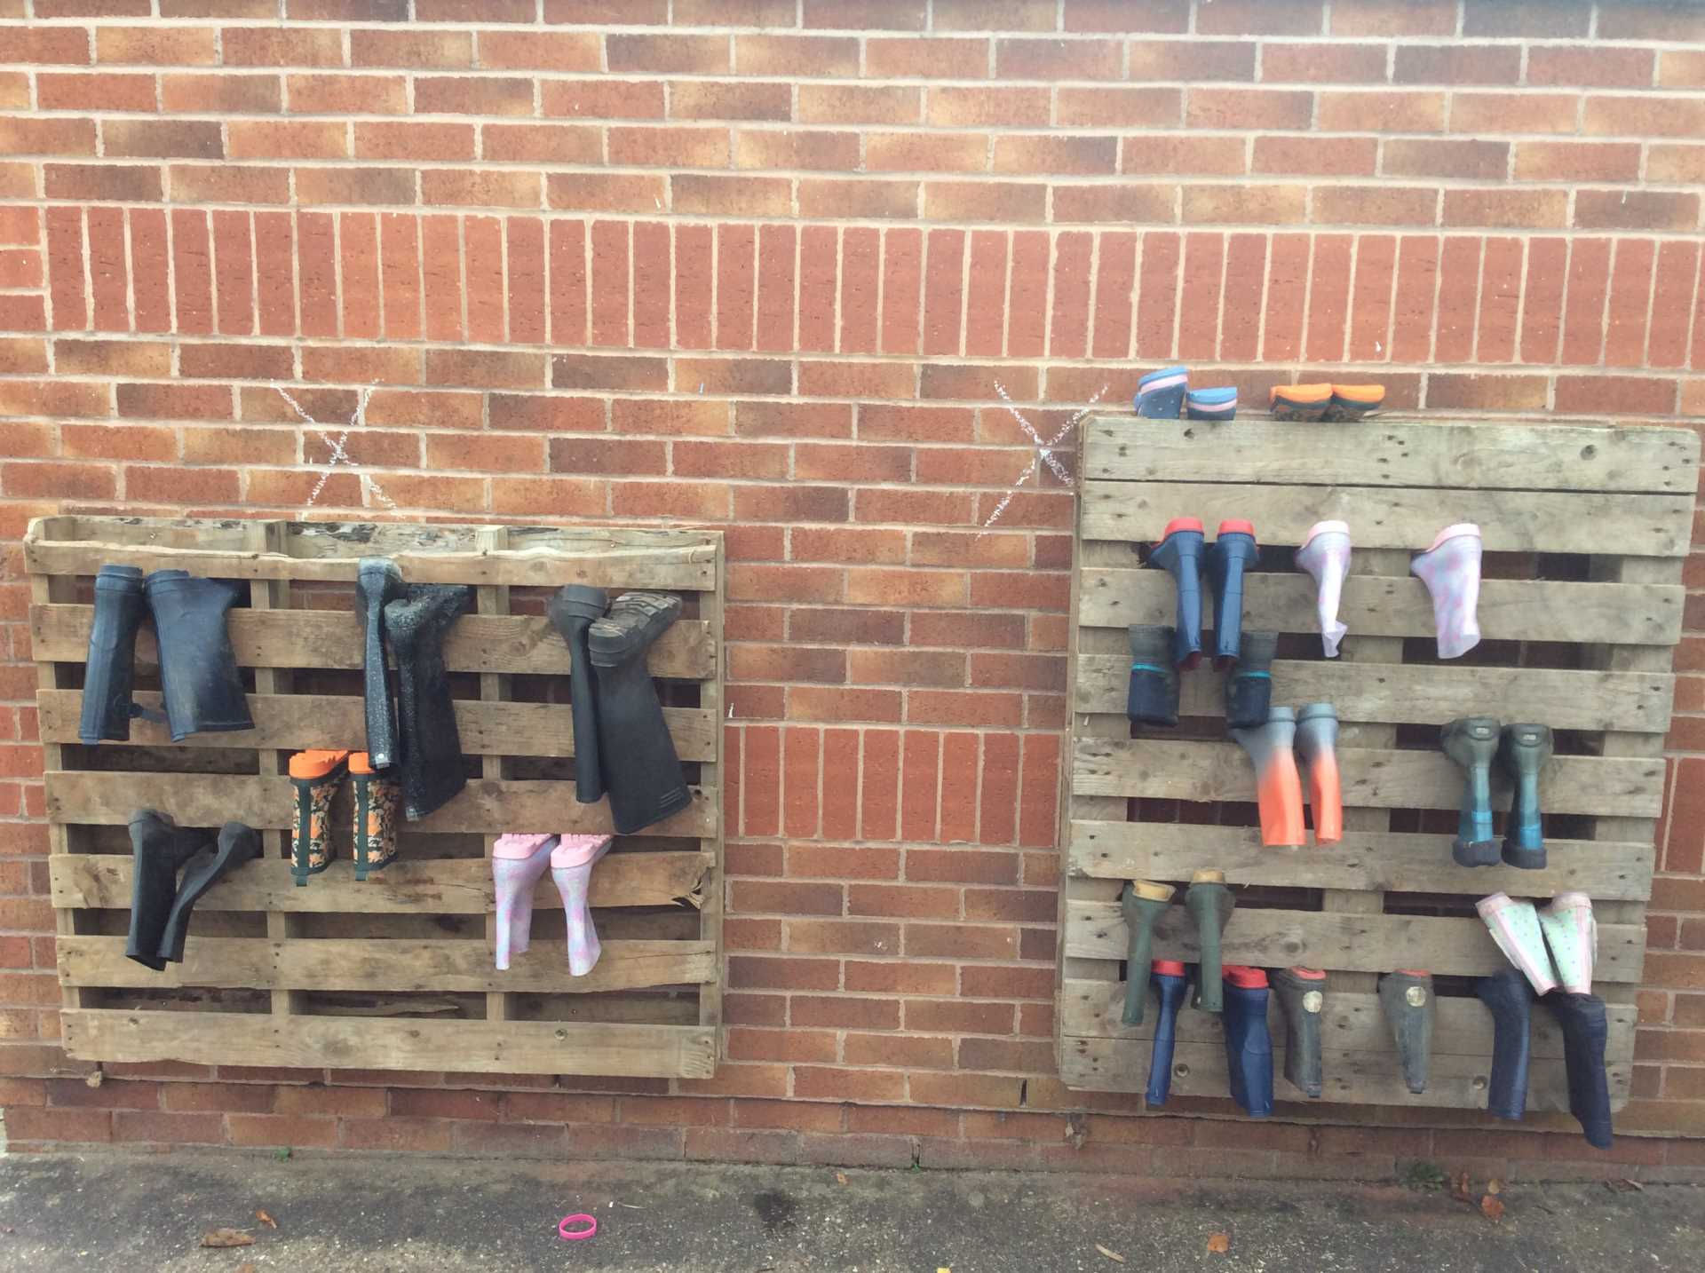
Reminder of Rules
1. Year 6 to go on scooters at 12:55 when KS1 are tidying up , not before.
2.If there is an incident at lunch time you MUST tell a member of the play team.
3. Keep wellies on the rack.

Slide 7


The Golden Brush and Welly Awards

