Slide 1


Slide 2
We need your help!
We really need to more scooters to make our wheelie zone better.
Does anyone have an old scooter that they don't want anymore?

Slide 3
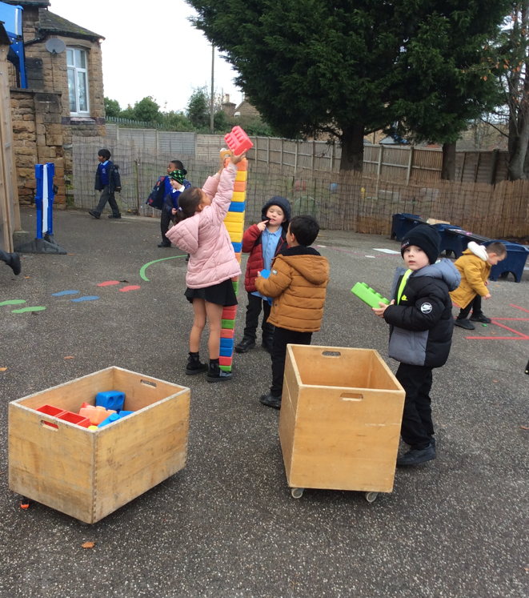
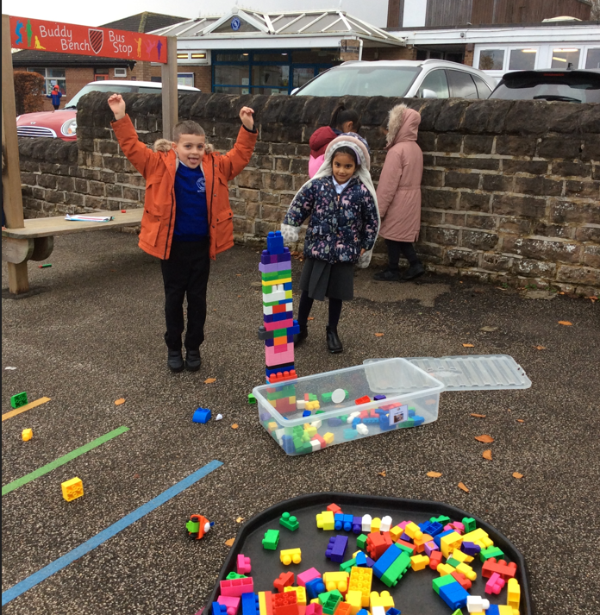
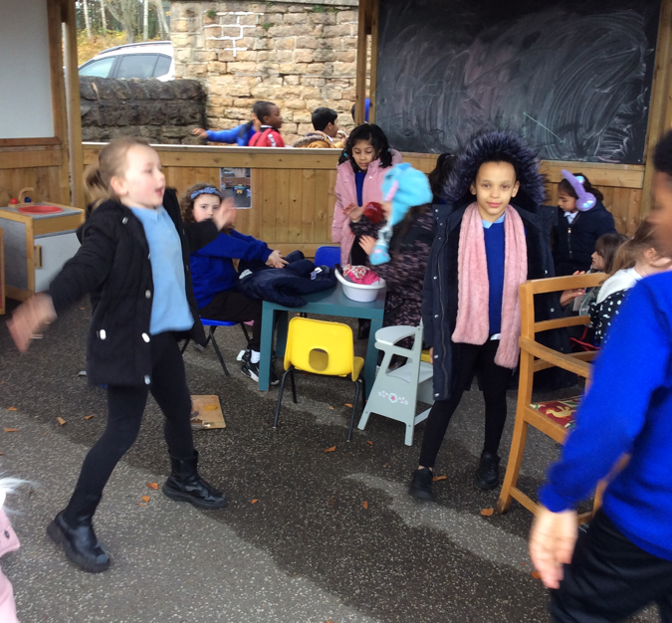
Amazing play last week!

Slide 4
Tidy Up Time
creative area
What type of things need to be put away?

Slide 5
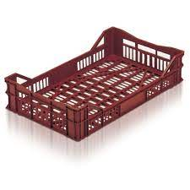
INNOVATE
New this week ...
crates on the field
mini fort, obstacle course, pretend vehicle, 'dominoes', bridge for cars

Slide 6
Negotiate: Rules For Playing On The Field With the Crates
1. No jumping on them (they will break)
2. Walking is ok but take care to not slip- one crate high
3. Don't knock over on purpose
4. Build as high as your hip only
5. Don't climb up them
6. If you make a bridge, no walking on it

Slide 7
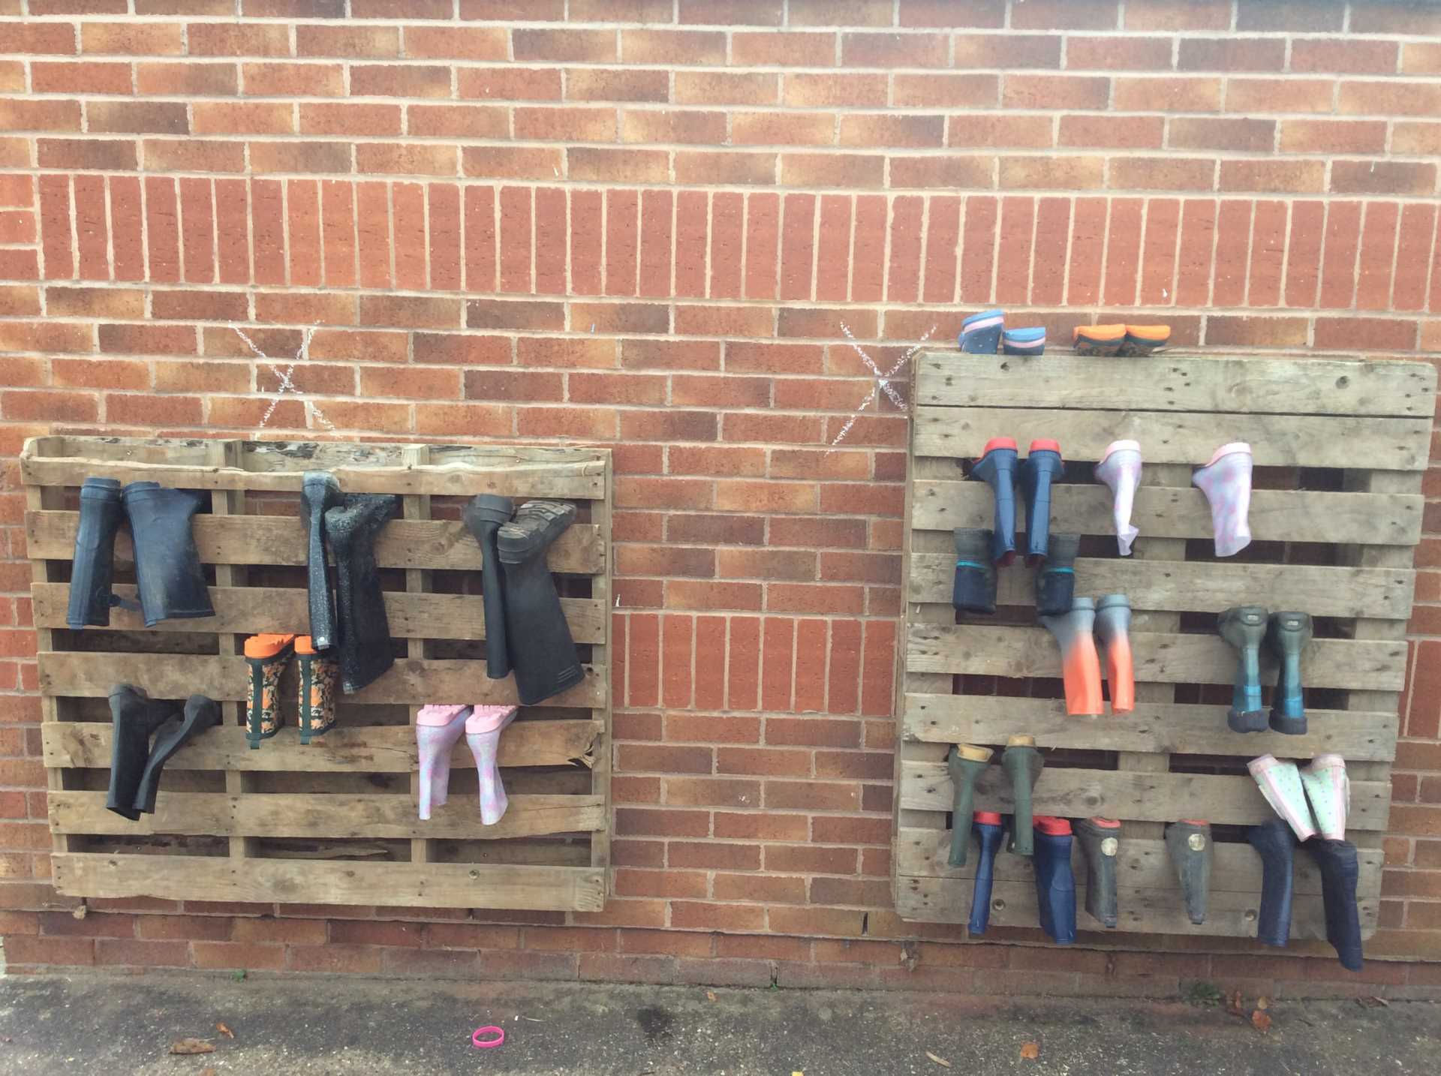
Welly Library Rules
1. You can only take boots from the welly library when it is your turn on the field.
2.You must return the boots to the library when you have finished using them ( not back to your year group rack).

Slide 8


The Golden Brush and Welly Awards

