Slide 1


Slide 2
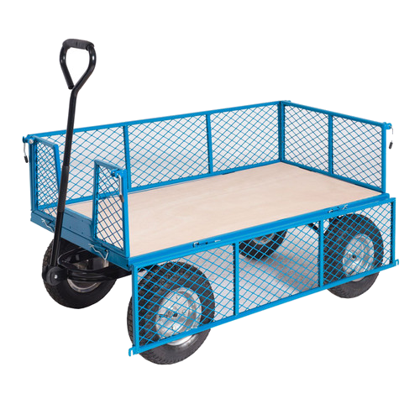
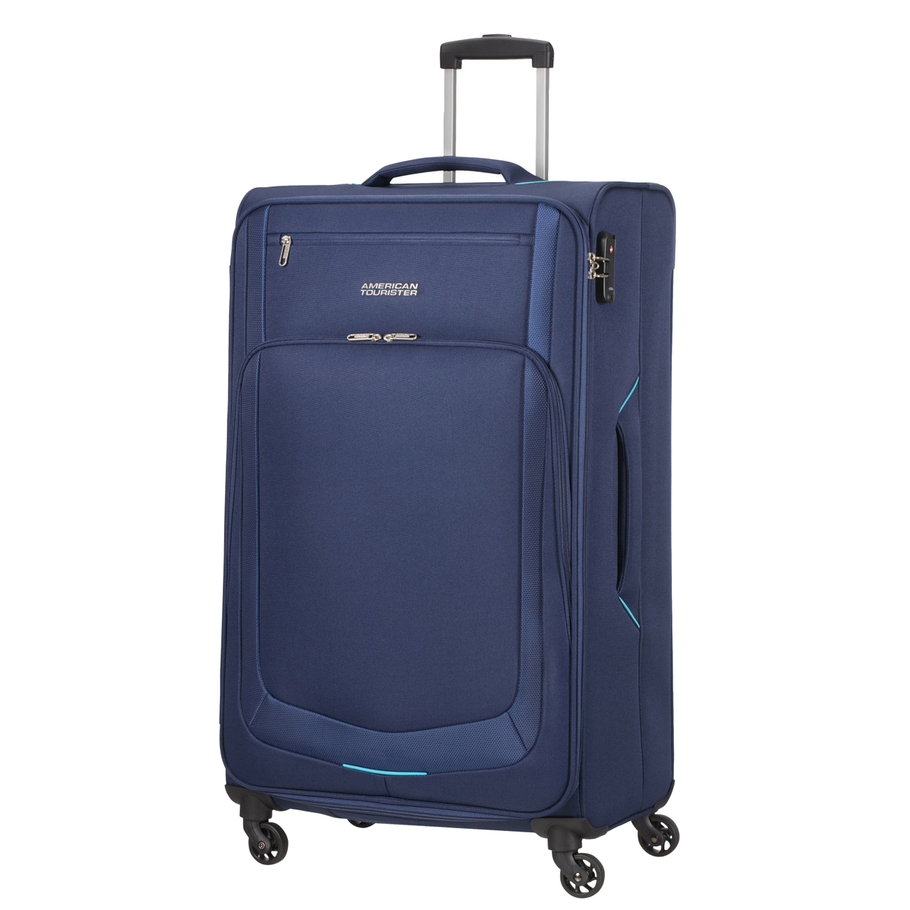
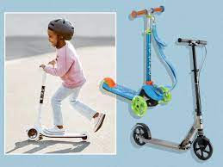
What will be new to play with this week:
Inform
Wheelie Zone

Slide 3
How could you play with the scooters, suitcases and carts?
Innovate

Slide 4
What rules will we need for the scooters, suitcases and cart?
Negotiate
* Do not go inside the suitcases or lock them
* Be careful with the scooters and don't lift them up
* Keep the suitcases on the ground
* Maximum of 2 in a cart
* Look where you are going
* Do not stand up in the carts - sitting only
* Bottom yard only in wheelie zone
* No crashing and bumping

Slide 5
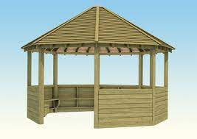
Suggestions please
We are going to change what goes in the shelter on the top playground.
What would you like to see in the shelter?

Slide 6
The Field
The messy kitchen will be closed until we are ready for everyone to play on the field.
This means that only the trim trail and calm corner will be open.

Slide 7


The Golden Brush and Welly Awards

