Slide 1


Slide 2
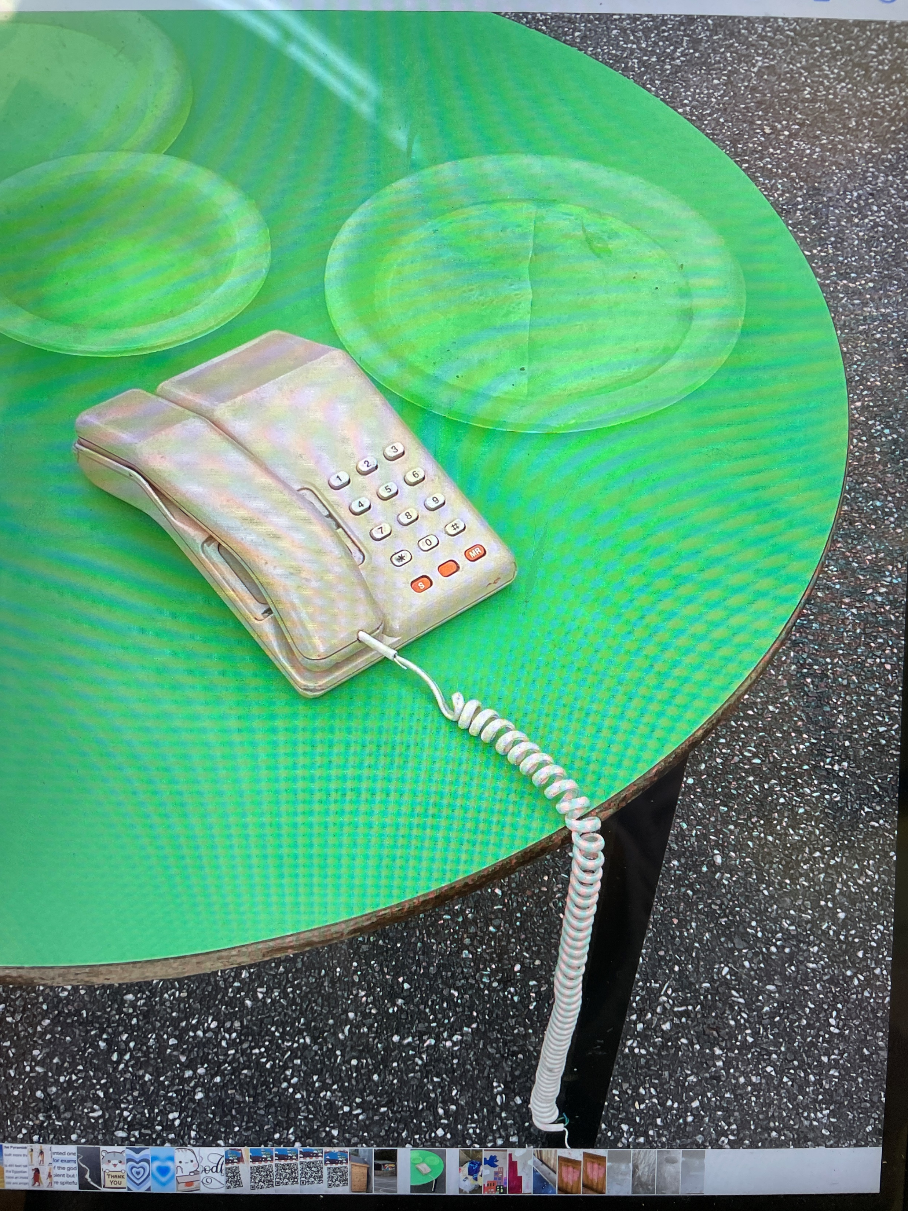
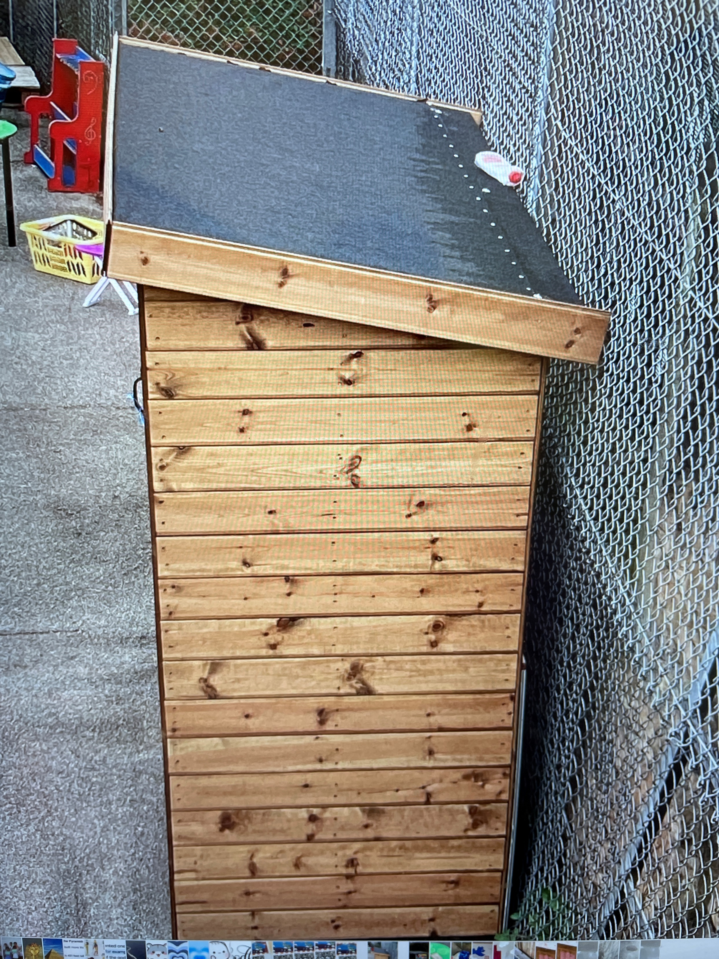
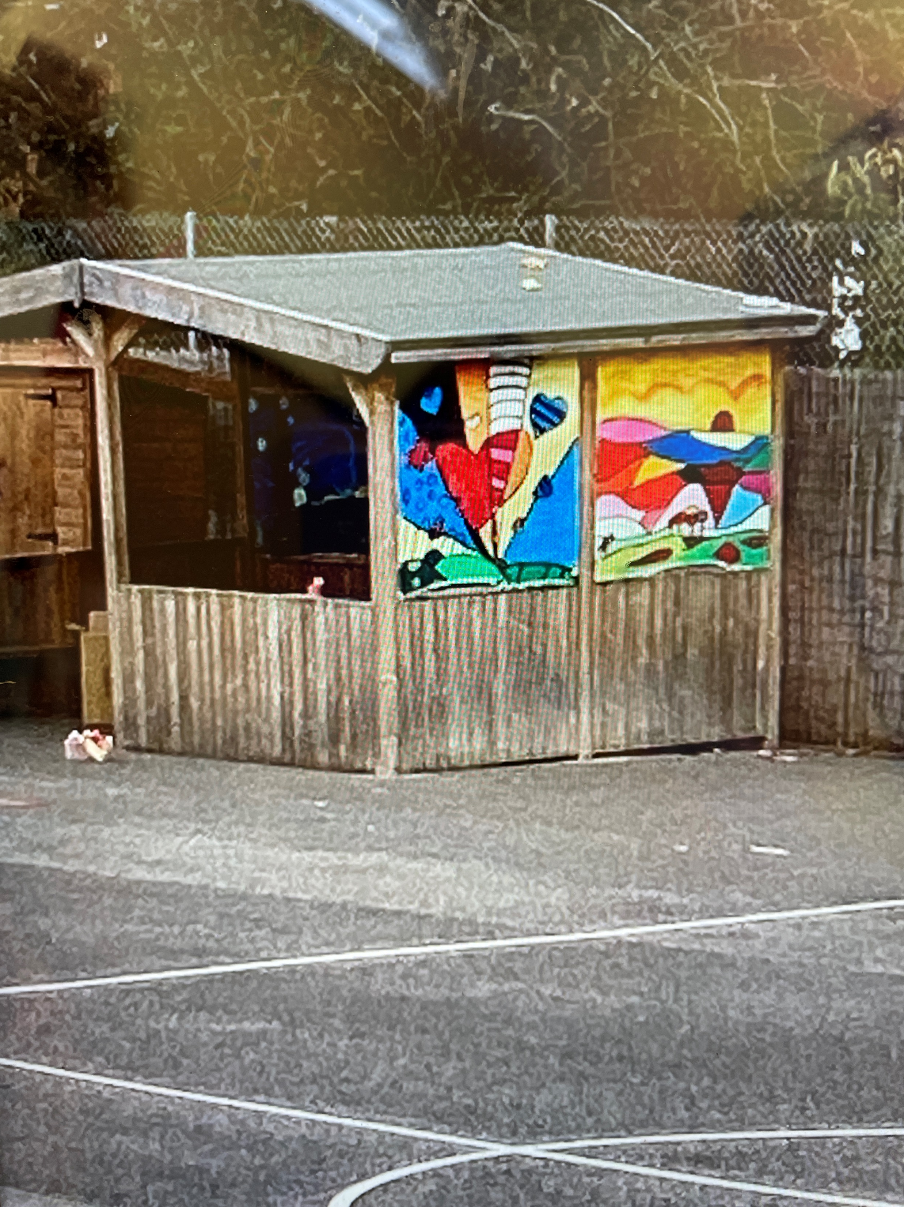
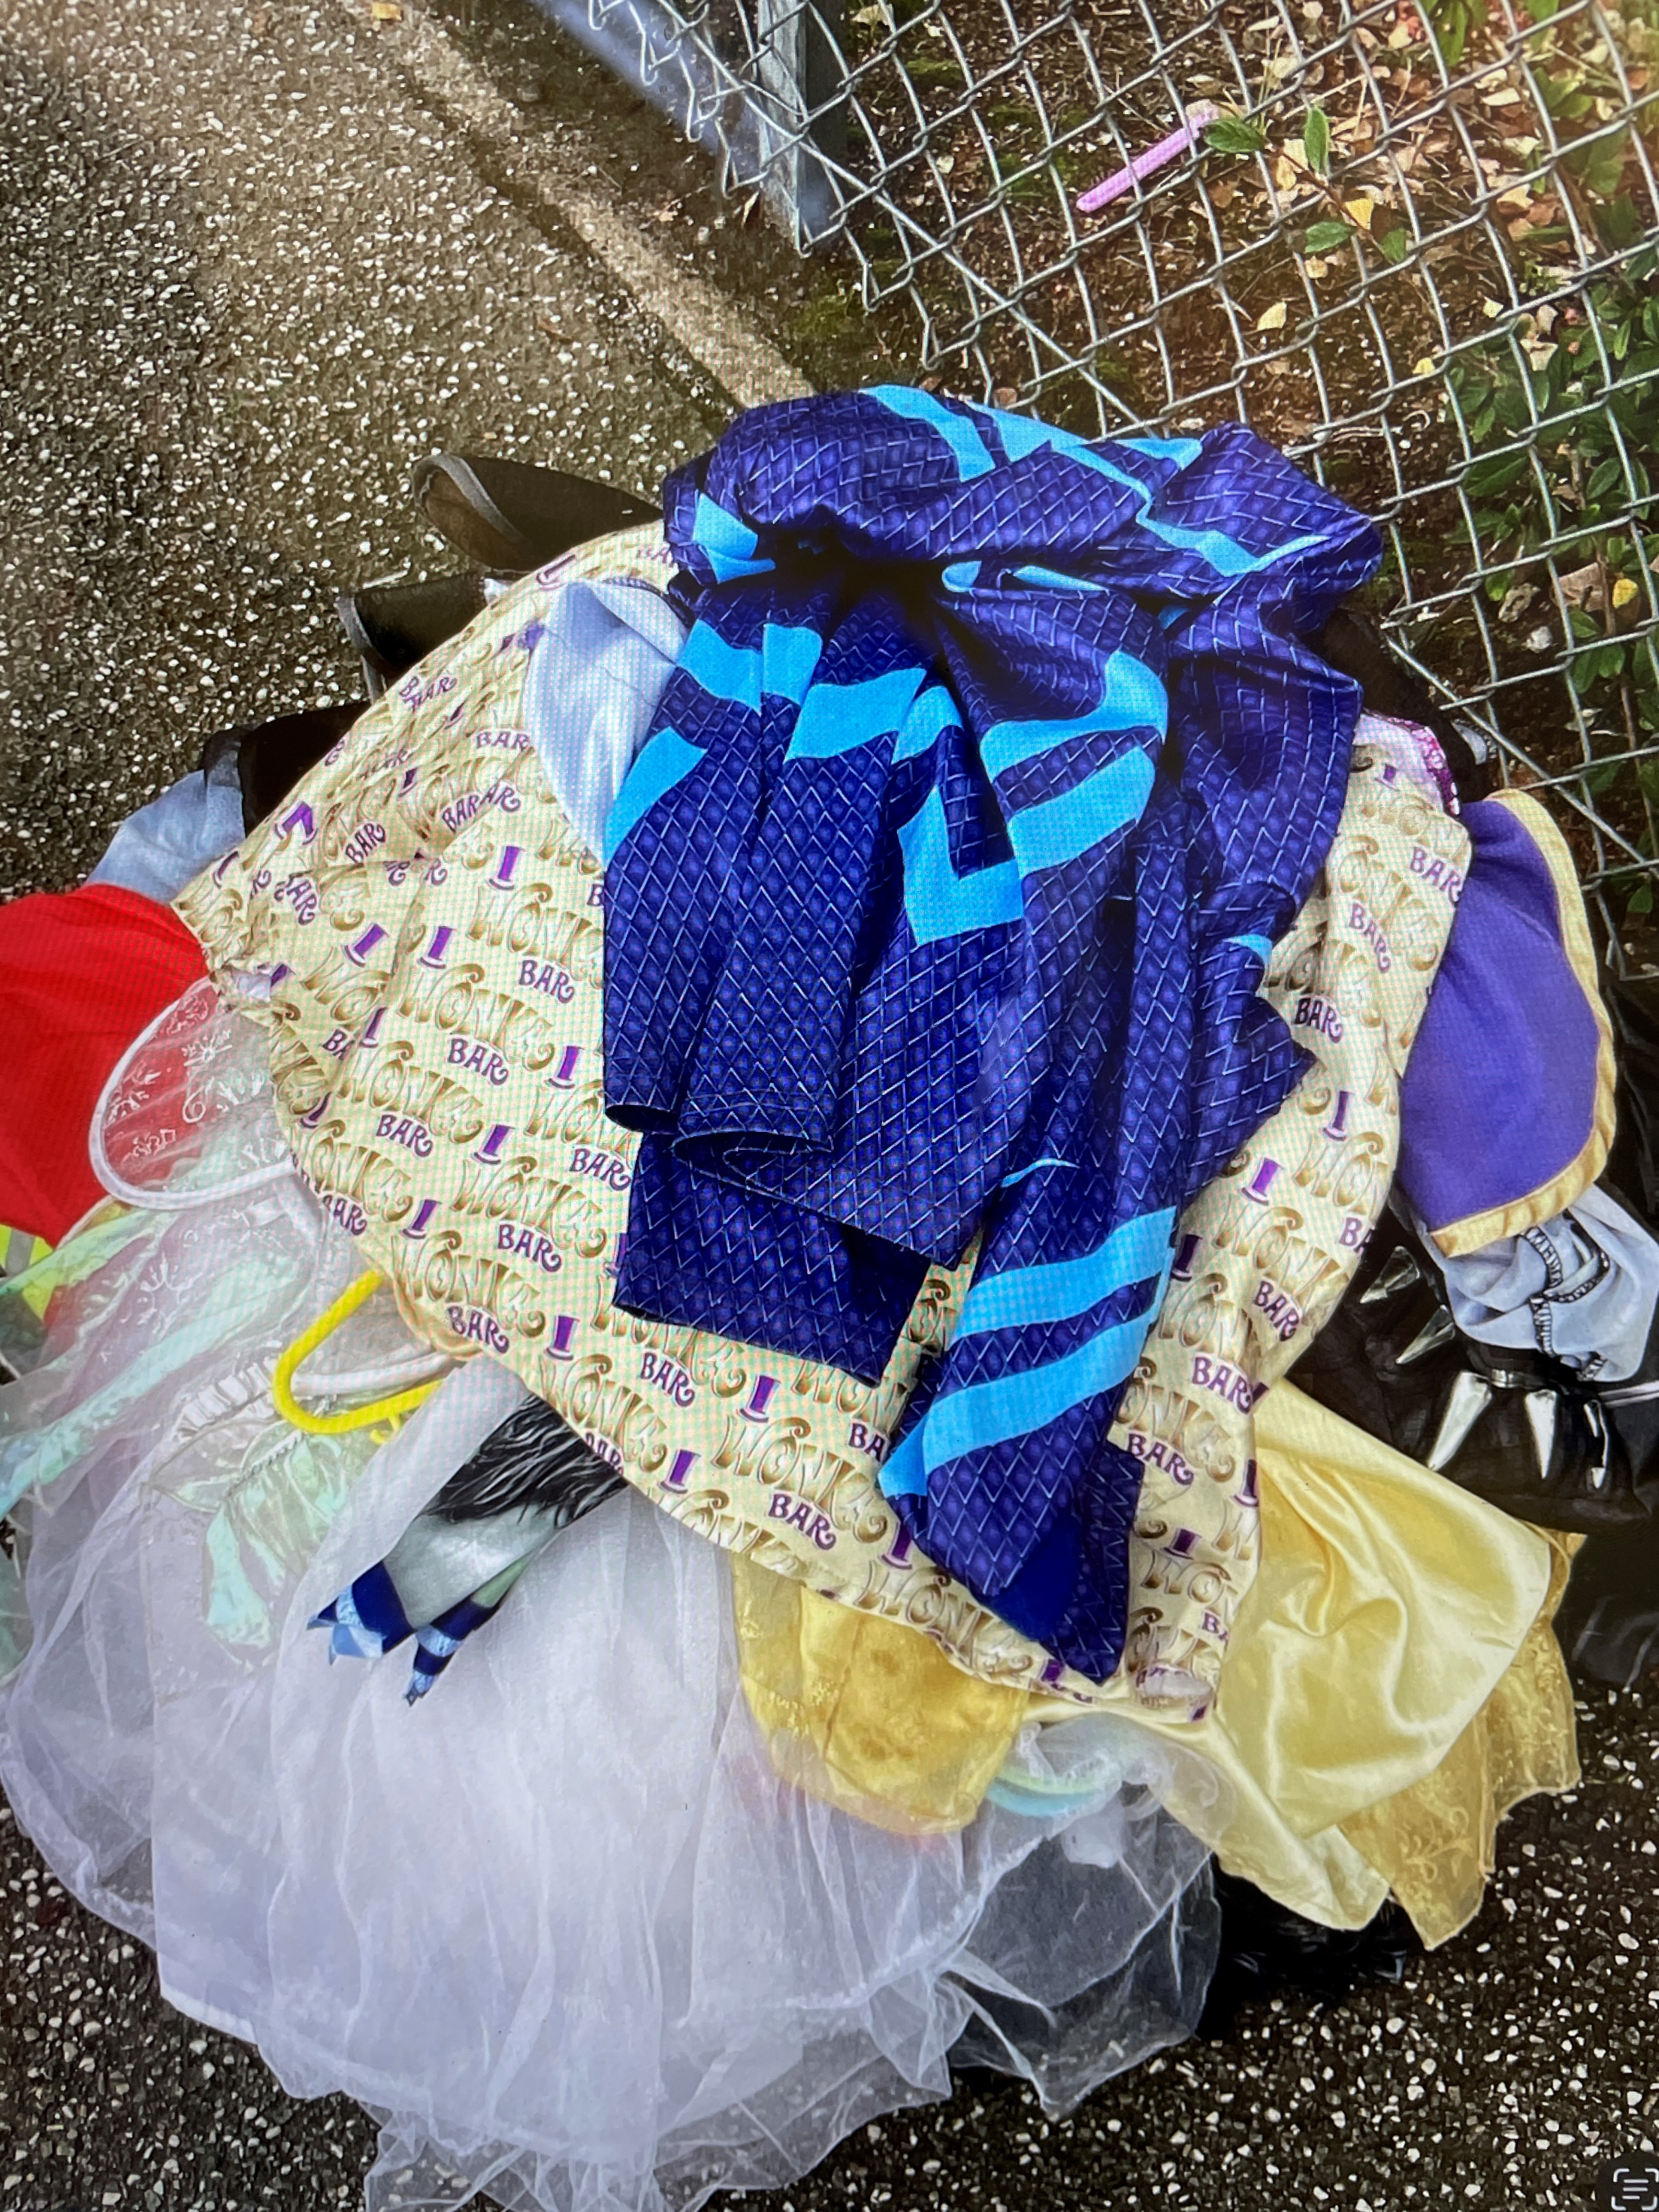
Oh dear!

Slide 3
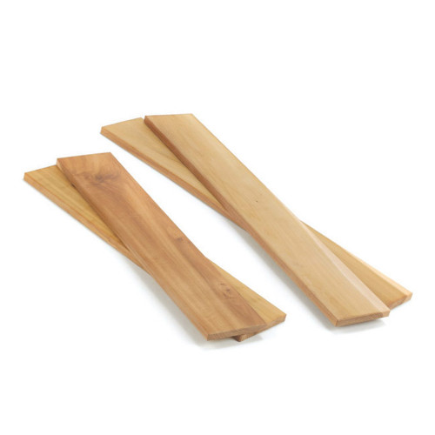
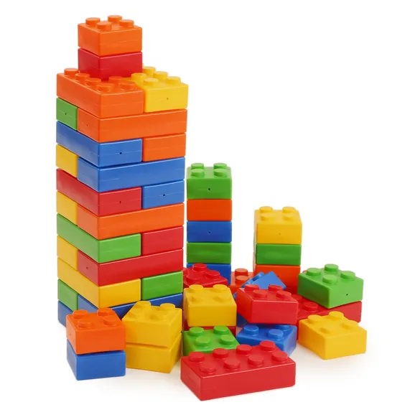
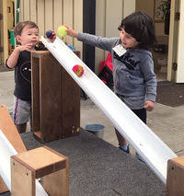
What will be new to play with this week:
Inform

Slide 4
How could you play with these parts?
Innovate

Slide 5
What rules will we need for the planks, blocks and pipes?
Negotiate
Keep it low.
2 people to carry
Don't drag on the floor
No standing on them-don't break them
No hitting with them
Don't throw

Slide 6


The Golden Brush and Welly Awards

Slide 7
Reminder about the field
* No field until after half term holiday.
* You must bring in wellies if you want to go on the field.
* You must have a coat.

