Slide 1


Slide 2
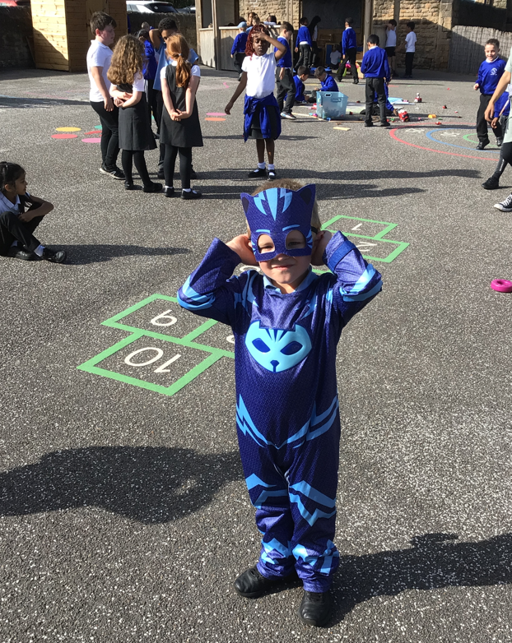
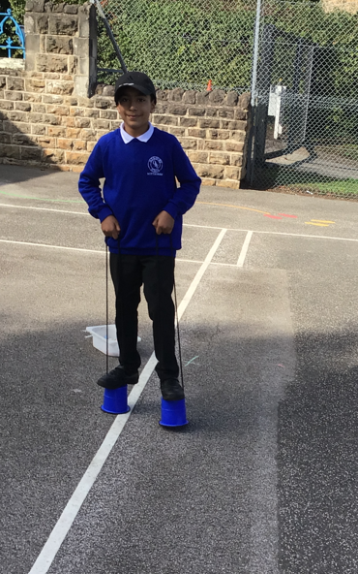
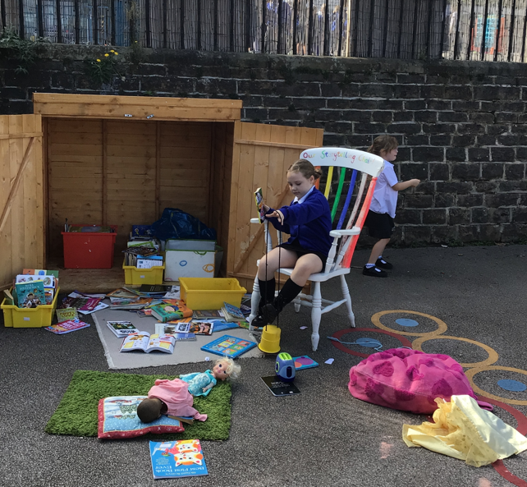
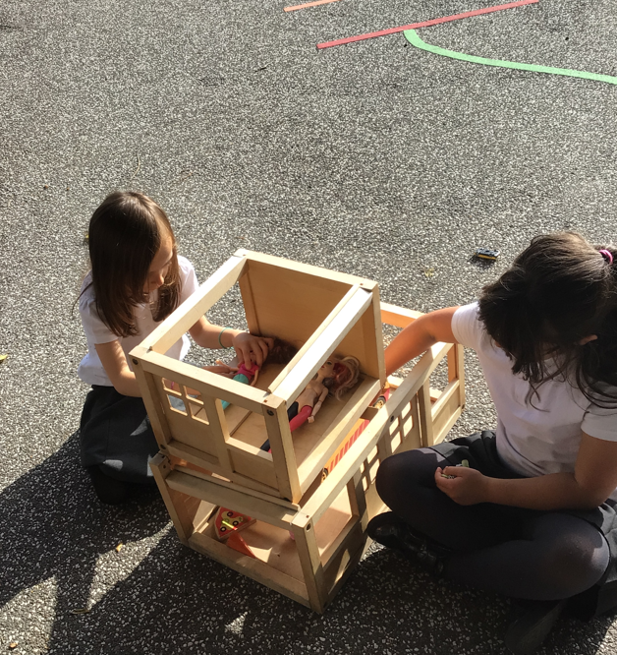
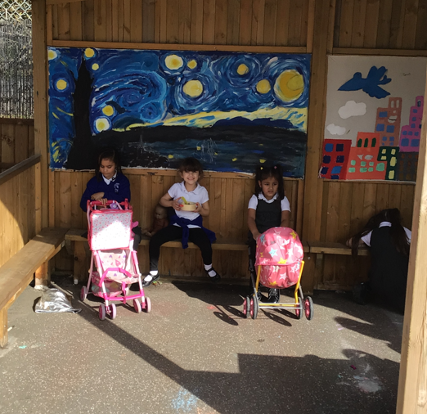
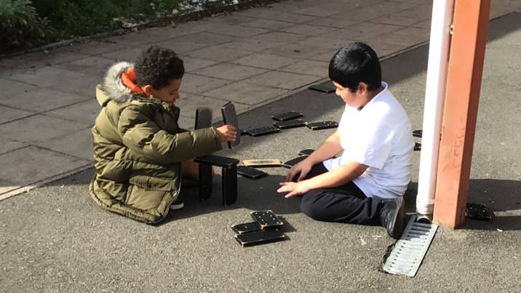
Monday was the BEST Opal Playtime EVER!
Celebrate

Slide 3
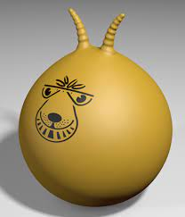
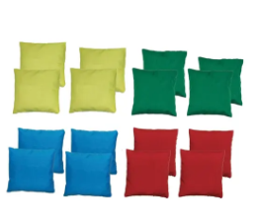
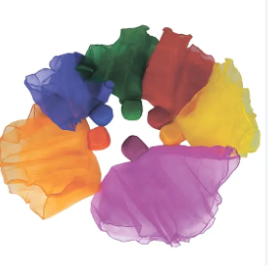
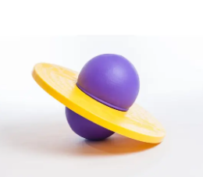
What will be new to play with this week:
Inform

Slide 4
What rules will we need for the crates, tarpaulin and pipes?
Negotiate
Bean bags
space hopper
scarves
moon hopper

Slide 5

The Golden Brush Award

Slide 6

The Golden Welly Award

Slide 7
Reminder about the field
* No field until after half term holiday.
* You must bring in wellies if you want to go on the field.
* You must have a coat.

