Slide 1


Slide 2
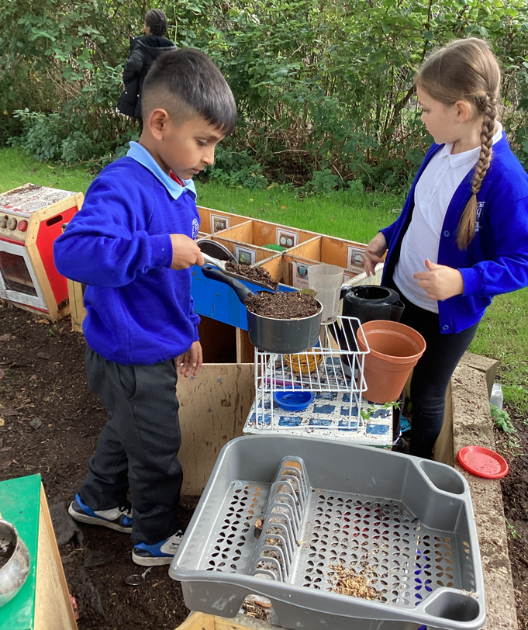
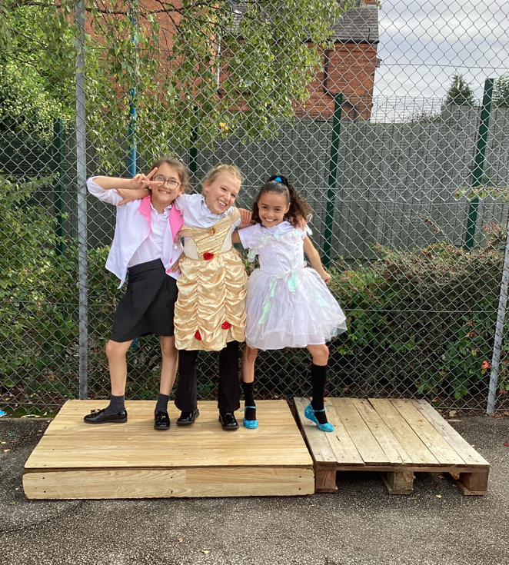
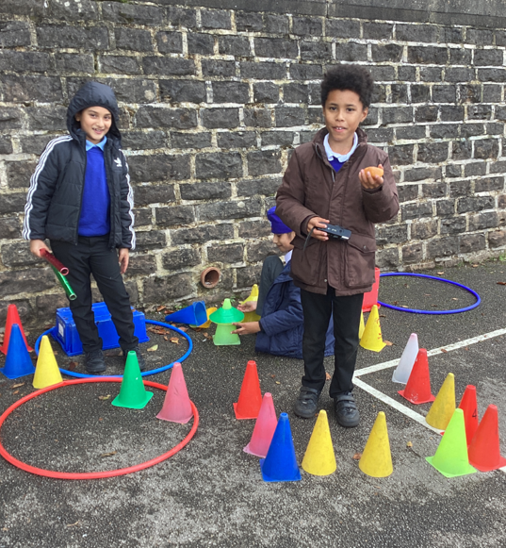
Examples of AMAZING play!
Celebrate

Slide 3
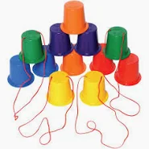
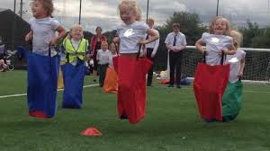

What will be new to play with this week:
A NEW AREA!- Circus skills
Inform
sacks
stilts
ribbon wands

Slide 4
What rules will we need for the ribbon wands, stilts and sacks?
Negotiate
STILTS
Don't tie the ropes.
Don't throw them.
Don't use them in the mud kitchen.
SACKS
Don't put them over your head.
Don't push someone in the sack.
Only 1 person in the sack.
RIBBON WANDS
Don't put the tape on your mouth.
Don't put the ribbon around your neck.
Don't tie the ribbon on anyone

Slide 5

The Golden Brush Award
Charlie in Y2!

Slide 6

The Golden Welly Award
Jake in Y2!

