Slide 1


Slide 2
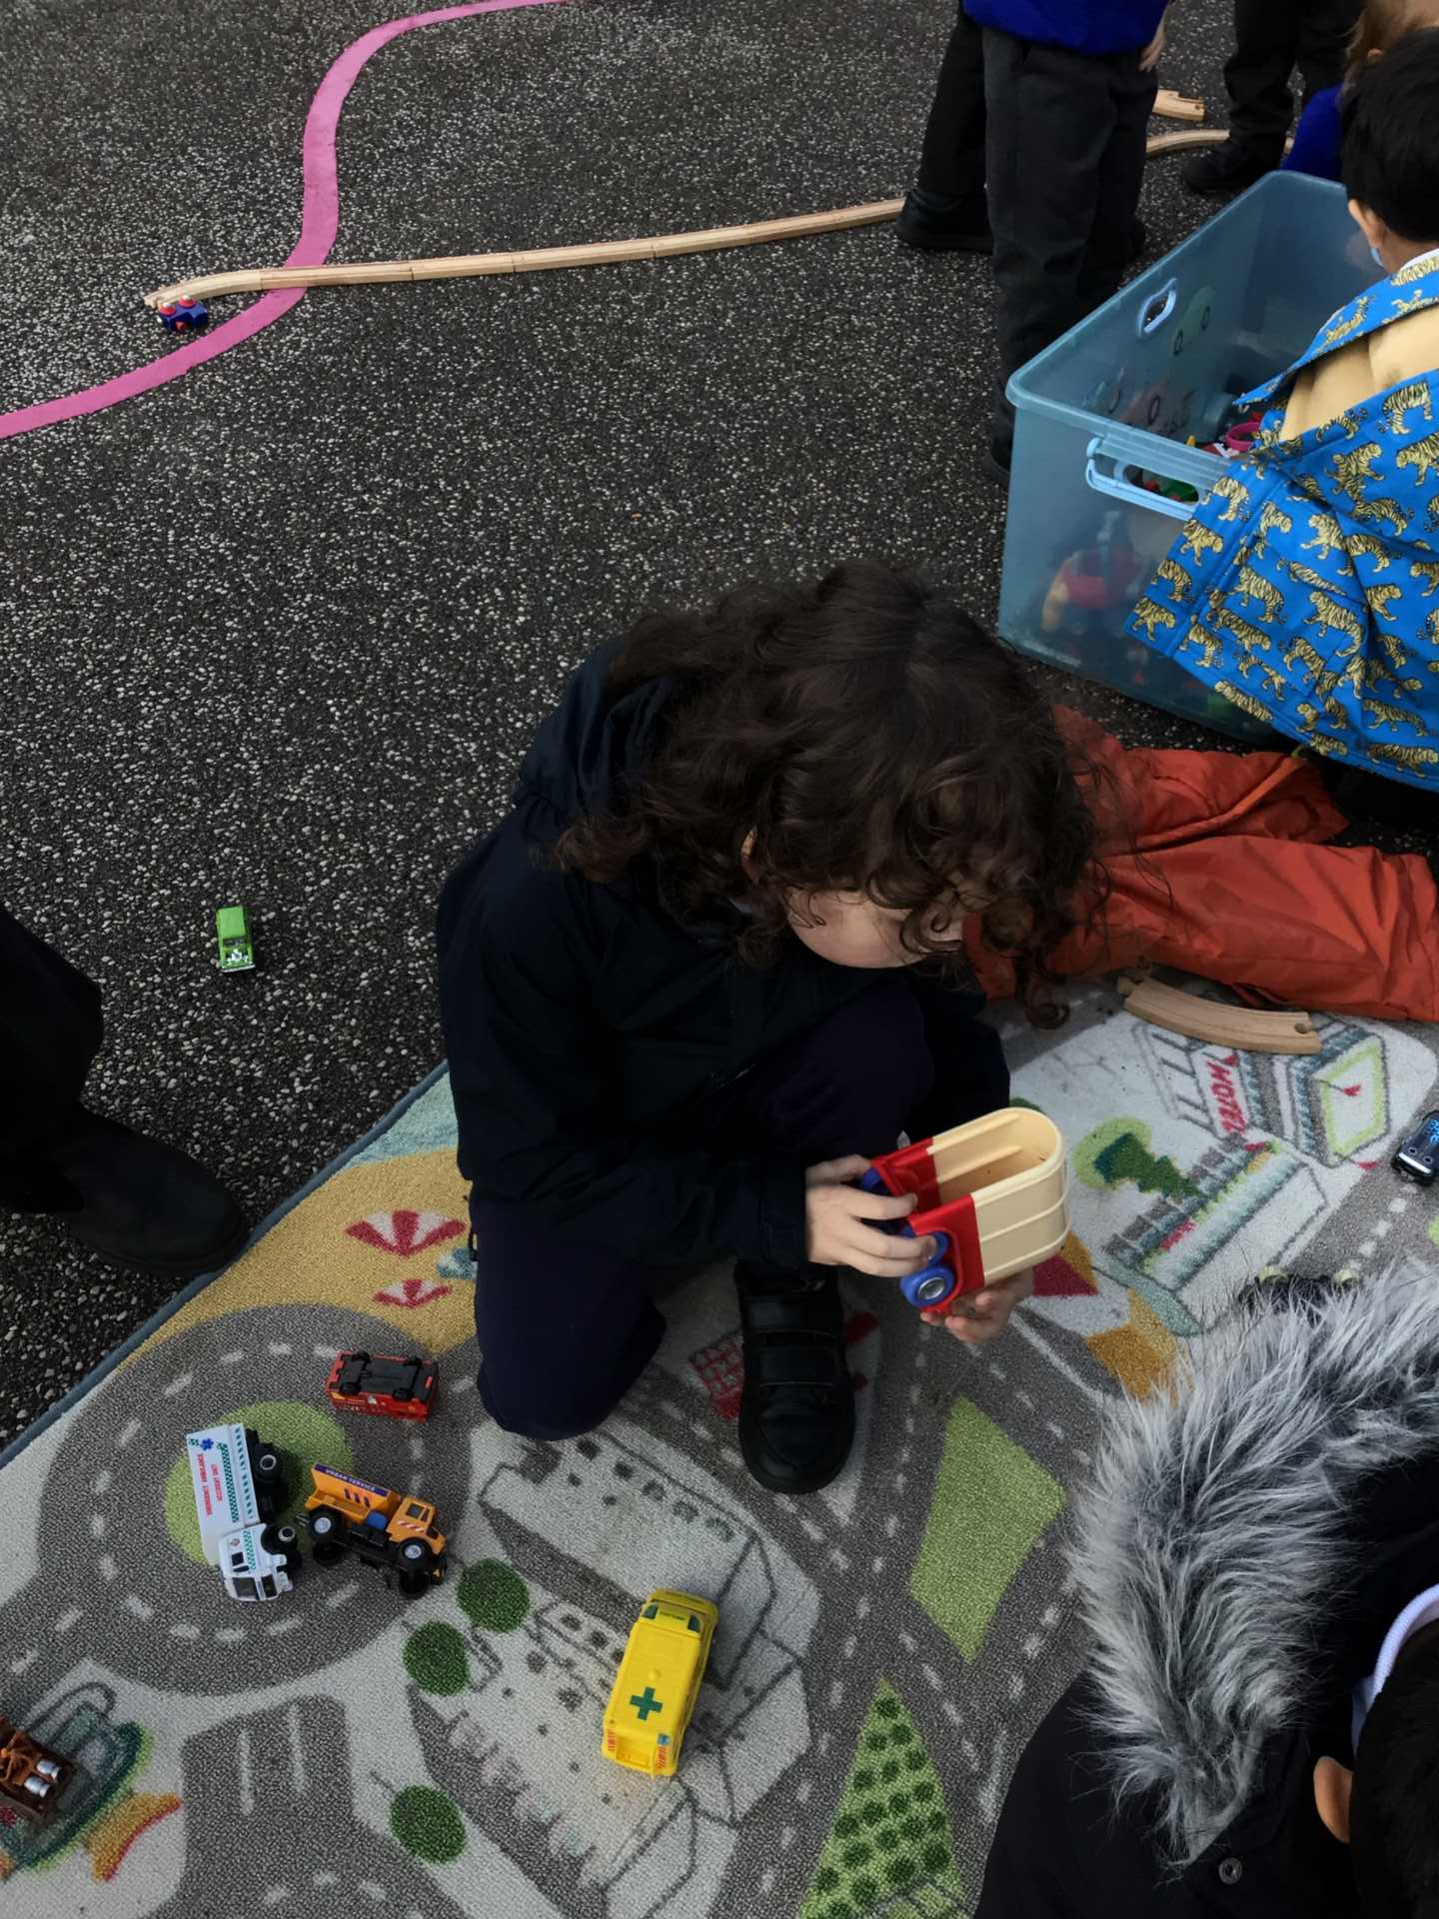
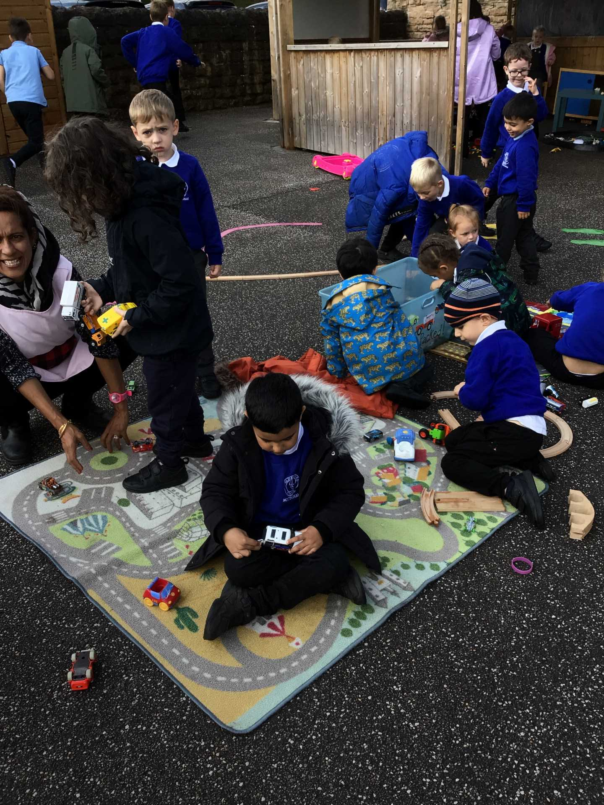
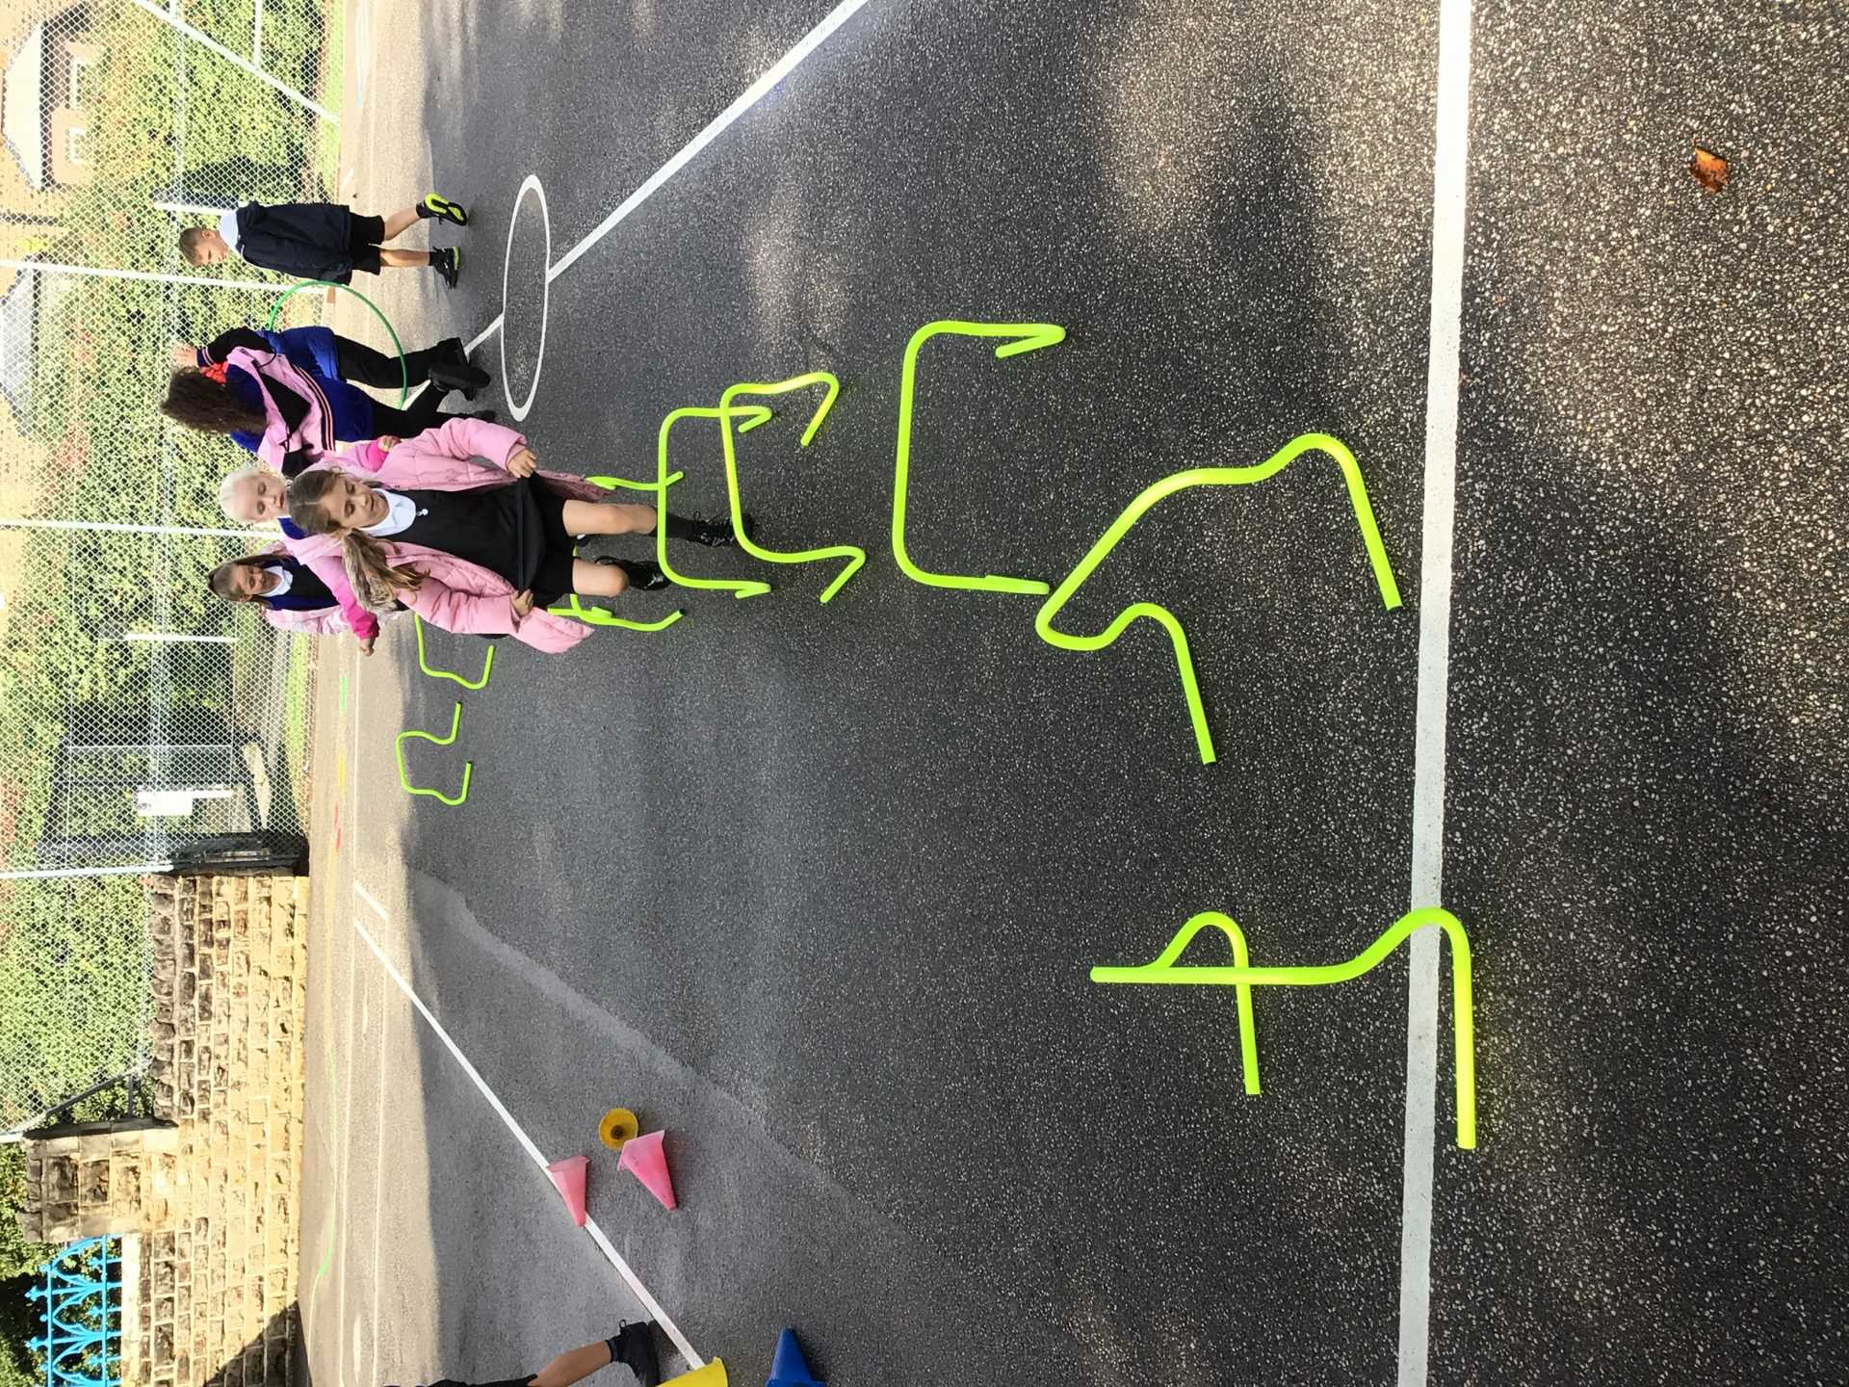
Examples of AMAZING play!
Celebrate

Slide 3
What will be new to play with this week?
Nothing new this week , because we have noticed that we are still not getting tidy up time right .
Worst areas, where we need more help:
Calm Area - felt tips thrown everywhere without lids on.
ONLY PLAY WITH WHAT HAS BEEN LEFT OUT !
Role Play - costumes not put away in boxes and left out to get wet.
Inform

Slide 4
Innovate
We want to praise those children who are really helping with Opal Play, so we have made some awards.

Slide 5

The Golden Brush Award

Slide 6

The Golden Welly Award

