Slide 1


Slide 2
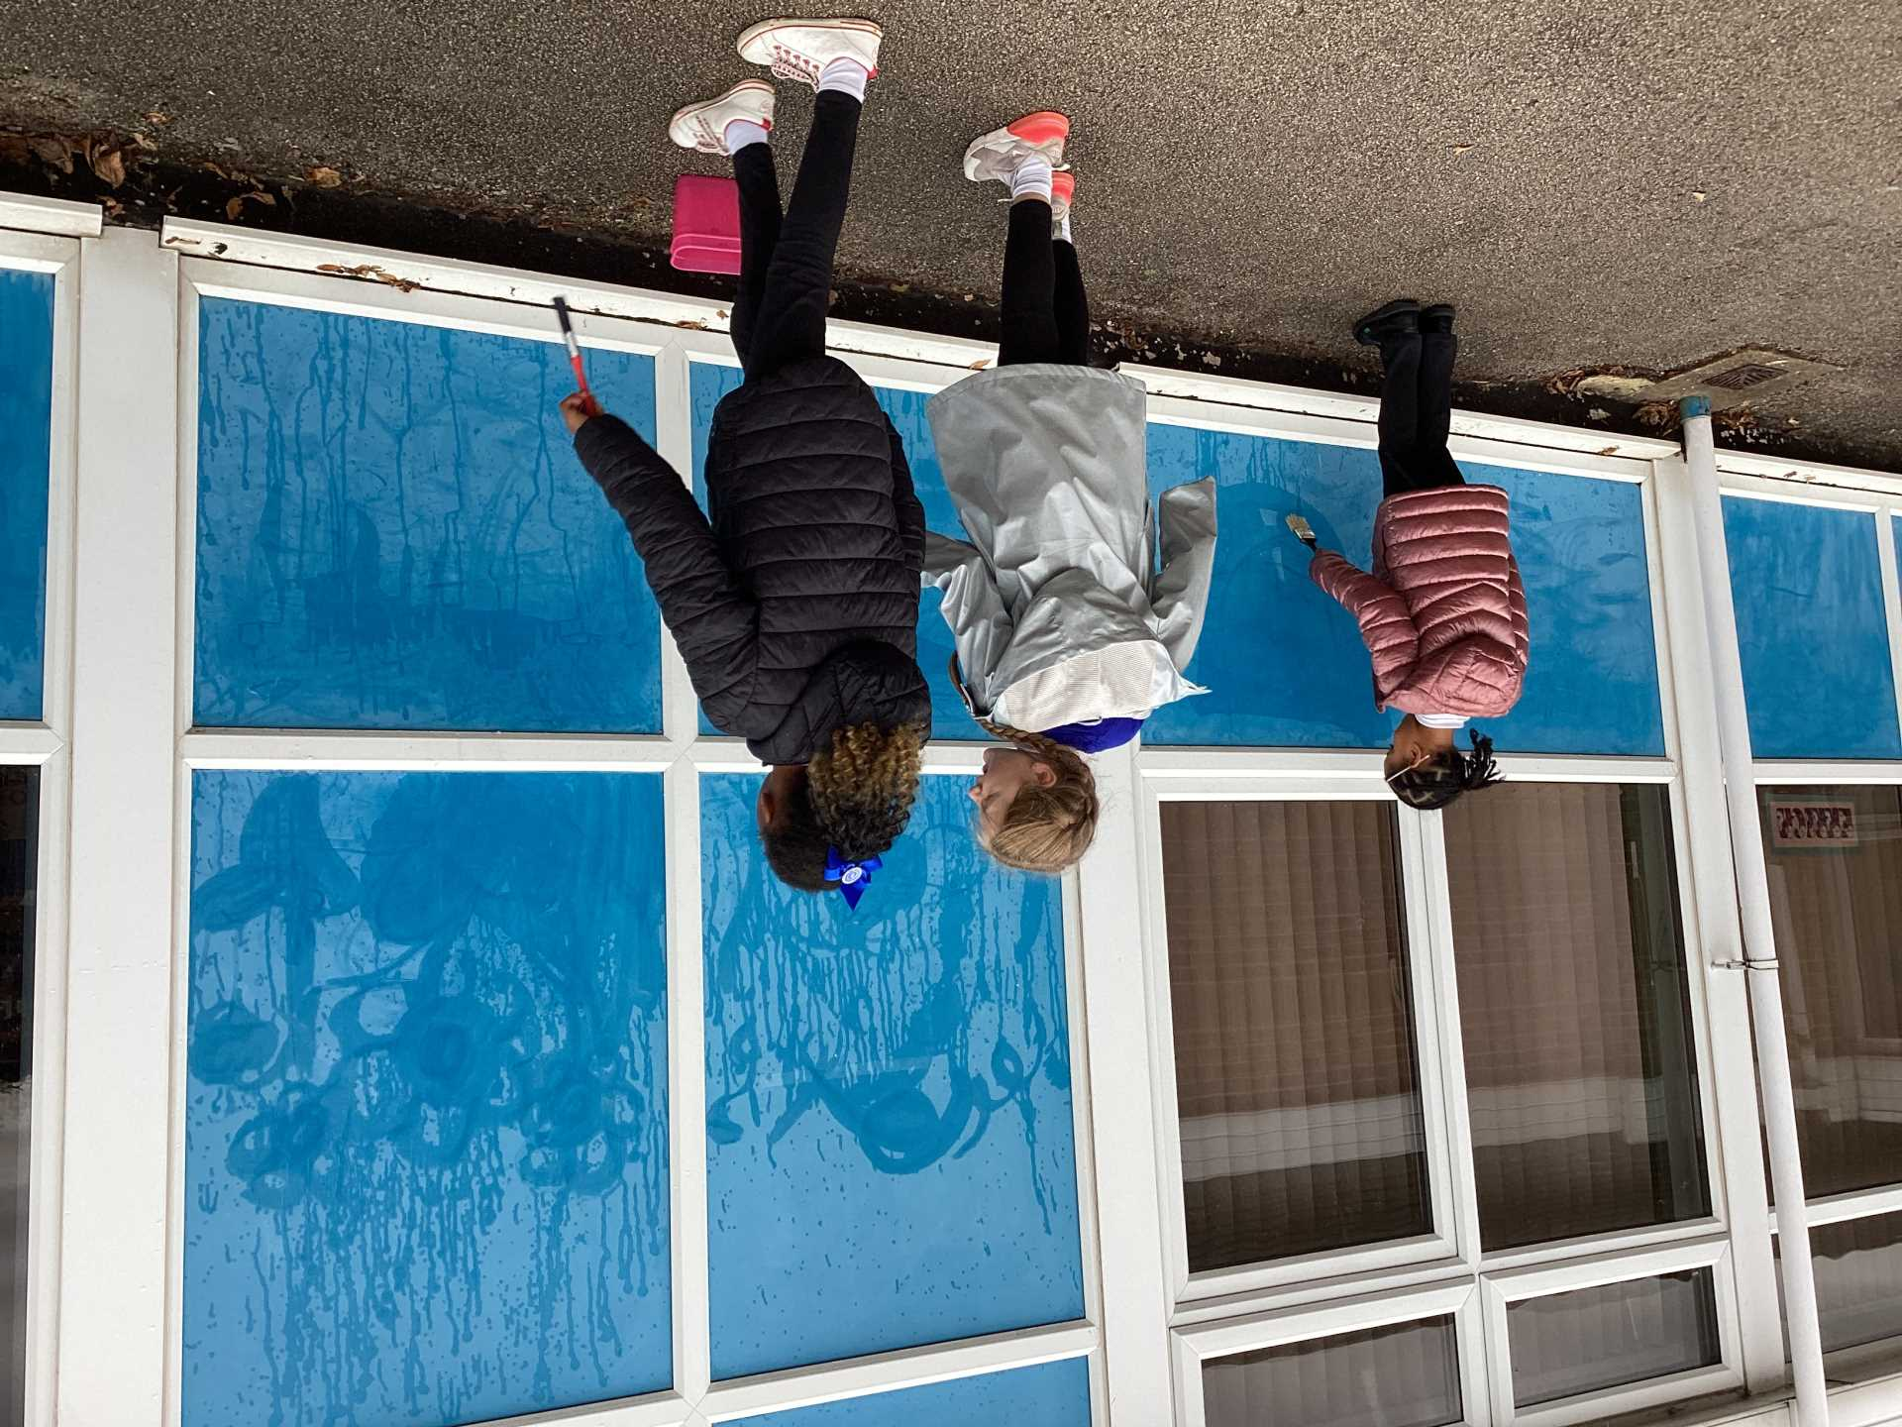
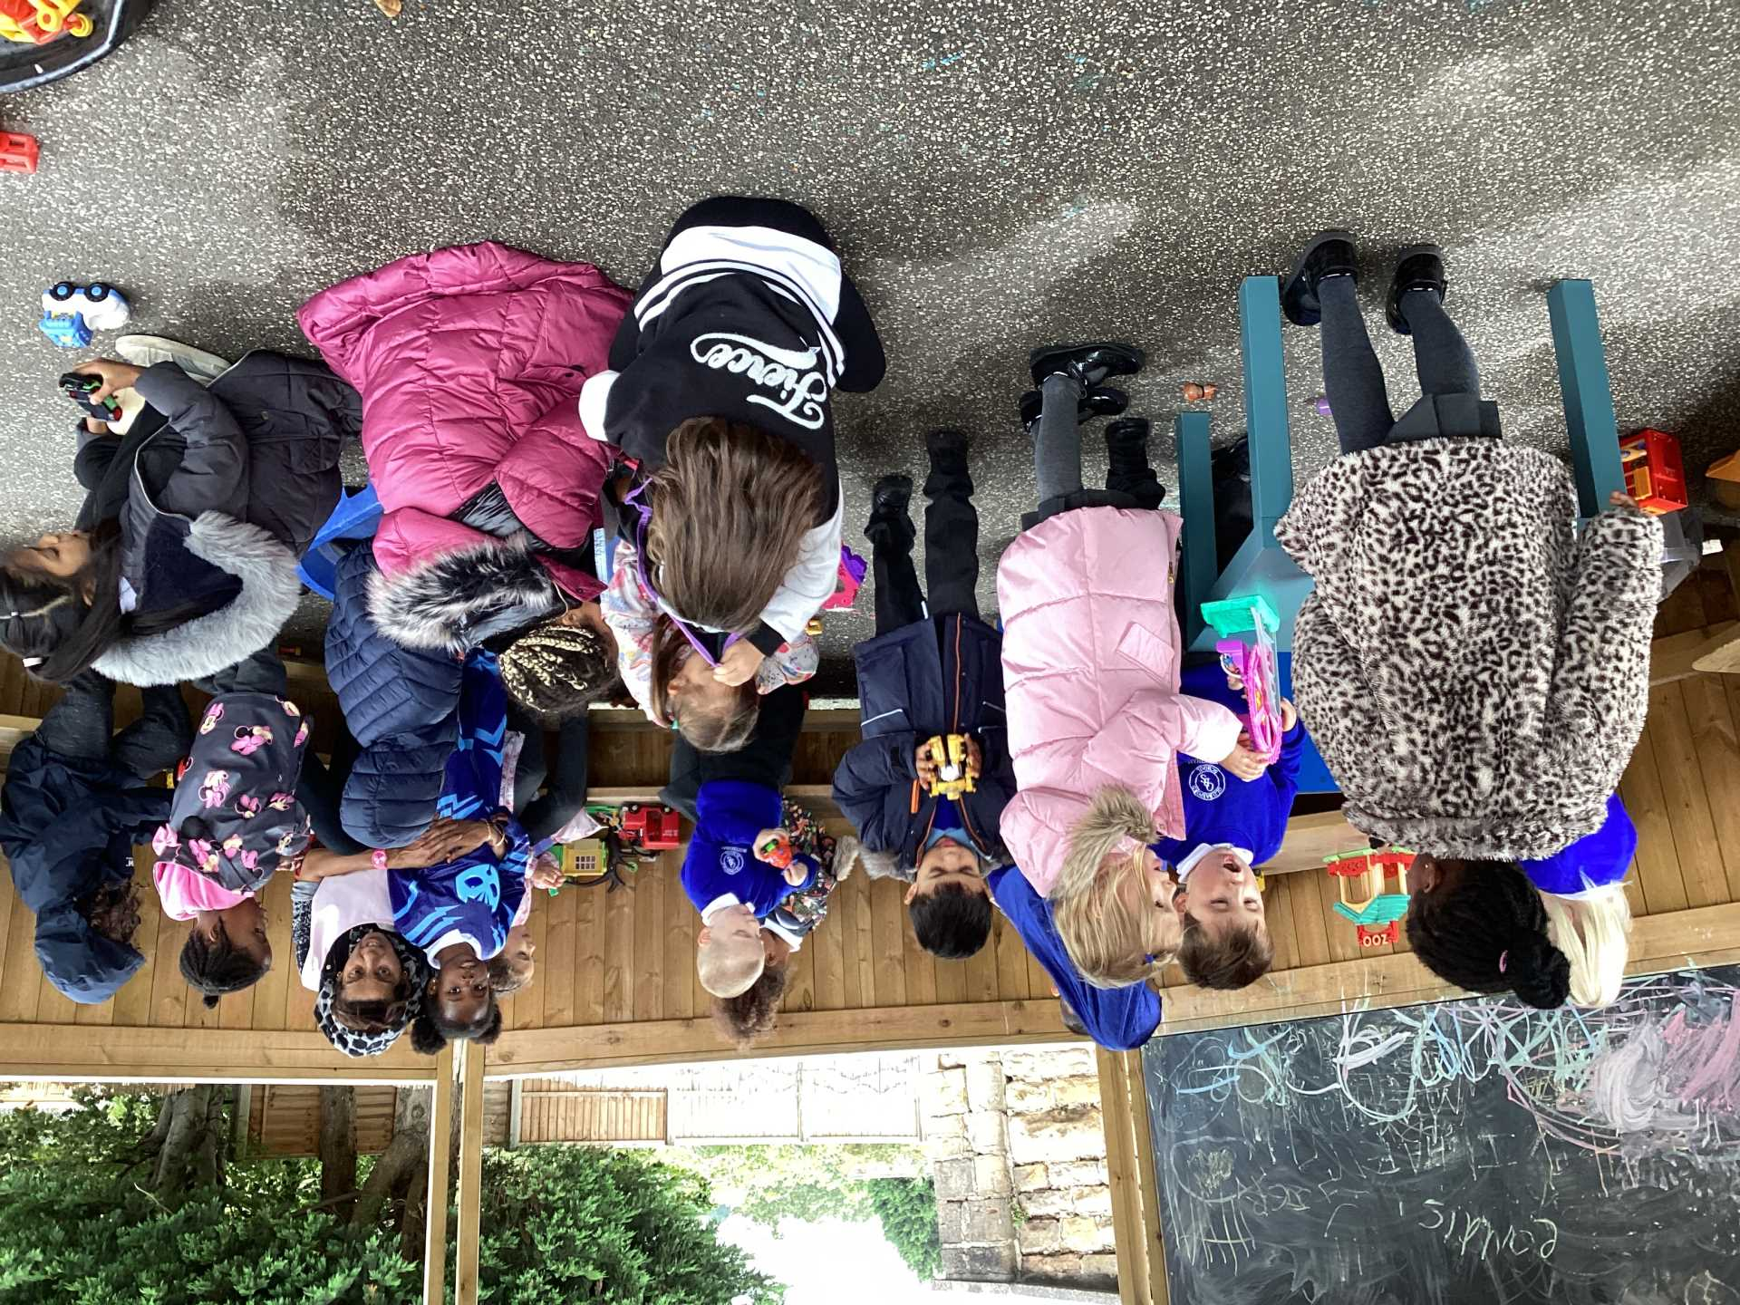
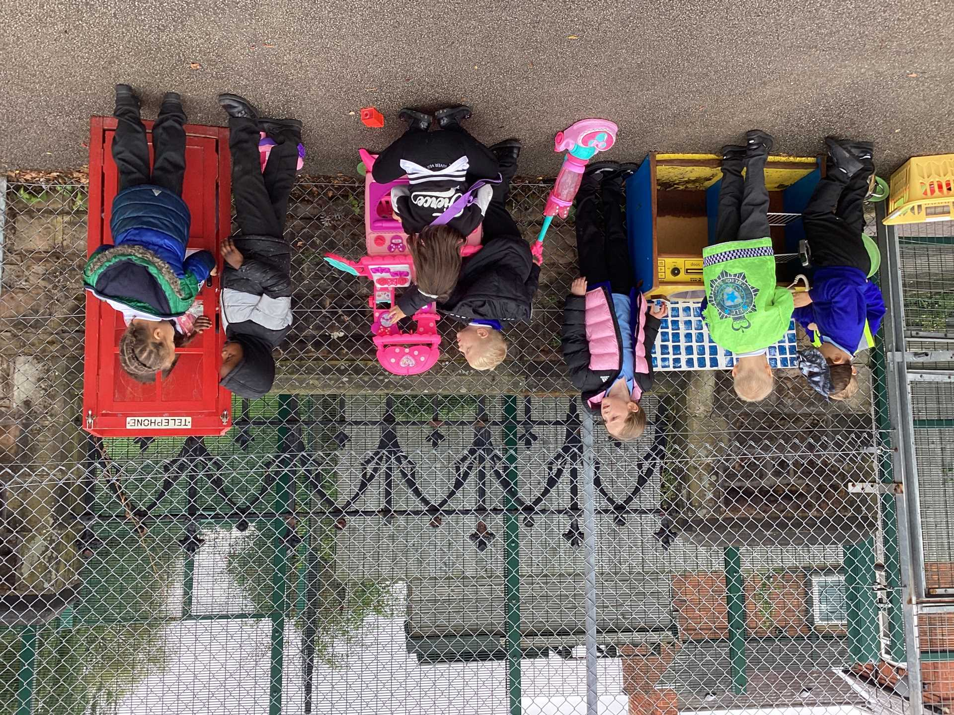
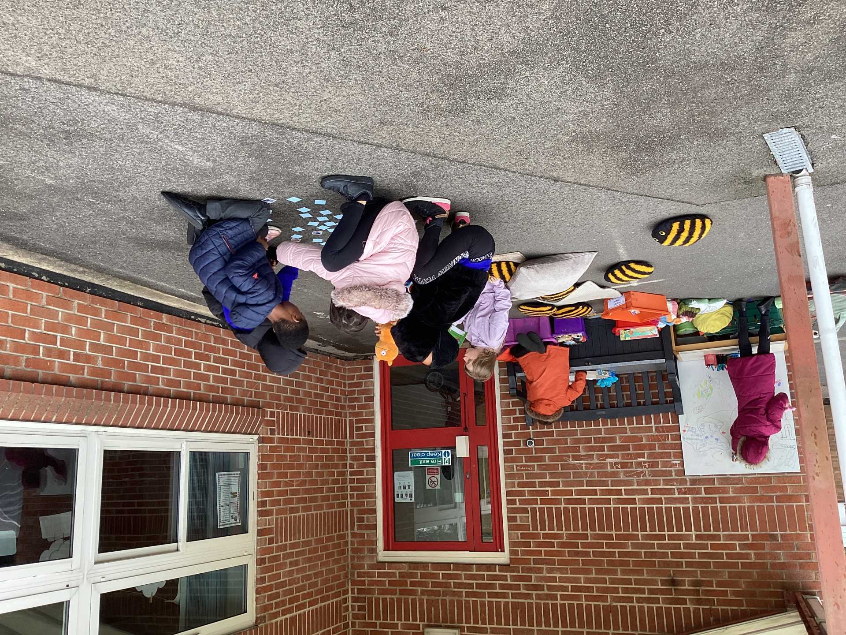
Examples of AMAZING play!
Celebrate

Slide 3
What do we already have out on the playgrounds and field?
* kitchen
* small construction
* small world
* role play
* active zone
* creative area
* calm corner
* water play

Slide 4
What will be new to play with this week?
Nothing new this week , because we want to get it right with the activities that are out already.
* Creative area - Closed at playtime
* Active Zone - batons, bibs cones etc to make your own races.
* Water play - brushes and rollers and buckets of water to 'paint' the walls, floor etc
Inform

Slide 5
Creative Play
This area will be closed at playtime.
Only white board pens should be used on white board.
Lids on pens.
If you create something you can take it home, if not put it in the bin.

Slide 6
Calm Zone
Only play with what has been put out.
Enjoy being calm.

Slide 7
Innovate
Active Zone
What have you been playing with already?
What else could you play?
What extra equipment could we get?

Slide 8
Negotiate
What new rules do we need for our activities this week?
Water play -
Active zone-
Creative area-

Slide 10
Inform
Wellies
Look out for the welly sign. If the sign is on the field , you MUST have wellies on to go on the field.
Both wellies must have your name on them and be in a bag.

Slide 12


