Slide 1


Slide 2
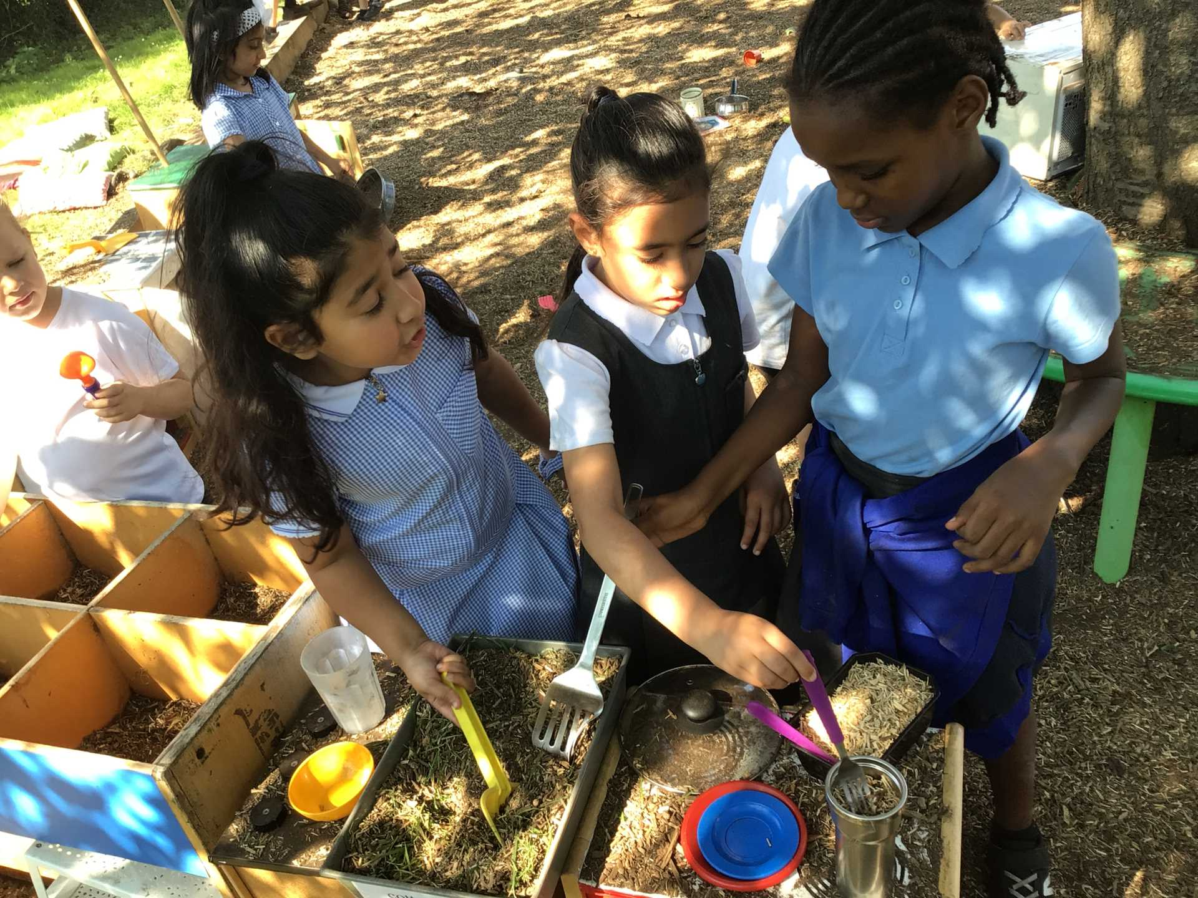
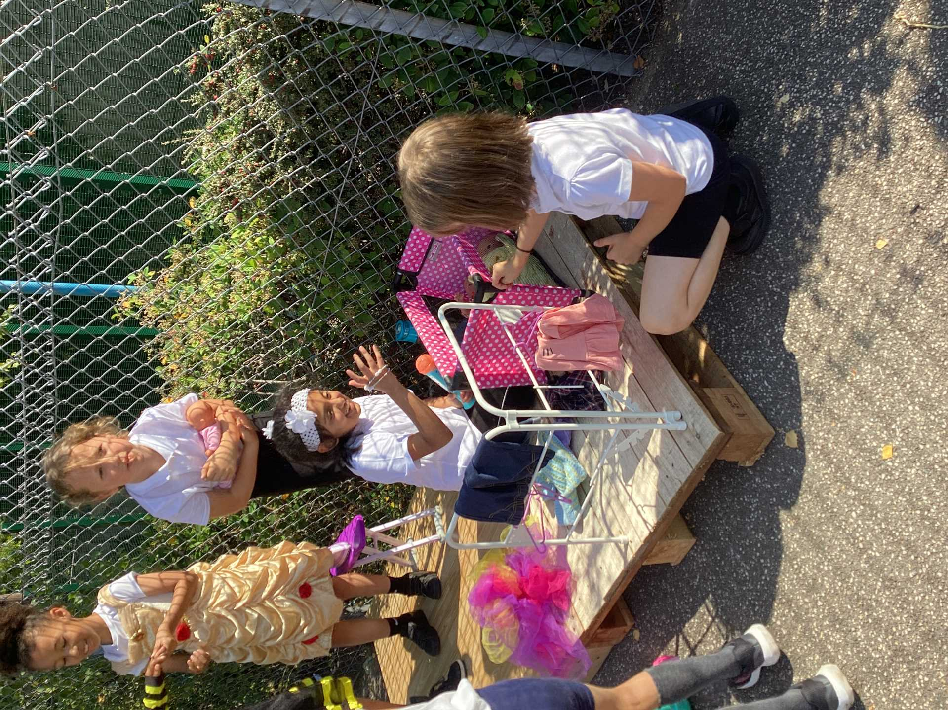
Celebrate
Examples of AMAZING play!

Slide 3
What do we already have out on the playgrounds and field?
* kitchen
*small construction
* small world
* role play

Slide 4
Inform
What will be new to play with this week?
What do we have to do to make sure that everyone enjoys their play?
* Creative area - chalks, felt tips , rolls of paper and cardboard
* Active Zone - batons, bibs cones etc to make your own races.
* Water play - brushes and rollers and buckets of water to 'paint' the walls, floor etc

Slide 5

Inform
Infinity Club
Children who are members of Infinity Club at lunchtime will get to play with the new equipment and test it out for the Play Team.
Only Infinity Club will get to do this . Look out for the sign that says...

Slide 6
Negotiate
What new rules do we need for our new activities this week?
Water play -
Active zone-
Creative area-

Slide 7

Innovate
Walking in after tidy up time
Key Stage 1 - once tidy , walk to playground
Key Stage 2
To give you a longer time to play, we are going to test not lining up at the end of lunch time . Instead, once you have tidied up you will be able to sensibly walk back to your classroom.

Slide 8
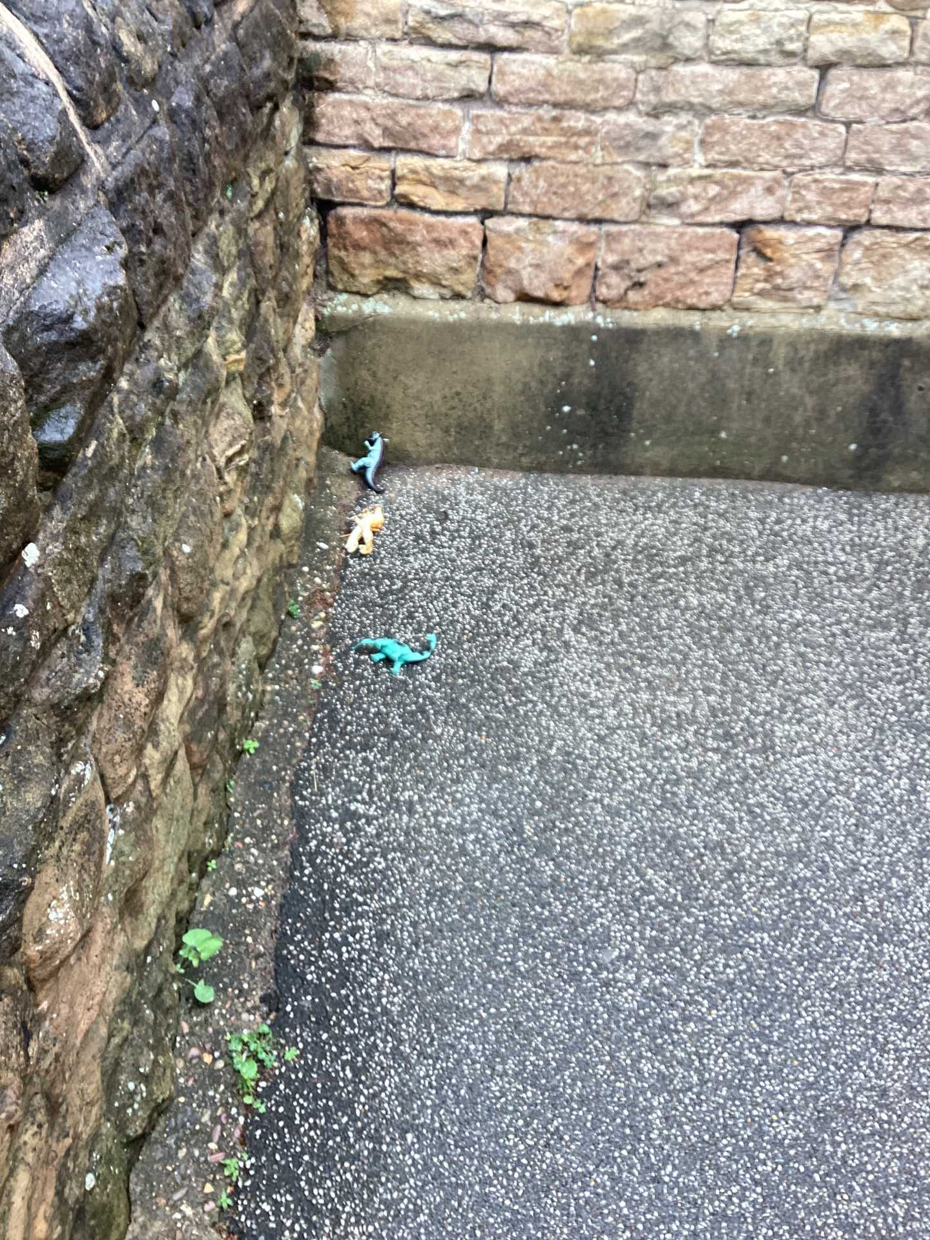
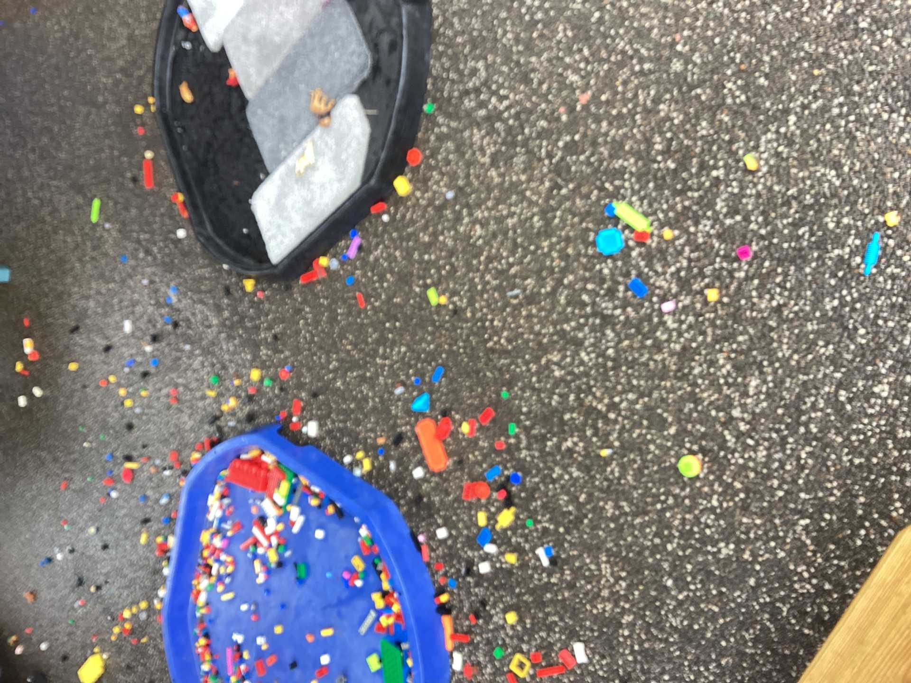
Tidy up after playtime

Slide 9


