Slide 1


Slide 2
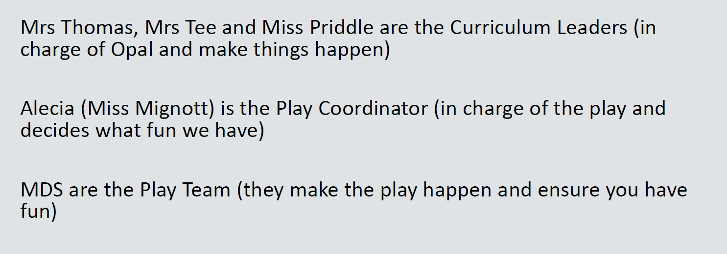
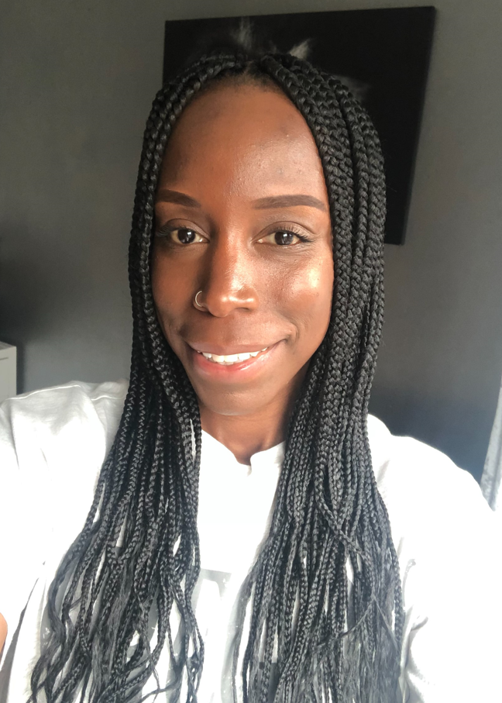

The Opal Play Team

Slide 3

What does Opal Play look like?
https://www.youtube.com/watch?v=cm7IfAEsjqI

Slide 4
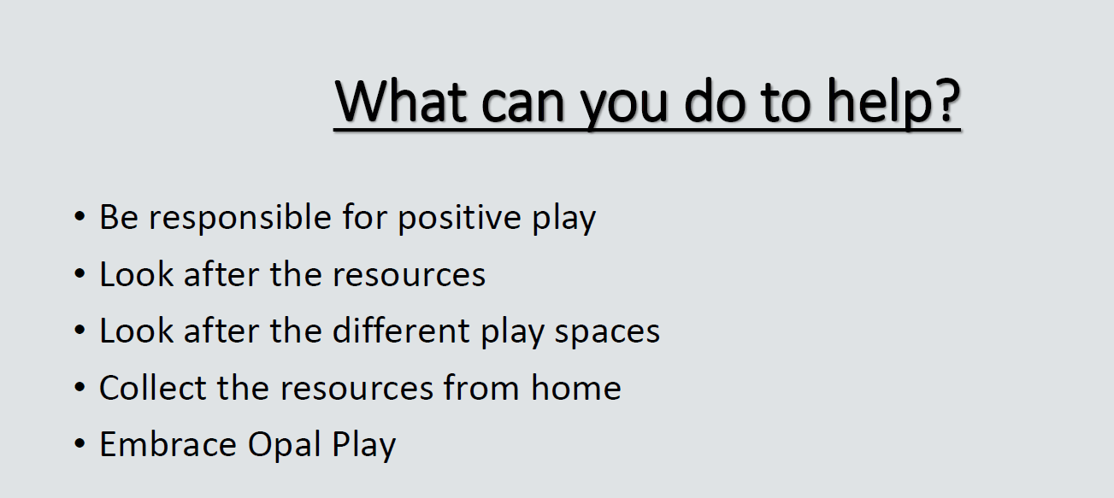

Slide 5
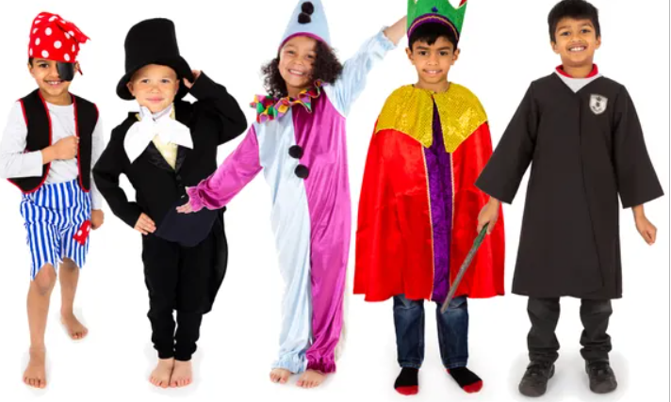
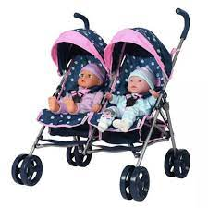
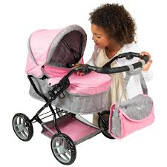
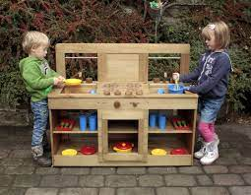
What will be new to play with this week?
What do we have to do to make sure that everyone enjoys their play?
* Dressing up and stage
* Role play
* Babies and prams
* Kitchen

Slide 6
Tidy up time!
Help us make our rules for keeping Opal Play tidy.
What should our rules be?

Slide 7
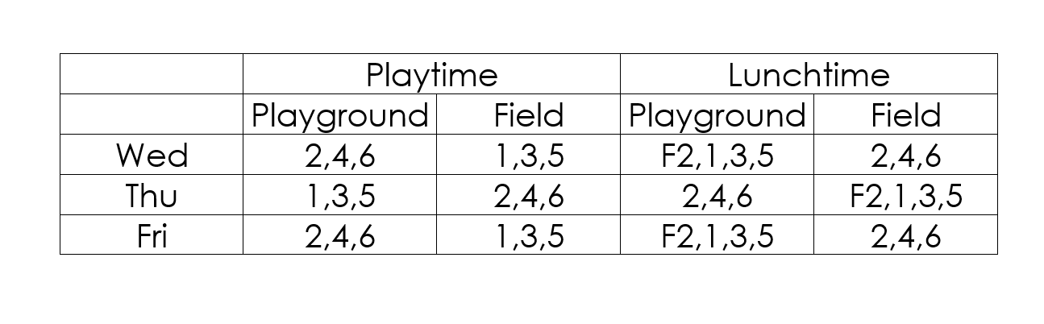

Slide 8


