Slide 1

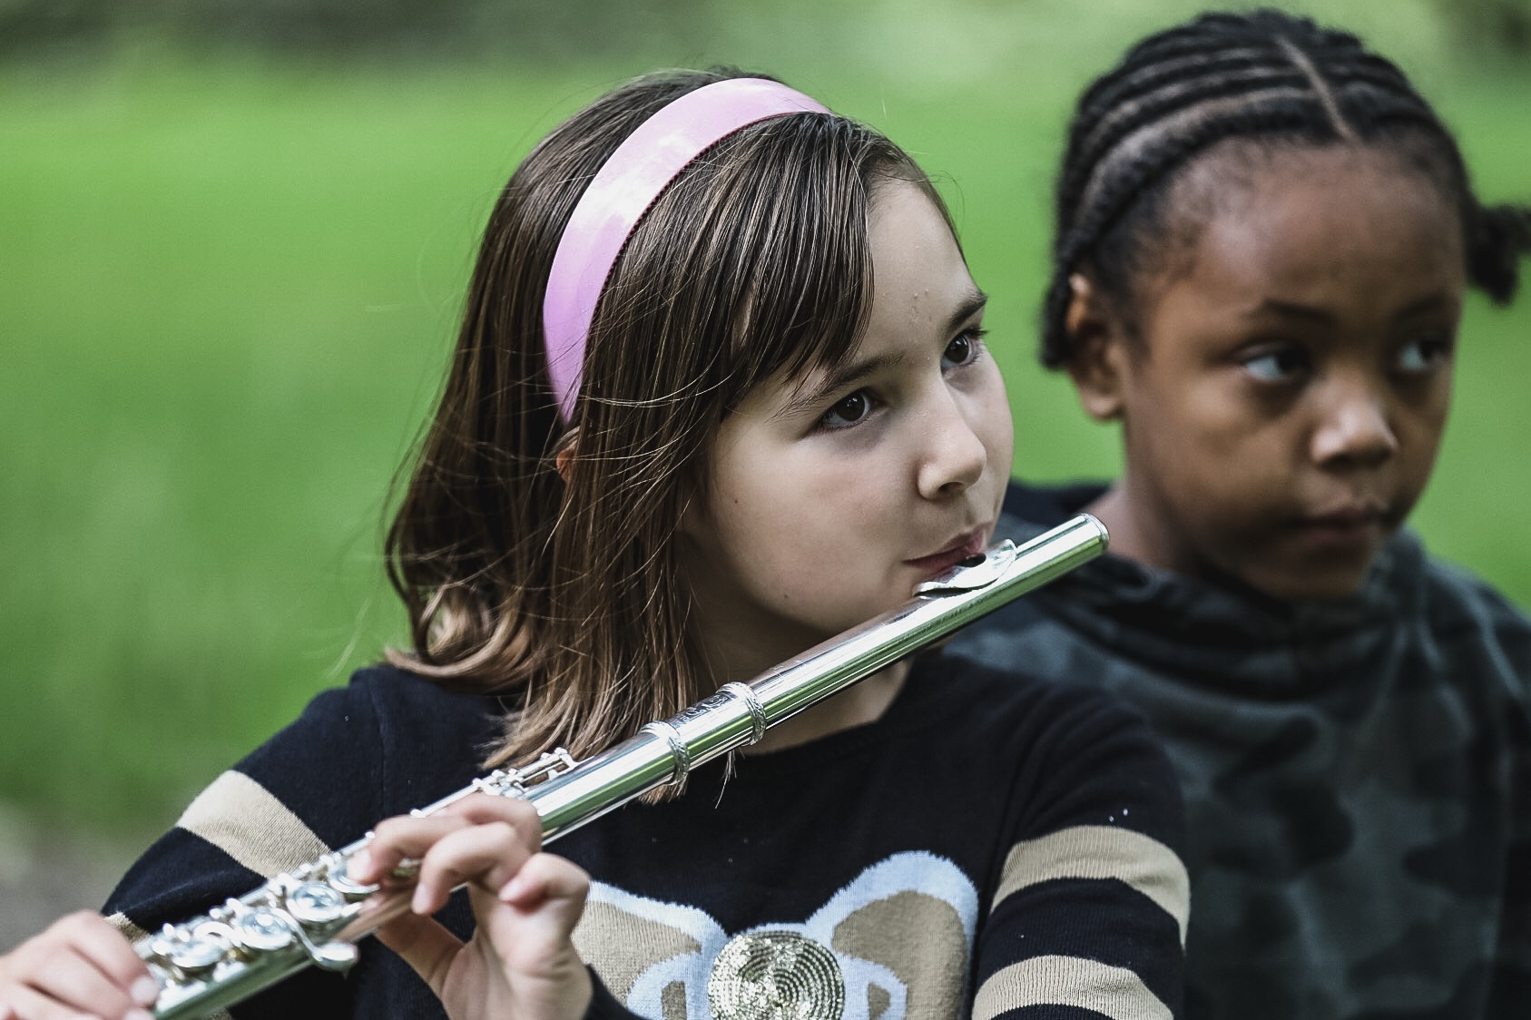
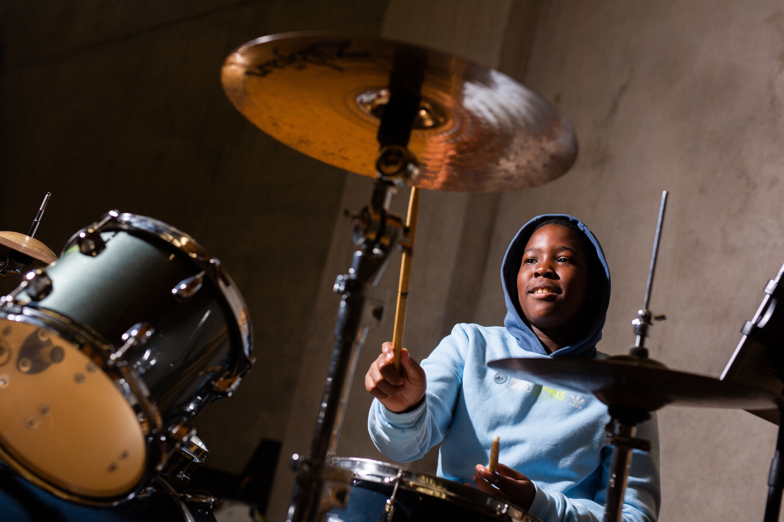
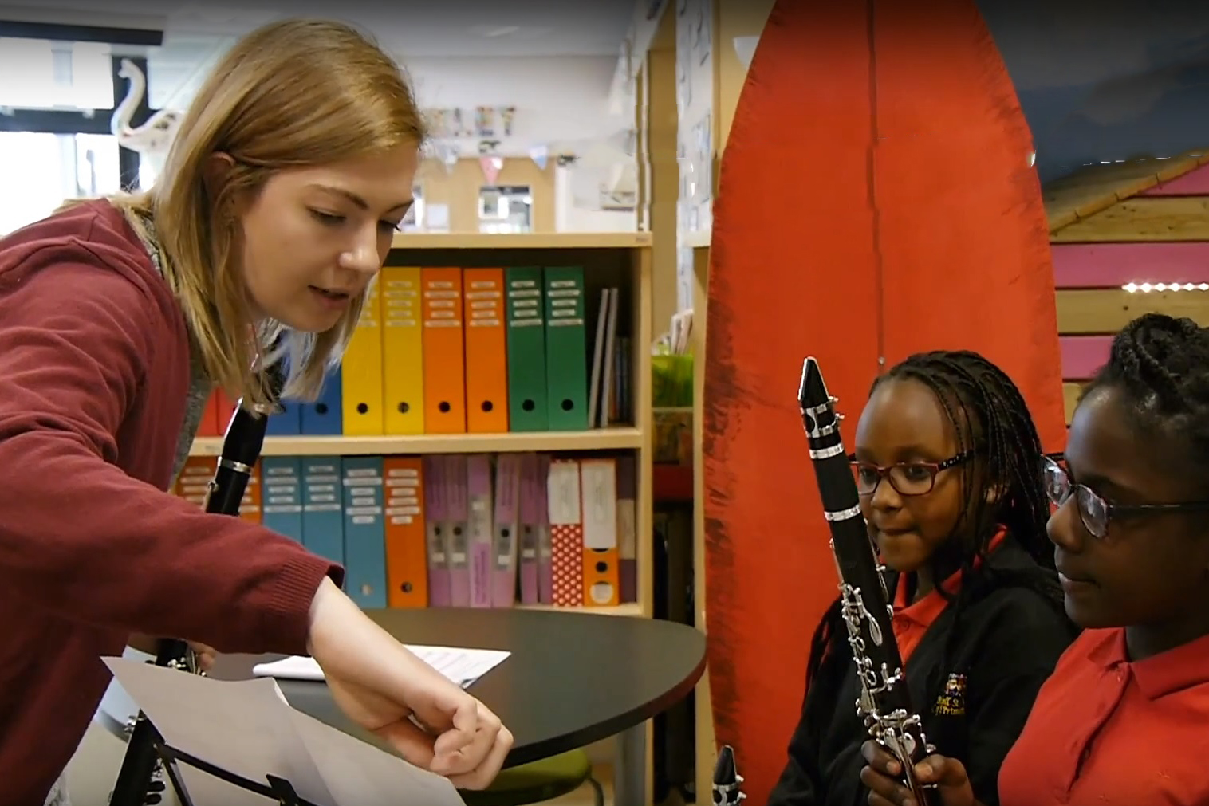
We have music groups for everyone.
You can learn a new instrument and some of our
groups are open to beginners!

Slide 2
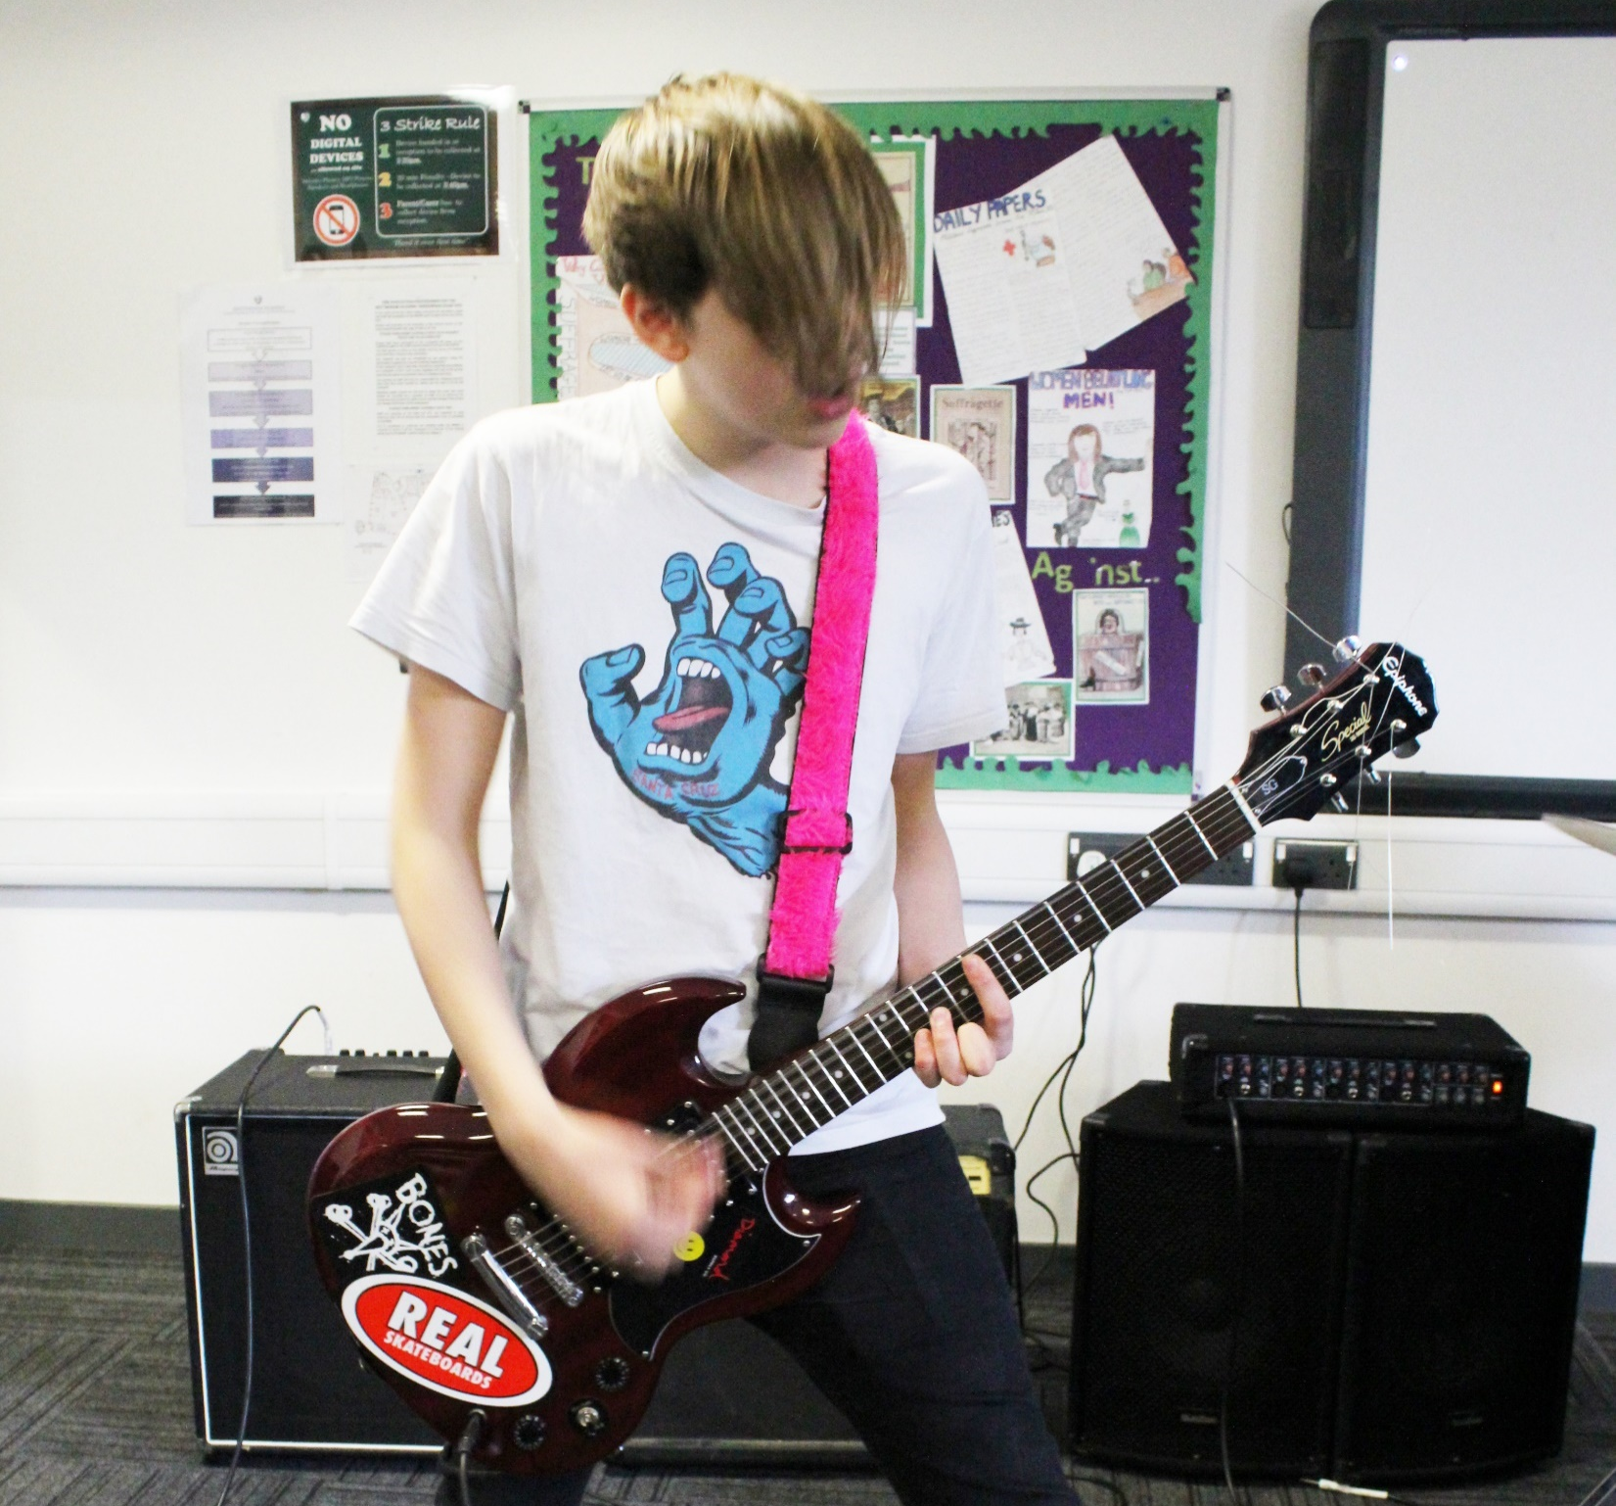
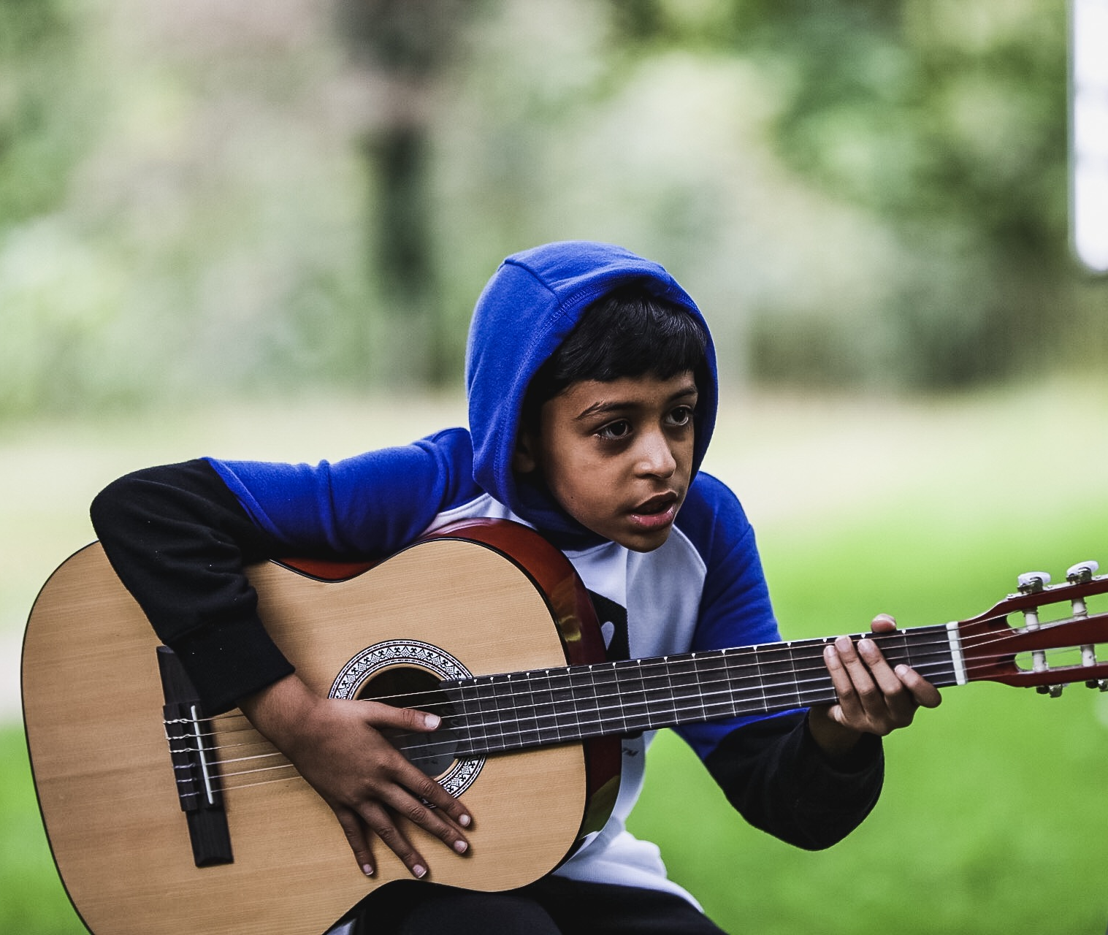

8
We’ve got different groups.
Including
Band Connect
Guitar Connect
Robin Hood Young Voices
All groups take place in Nottingham city centre & rehearse after school during the week from 4pm.
If you're interested in any of them, ask your teachers for more information.

Slide 3
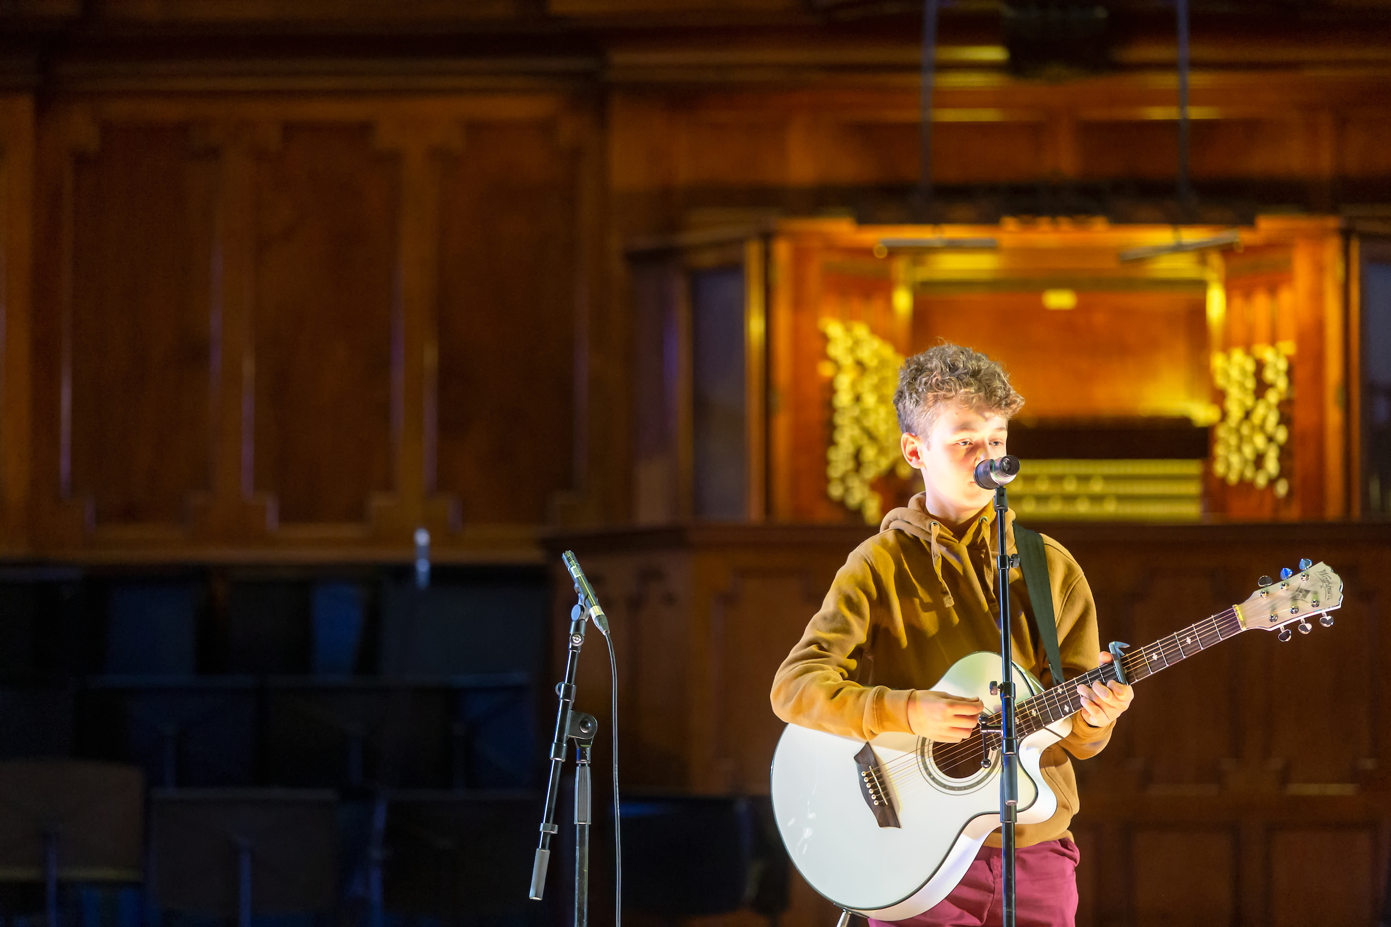
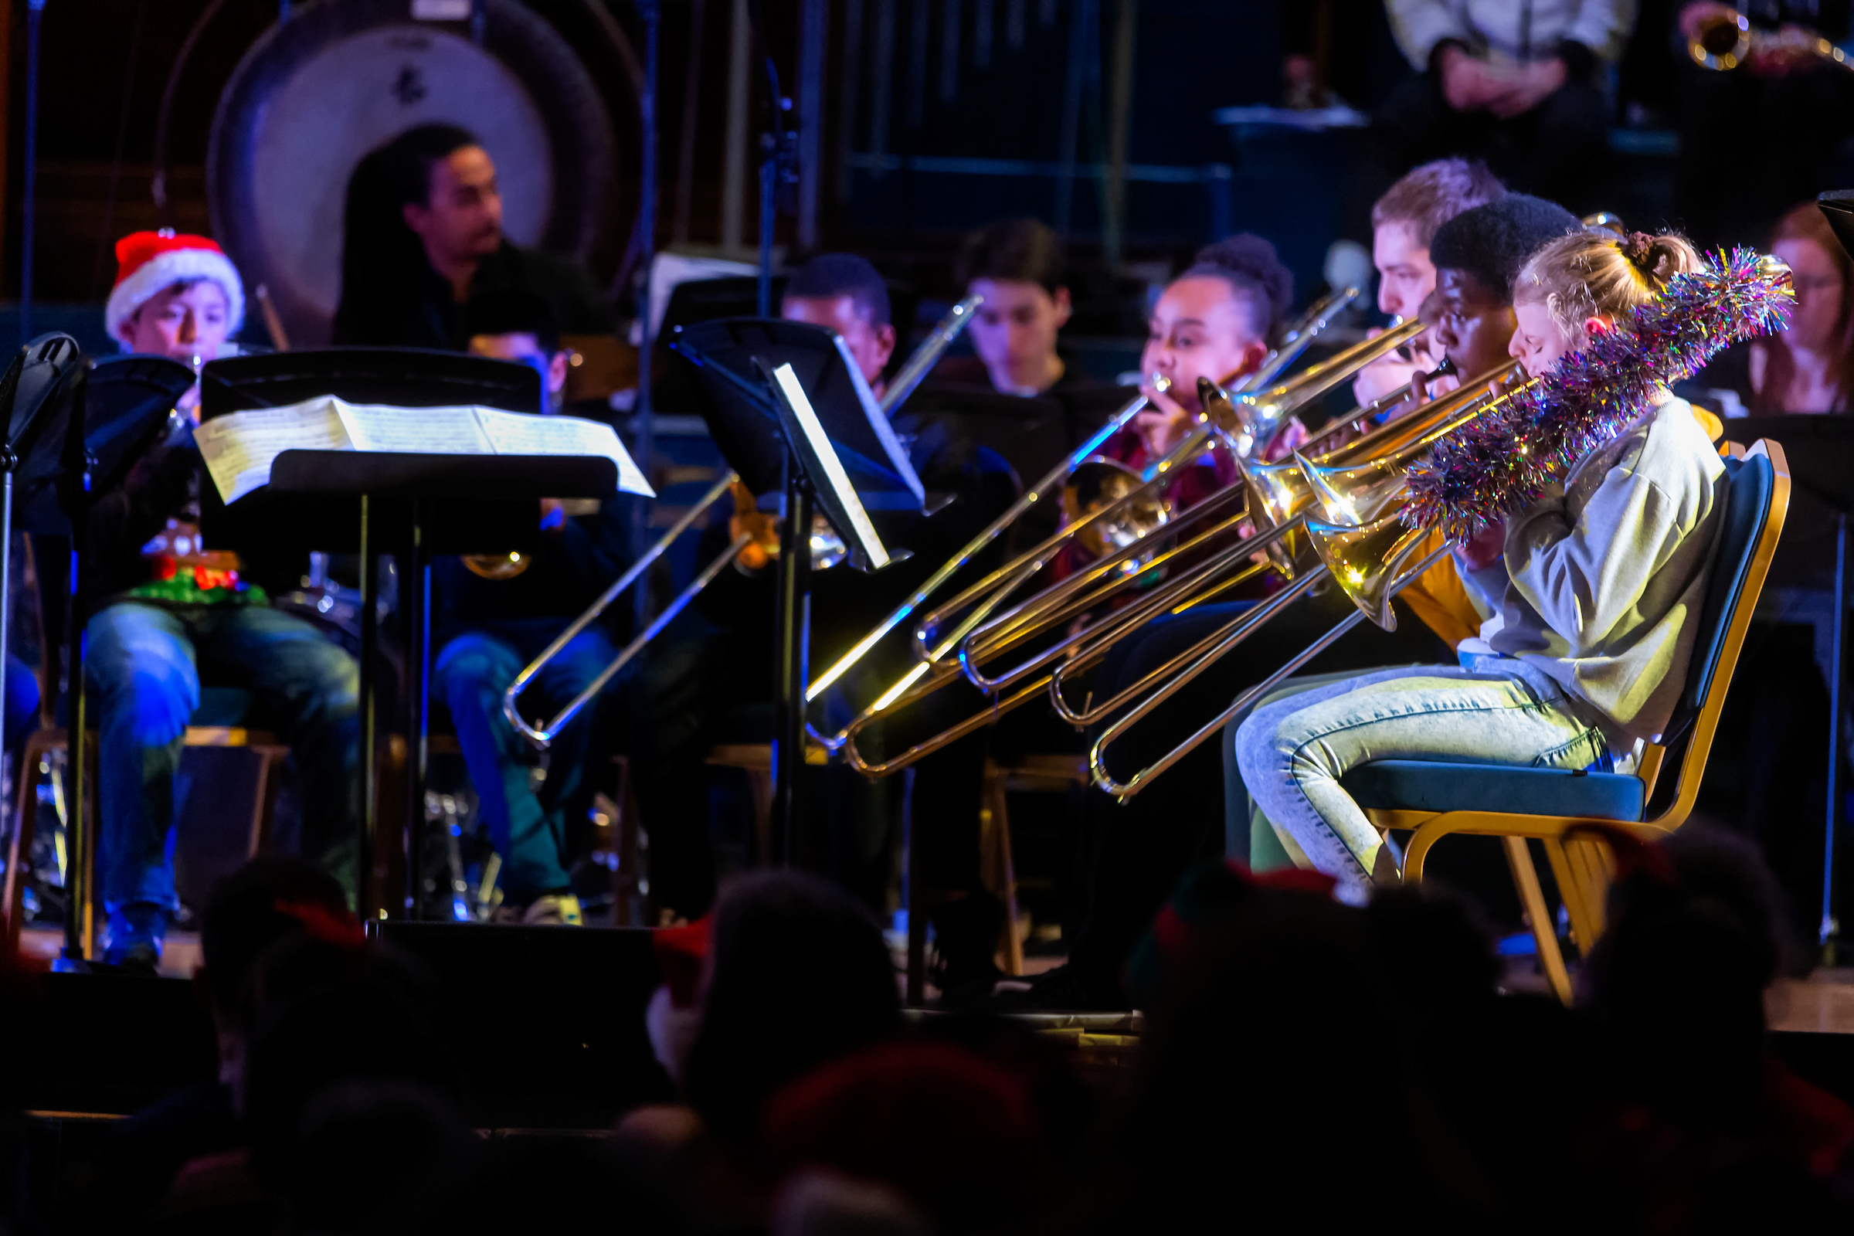
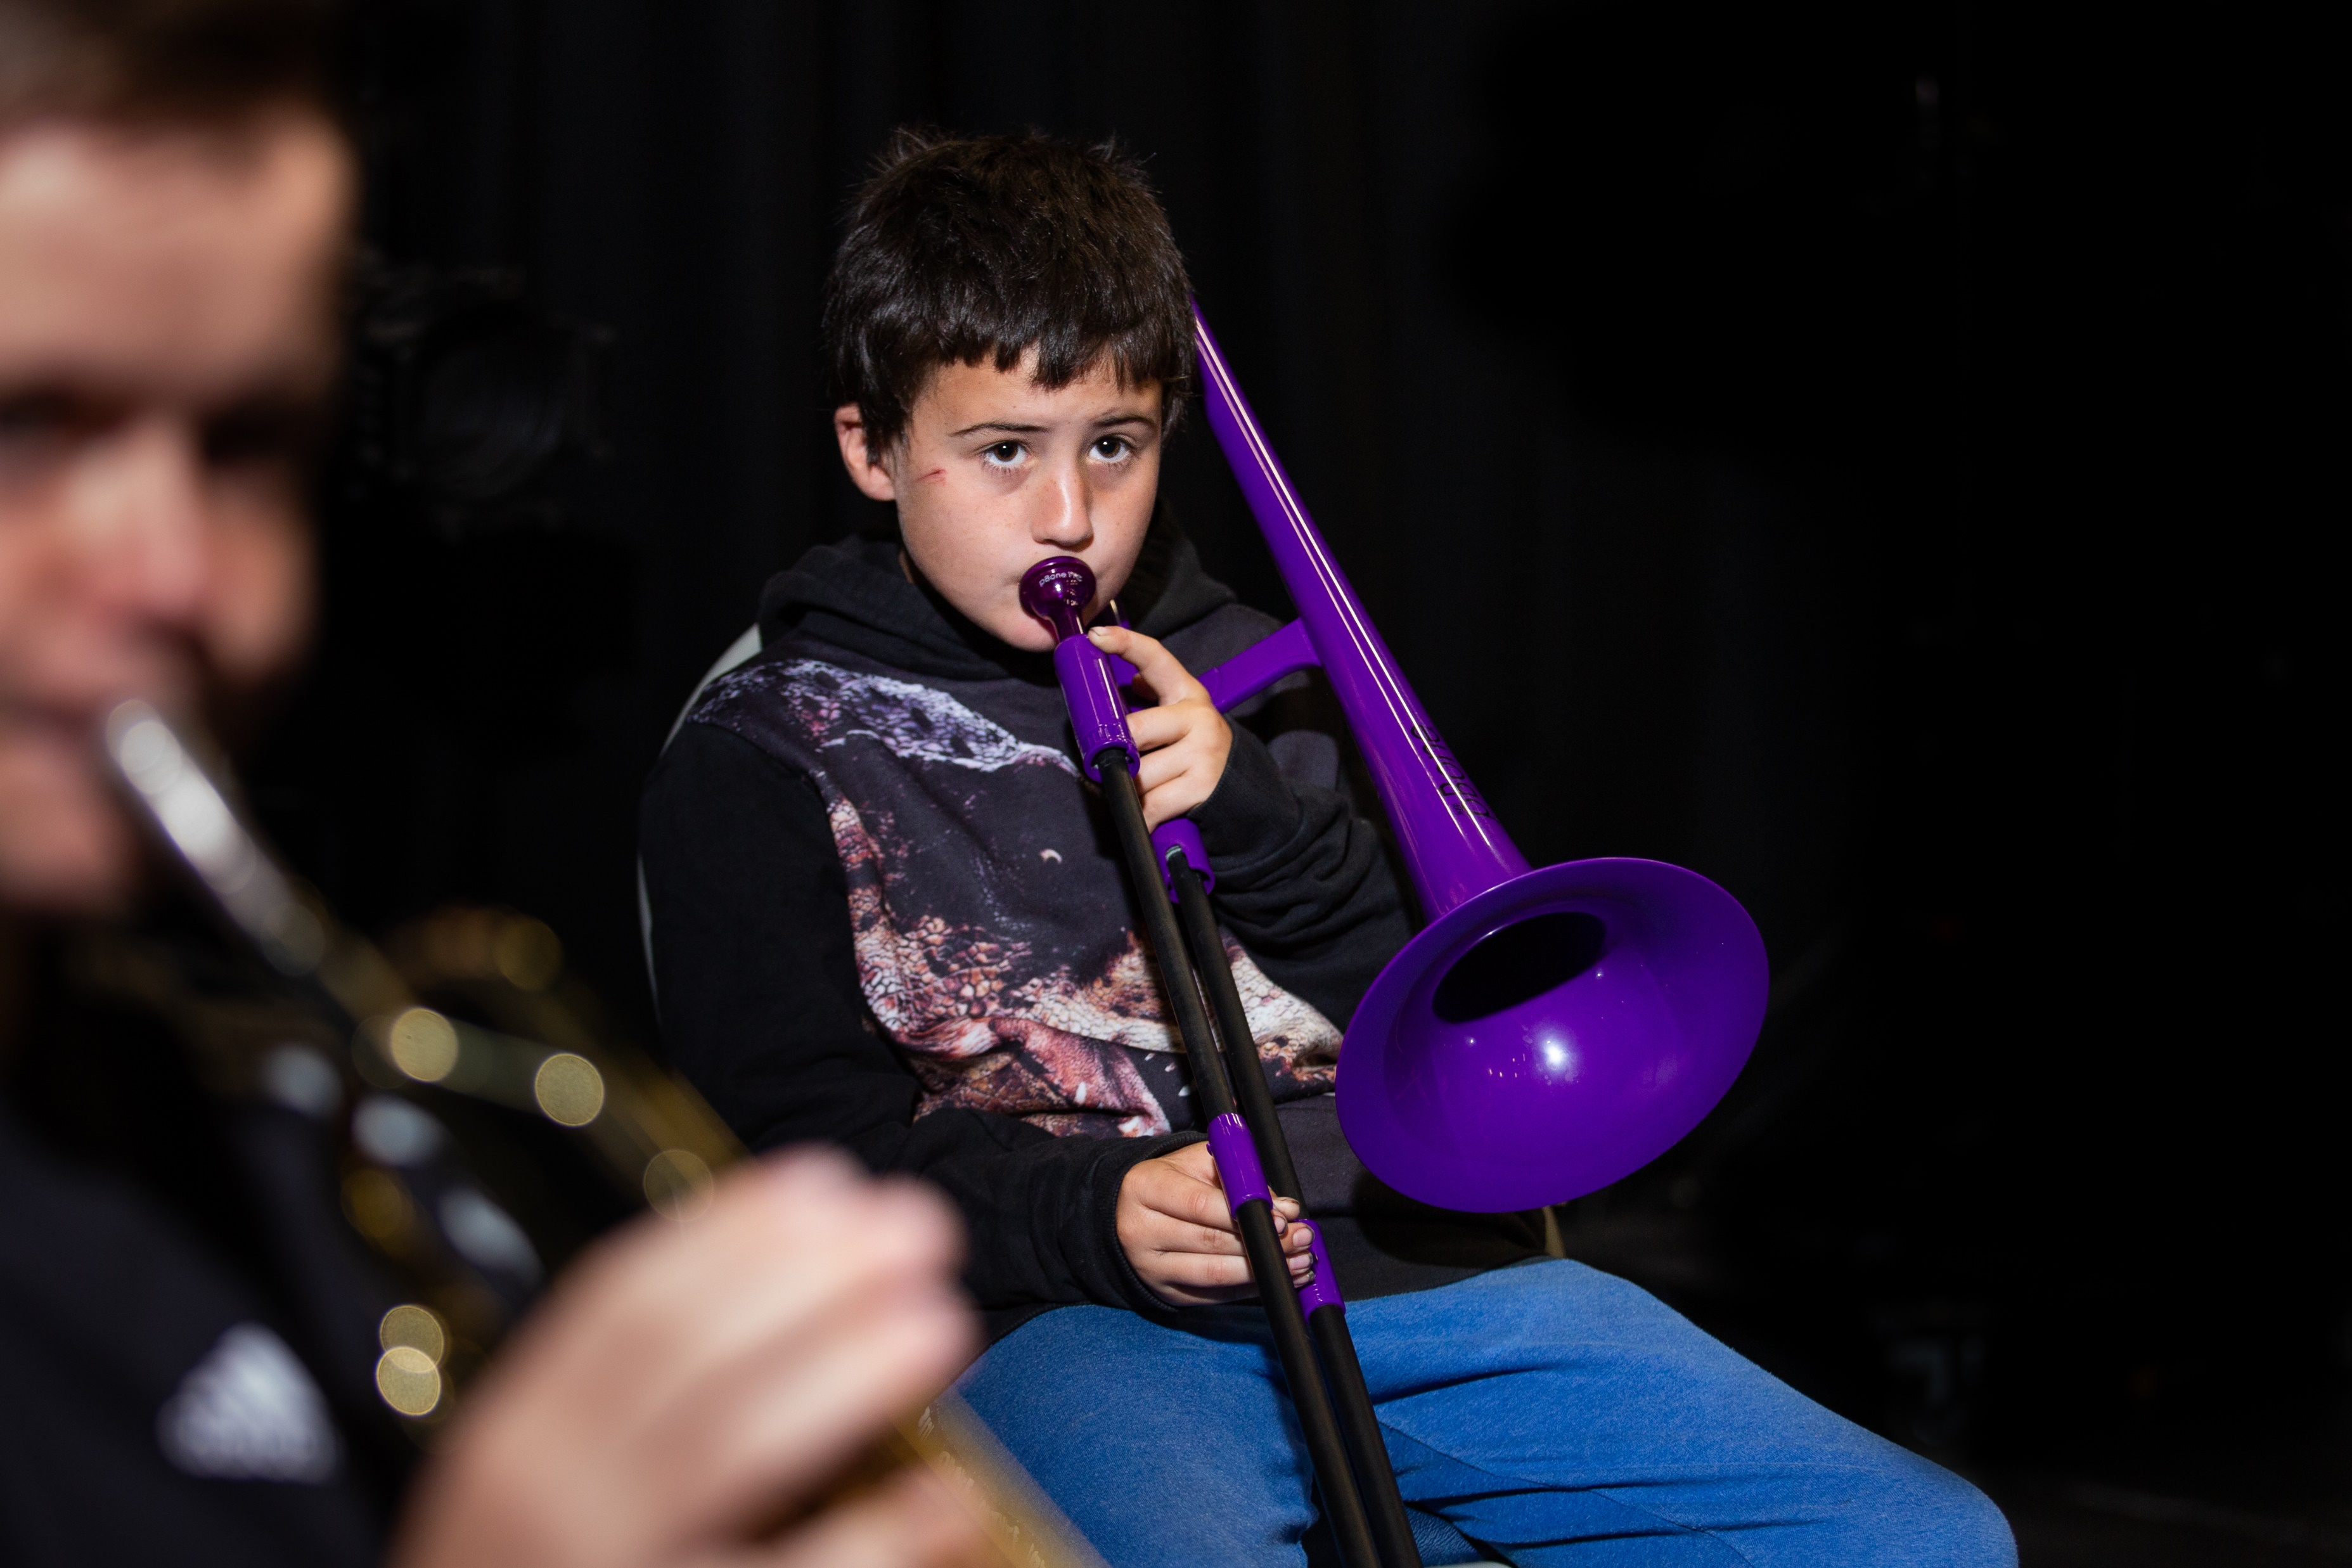
Why join?
Make music with your friends & meet new people
Learn a new instrument or get better at your own
Lots of exciting performance opportunities at amazing Nottingham City venues.
What next?
If you’re interested in finding out more about our music groups, letters will be sent home soon!
Find out more:
www.nottinghammusichub.org.uk/ensembles

