Slide 1

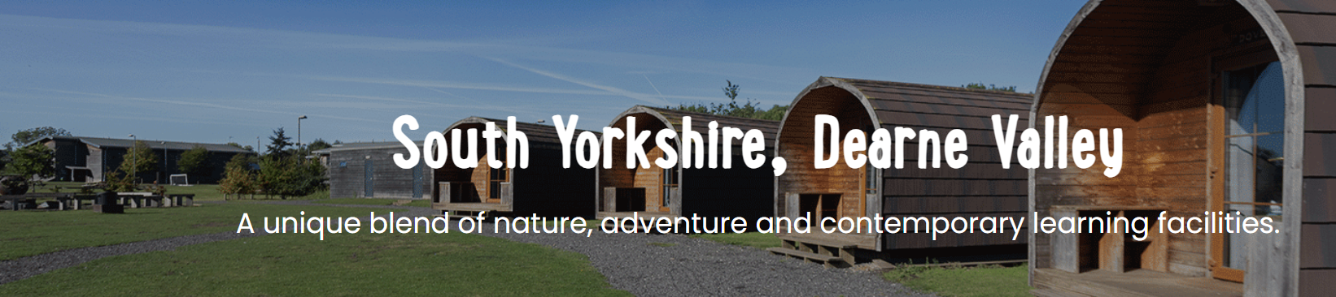
Monday 21st-Wednesday 23rd June 2027

Slide 2


Slide 3


Slide 4
We know how daunting it can be letting your child go on a residential visit, so we do everything we can to make it a safe and enjoyable experience for all.
Our policies and procedures are designed to make sure we adhere to the highest safety standards at all times:
Continual safety and first aid training for all staff
Regular checks on equipment before and after every activity session
Qualified First-Aider on centre 24/7
All staff are fully DBS checked.
We create a warm, supportive environment for students so they quickly feel at home. All our activities are progressive, allowing students to join in at whatever level they’re comfortable with.
We have found the best way to help children cope with being away from home is to keep them busy, having fun from dawn ‘til dusk.

Slide 5
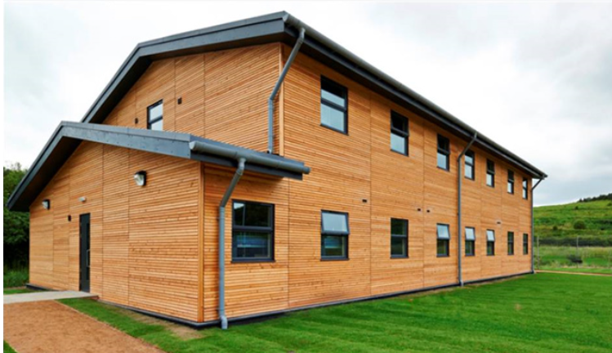
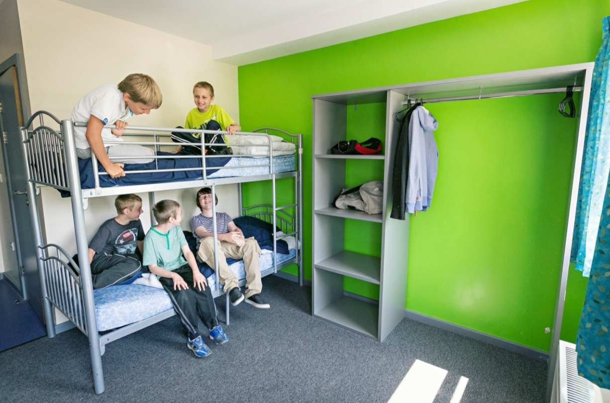
Accommodation
The children will be sleeping in single sex dormitories of 4, 6, 8 or 10.
All dormitories have en-suite bathrooms
Sleeping Bags are needed
Teacher rooms are located between the children’s bedrooms.
We may be sharing the block (not rooms) with other schools

Slide 6
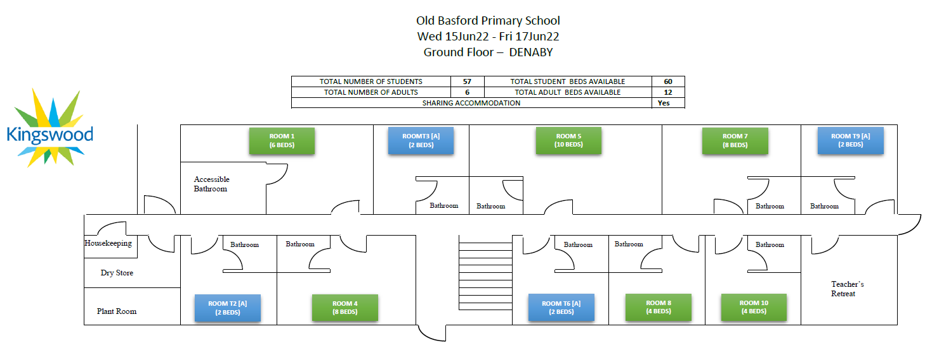
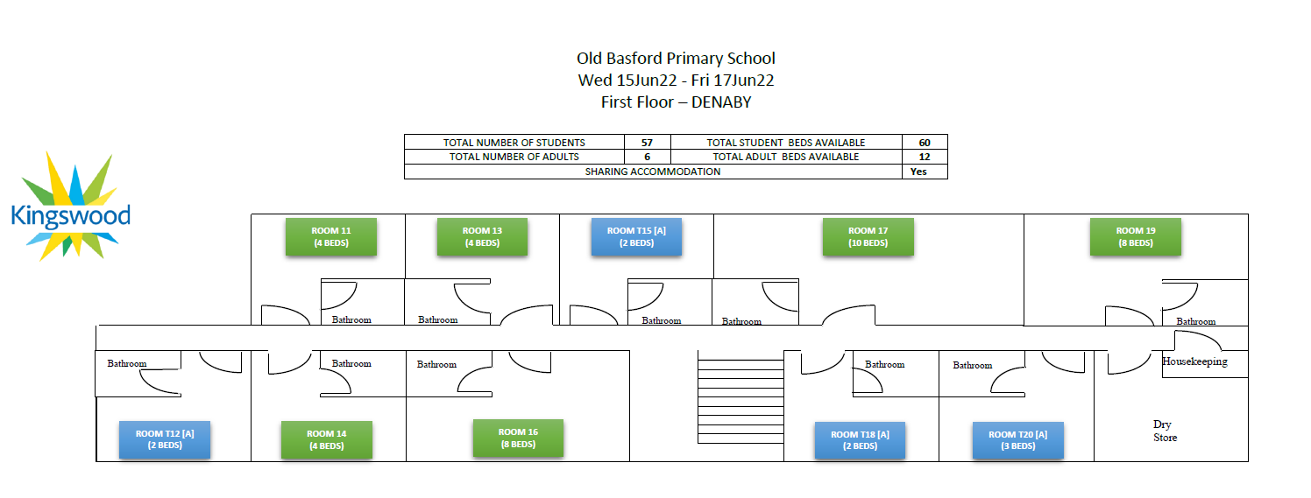

Slide 7
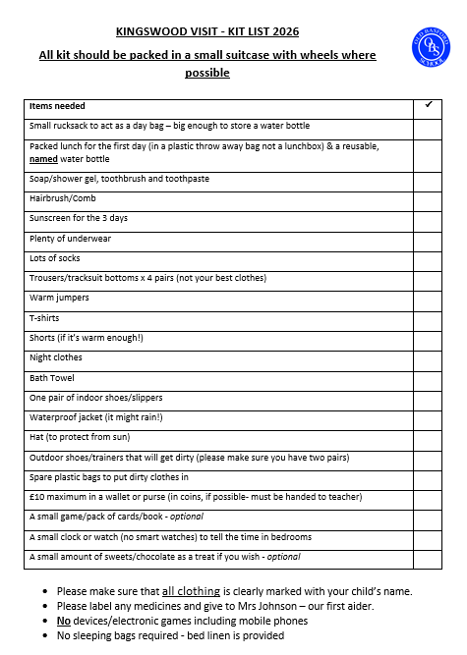

Slide 8
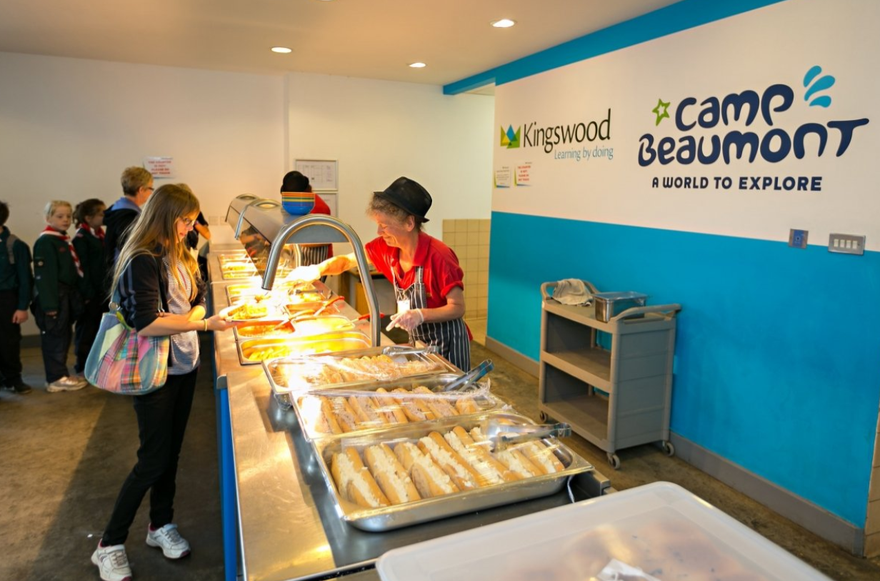
MEAL TIMES!
3 buffet style meals each day
Plenty of variety available – hot and cold meals
At least one vegetarian option
Salad bar
Plenty of water available at every meal time
Dietary requirements catered for – please let us know

Slide 9

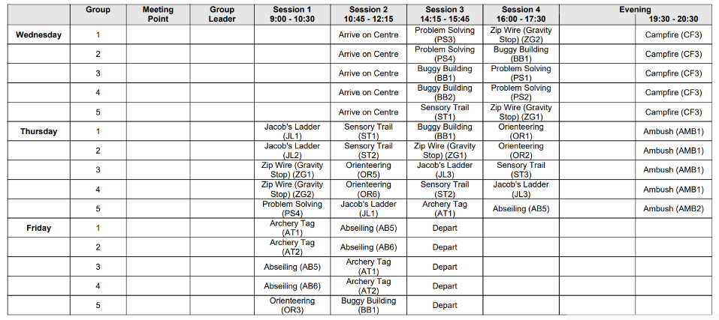
PLAN!

Slide 10



Slide 11
Cost
We have worked very hard to make the cost as low and as manageable as possible which school has subsidised some of. PGL can be paid in full or in instalments.
Full cost: £270.00
If your child is entitled to Free School Meals: £240.00
We are asking parents to pay a non-refundable deposit of £40 (£30 for children in receipt of Free school meals) to secure your child a place on the residential trip by Friday 21st August 2026 .
Only deposits received by this date will guarantee a place on this trip. If you have not paid a deposit by Friday 21st August 2026 then we cannot guarantee that your child will be able to come.
Payment of a deposit means you are committing to a full booking and you will make all payments.
All payments are non-refundable.

Slide 12
Payments
To help, after paying the deposit we are offering the option of paying the remaining balance in monthly instalments of £28.75 (£26.25 for those entitled to Free School Meals).
Or
After paying your deposit in July, you can pay the whole amount if you prefer. Payments must be made regularly to keep up with the monthly invoices from PGL. Payment of a deposit means you are committing to a full booking and all payments must are required.
Payments can only be made on the Arbor App and the deposit should be received by Friday 21st August 2026
ALL PAYMENTS ARE NON-REFUNDABLE AND ARE A COMMITMENT TO PAY THE FULL BALANCE BY FRIDAY 30TH APRIL 2027
Child’s profile - scroll down to Activities – select trips – Trips open to (name of child) - select Y6 Dearne Valley 2027 – press the tab Sign up (name of child) for Trip – make payment (enter the amount to be paid either full amount or instalment)
Press Pay (Green Tab) then enter your card details and press Pay (Green Tab)

