Slide 1

Welcome to Year 3
Class 7-
Mon-Wed -Mrs Baguley
Wed-Fri –Miss Booth
Class 8 –
Miss Beard

Slide 2

What your children will experience in Year 3
Autumn Term:
Stone Age to Iron Age
Extreme Earth
Spring Term:
Super Science
What Makes Britain Great
Summer Term:
It’s a Wonderful Life
The Egyptians

Slide 3
Playtimes in Year 3
Breaktime snacks are not provided in Year 3. You can provide them with a healthy snack. (fruit ideally)
No chocolate or biscuits please
Only water in their named water bottle please.
We encourage children to have a drink and go to the toilet after break / lunch times but they have access to their bottles whenever necessary.
There is a medical station at playtime and lunchtime. If your child receives treatment in the day they will receive a red or a blue wristband and a letter explaining the treatment given.

Slide 4
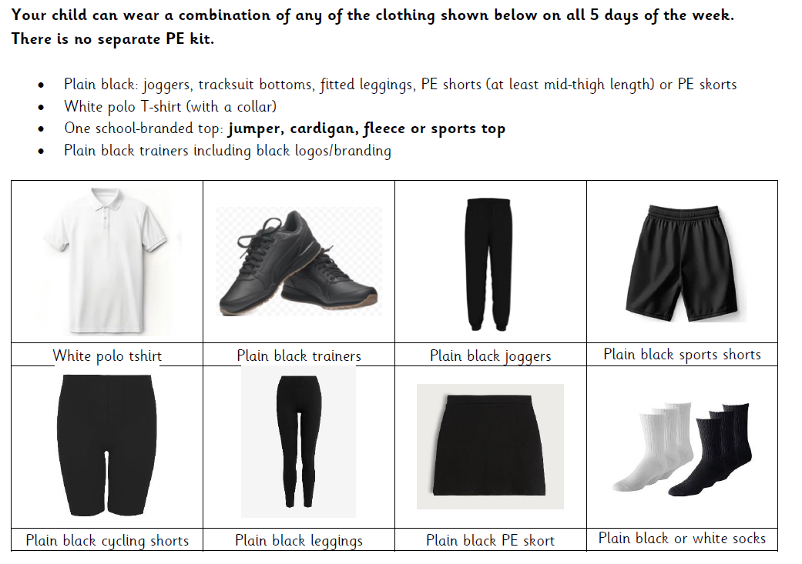
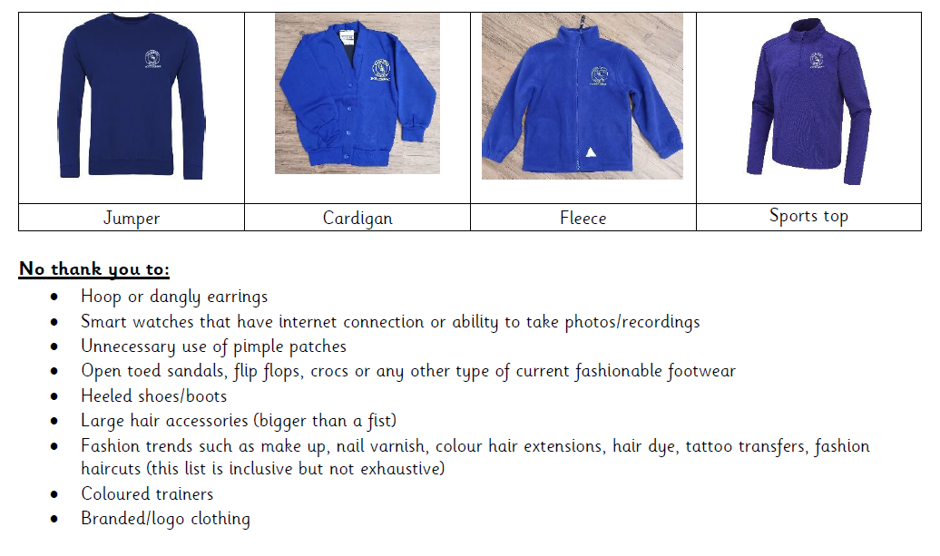
PE
We now have our active uniform, see below as shared by Mrs Duffin.
Year 3 P.E days are Tuesday and Thursday.
Outdoor PE is on a Tuesday, we will still go out when it is cold, they can wear their jumpers, fleeces and coat in winter.

Slide 5
Working with you as a team
Across the year we will invite you into school for…
Parent workshops- to support you help your children usually based on Writing and Maths.
PROUD assembly to share why your child is magnificent
Parent showcase events so you can celebrate your child’s work
Opal play events
Parents evenings
All dates to be confirmed in Mrs Duffin’s newsletter ASAP

Slide 6
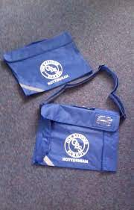
Uniform
Please can names be on all of the following items…
Jumpers/cardigans
Coats
Water bottles
Book bags
Lunch boxes

Slide 7

Reading
EB
Your child’s book colour will be selected based on reading assessments and teachers listening to your child read. They will bring a book home corresponding to this colour.
They will also bring home a reading for pleasure book.
These books will be changed weekly.
In year 3 we ask that you read your child’s book band books at least 3 times a week with your child and record the name of the book and your signature in their diaries.
Diaries are checked once weekly.

Slide 8

Times Tables
Your child’s TTRockstars log ins have been stuck in the front of their diary.
In Year 3 we have a big push on learning times tables. We expect children to be going on for at least 10 minutes per week.

Slide 9
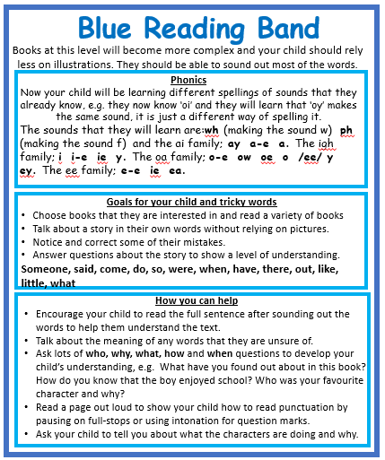

In their diary you will see…
Book bands
This shows you how you can help your child, with their reading. A few pages are ok, don’t pressure your child to read a whole book. Unless they want to.

Slide 10
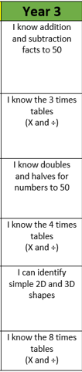
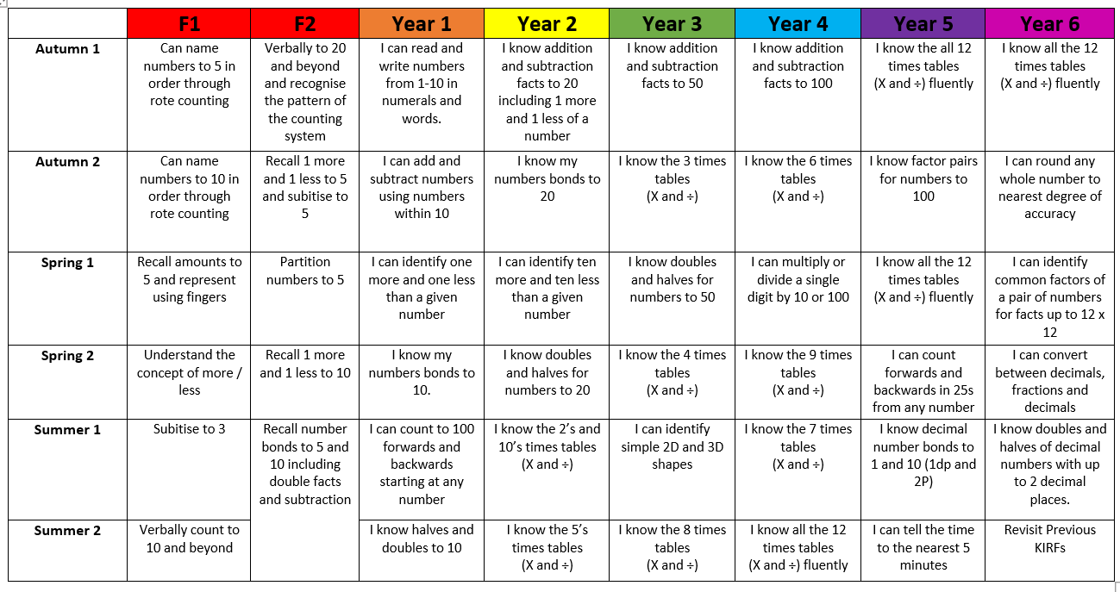
Maths -KIRFS
Key Instant Recall Facts

Slide 11
Y3 School Website Page
We will update the school website weekly with pictures and what's been going on throughout the week
We will also put important dates and information on the website

Slide 12
Rewards
PROUD points sent via Arbor.
PROUD certificate each term
Stickers
Certificates - postcards
Recognition time with Mrs Duffin
Opal play awards/ lunchtime tidy awards
Please make sure you look at the lovely messages that are sent via Arbor.

Slide 13
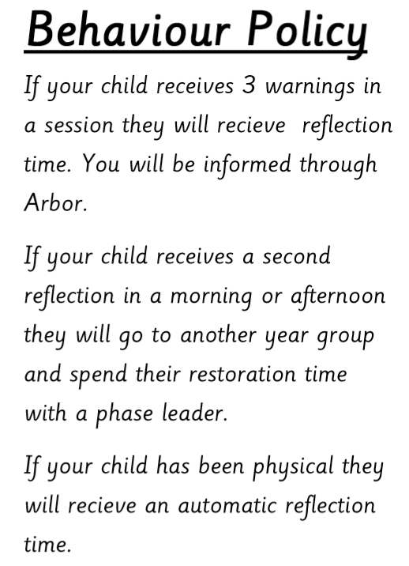
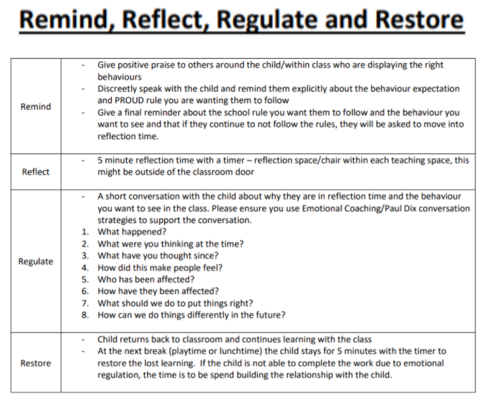

Slide 14


